Slide 1
Data Structure & Algorithms
Augmenting Data Structures

Slide 2
Augmentation Process
Augmentation is a process of extending a data structure in order to support additional functionality. It consists of four steps:
Choose an underlying data structure.
Determine the additional information to be maintained in the underlying data structure.
Verify that the additional information can be maintained for the basic modifying operations on the underlying data structure.
Develop new operations.

Slide 3
Examples for Augmenting DS
Dynamic order statistics: Augmenting binary search trees by size information
Interval trees
Priority search trees

Slide 4
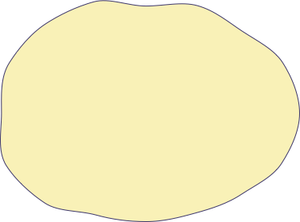
Dynamic Order Statistics
Problem: Given a set S of numbers that changes under insertions and deletions, construct a data structure to store S that can be updated in O(log n) time and that can report the k-th order statistic for any k in O(log n) time.
S
5
51
85
13
48
7
34
22
14

Slide 5
Order Statistics Tree
Beside the usual red-black tree fields key[x], color[x], p[x], left[x], and right[x] in a node x, we have another field size[x]. This field contains the number of (internal) nodes in the subtree rooted at x (including x itself), that is the size of the subtree. If we define the sentinel’s size to be 0, that is, we set size[nil[T]] to be 0, then we have the identity
size[x] = size[left[x]] + size[right[x]] +1

Slide 6
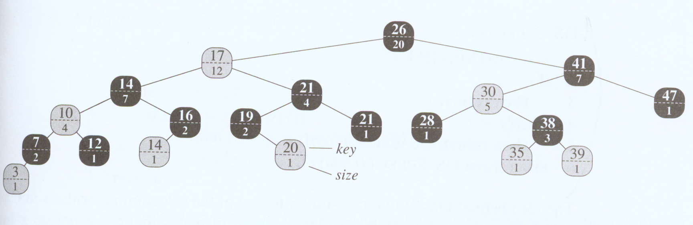
An order-statistic tree

Slide 7
Retrieving an element with a given rank
Note that: rank(x) = size[left[x]] + 1
OS-SELECT(x, i)
1 r ← size[left[x]]
2 if i == r
3 then return x
4 else if i < r
5 then return OS-SELECT(left[x], i)
6 else return OS-SELECT(right[x], i – r)
Time complexity :O(lg n)
Because each level of tree has a constant cost, so overall cost will be equal to
heightOfTree * ConstantTime → O(lgn).

Slide 8
Selection Example
26
20
17
12
41
7
14
17
21
4
30
5
47
1
10
4
16
2
19
2
21
1
28
1
38
3
7
2
12
1
14
1
20
1
35
1
39
1
What is the 17th number?
3
1

Slide 9
Selection Example
17>13
26
20
17
12
rank= 12+1=13
41
7
14
17
21
4
30
5
47
1
10
4
16
2
19
2
21
1
28
1
38
3
7
2
12
1
14
1
20
1
35
1
39
1
What is the 17th number?
3
1

Slide 10
Selection Example
17>13 → 17-13=4
26
20
17
12
rank= 12+1=13
41
7
rank= 6
4<6
14
17
21
4
30
5
47
1
10
4
16
2
19
2
21
1
28
1
38
3
7
2
12
1
14
1
20
1
35
1
39
1
What is the 17th number?
3
1

Slide 11
Selection Example
17>13 → 17-13=4
26
20
17
12
rank= 12+1=13
41
7
rank= 6
4<6
14
17
21
4
rank=2
30
5
4>2
47
1
10
4
16
2
19
2
21
1
28
1
38
3
7
2
12
1
14
1
20
1
35
1
39
1
What is the 17th number?
3
1

Slide 12
Selection Example
17>13 → 17-13=4
26
20
17
12
rank= 12+1=13
41
7
rank= 6
4<6
14
17
21
4
rank=2
30
5
4>2
47
1
10
4
16
2
19
2
21
1
28
1
38
3
rank=2 ==2
Success!
7
2
12
1
14
1
20
1
35
1
39
1
What is the 17th number? 38
3
1

Slide 13
Determining the rank of an element
OS-RANK(T, x)
1 r ← size[left[x]] + 1
2 y ← x
3 while y ≠ root[T]
4 do if y == right[p[y]]
5 then r ← r + size[left[p[y]]] + 1
6 y ← p[y]
7 return r
The running time of OS-RANK is at worst proportional to the height of the tree: O(lg n)

Slide 14
Maintaining subtree sizes
To use OS_Select & OS_Rank, the size property should be correct. So while insertion and deletion we should update it

Slide 15
Maintaining subtree sizes in insertion
Each insertion has 2 phases as we mentioned in previous lectures:
Adding the new element:
In this phase, we should increment the sizes in added element to root by 1 which takes O(lg n) time.
Fixup:
Rotation is the only operation which affects size property, so we change it as explained in the next slide.

Slide 16
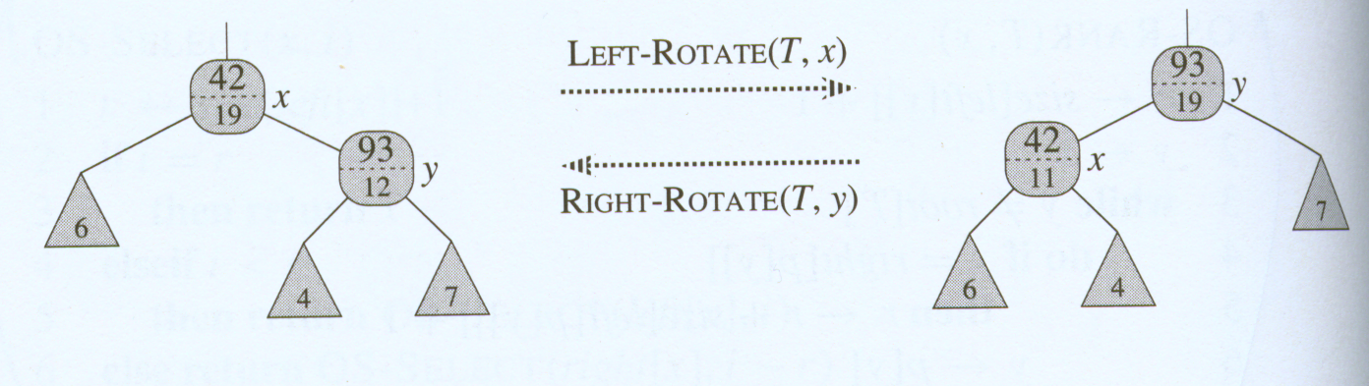
Updating subtree sizes during rotations
Referring to the code for LEFT-ROTATE(T, x) we add the following lines:
12 size[y] ← size[x]
13 size[x] ← size[left[x]] + size[right[x]] + 1

Slide 17
Maintaining subtree sizes in deletion
Each deletion has 2 phases as we mentioned in previous lectures:
Deleting the desired element:
In this phase, we should decrement the sizes from y to root by 1which takes
O(lg n) time.
Fixup:
Rotation is the only operation which affects size property, so we change it as explained in the previous slide which also takes O(lg n) time.

Slide 18
Augmenting red-black trees
Theorem 14.1 (Augmenting a red-black tree)
Let f be a field that augments a red-black tree T of n nodes, and suppose that the contents of f for a node x can be computed using only the information in nodes x, left[x], and right[x], including f[left[x]] and f[right[x]]. Then, we can maintain the values of f in all nodes of T during insertion and deletion without asymptotically affecting the O(lg n) performance of these operations.

Slide 19
Proof.
The main idea of the proof is that a change to an f field in a node x propagates only to ancestors of x in the tree.

