Slide 1
Data Structure & Algorithms
Shortest Path

Slide 2
Example Problem
The ticket prices for traveling by bus between pairs of cities are known. Implement a travel planner for planning a journey from a source city to a destination city, using buses such that the total cost of the journey is minimum.
Find a shortest path from source to destination,
taking into account that edge weights are positive!

Slide 3
Weighted graph – positive weights
t
2
x
8
s
1
3
y
z
1
Shortest path from s to t is s-> y-> z -> x -> t

Slide 4
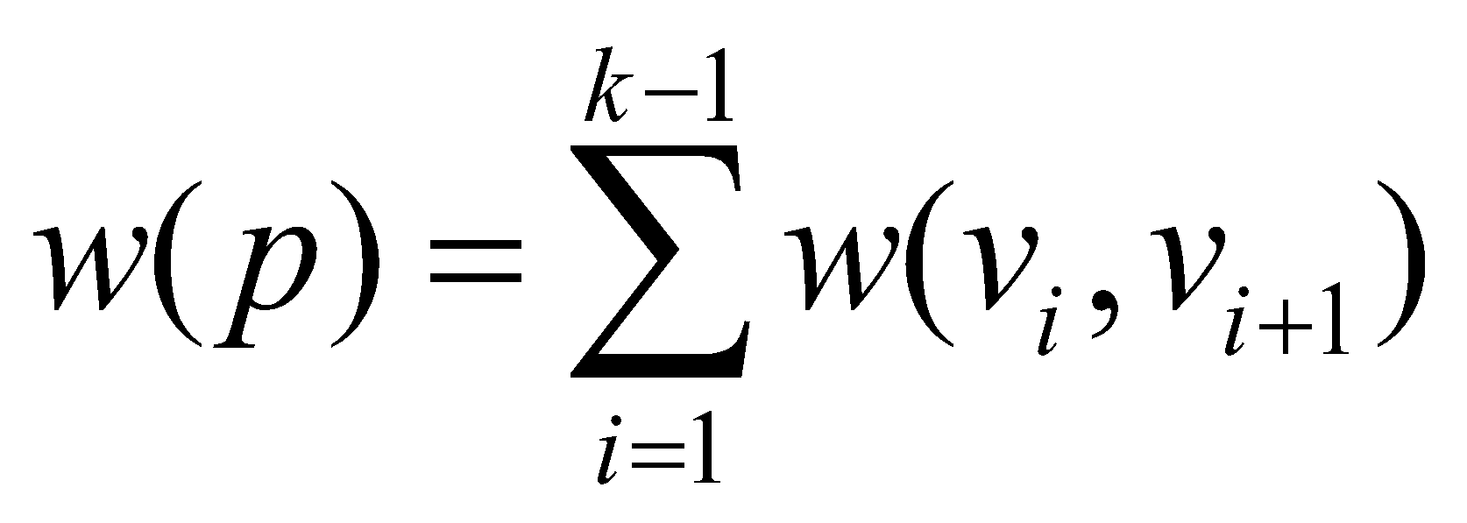
(Shortest) paths in weighted graphs
G = ( V, E ), edge weight function w : E → R
Weight of a path p = v₁ → v₂ → … → v_{k} is
The shortest path weight from u to v is δ(u,v).
A shortest path from u to v is any path such that w(p) = δ(u, v).
δ(u,v)= min {w(p) : u v}; if there is a path from u to v,
∞ otherwise.

Slide 5
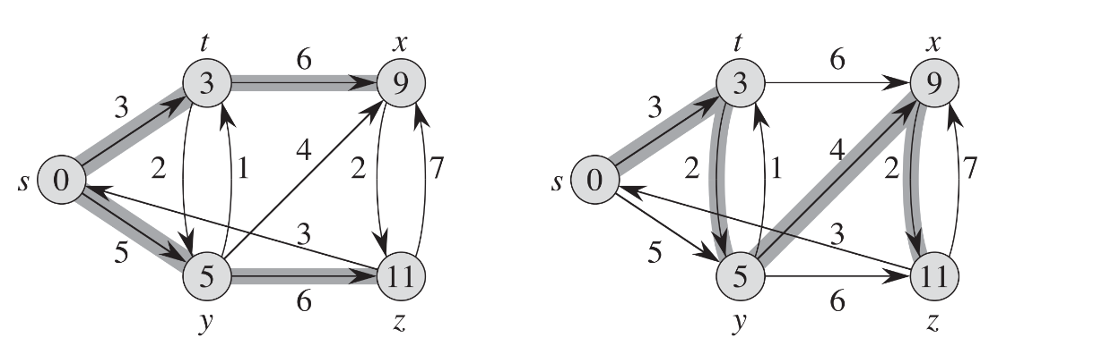
Shortest path problem
Single-pair: Find shortest path from a vertex u to another vertex v.
A shortest-path is not necessarily unique!
Example : shortest path from s to z:

Slide 6
Properties of Shortest paths
The optimal substructure property: Any subpath of a shortest path is a shortest path.
Shortest paths can’t contain cycles.

Slide 7
Properties of shortest paths: 1. Optimal Substructure Property
Theorem: Subpaths of shortest paths are also shortest paths
Let P_{1k} = <v₁, ... ,v_{k} > be a shortest path from v₁ to v_{k}
Let P_{ij} = <v_{i}, ... ,v_{j} > be subpath of P_{1k} from v_{i} to v_{j}
for any i, j
Then P_{ij} is a shortest path from v_{i} to v_{j}

Slide 8
Optimal Substructure Property – proof (cont)
Proof: By cut and paste
If some subpath P_{ij} = <v_{i}, ... ,v_{j} > were not a shortest path from v_{i} to v_{j,} then we could substitute it by the shorter subpath to create a shorter total path
Hence, the original path would not be shortest path
v₁
v_{i}
v_{j}
v_{k}

Slide 9
Properties of shortest paths: 2. No cycles
Property: shortest paths cannot contain cycles
Sketch of proof:
Already ruled out negative-weight cycles.
Positive-weight cycles: we can get a shorter path by omitting the cycle.
Zero-weight cycles: no reason to use them - assume that our solutions won’t use them.

Slide 10
Designing shortest path algorithms
The starting point is the optimal substructure property: Subpaths of shortest paths are also shortest paths
If we know the shortest paths composed of maximum k vertices, we can build shortest paths of maximum k+1 vertices by adding a new vertex to one of the paths

Slide 11
Dijkstra’s algorithm – The Idea
Consider all the vertices in the order of their shortest paths from the source vertex s
Initially, we check all outgoing edges of s. Let (s, x) be the minimum edge outgoing from s. Because all edges are positive, it is also the shortest path from s to x.
Next step: find the shortest path from s to one more vertex. The only paths to consider are other edges from s or a path formed by (s, x) and an outgoing edge from x

Slide 12
Output of single-source shortest paths algorithms
For each vertex v in V, attributes v.d and v.p are calculated:
v.d= the shortest path estimate
Initially, v.d=infinity
v.d is reduced as algorithms progress. But always maintain v.d>=δ(s,v)
v.d is called a shortest-path estimate.
v.p = predecessor of v on a shortest path from s.
If no predecessor, v.p = NIL.
induces a tree—shortest-path tree.

Slide 13
Principle of single-source shortest paths algorithms
Goal: determine shortest paths with source vertex s
Initialization: for all vertices v<>s, initialize v.d=infinity and v.p=NIL. Initialize s.d=0.
Repeatedly try to improve the shortest-path estimates of every vertex v.d by replacing it with a path following the shortest path to u and the edge (u,v) (The “Relaxation” operation)

Slide 14
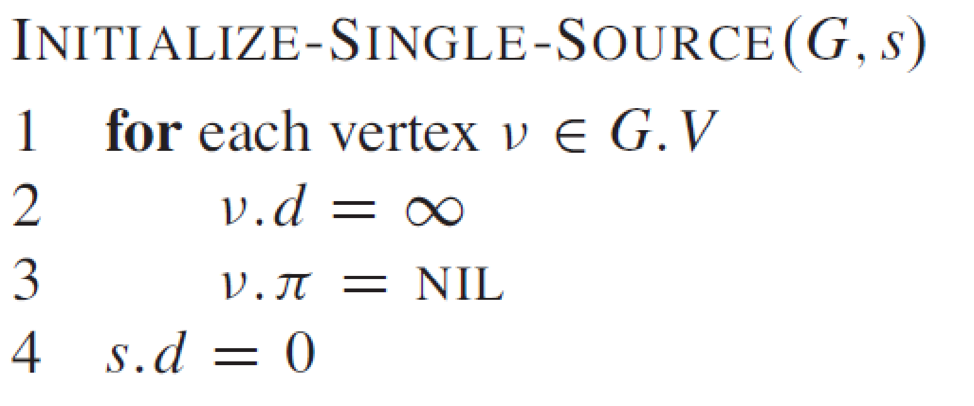
Initialization of shortest paths estimates

Slide 15
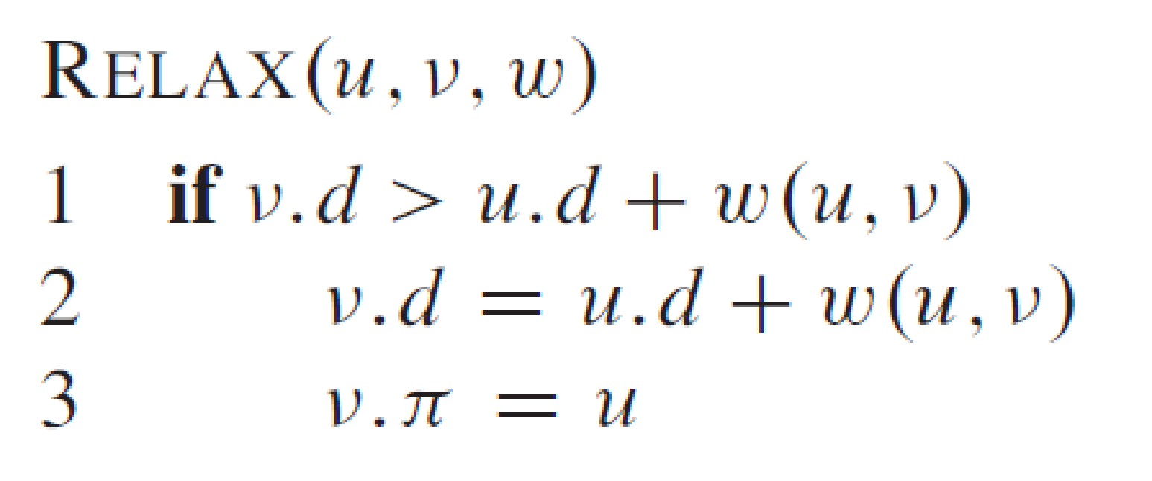
Relaxation
Relaxing an edge (u, v) = testing whether we can improve the shortest path to v found so far by going through u

Slide 16
Dijkstra’s algorithm
Precondition: No negative-weight edges!
Uses a priority queue where keys are shortest-path weights ( v.d).
Have two sets of vertices:
S = vertices whose final shortest-path weights are determined,
Q = priority queue = V - S.

Slide 17
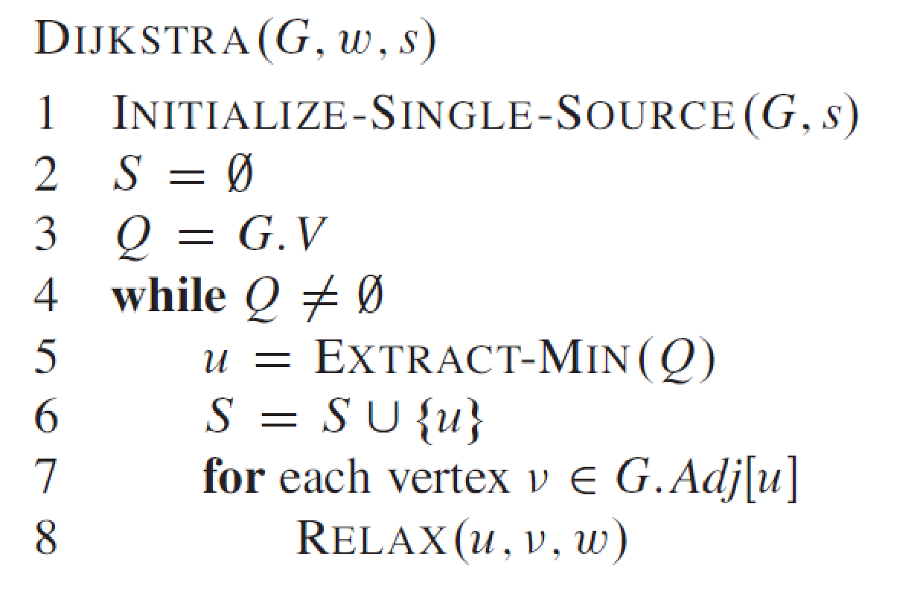
// RELAX performs also
a DECREASE-KEY !

Slide 18
Example – Dijkstra
t
x
1
10
9
s
7
2
3
4
6
5
2
y
z
Apply Dijkstra’s algorithm in order to determine the shortest paths from s

Slide 19
Example – Dijkstra (step 0)
t
x
1
∞
∞
10
9
s
0
7
2
3
4
6
5
∞
∞
2
y
z

Slide 20
Example – Dijkstra (step 1)
t
x
1
10
∞
10
9
s
0
7
2
3
4
6
5
5
∞
2
y
z
Notations: The shortest-path estimates appear within the vertices, and shaded edges indicate predecessor values. Black vertices are in the set S, and white vertices are in the min-priority queue. The shaded vertex has the minimum d value and is chosen as vertex u in line 5.

Slide 21
Example – Dijkstra (step 2)
t
x
1
8
14
10
9
s
0
7
2
3
4
6
5
5
7
2
y
z
Notations: The shortest-path estimates appear within the vertices, and shaded edges indicate predecessor values. Black vertices are in the set S, and white vertices are in the min-priority queue. The shaded vertex has the minimum d value and is chosen as vertex u in line 5.

Slide 22
Example – Dijkstra (step 3)
t
x
1
8
13
10
9
s
0
7
2
3
4
6
5
5
7
2
y
z
Notations: The shortest-path estimates appear within the vertices, and shaded edges indicate predecessor values. Black vertices are in the set S, and white vertices are in the min-priority queue. The shaded vertex has the minimum d value and is chosen as vertex u in line 5.

Slide 23
Example – Dijkstra (step 4)
t
x
1
8
9
10
9
s
0
7
2
3
4
6
5
5
7
2
y
z
Notations: The shortest-path estimates appear within the vertices, and shaded edges indicate predecessor values. Black vertices are in the set S, and white vertices are in the min-priority queue. The shaded vertex has the minimum d value and is chosen as vertex u in line 5.

Slide 24
Example – Dijkstra (step 5)
t
x
1
8
9
10
9
s
0
7
2
3
4
6
5
5
7
2
y
z

Slide 25
Dijkstra- Correctness
Loop invariant: At the start of each iteration of the while loop,
v.d= δ(s, v) for all v in S.
Initialization: Initially, S =0 so trivially true.
Termination: At end, Q=0 => S = V, v.d = δ(s, v) for all v in V .
Maintenance: Need to show that u.d = δ(s, u) when u is added to S in each iteration.

Slide 26
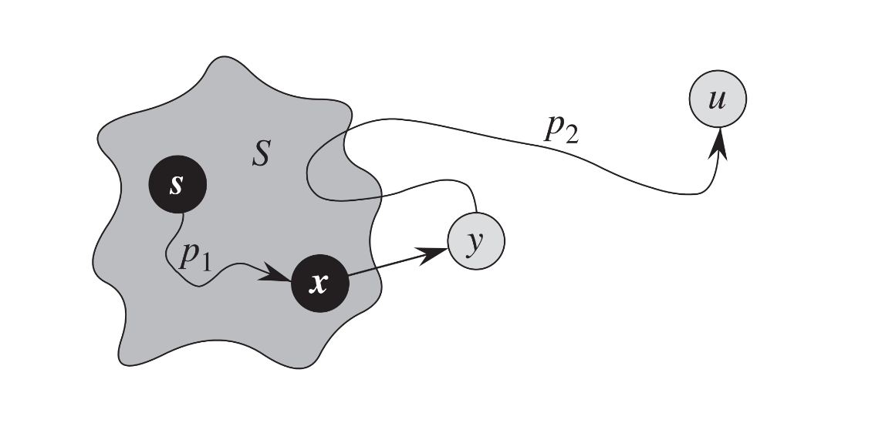
Dijkstra - Proof
We need to prove that u.d = δ(s, u) when u is added to S in each iteration.

Slide 27
Dijkstra - Analysis
V times
E times
Suppose that Q is implemented using:
Arrays: DECREASE-KEY O(1), EXTRACT-MIN O(V) => algo is O(V*V)
Heaps: DECREASE-KEY O(log V), EXTRACT-MIN O(log V) => algo is O((V+E)*log V)

