Slide 1
تمرین هفتم مدار منطقی

Slide 2
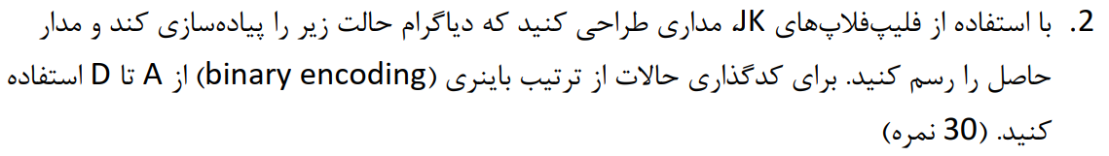
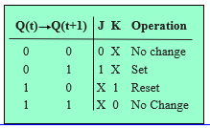
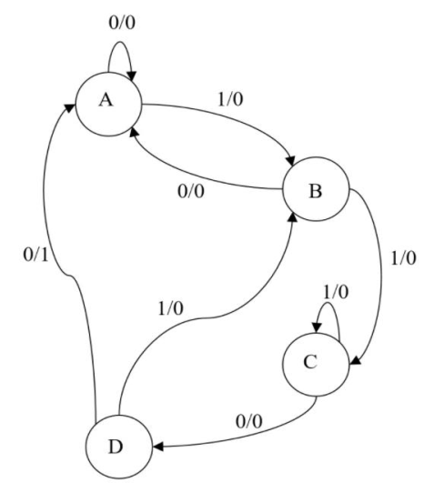
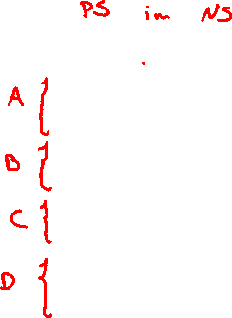
s1 | s0 | x | S1+ | S0+ | j1 | k1 | J0 | k0 | Z
0 | 0 | 0 | 0 | 0 | 0 | X | 0 | X | 0
0 | 0 | 1 | 0 | 1 | 0 | X | 1 | X | 0
0 | 1 | 0 | 0 | 0 | 0 | X | X | 1 | 0
0 | 1 | 1 | 1 | 0 | 1 | X | X | 1 | 0
1 | 0 | 0 | 1 | 1 | X | 0 | 1 | X | 0
1 | 0 | 1 | 1 | 0 | X | 0 | 0 | X | 0
1 | 1 | 0 | 0 | 0 | X | 1 | X | 1 | 1
1 | 1 | 1 | 0 | 1 | X | 1 | X | 0 | 0

Slide 3







Slide 4


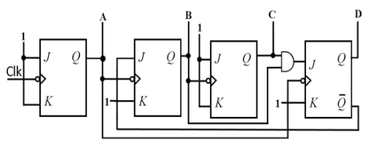
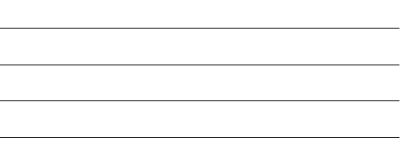

Slide 5
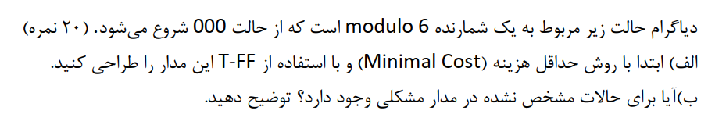
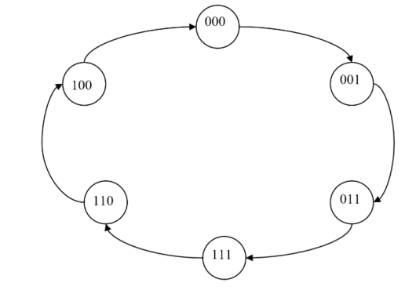

Slide 6
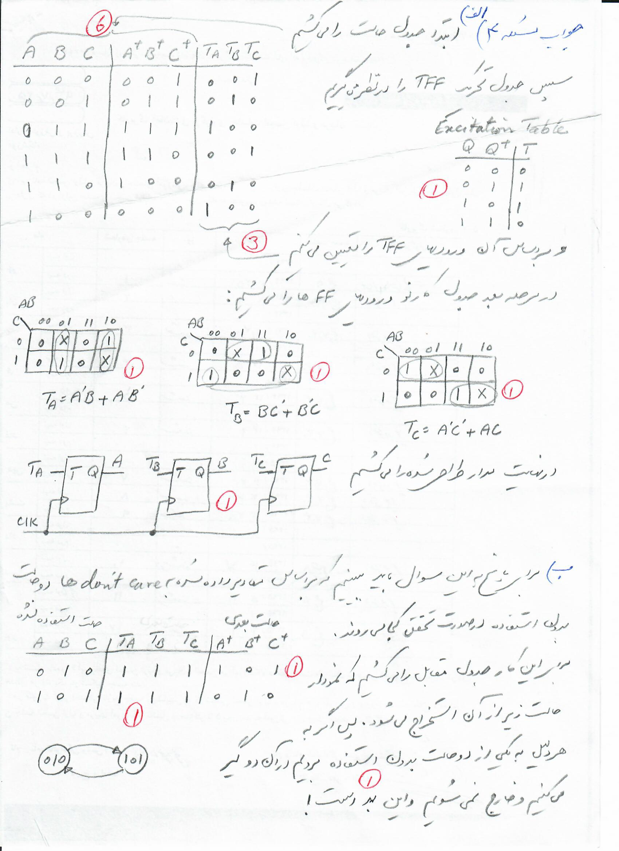

Slide 8
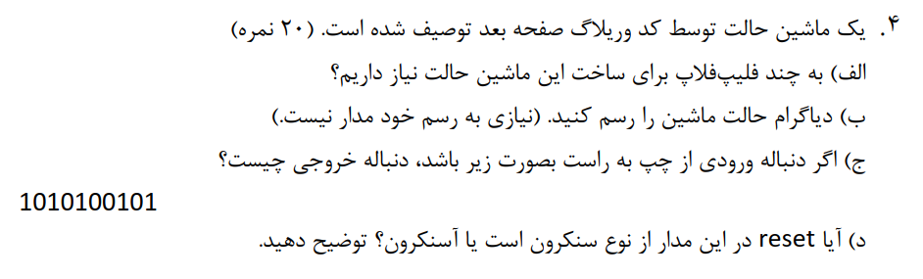



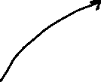






Slide 9
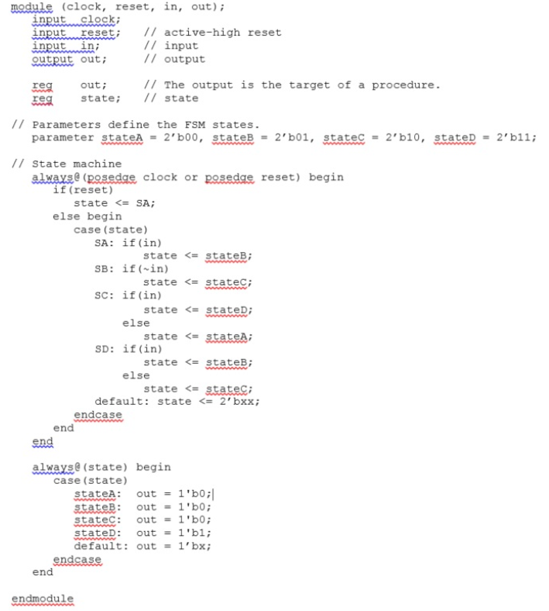

Slide 10
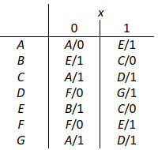




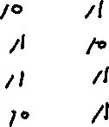

Slide 11
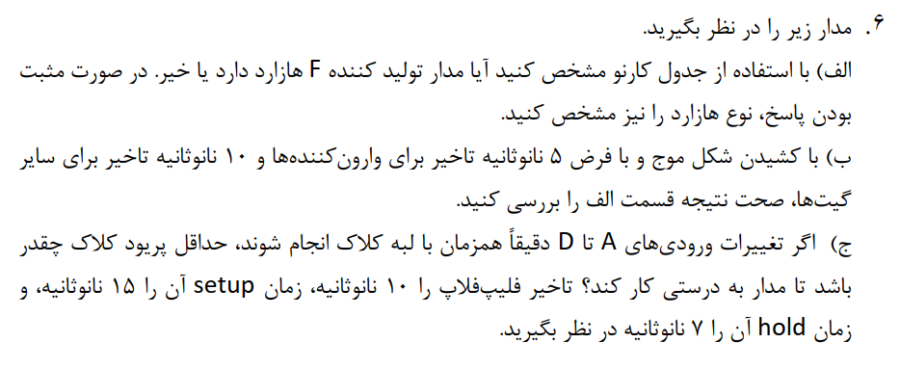
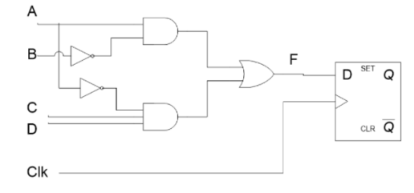

Slide 12
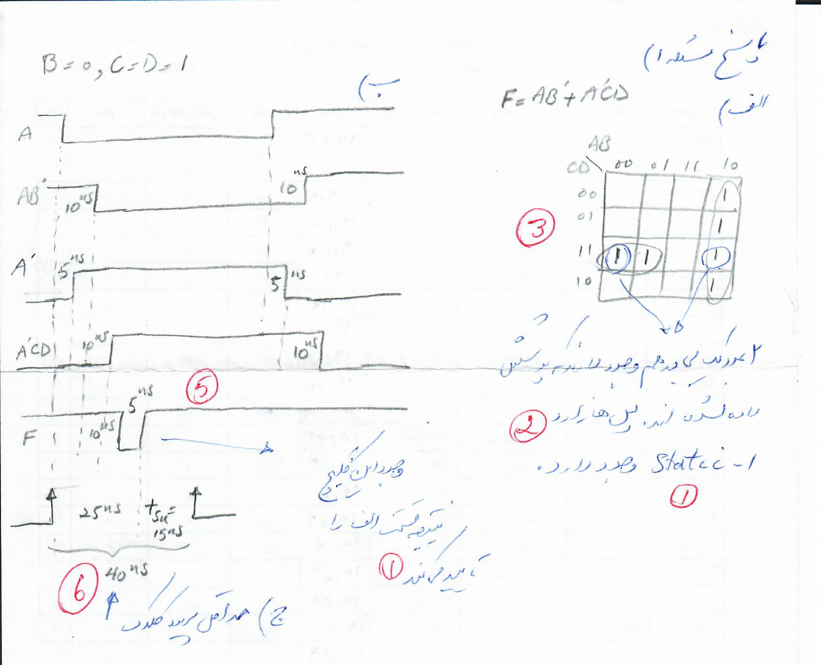

Slide 13
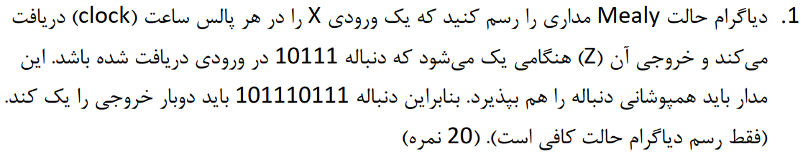



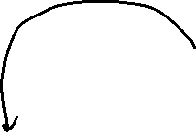

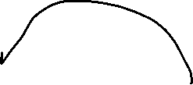


Slide 14
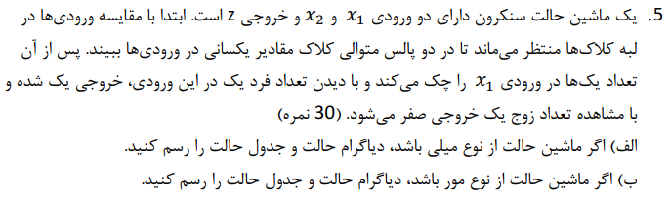










Slide 15
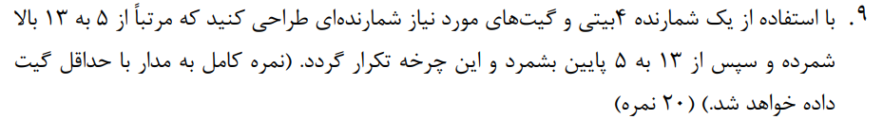
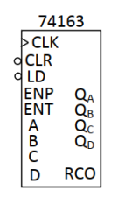





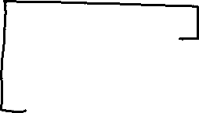





Slide 16

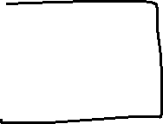
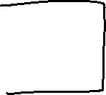

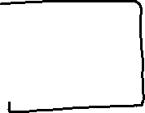
1 | 1 | 0 | 1 | 1 | 0 | 1 | 1
1 | 1 | 0 | 0 | 1 | 0 | 1 | 0
1 | 0 | 1 | 1 | 1 | 0 | 0 | 1
1 | 0 | 1 | 0 | 1 | 0 | 0 | 0
1 | 0 | 0 | 1 | 0 | 1 | 1 | 1
1 | 0 | 0 | 0 | 0 | 1 | 1 | 0
0 | 1 | 1 | 1 | 0 | 1 | 0 | 1
0 | 1 | 1 | 0 | 0 | 1 | 0 | 0
0 | 1 | 0 | 1 | 0 | 0 | 1 | 1

Slide 17
