Slide 1
Programmable Logic
PAL, PLA

Slide 2
PLAs
Programmable Logic Array
  Pre-fabricated building block of many AND/OR gates (or NOR, NAND)
  General purpose logic building blocks
  “Personalized” or “customized” by making/breaking connections among the gates
  This process is called “programming”

Slide 3
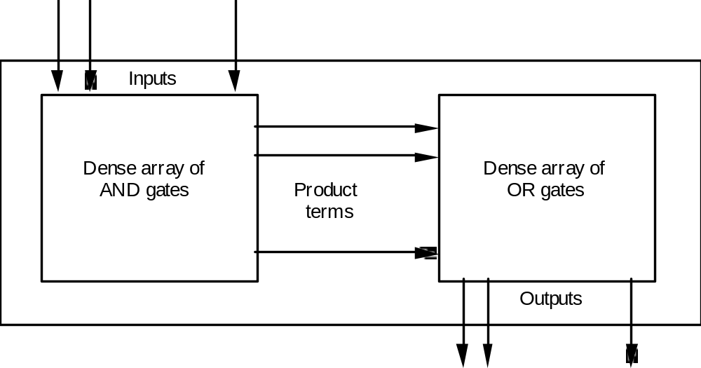
PLA
Realizes Sums of Products

Slide 4
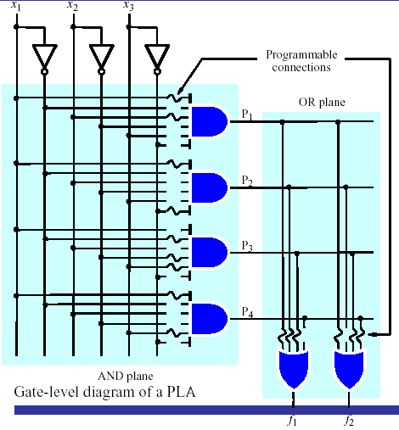
PLA

Slide 5
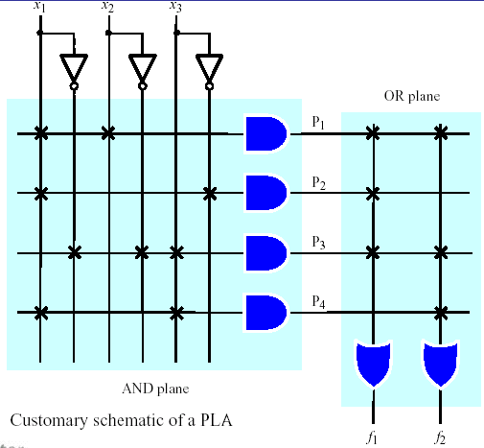
PLA
A 3×2 PLA with 4 product terms.

Slide 6
Design for PLA:
Example
  Implement the following functions using PLA
F0 = A + B' C'
F1 = A C' + A B
F2 = B' C' + A B
F3 = B' C + A
Input Side:
1 = asserted in term
0 = negated in term
- = does not participate
Personality Matrix
Product
Inputs
Outputs
t
Output Side:
erm
A
B
C
F
F
F
F
0
1
2
3
1 = term connected to output
0 = no connection to output
A B
1
1
-
0
1
1
0
B C
-
0
1
0
0
0
1
A C
1
-
0
0
1
0
0
B C
-
0
0
1
0
1
0
A
1
-
-
1
0
0
1

Slide 7
Example: Continued
A
B
C
F0 = A + B' C'
F1 = A C' + A B
F2 = B' C' + A B
F3 = B' C + A
AB
B’C
AC’
B’C’
Personality Matrix
A
Product
Inputs
Outputs
t
erm
A
B
C
F
F
F
F
0
1
2
3
F0
F1
F2
F3
A B
1
1
-
0
1
1
0
B C
-
0
1
0
0
0
1
A C
1
-
0
0
1
0
0
B C
-
0
0
1
0
1
0
A
1
-
-
1
0
0
1

Slide 8
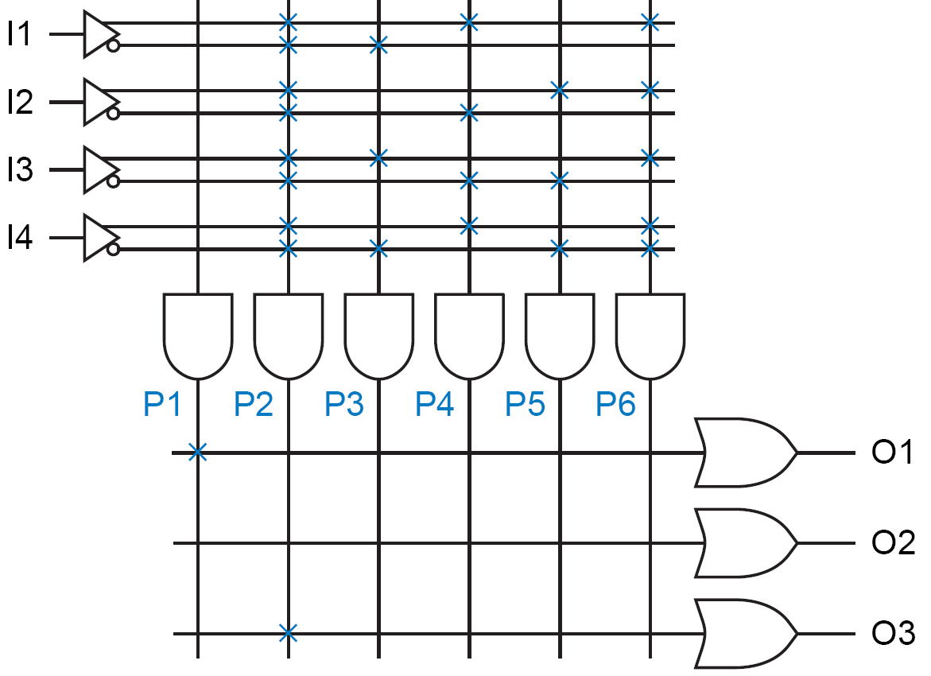

Generating Constant 1 at output
  Sometimes a PLA output must be programmed to be a constant 1 or a constant 0.
  Use OR gates to generate a constant 1

Slide 9
Generating Constant 0 at output
  Use one of the AND gates to generate a constant 0

Slide 10
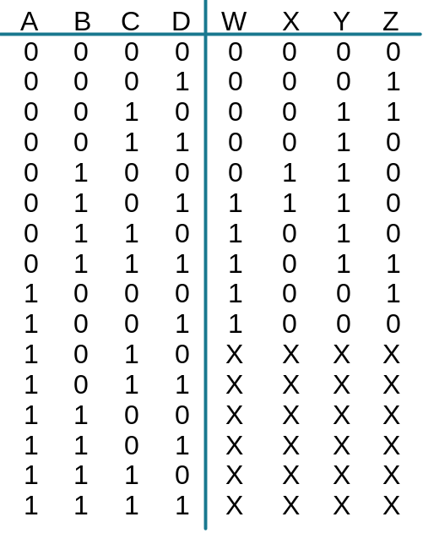
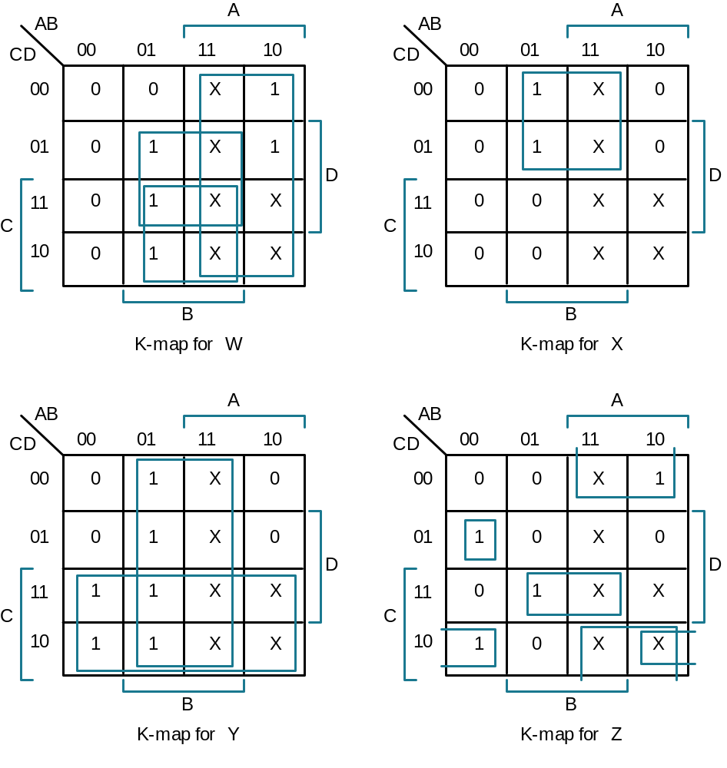
BCD to Gray Code Converter
Minimized Functions:
W = A + B D + B C
X = B C'
Y = B + C
Z = A'B'C'D + B C D + A D' + B' C D'

Slide 11
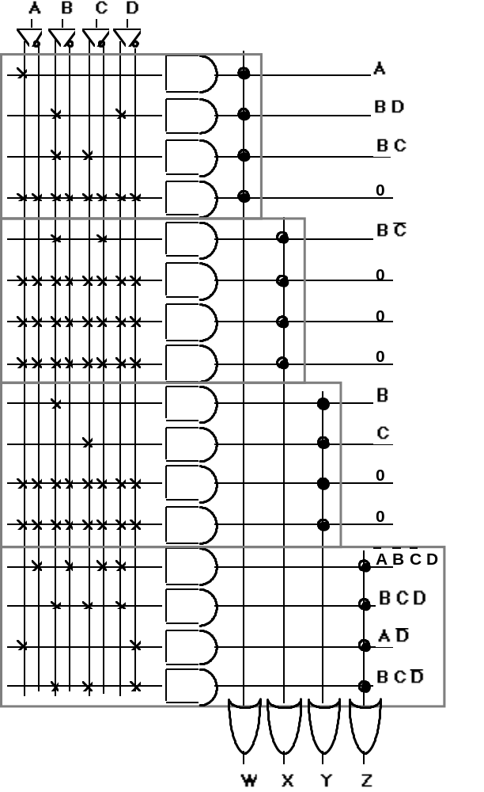
Example (Continued)
Notes:
4 product terms preassigned to each OR gates’ inputs
The OR gates’ inputs may or may not be internally pulled down by the manufacturer
It is a safe engineering practice to not leave any OR input unconnected
A B C D
A
BD
BC
BC’
B
C
- A PLA achieves higher flexibility at the cost of lower speed!
- Too much programmability?
BCD
AD’
BCD’
W X Y Z

Slide 12
PALs
Programmable Array Logic
  Realizes Sums of Products but with a fixed OR array

Slide 13
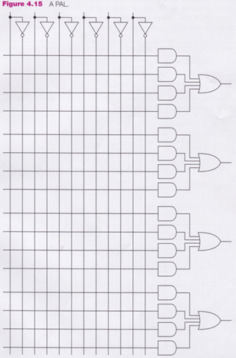
PAL
inputs
1st output
section
2nd output
section
Only functions with
at most four
products can be
implemented
3rd output
section
4th output
section

Slide 14
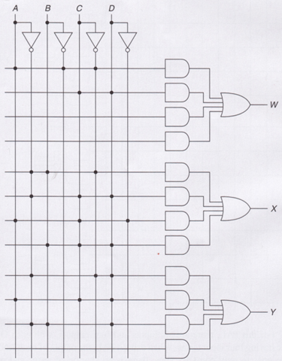
PAL
x
x
x
W = AB ′C ′ + CD
X = A′BC ′ + A′CD + ACD ′ + BCD
Y = A′C ′D + ACD + A′BD

Slide 15
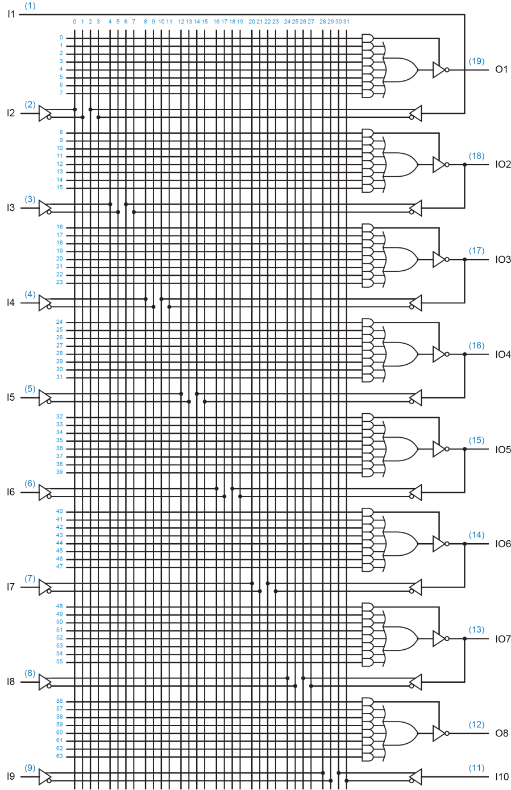
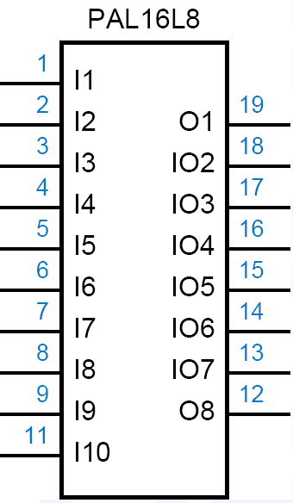

Slide 16

Helper Terms
  If an I/O pin’s output-control gate produces a constant 1, → the output is always enabled, but the pin may still be used as an input too.
  → outputs can be used to generate first-pass “helper terms” for logic functions that cannot be performed in a single pass with the limited number of AND terms available for a single output.

