Slide 1
Read-Only Memory
ROM

Slide 2
ROM
Can be used:
  to implement any arbitrary combinational circuit
  as a memory
Consists of:
  an n-to-2^{n} decoder that produces ALL minterms
  a set of programmable OR gates that produce SoP’s
Is usually described in terms of:
  size of its decoder output (number of memory rows)
  number of OR gates (memory width)
  i.e., 2^{n} x w, e.g., 8x4, 1024x8, etc.

Slide 3

ROM: Example 1
A 4-to-16 decoder
Three OR gates
Implemented three Boolean functions
Has an “enable” input to control the output
Can be viewed as a 16 x 3 memory
Memory content?
0
A
‘B’C’D’
1
A
‘B’C’D
F
2
A
‘B’CD’
1
3
A
‘B’CD
A
S₃
4
A
‘BC’D’
S₂
5
A
‘BC’D
B
6
A
‘BCD’
4:16
7
A
‘ BCD
C
S₁
dec
8
A
B’C’D’
F
9
A
B’C’D
2
D
S₀
10
A
B’CD’
1
1
A
B’CD
12
A
B C’D’
13
A
B C’D
14
A
B C D’
F
15
A
B C D
3
Enb

Slide 4
ROM: Example 2
A 3-to-8 decoder
Four OR gates
Can implement four Boolean
functions
Can be viewed as a 8 x 4 memory
No “enable” input
Memory content?
D7
X
X
X
D6
D5
X
X
D4
X
A
A2
D3
X
D2
X
X
B
A1
D1
A0
D0
X
C
F3
F2
F1
F0

Slide 5
ROM vs. PLA/PAL
Fixed
Programmable
Programmable
Inputs
AND array
Connections
OR array
Outputs
(decoder)
(a) Programmable read-only memory (PROM)
Inputs
Programmable
Programmable
Fixed
Connections
AND array
OR array
Outputs
(b) Programmable array logic (PAL) device
Programmable
Programmable
Programmable
Programmable
Inputs
Connections
AND array
Connections
OR array
Outputs
(c) Programmable logic array (PLA) device

Slide 6
General Logic Implementation
  Given a 2^{k}xn ROM, we can implement ANY combinational circuit with at most k inputs and at most n outputs.
Why?
  k-to-2^{k} decoder will generate all 2^{k} possible minterms
  Each of the OR gates can implement a ∑m()
  Each ∑m() can be programmed to represent one function

Slide 7
Example
Find a ROM-based circuit implementation for:
  f(a,b,c) = a’b’ + abc
  g(a,b,c) = a’b’c’ + ab + bc
  h(a,b,c) = a’b’ + c
Solution:
  Determine the required ROM size
  Express f(), g(), and h() in ∑m() format (use truth tables)
  Program the ROM, based on the 3 ∑m()’s

Slide 8
Example (Continued)
There are 3 inputs and 3 outputs, thus we need an 8x3 ROM block.
Prepare the minterm lists:
    f = ∑m(0, 1, 7)
    g = ∑m(0, 3, 6, 7)
    h = ∑m(0, 1, 3, 5, 7)
Program the ROM
a
0
1
2
3
4
5
6
7
b
3-to-8
decoder
c
f
g
h

Slide 9
ROM as a Memory
ROM’s can be viewed as memory with the inputs as address lines, and outputs as the stored data
Usually have:
  N input lines,
  M output lines,
  Provide 2^{N} x M bits of memory

Slide 10
ROM as Memory (Example)
Read Example: For input (A₂,A₁,A₀) = 011, output is (F₃,F₂,F₁,F₀ ) = 0010.
What are functions F₃, F₂ , F₁ and F₀ in terms of (A₂, A₁, A₀)?
Address
8x4 ROM
D0
X
X
X
0 | 1 | 1 | 0 | 1
1 | 0 | 0 | 0 | 0
2 | 1 | 0 | 0 | 1
3 | 0 | 0 | 1 | 0
4 | 0 | 0 | 0 | 0
5 | 1 | 0 | 0 | 0
6 | 0 | 0 | 1 | 1
7 | 0 | 1 | 0 | 0
D1
D2
X
X
D3
X
A2
A2
D4
X
A[2:0]
F[3:0]
D5
X
X
A1
A1
D6
A0
A0
D7
X
F3
F2
F1
F0

Slide 11
ROM as a Memory
History:
  ROM: the first generation, used as a memory but preprogrammed at the time of manufacturing
  PROM: Programmable ROM, the second generation, able to be programmed at the time of usage
  EPROM: Erasable PROM, able to be erased by UV, and reprogrammed
  EEPROM: Electronically EPROM, able to be erased electronically and reprogrammed

Slide 12
(Memories)
Volatile:
  Random Access Memory (RAM):
    SRAM: "static"
    DRAM: "dynamic"
Non-Volatile:
  ROM
  PROM
  EPROM
  EEPROM
  FLASH memory: similar to EEPROM with programmer integrated on chip

Slide 13
Design by ROM: Example
BCD to 7-Segment Display Controller (Decoder)
A B C D
C0 C1 C2 C3 C4 C5 C6
0 0 0 0
0 0 0 1
0 0 1 0
0 0 1 1
0 1 0 0
0 1 0 1
0 1 1 0
0 1 1 1
1 1 1 1 1 1 0
0 1 1 0 0 0 0
1 1 0 1 1 0 1
1 1 1 1 0 0 1
0 1 1 0 0 1 1
1 0 1 1 0 1 1
1 0 1 1 1 1 1
1 1 1 0 0 0 0
1 1 1 1 1 1 1
1 1 1 0 0 1 1
Reminder:
C
0
C
C
5
C
6
1
1 0 0 0
1 0 0 1
1 0 1 0
1 0 1 1
1 1 0 0
1 1 0 1
1 1 1 0
0 1 1 1
C
C
4
2
C
X X X X X X X
X X X X X X X
X X X X X X X
X X X X X X X
X X X X X X X
X X X X X X X
3
Need a ROM with at least 4 address lines and 7 bits of output

Slide 14
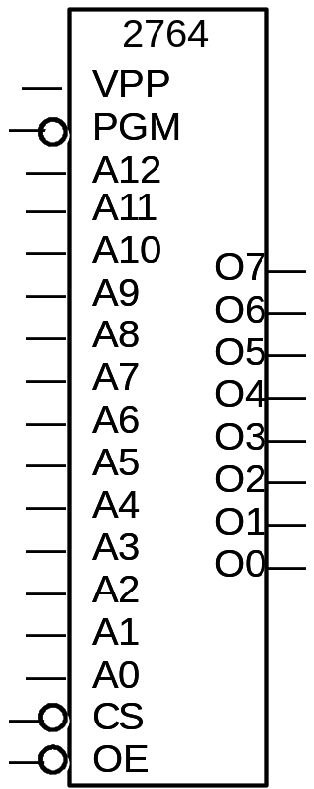
Design by ROM: Example Continued
  There are some standard devices such as 2764
  Vpp and PGM are used when programming
  Chip Select (CS) and Output Enable (OE) inputs are used to control the chip
  13 address lines provide 2¹³ (=8192=8K) memory bytes of 8 bits
  Extra address lines grounded
  Extra output line not connected
2764 EPROM
8K x 8
?
?
0
0
0
0
C
0
0
0
C
1
0
C
2
0
C
3
0
C
4
A
C
5
B
C
6
C
D
?
?

Slide 15
ROM vs. PLA/PAL
ROM approach advantageous when
  (1) design time is short (no need to minimize output functions)
  (2) little sharing of product terms among output functions
ROM problem:
  (1) Size doubles for each additional input,
  (2) Can't use don't cares
PLA approach advantageous when
  (1) a design tool (like espresso) is available
  (2) many minterms are shared among the output functions
PLA problem:
  Too much programmability for ordinary applications => too expensive
PAL problem:
  Constrained fan-ins on OR planes

Slide 16
ROM vs. PLA
ROM
  Cheap (high-volume component)
  Medium speed
PLA
  Expensive
    Complex design; need more sophisticated tools
  Slow
    Two programmable planes

