Slide 1
Building Blocks:
Tri-State Buffer
Decoder
Encoder

Slide 2
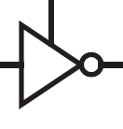
Tri-State (Output Enable) Gate
Tri-State (Three-State) Inverter:
  The output is the NOT of input if the Enable input is HIGH
  Else output is Hi-Impedance (Hi-Z)
    Unconnected
Enable
input
output
Tri-State Buffer:
Enable
input
output

Slide 3
Active Low Input
Tri-State Buffer with Active Low Enable:
EN
in
out
Tri-state BUF, EN low
Tri-State Inverter with Active Low Enable:
EN
in
out
Tri-state INV, EN low

Slide 4
Decoder Description
Binary decoder is a very common combinational circuit used as a building block for:
  Implementing general logic
  Making larger circuits such as Read-Only Memories (ROM)
  Steering logic in large designs (also called glue logic)
  Can be found in n-to-2^{n} denominations
    e.g., 2-to-4, 3-to-8, etc.
  For simplicity, will be called “decoder”

Slide 5
A 3-to-8 Decoder
O₀
ABC
E | A | B | C | O₀ | O₁ | O₂ | O₃ | O₄ | O₅ | O₆ | O₇
0 | X | X | X | 0 | 0 | 0 | 0 | 0 | 0 | 0 | 0
1 | 0 | 0 | 0 | 1 | 0 | 0 | 0 | 0 | 0 | 0 | 0
1 | 0 | 0 | 1 | 0 | 1 | 0 | 0 | 0 | 0 | 0 | 0
1 | 0 | 1 | 0 | 0 | 0 | 1 | 0 | 0 | 0 | 0 | 0
1 | 0 | 1 | 1 | 0 | 0 | 0 | 1 | 0 | 0 | 0 | 0
1 | 1 | 0 | 0 | 0 | 0 | 0 | 0 | 1 | 0 | 0 | 0
1 | 1 | 0 | 1 | 0 | 0 | 0 | 0 | 0 | 1 | 0 | 0
1 | 1 | 1 | 0 | 0 | 0 | 0 | 0 | 0 | 0 | 1 | 0
1 | 1 | 1 | 1 | 0 | 0 | 0 | 0 | 0 | 0 | 0 | 1
A
S₂
O₁
ABC
O₂
ABC
B
S₁
3:8
O₃
ABC
C
dec
O₄
ABC
S₀
O₅
ABC
O₆
ABC
O₇
ABC
E (Enable)
Each decoder output is a minterm:
Any combinational circuit can be constructed using decoders and OR gates

Slide 6
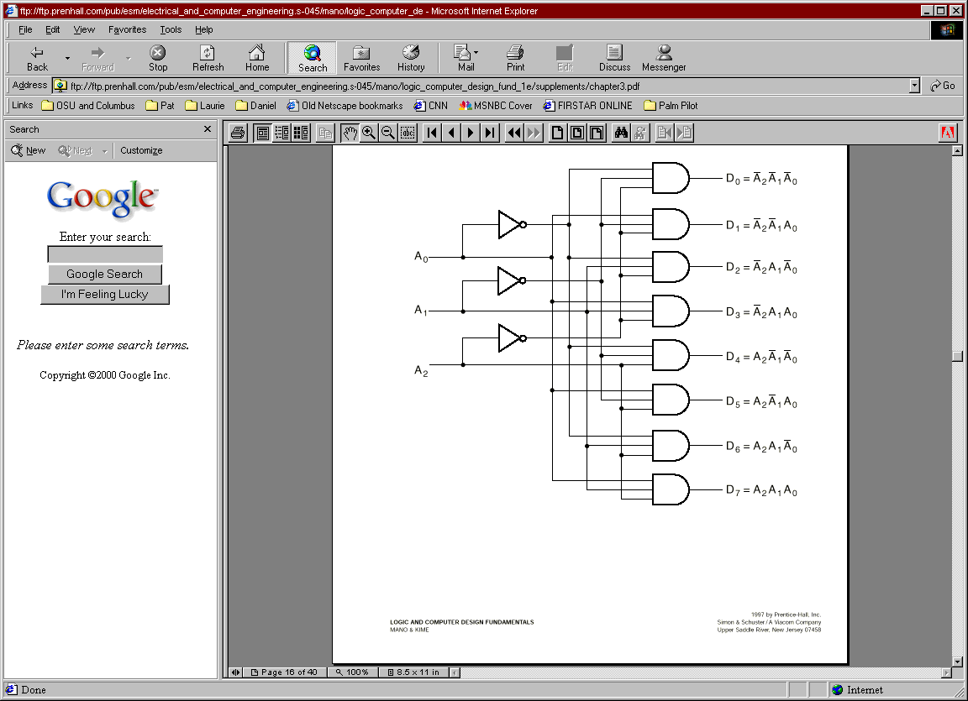
Decoder Internal Circuit

Slide 7

Design Using Decoder
Basic Idea:
  A decoder can be used to implement any combinational circuit (reminder: each decoder output is a minterm)
Example:
0
A
‘B’C’D’
1
A
‘B’C’D
F
F1 = A' B C' D + A' B' C D + A B C D
F2 = A B C' D' + A B C
F3 = A' + B' + C' + D'
2
A
‘B’CD’
1
3
A
‘B’CD
A
S₃
4
A
‘BC’D’
S₂
5
A
‘BC’D
B
6
A
‘BCD’
4:16
7
A
‘ BCD
C
S₁
dec
8
A
B’C’D’
F
9
A
B’C’D
2
D
S₀
10
A
B’CD’
1
1
A
B’CD
12
A
B C’D’
13
A
B C’D
14
A
B C D’
F
15
A
B C D
3
Enb

Slide 8
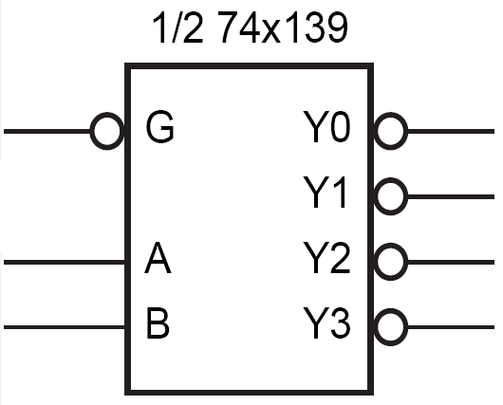
Inputs/Outputs Can Be Active Low
Decoder with
  Active Low Enable
  Active Low Outputs
G | A | B | Y₀ | Y₁ | Y₂ | Y₃
1 | X | X | 1 | 1 | 1 | 1
0 | 0 | 0 | 0 | 1 | 1 | 1
0 | 0 | 1 | 1 | 0 | 1 | 1
0 | 1 | 0 | 1 | 1 | 0 | 1
0 | 1 | 1 | 1 | 1 | 1 | 0

Slide 9
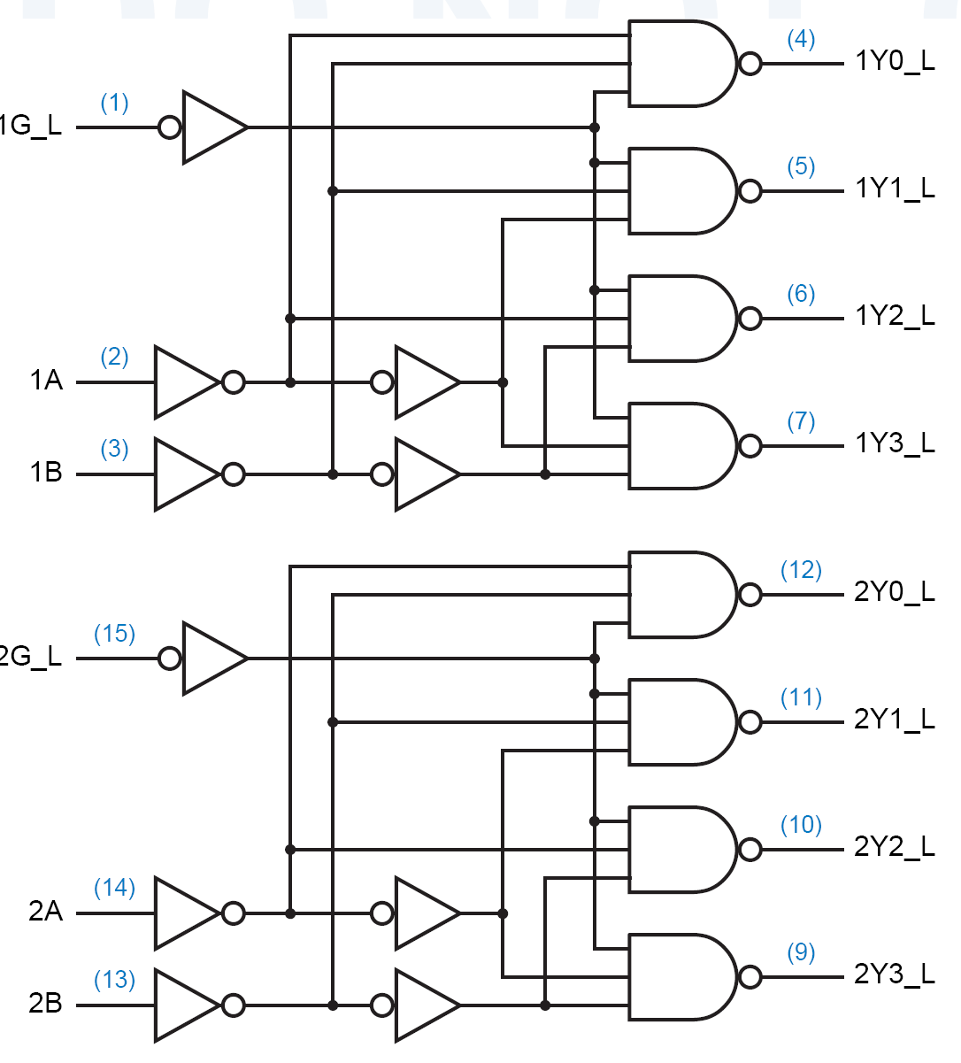
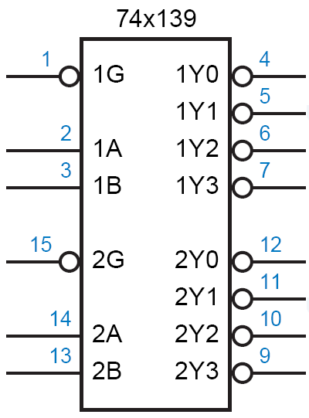
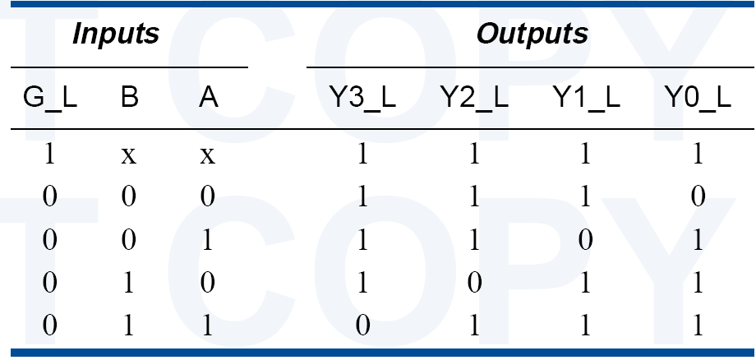
74x139 dual 2-to-4 decoder

Slide 10
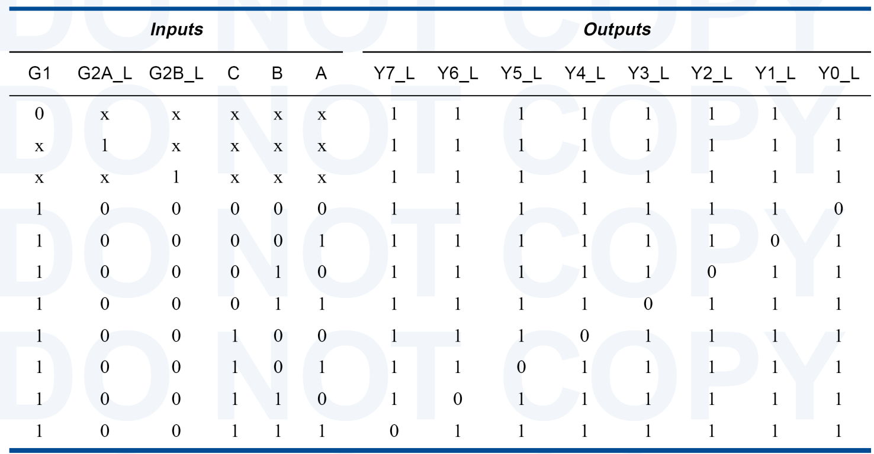
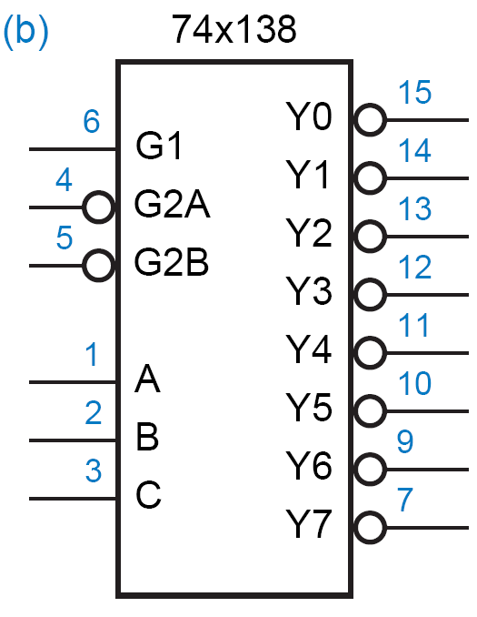
74x138 3-8 Decoder

Slide 11
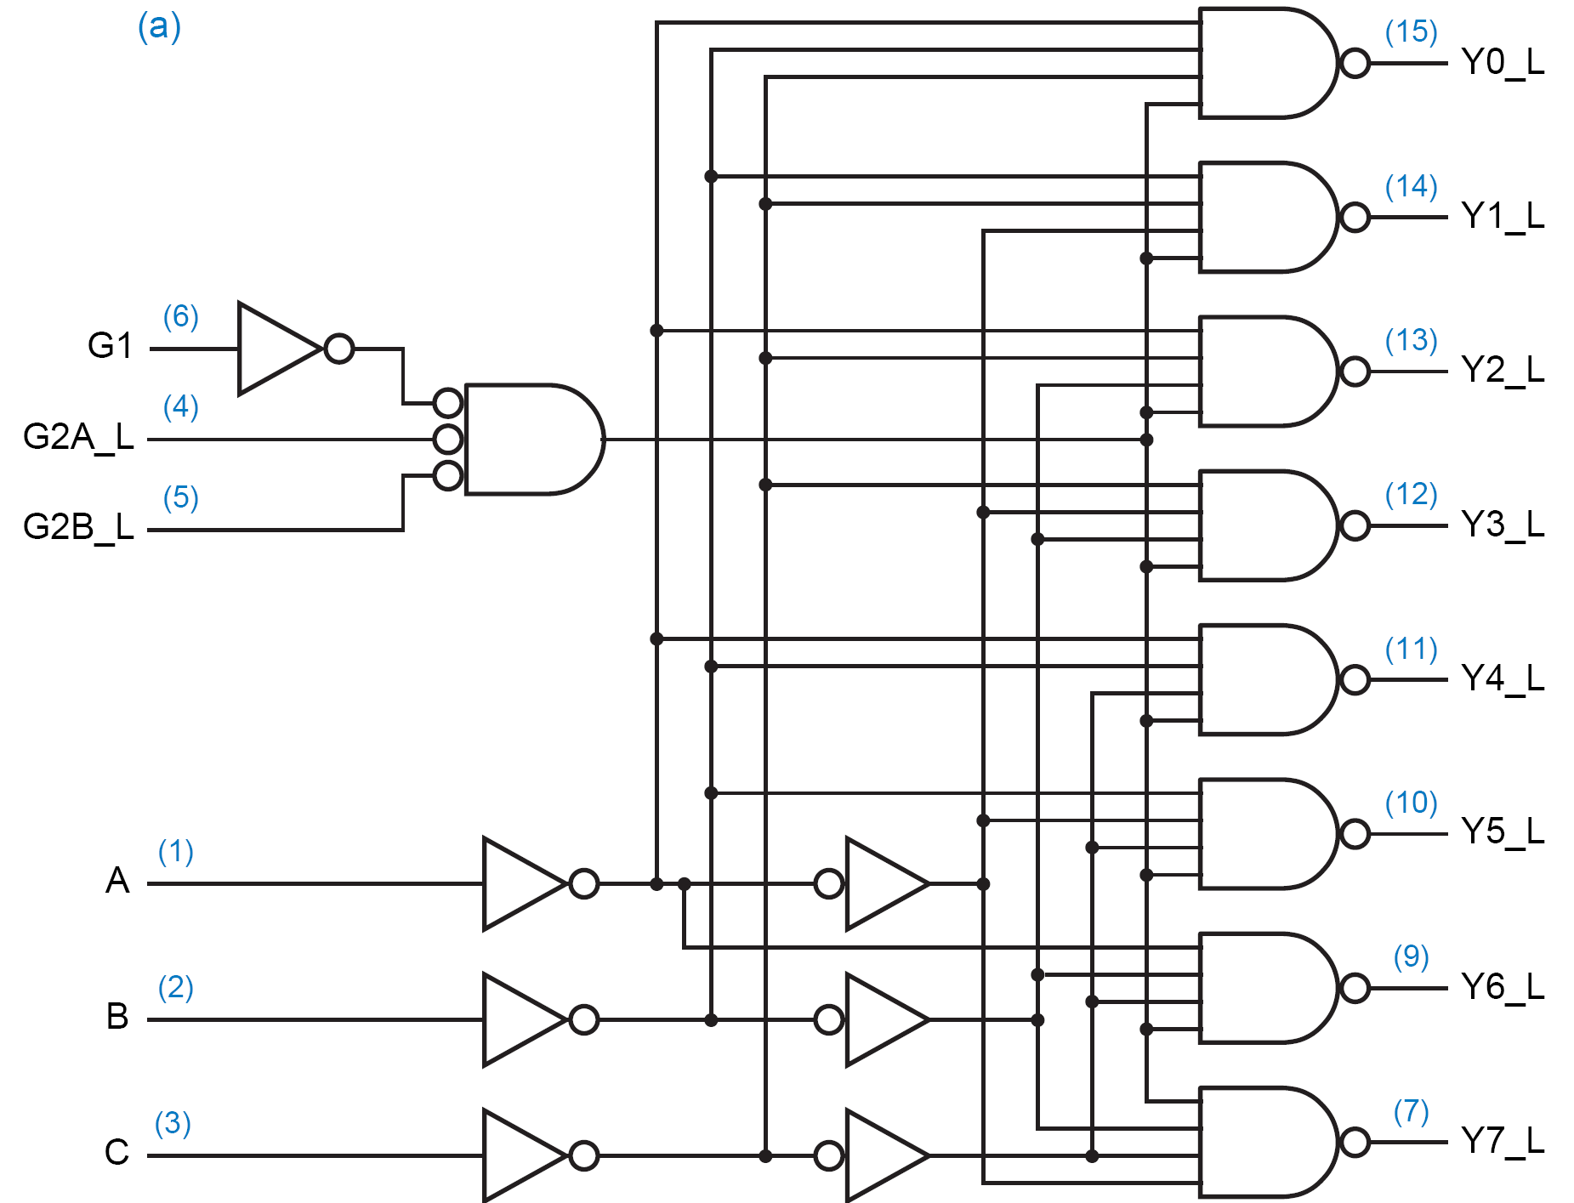
74x138 3-8 Decoder

Slide 12
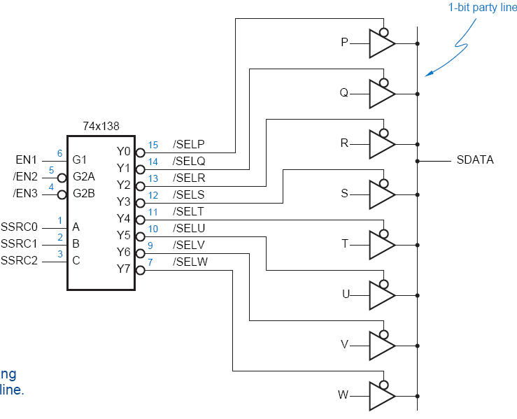
Application: Device Selection
  Normally, gate outputs cannot be tied together
    Have to use tri-state buffers to do that
    Have to make sure the buffers are not on simultaneously
    Can use a decoder to control the buffers
  Example: a decoder and 8 tri-state buffers are used to share a single line among 8 devices
  The decoder guarantees that no two buffers are on simultaneously
  Some decoders have built-in tri-state outputs

Slide 13
Larger Decoders?
  Can build a decoder by using smaller decoders
  Example: a 4-to-16 based on two 3-to-8 decoders
A
O₀
0
B
S₂
O₁
1
B
C
S₁
O₂
3:8
O₃
2
D
S₀
dec
O₄
3
O₅
A
S₃
4
O₆
5
Enb
O₇
B
S₂
6
4:16
7
C
S₁
dec
8
C
9
O₀
D
S₀
10
B
S₂
O₁
1
1
O₂
12
C
S₁
3:8
O₃
13
D
S₀
dec
O₄
14
O₅
15
D
Enb
O₆
O₇
Enb

Slide 14
Decoders
  How to build a 5-32 decoder by using 4-16 and 2-4 decoders?

Slide 15
Decoders
Decoder: a more general term
  Our focus was on “binary decoders”

Slide 16
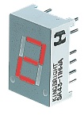
7-Segment Decoder
Seven-segment display:
  7 LEDs (light emitting diodes), each one controlled by an input
  1 means “on”, 0 means “off”
  Display digit “3”?
    Set a, b, c, d, g to 1
    Set e, f to 0
a
f
b
g
e
c
d

Slide 17
7-Segment Decoder
C
0
C
C
5
C
6
1
C
C
4
2
C
3
C
C
C
C
C
C
C
0
1
2
3
4
5
6
BCD-to-7-segment
control signal
decoder
A
B
C
D

Slide 18
7-Segment Decoder
7-Segment Decoder:
  Input is a 4-bit BCD code → 4 inputs (A, B, C, D).
  Output is a 7-bit code (a,b,c,d,e,f,g) that allows for the decimal equivalent to be displayed.
Example:
  Input: 0000_{BCD}
  Output: 1111110
  (a=b=c=d=e=f=1, g=0)
a
f
b
g
e
c
d

Slide 19
BCD-to-7Segment Truth Table
Digit
ABCD
abcdefg
Digit
ABCD
abcdefg
0
0000
1111110
8
1000
1111111
1
0001
0110000
9
1001
111X011
1010
XXXXXXX
2
0010
1101101
1011
XXXXXXX
3
0011
1111001
1100
XXXXXXX
4
0100
0110011
1101
XXXXXXX
5
0101
1011011
1110
XXXXXXX
6
0110
X011111
1111
XXXXXXX
7
0111
11100X0
??

Slide 20
K-maps
AB
A
AB
A
AB
A
CD
00
01
11
10
CD
00
01
11
10
CD
00
01
11
10
00
1
0
X
1
00
1
1
X
1
00
1
1
X
1
01
0
1
X
1
01
1
0
X
1
01
1
1
X
1
D
D
D
11
1
1
X
X
11
1
1
X
X
11
1
1
X
X
C
C
C
10
1
1
X
X
10
1
0
X
X
10
0
1
X
X
B
B
B
K-map for
a
K-map for
b
K-map for
c
A
AB
A
AB
A
AB
A
AB
CD
00
01
11
10
CD
00
01
11
10
CD
00
01
11
10
CD
00
01
11
10
00
1
0
X
1
00
1
0
X
1
00
1
1
X
1
00
0
1
X
1
01
0
1
X
0
01
0
0
X
0
01
0
1
X
1
01
0
1
X
1
D
D
D
D
11
1
0
X
X
11
0
0
X
X
11
0
0
X
X
11
1
0
X
X
C
C
C
C
10
1
1
X
X
10
1
1
X
X
10
0
1
X
X
10
1
1
X
X
B
B
B
B
K-map for
d
K-map for
e
K-map for
f
K-map for
g
a = A + B D + C + B' D'
b = A + C' D' + C D + B'
c = A + B + C' + D
d = B' D' + C D' + B C' D + B' C
e = B' D' + C D
f = A + C' D' + B D' + B C'
g = A + C D' + B C' + B' C

Slide 21
Encoder

Slide 22
Encoder
Encoder:
  The reverse operation of a decoder
  Has 2^{n} input lines and n output lines
  The output lines generate the binary equivalent of the input line whose value is 1
I0
z1
4-2
Binary
Encoder
I1
I2
z2
I3

Slide 23
Encoder
O₀
I₀
A
S₂
O₁
I₁
Z₂
A
O₂
I₂
B
S₁
3:8
O₃
I₃
8:3
Z₁
B
C
decoder
O₄
I₄
encoder
C
S₀
Z₀
O₅
I₅
O₆
I₆
O₇
I₇

Slide 24
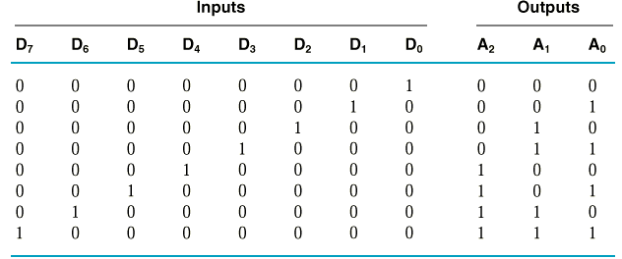
Encoder Circuit Design
Example:
  8-3 Binary Encoder
A₀ = D₁ + D₃ + D₅ + D₇
A₁ = D₂ + D₃ + D₆ + D₇
A₂ = D₄ + D₅ + D₆ + D₇

Slide 25
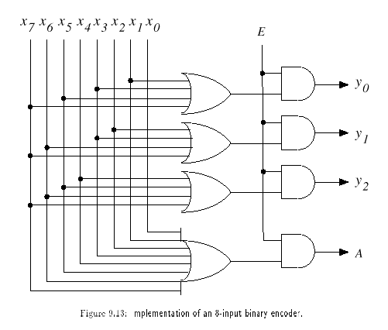
Encoder Circuit
With Enable
With Acknowledge

Slide 26
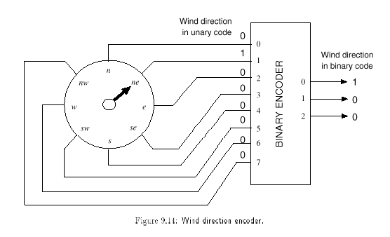
Application
The number of inputs: large
→ fewer lines

Slide 27
Encoder Design Issues
  The previous design has a major problem:
    Only one input can be active at any given time
    If two inputs are active simultaneously, the output produces an undefined combination
      (for example, if D₃ and D₆ are 1 simultaneously, the output of the encoder will be 111.
A₀ = D₁ + D₃ + D₅ + D₇
A₁ = D₂ + D₃ + D₆ + D₇
A₂ = D₄ + D₅ + D₆ + D₇
May still be fine in particular applications! Example: next slide

Slide 28
Encoder Application Example
  Multiple contestant switch board
  Contestants have to push their buttons if they know the answer
  The winner’s number will be shown
  One input from each contestant to the encoder
  Problems: too many inputs, small chance for simultaneous pushes

Slide 29
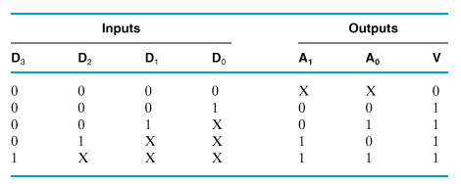
Priority Encoder
  Multiple asserted inputs are allowed; one has priority over all others.

Slide 30
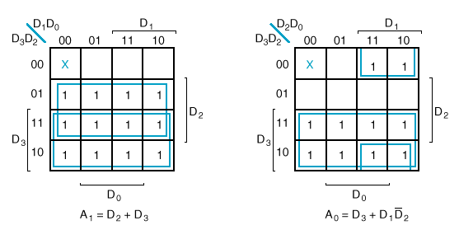
K-Maps

Slide 31
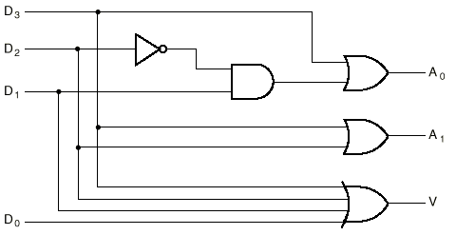
Circuit

Slide 32
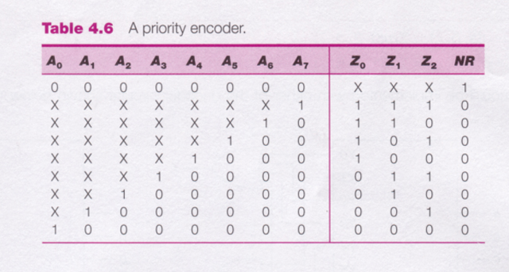
8-3 Priority Encoder

Slide 33
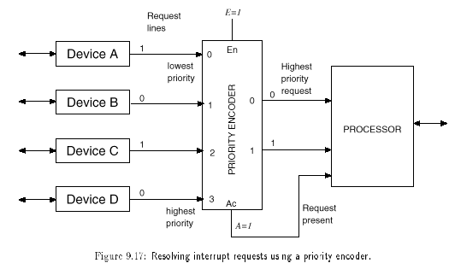
Priority Encoder: Application

Slide 34
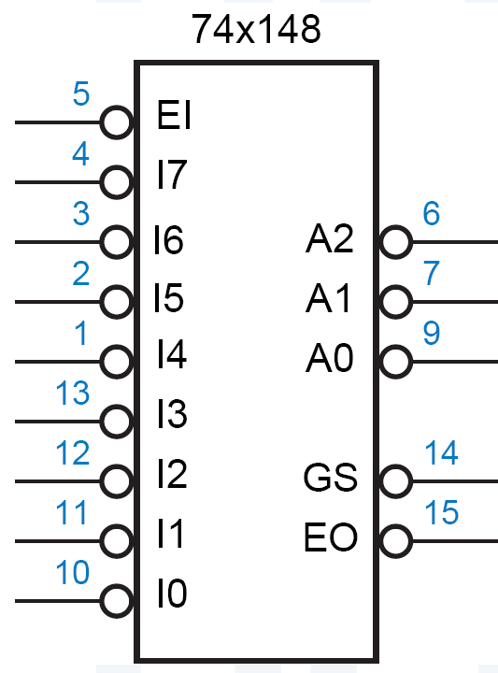
74x148
Features:
  Inputs and outputs are active low
  EI must be asserted for any of its outputs to be asserted
  GS is asserted when the device is enabled and one or more of the request inputs is asserted (“Group Select” or “Got Something”)
  EO is an enable output designed to be connected to the EI input of another ’148 that handles lower-priority requests
    It is asserted if EI is asserted but no request input is asserted; thus, a lower-priority ’148 may be enabled

Slide 35
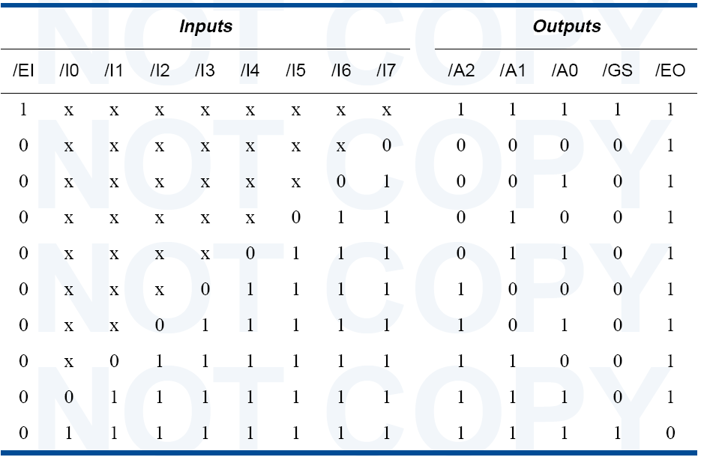
74x148 Truth Table

Slide 36
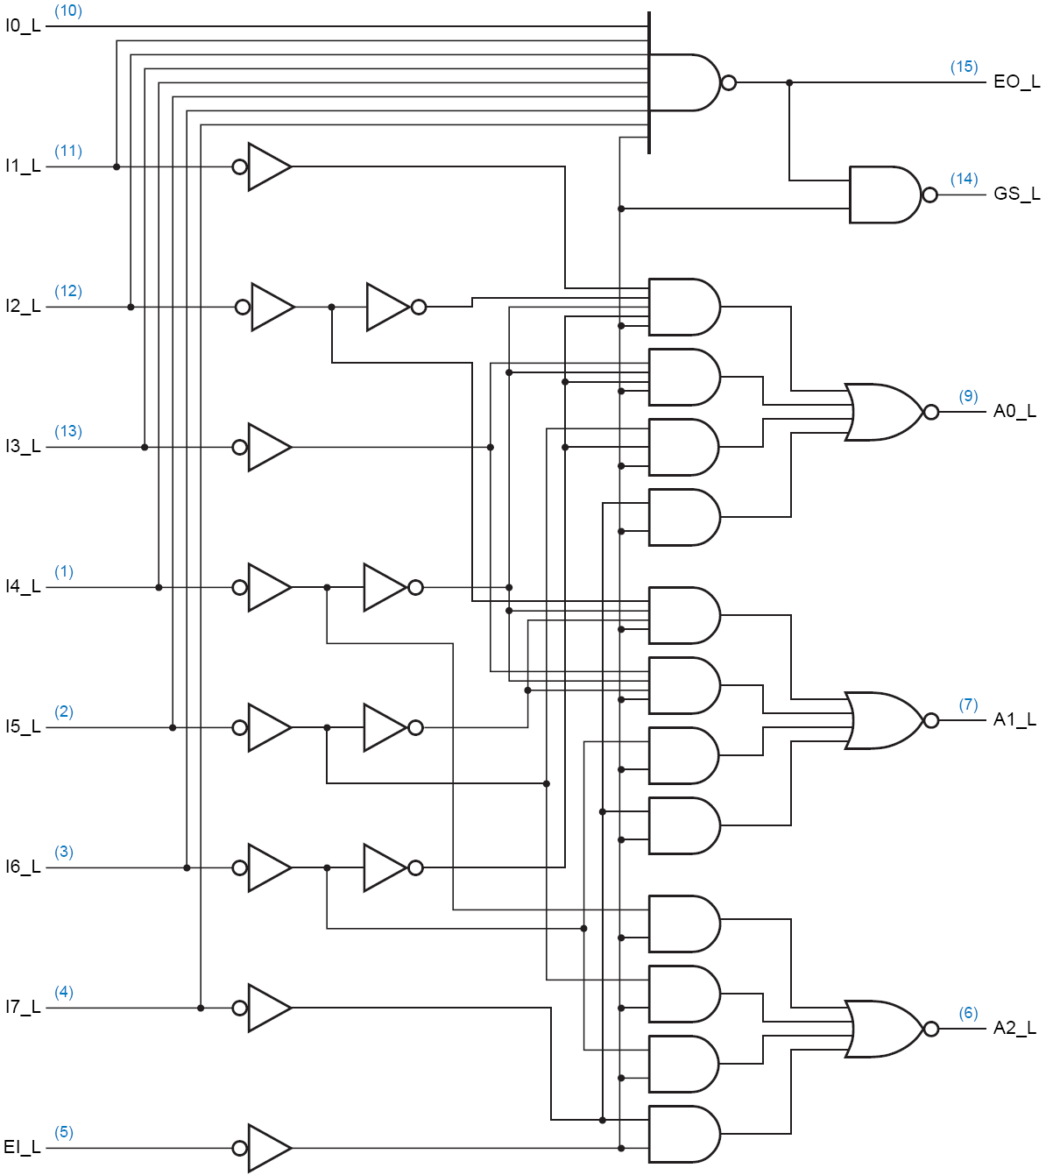
Circuit Diagram

