Slide 1
Project 3: Quail Call Estimation
Farshad Bolouri
Anindita Das
Brennae Stinson

Slide 2
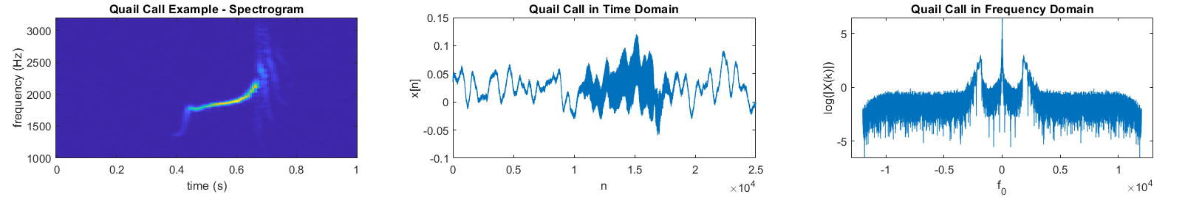
Signal Description
Quail call acquired using four Song Meter SM3 Pro microphones placed in quail environment
Sampling Rate: 24 kHz
Non-Wide Sense Stationary
Bandwidth: 1850-2400 Hz

Slide 3
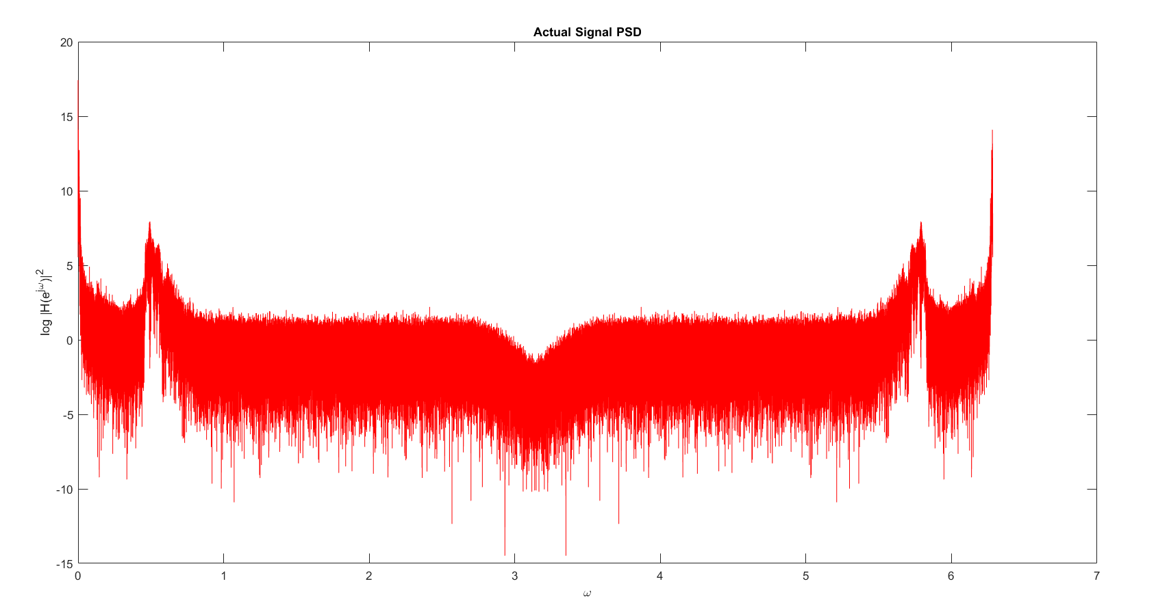
Actual PSD of the Quail Call

Slide 4
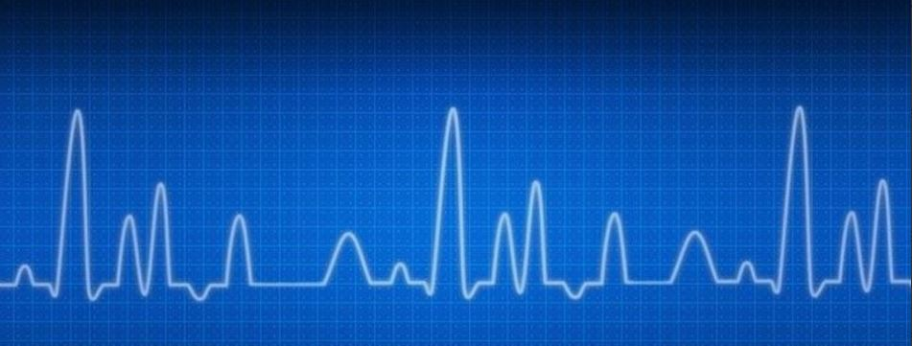
Traditional Methods
BARTLETT
WELCH
BLACKMAN-TUKEY

Slide 5
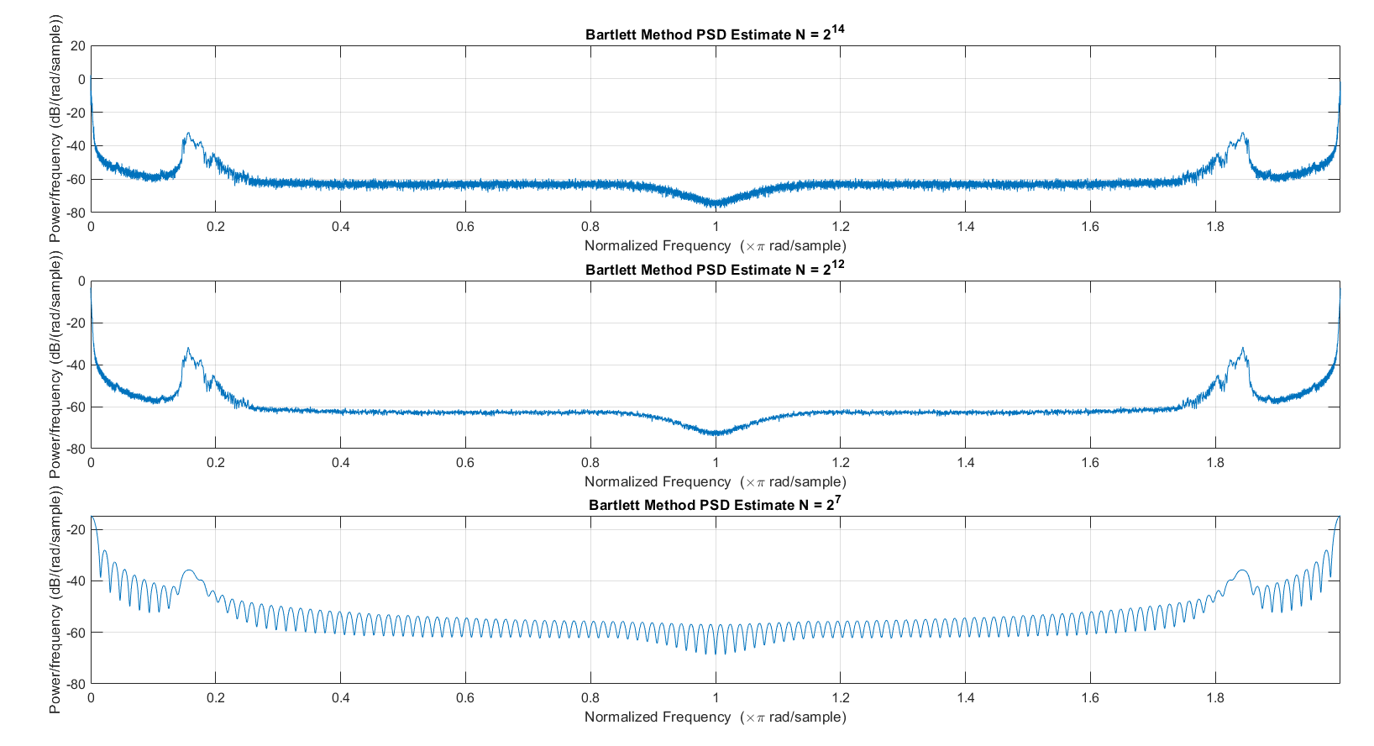
Bartlett Results

Slide 6
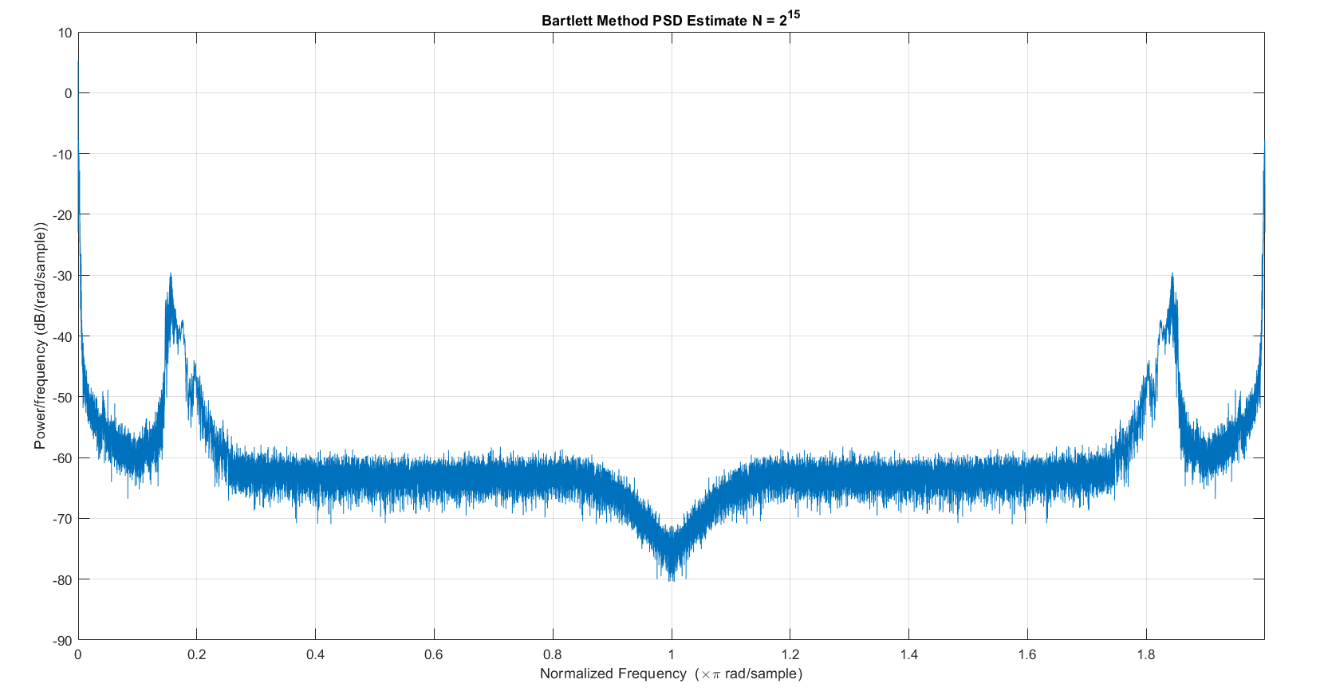
Bartlett PSD Estimate

Slide 7
Traditional: Pros and Cons
Bartlett:
Pros
Welch
Blackman-Tukey
Reduces noise when compared to regular periodogram
Simple to implement
Cons
Frequency resolution trade off
The best estimate is not consistent with actual PSD

Slide 8
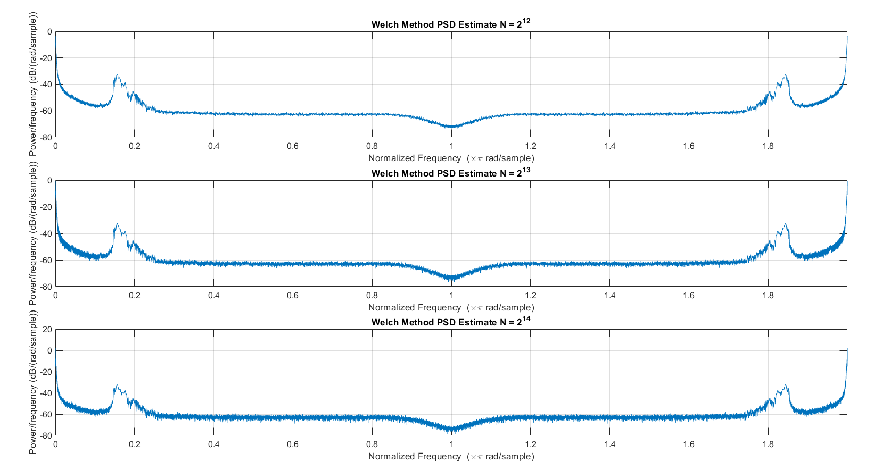
Welch Results

Slide 9
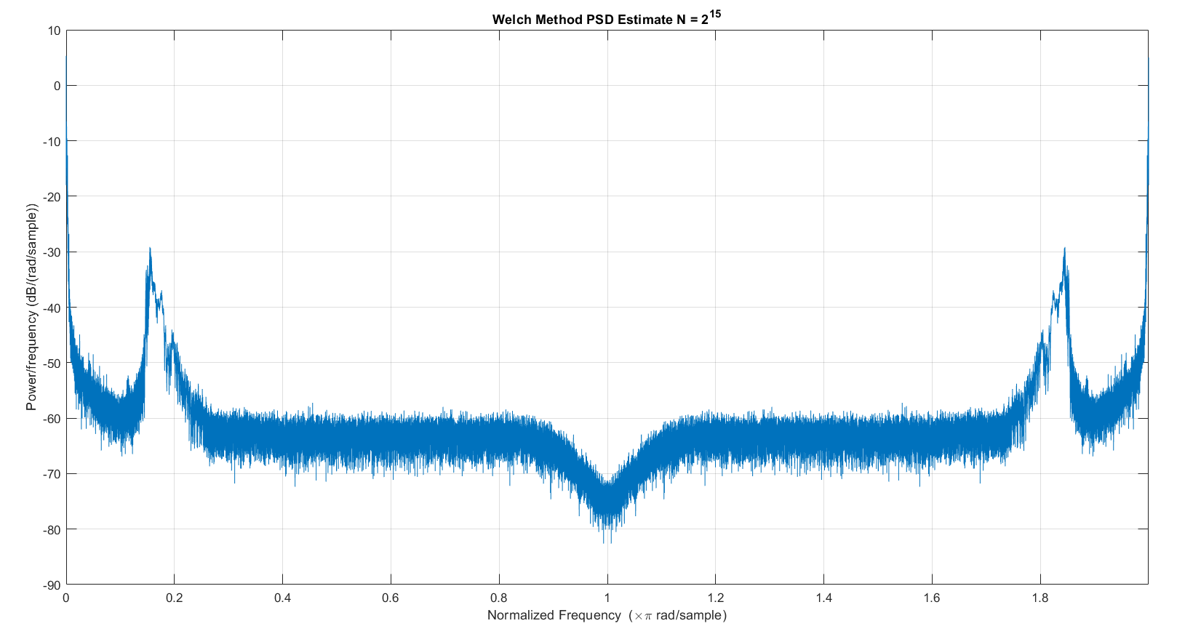
Welch PSD Estimate

Slide 10
Traditional: Pros and Cons
Bartlett:
Welch
Blackman-Tukey
Pros
Refinement from Bartlett Method
Overlap allows additional way to adjust frequency resolution
Cons
Frequency resolution trade off with window size
Closer than Bartlett, however signal estimate is still off

Slide 11
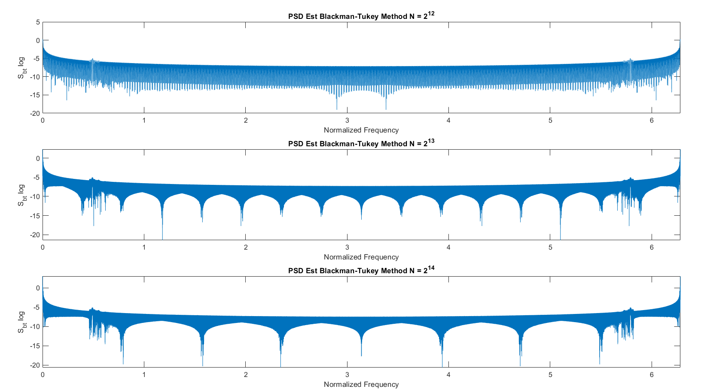
Blackman-Tukey Results
Blackman-Tukey Results

Slide 12
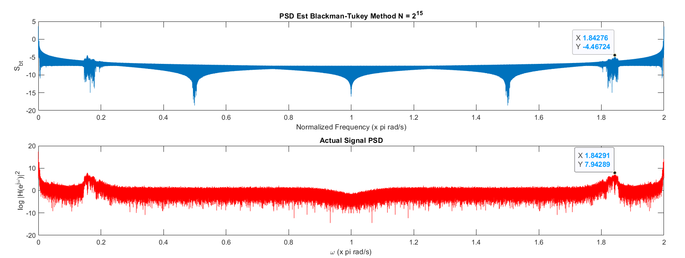
Blackman Method PSD Estimate
Blackman-Tuckey PSD Estimate

Slide 13
Traditional: Pros and Cons
Bartlett:
Welch
Blackman-Tukey
Pros
Better estimate compared to Bartlett and Welch Methods
Improvement in frequency resolution
Cons
More complicated calculation
Variance of method decrease with smaller window size along with resolution

Slide 14
Parametric Methods
YULE-WALKER
ARMA

Slide 15
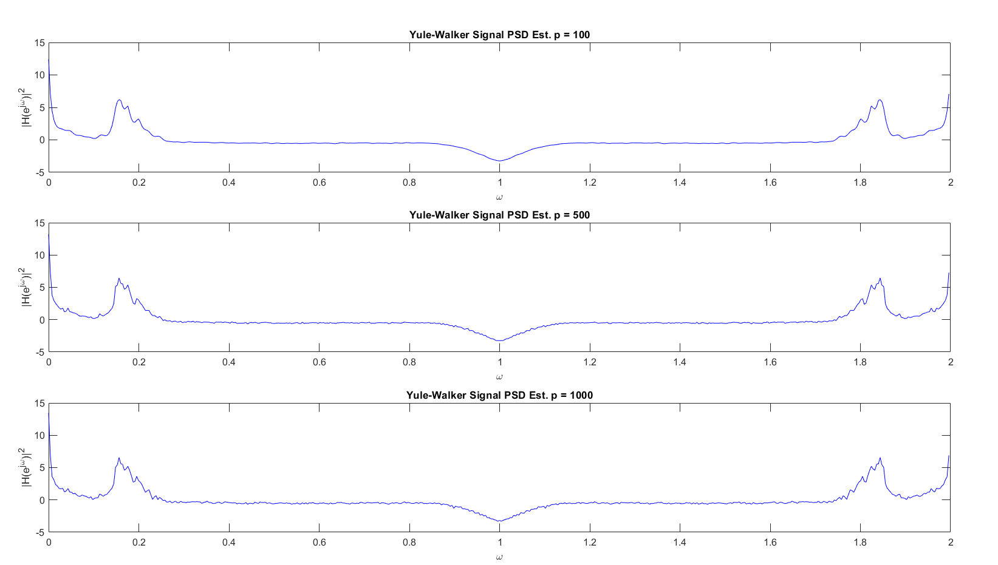
Parametric Methods
Yule-Walker Results

Slide 16
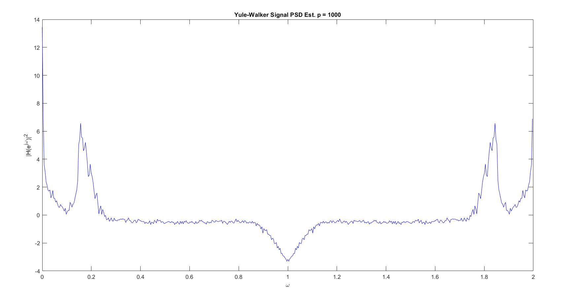
Yule-Walker PSD Estimate

Slide 17
Traditional: Pros and Cons
Bartlett:
Welch
Blackman-Tukey
Pros
Better estimate compared to Bartlett and Welch Methods
Improvement in frequency resolution
Cons
More complicated calculation
Variance of method decrease with smaller window size along with resolution

Slide 18
Pros
Better estimate compared to Bartlett and Welch Methods
Improvement in frequency resolution
Cons
More complicated calculation
Variance of method decrease with smaller window size along with resolution

