Slide 1
Maricopa Housing project
By Sebastian Ivan

Slide 2
problem Statement
Predicting house prices in Maricopa County
The model aids consumers to gauge their expectations for how much the house is worth
Current appraisals are limited to a very narrow area around the subject house, usually a half mile radius.
Criteria for success: To predict the sale price within 1% of actual sold price

Slide 3
Data Collection
3117 listings were sold between Feb 01, 2024 and March 01, 2024.
These listings were found in MLS (Multiple Listings Services) Arizona.
Each listing had 29 features, ie. nr of bedrooms, bathrooms, Approx. SqFt, etc...

Slide 4
Data Cleaning
Entries of listings in MLS had many agent errors.
Data integrity was verified,
Data ranges were checked for abnormal outliers.
Missing data was found and replaced with binary values where appropriate.

Slide 5
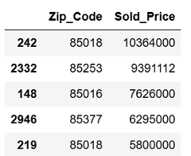
Exploratory Data Analysis
Most 5 expensive houses were sold in Zip codes 85018, 85253, 85016 and 85377, corresponding to Phoenix, Paradise Valley, and Carefree cities.

Slide 6
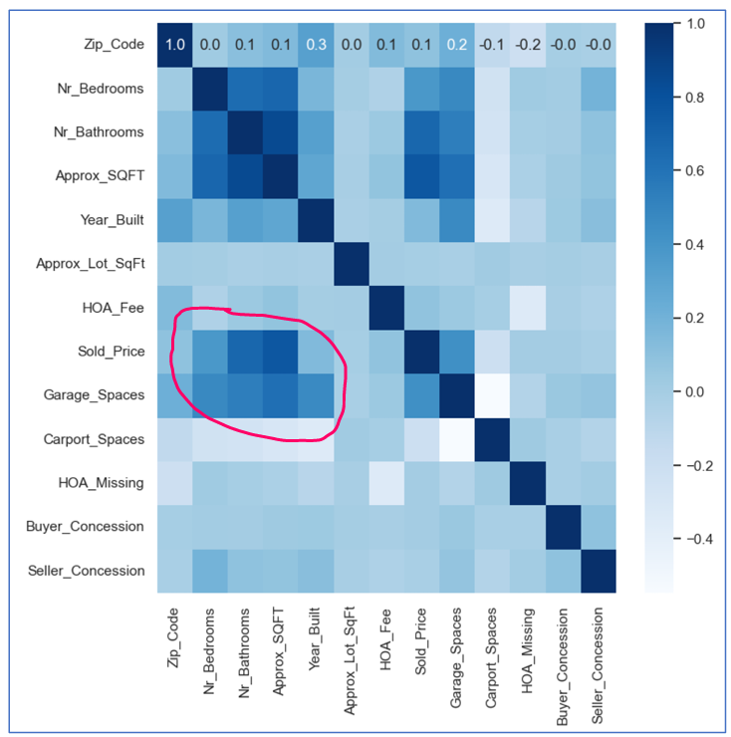
Exploratory Data Analysis
A correlation heatmap shows a visual on correlation
between features, with area of higher correlation
circled in red

Slide 7
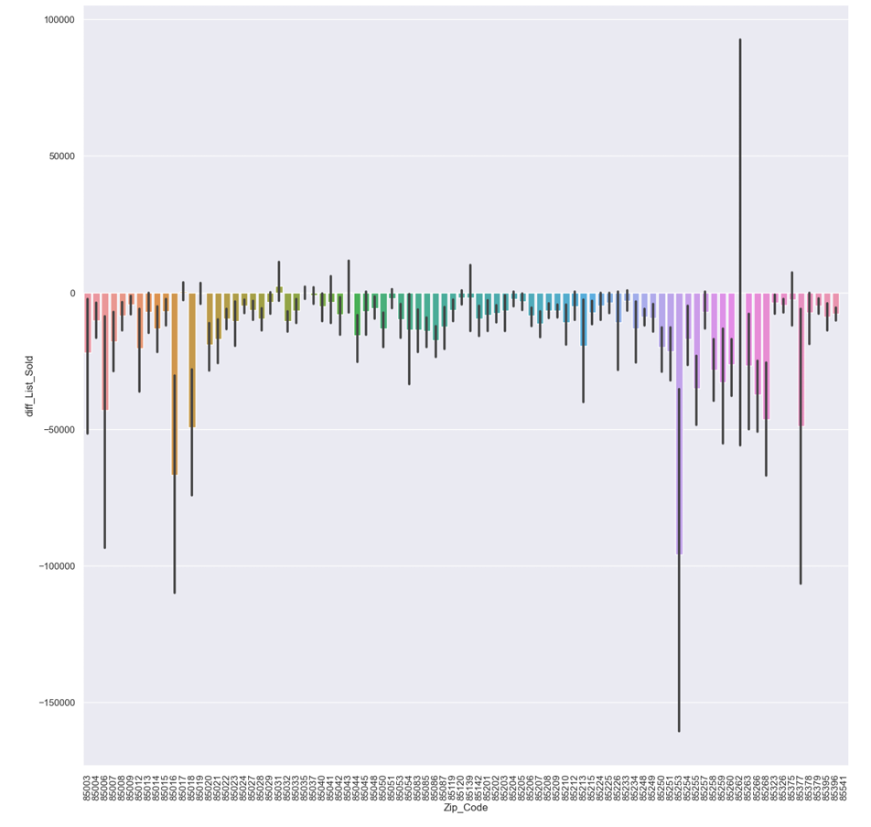
Exploratory Data Analysis
Majority of houses sold for less than the listing price, as reflected by diff_List_Sold feature which shows the difference between listing and sold price.

Slide 8
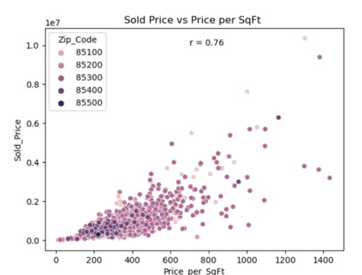
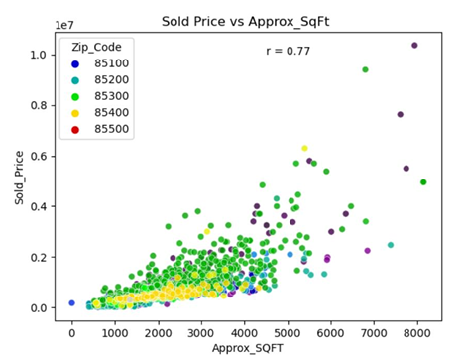
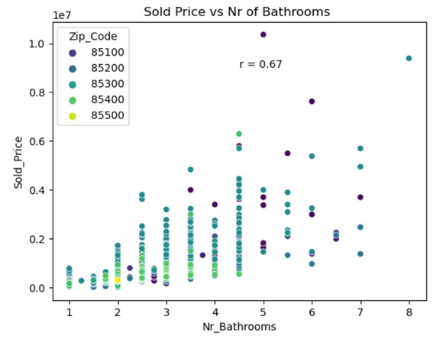
Exploratory Data Analysis
Correlations of Sold Price vs Price_per_SqFt , Approx_SqFt and Nr_Bathrooms
r = 0.76 r = 0.77 r = 0.67

Slide 9
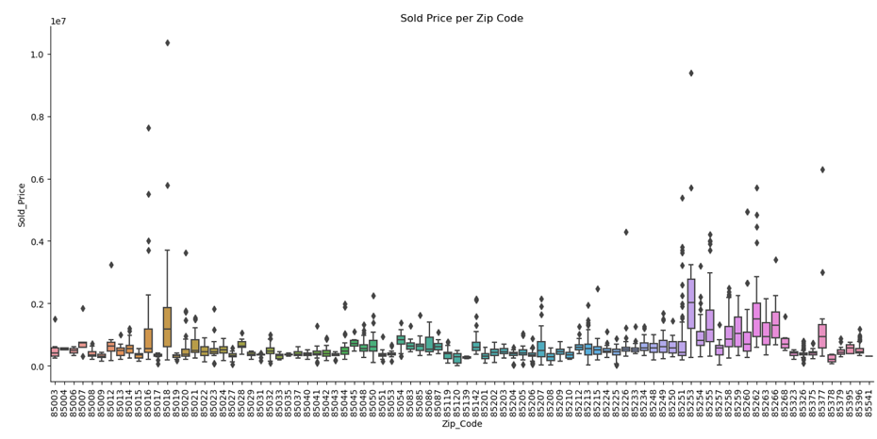
Exploratory Data Analysis
using boxplots for every individual zip code to show price volatility and spread

Slide 10
Machine Learning Modeling
Metrics: Models:
R-squared Linear Regression
MAE Mean Absolute Error Random Forest
MSE Mean Squared Error Extreme Gradient Booster

Slide 11
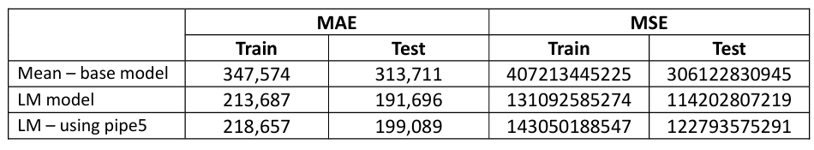
Modeling – LM Linear Regression model
The R-squared is 64.9 for train and 0.596 for test data set
Optimizing the model for most relevant features did not improve the metrics.
The LM using all features yielded best results

Slide 12
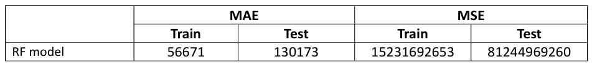
Modeling – RF random Forest model
The R-squared is 0.96 for training data and 0.73 for test data
Optimizing the model for most relevant features did not improve the metrics

Slide 13
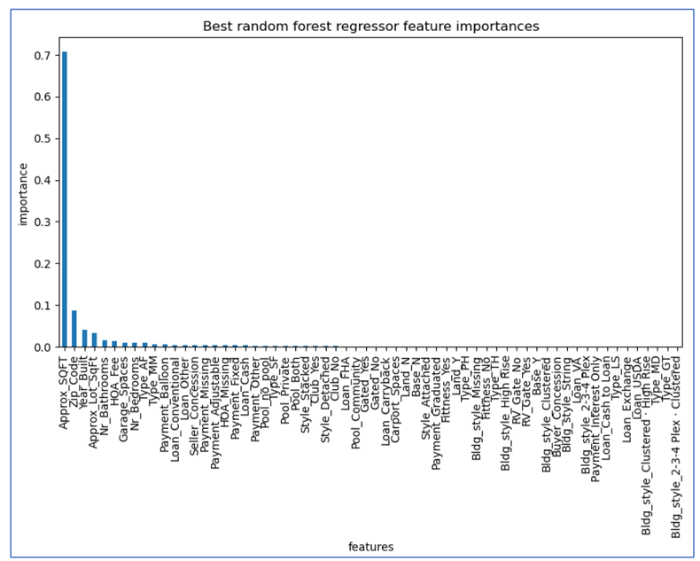
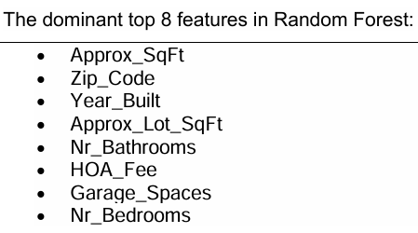
Modeling – RF random Forest model
Visualization of Feature importance.
The dominant feature is Approx. SqFt.

Slide 14
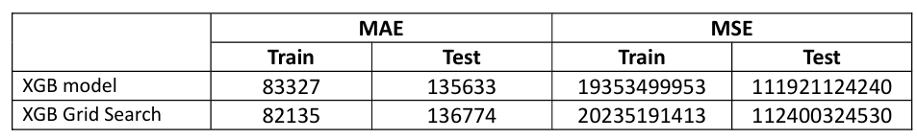
Modeling – XGB Extreme Gradient Booster model
The R-squared is 0.939 for training data and 0.7603 for test data.
An optimization process using Grid Search CV produced better metrics results, but still not as good as RF model

Slide 15
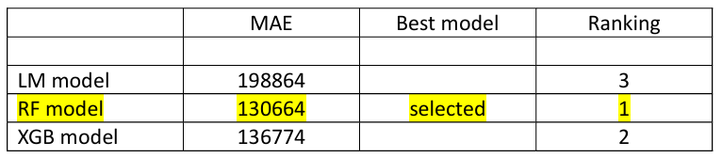
Model Selection
Summary for the 3 models LM, RF and XGB and Final Model Selection using cross validation on the negative of mean absolute error.
Best performing model is Random Forest

Slide 16
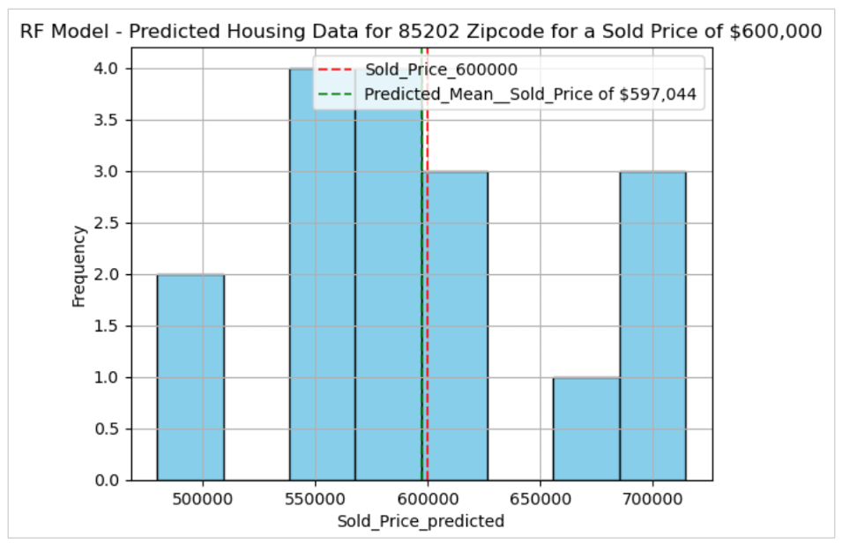
RF Model Deploying
Model was used for a house valued at $600,000 in zipcode 85202 in Maricopa County, Arizona.
The mean predicted value was $597,044
Check for criteria for success <1%
The predicted sale price has a 0.4% error < 1%

Slide 17
Future work
Population income and demographic are variables to be included in a an improved prediction model
10 years Treasury bond rates, which is the proxy for mortgage rates, will be considered in the future model.
The new buildings not listed in MLS are important for an expanded data set and for a more accurate predictions
The outliers in exclusive zipcode may constitute the basis to build a model designed exclusively for high end markets where the variability is excessive.
Influx of businesses, unemployment data and inflation are variables that would help improve the predictability of housing prices.

