Slide 1
Analysis of Income dataset
by Sebastian Ivan

Slide 2
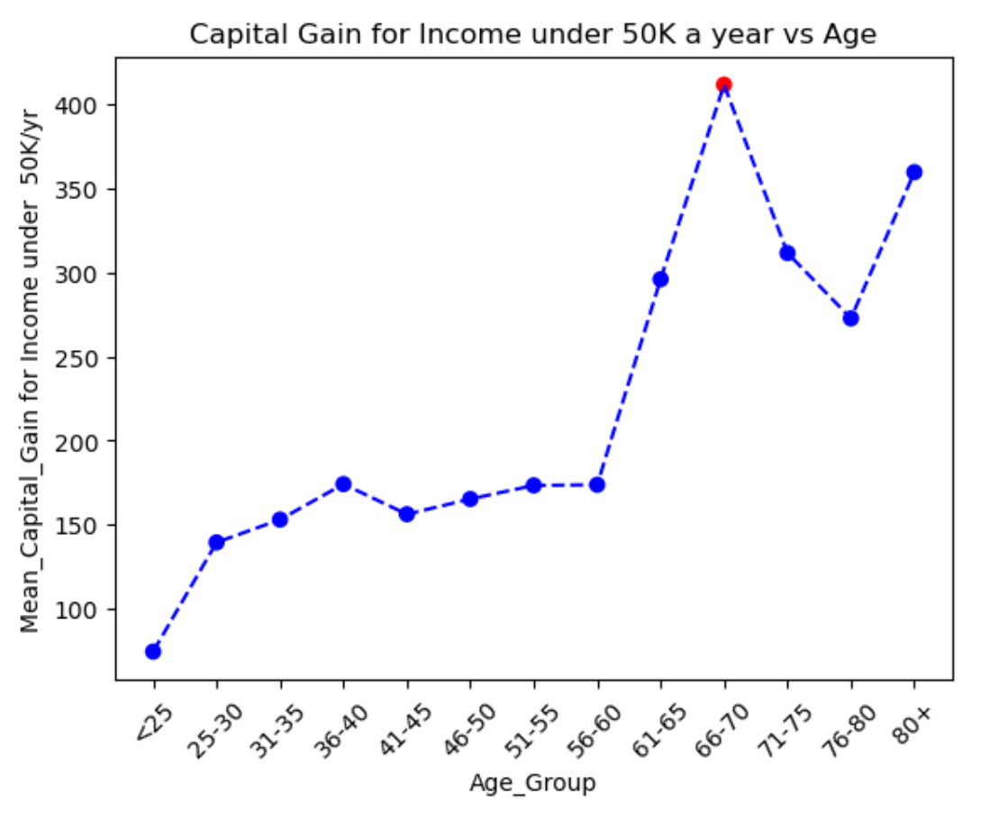
For income <50K, the 66 to 70 Age Group has the highest Capital Gains, shown by red dot

Slide 3
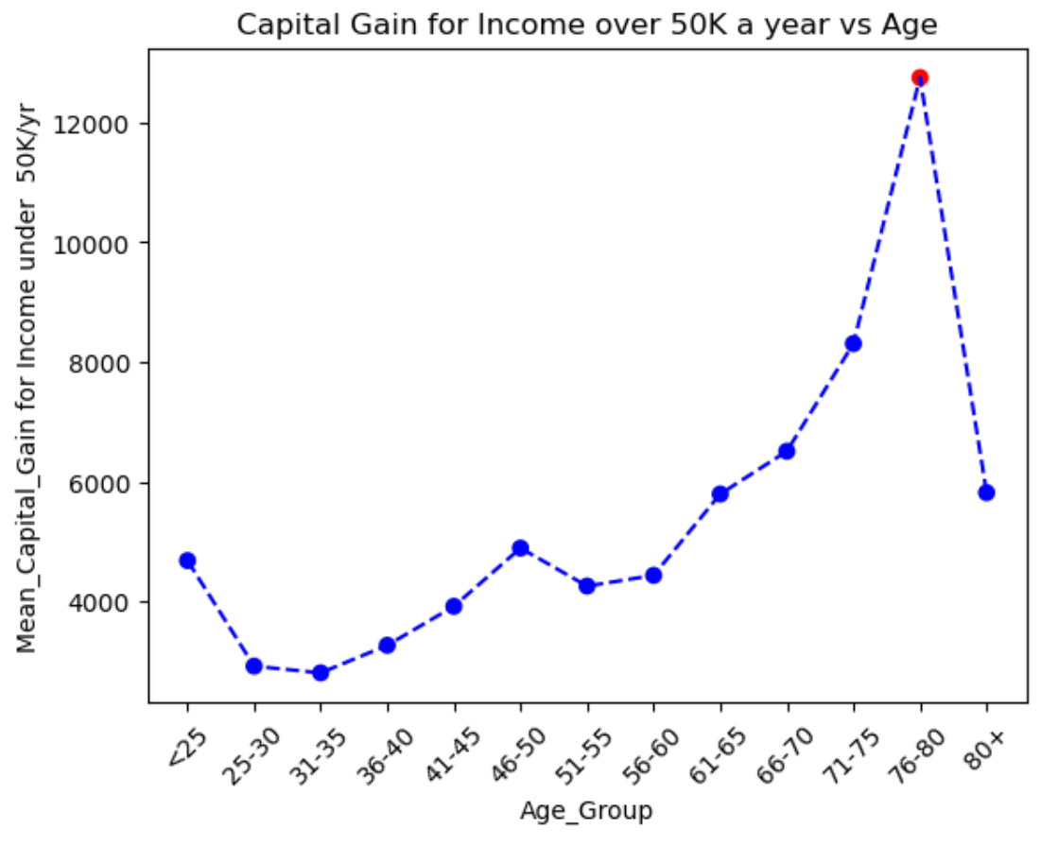
For income >50K, the 76 to 80 Age Group has the highest Capital Gains, shown by red dot
High earners (>50K), on average, have capital gains 10 times higher compared to lower earners (<50K)

Slide 4
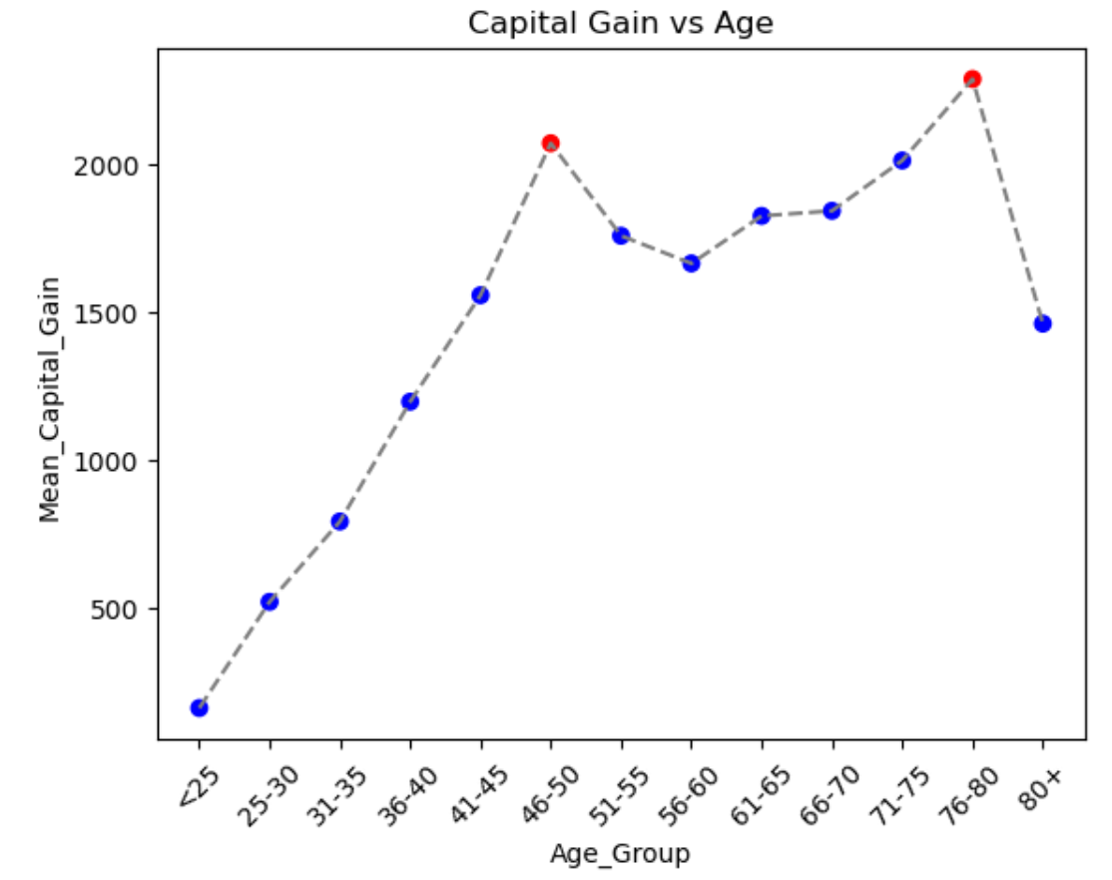
Capital gain vs age (all income combined)
There are 2 peaks at age 46-50 and 76-80.
* First peak –> career peak
* Second peak -> retirement/investments peak

Slide 5
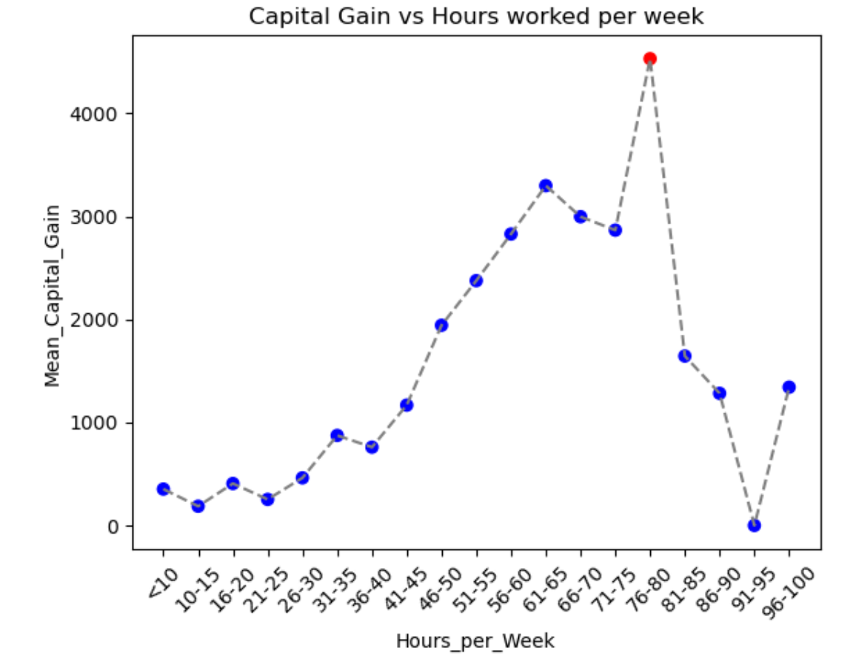
Capital gain vs Hours/wk (all income combined
About 75-80 hrs/week result in highest capital gains.
weekly hours greater than 75-80 do not translate in
higher capital gains

Slide 6
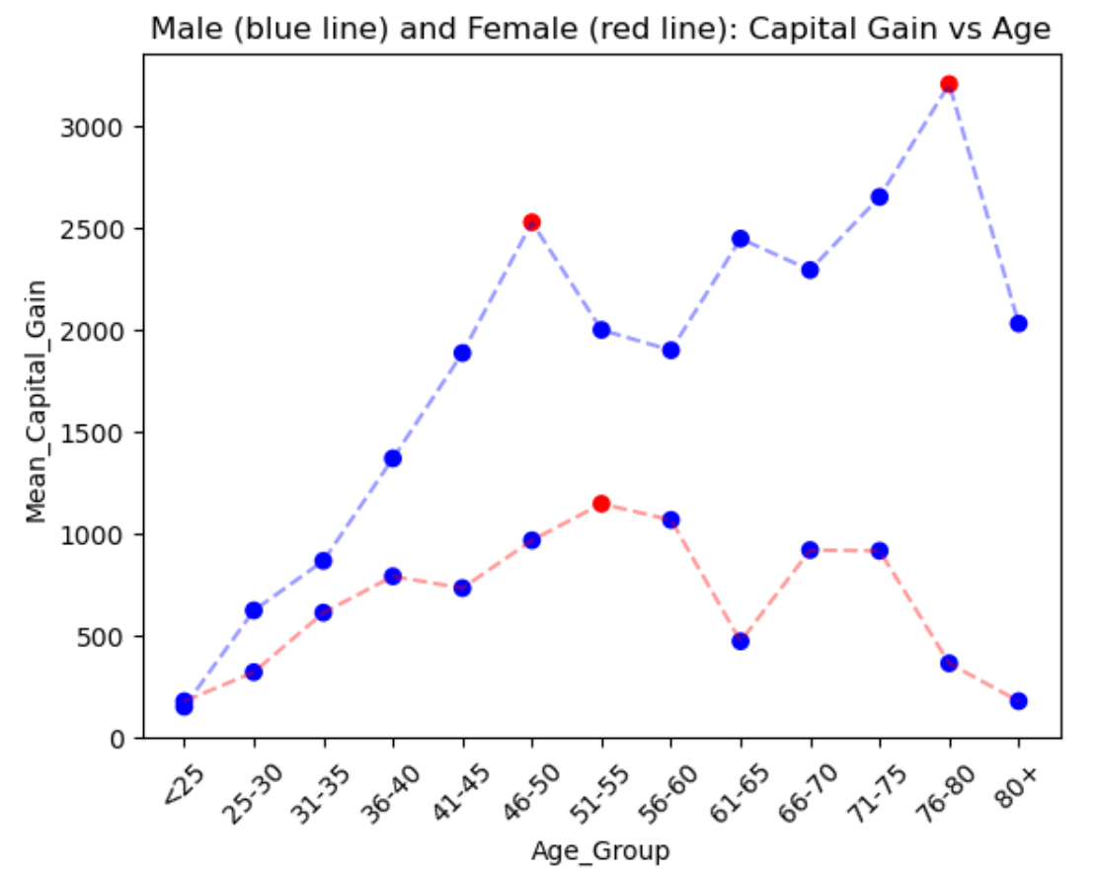
Capital Gains by age and gender
Men have higher capital gains than women over their life span
As men age, their capital gains increases
As women age, their capital gains decreases

Slide 7
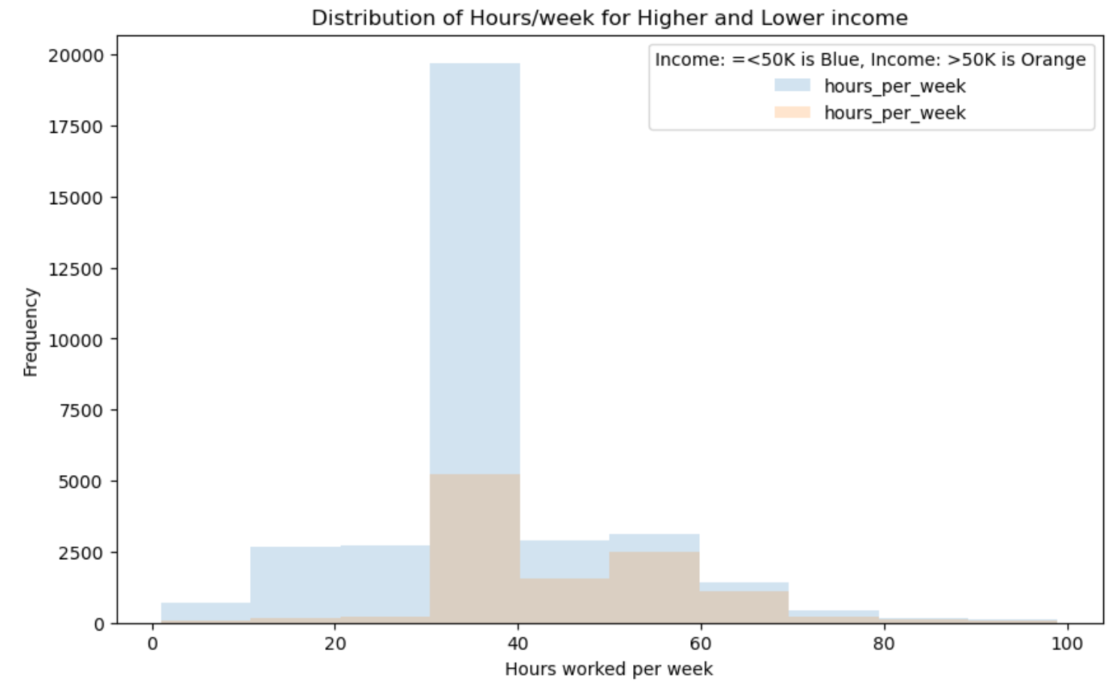
Distribution of Hours/week for higher and lower income
Earners under 50K have a wider spread of hours
worked in a week, most hours less than 40
Earners over 50K have a smaller spread of hours
worked in a week, most hours between 40 and 60

Slide 8
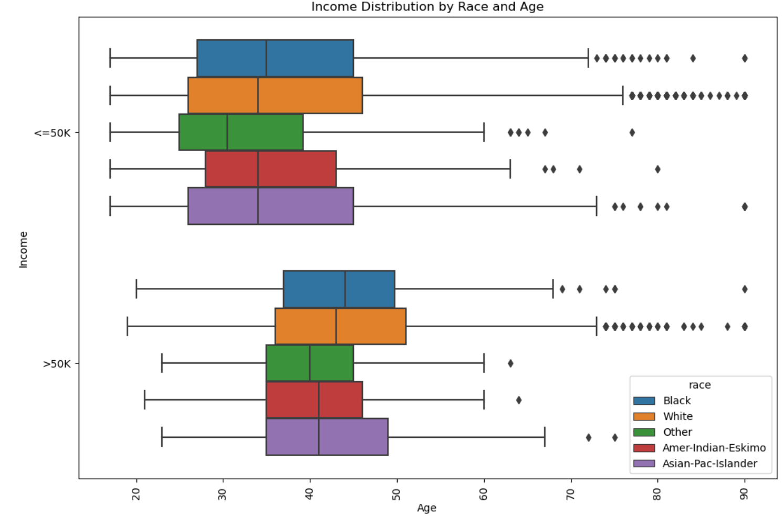
income distribution by race, income and age
White race has the widest spread by age with greater
outliers (age wise) in both income brackets
Black race has highest age mean in both income brackets
but with greatest number of outliers in lower income bracket
Higher income bracket is reached later in life by all races

Slide 9
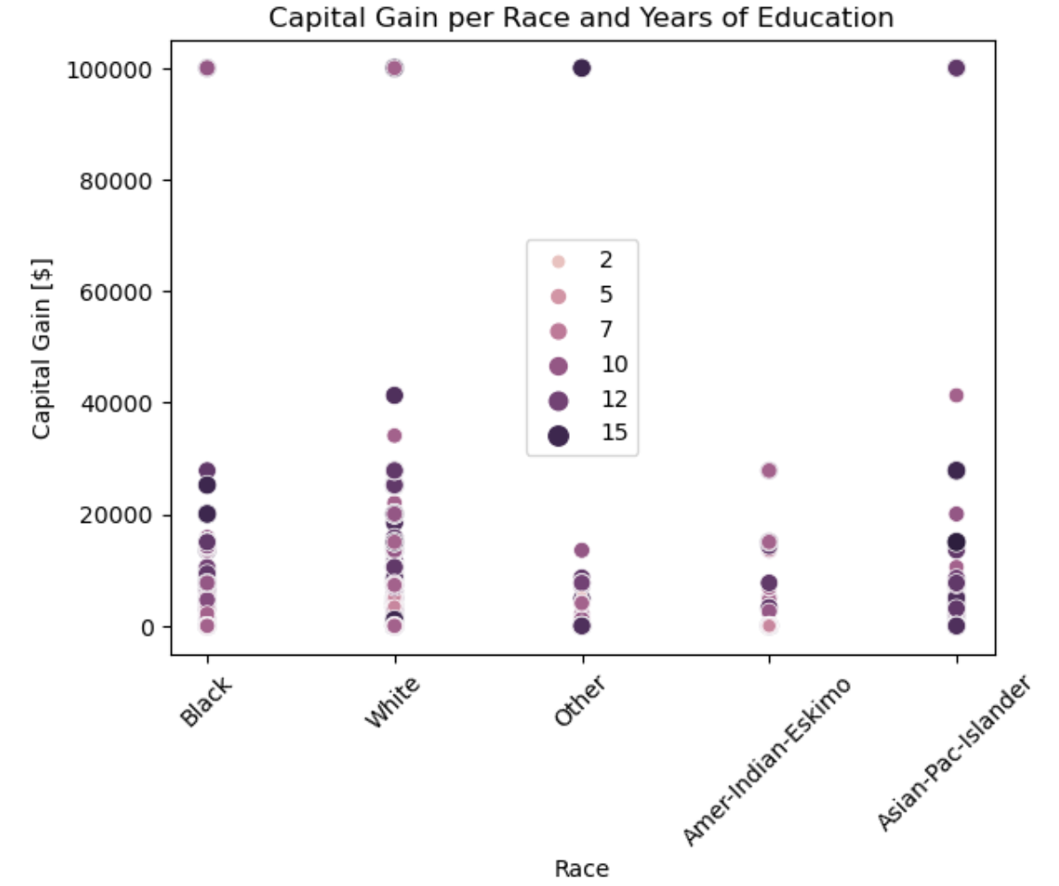
capital gain per race and years of education
Capital gain increases as years of education increase
White and Asian Pacific Islander tend to earn more with
increasing number of education

Slide 10
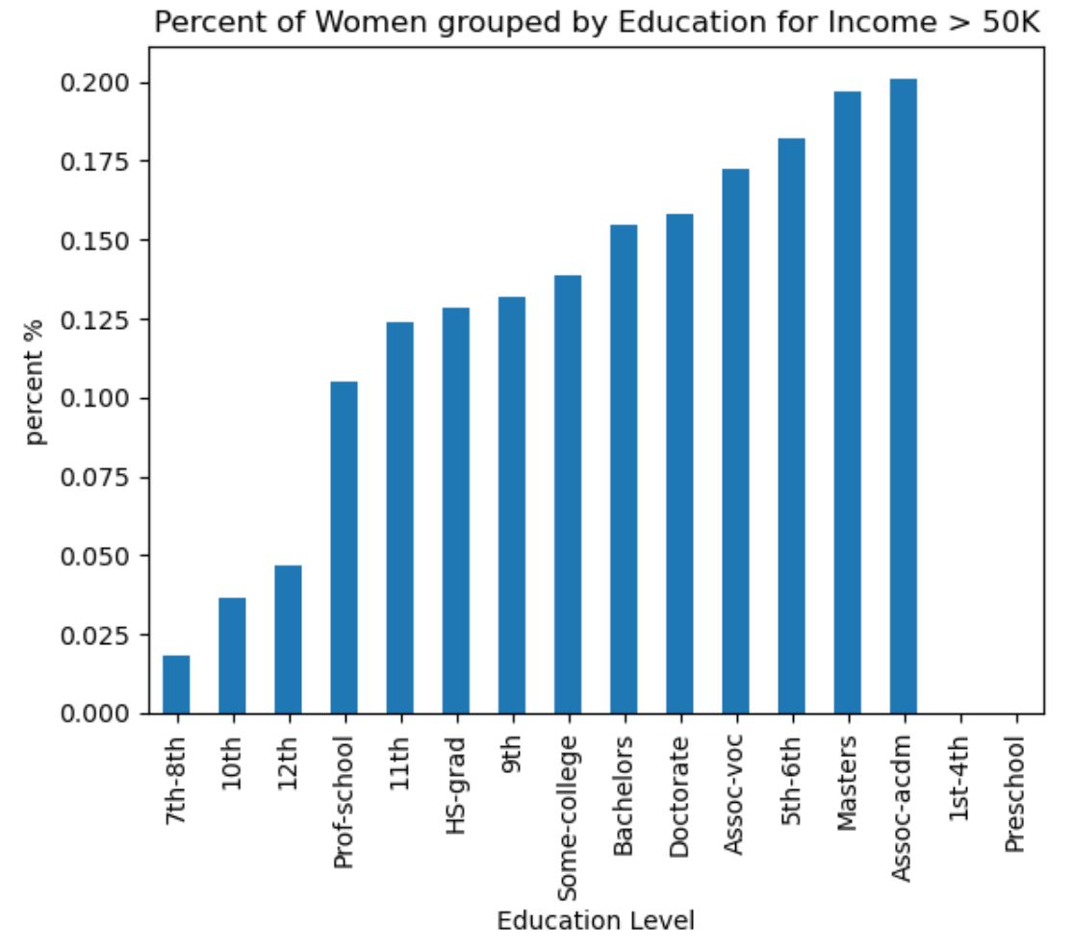
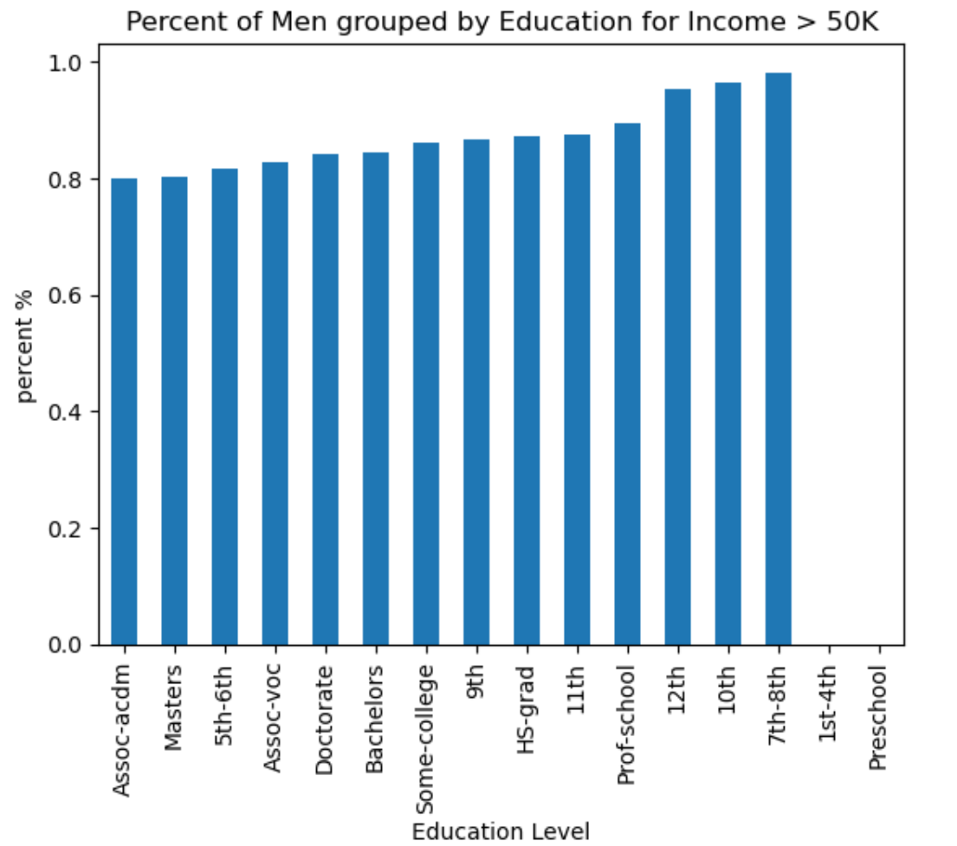
higher income percent of women and men by education level
lower education levels for
women have lower
women representation
men are almost evenly
represented in all
education levels

Slide 11
conclusion
Income is not equally distributed by age, race and gender
Years of education correlates with higher income in all categories
Majority of lower income earners work 40 hours per week or less, while higher income earners work between 40 and 60 hours a week
Men accumulate capital gains at much faster rate compared to women, with a continued widening gap as age increases
Capital gains for lower income earners are about 10 times smaller compared to higher income earners
Capital gains for lower income earners peak at around 66-70 years of age, while higher income earners continue to grow until they peak at about 76-80 years of age.

