Slide 1
The Big Mountain Resort
Ticket Pricing Strategy

Slide 2
Problem Statement
current price structure:
does not capitalize on existing resort features
is set by adding a premium to average price charged by other resorts in same market segment
cannot identify areas for investments and/or expense reduction
cannot offer insight on which features are most valued by visitors
cannot be used to create scenarios for adding or closing features while maintaining revenue growth.
cannot be used to rank resort by features.

Slide 3
Recommendation and Key Findings
The recommended price, based on trained model, is $89:
8 resort features are relevant to ticket pricing
Expenses can be reduced by closing one run, without reducing ticket price
Closing two runs has same effect on revenue as closing up to 5 runs
The price model shows that price increase is not justified when:
adding a run, increasing vertical drop by 150 ft, and adding an additional chair lift
increasing the longest run by 0.2 miles and adding 4 acres of snow making capability
Predicted revenue assumptions:
350,000 visitors/year
each visitor buys 5 tickets

Slide 4
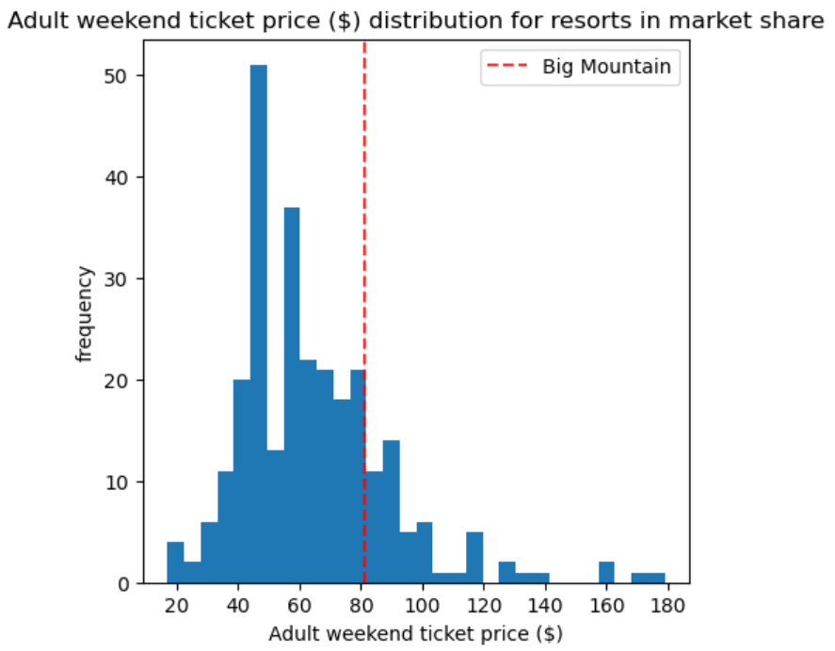
Modeling Results and Analysis
Vertical drop is the visitors’ most valued feature (The BMR ranks in top 25% of all resorts for vertical drop)
Snow making area is second most valued feature. The BMR ranks in top 10%
The number of total chairs for the BMR ranks amongst the highest for resorts in market share
Most resorts have no fast quads. The BMR has 3
The BMR compares well for the number of runs.

Slide 5
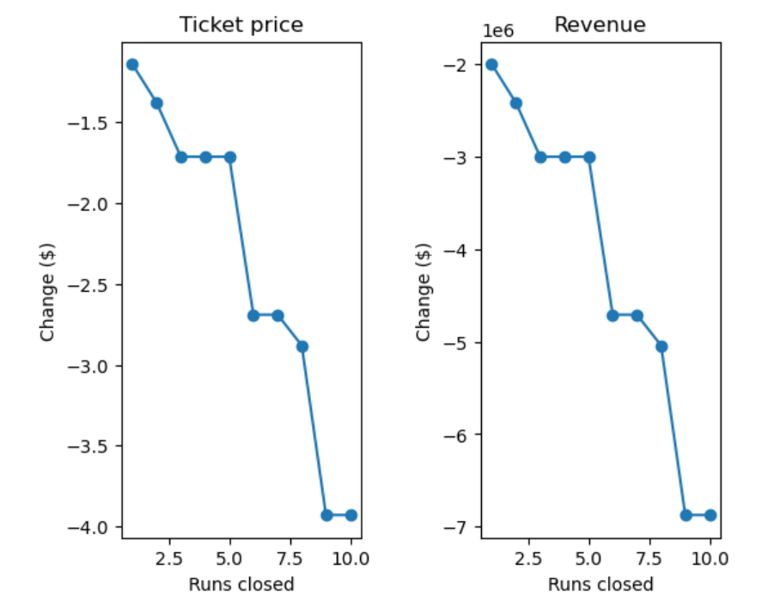
Modeling Results and Analysis
Random Forest regression model exhibited best performance
$ 9.53 mean absolute error
$1.50 standard deviation
Four scenarios were considered using the model:
Scenario 1: Close up to 10 of the least used runs. The number of runs is the only parameter varying.
Scenario 2: adding a run, increasing the vertical drop by 150 feet, and installing an additional chair lift.
Scenario 3: same as Scenario 2, but adding 2 acres of snow making
Scenario 4: increasing the longest run by .2 miles and guaranteeing its snow coverage by adding 4 acres of snow making capability.

Slide 6
Modeling Results and Analysis
Scenario 1 Findings:
Closing one run makes no difference.
Closing 2 and 3 successively reduces support for ticket price and so revenue. If Big Mountain closes down 3 runs, it seems they may as well close down 4 or 5 as there's no further loss in ticket price.
Increasing the closures down to 6 or more leads to a large drop.
Scenario 2 Findings:
Increases support for ticket price by $0.50
Over the season, this could be expected to amount to $875000
Scenario 3 Findings:
Increases support for ticket price by $0.50
Over the season, this could be expected to amount to $875000
Scenario 4 Findings:
No difference in price, whatsoever.

Slide 7
Summary and Conclusion
The recommended price: $89
No additional investments necessary to support this price
Decreasing the number of runs by one can reduce expenses and subsequently, increase revenue.
Further scenarios can be explored with varying investment budgets.

