Slide 1

TEAM QUANTA_HEX
Organization
Govt. of Goa
Problem Code
DR113
Problem Statement
Stray Cattle Challenge
Team Leader
Ferin Patel

Slide 2
Problem
Solution
Stray animals often bring the flow of traffic on busy roads to a standstill along with major road accidents.
Currently there is no flow of information between the government, people and relevant organizations as well.
This project creates a platform which coalesce the local people with Animal Husbandries, NGOs and Civic Forums.
User will submit the information to the system about stray cattle in the form of reports.
The reported problems then, will be resolved by Organizations.

Slide 3
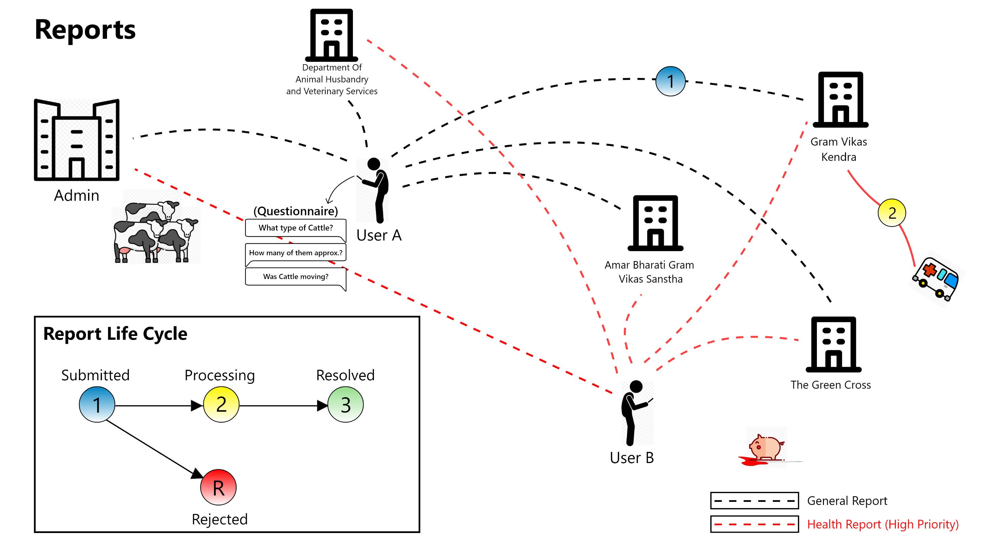

Slide 4
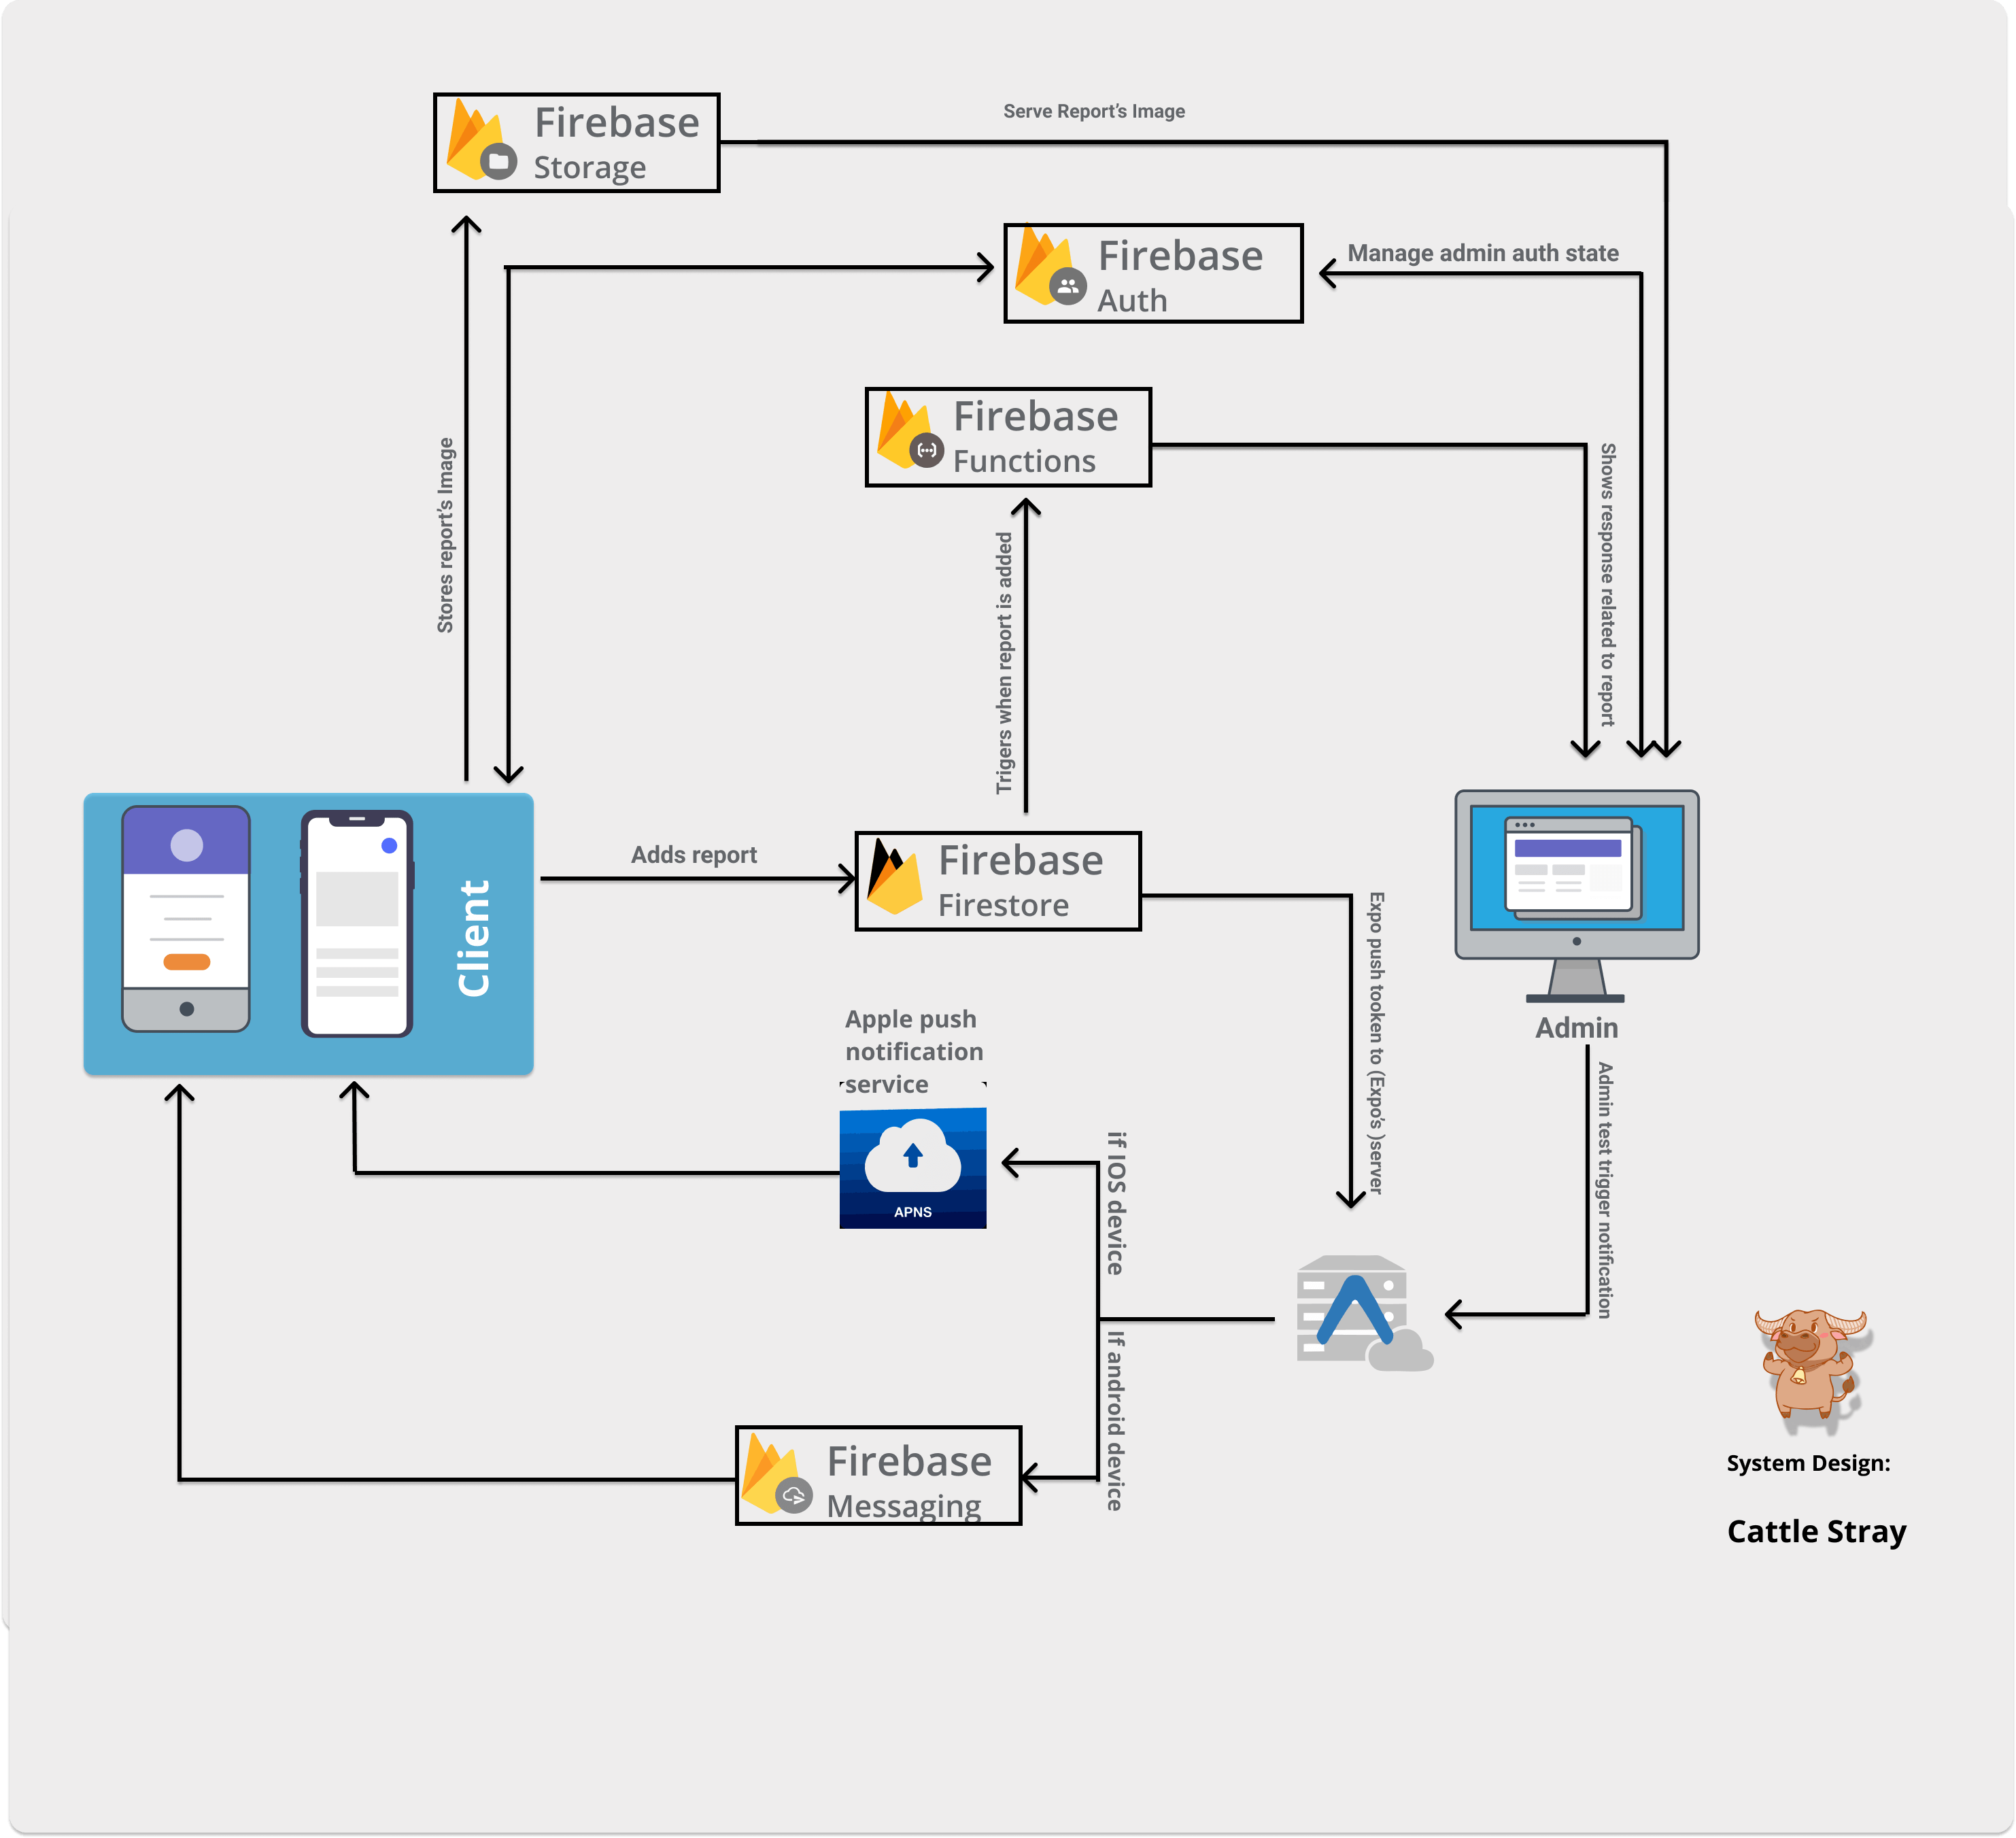

Slide 5
Features
There may be cases where multiple users spot cattle in same locality, multiple reports will create redundancy. For that, we introduced a feature named “Upvote”.
Also, there may be cases where some mischievous users report fake cattle presence, such cases must require disciplinary actions. For that, we introduced a feature named “Downvote”.
We also integrated “Points” system, if a user makes a genuine report he/she will be rewarded some points and if the report is illegitimate the points will be deduced. Using points system ,more users will be encouraged to make genuine reports.

Slide 6


Technology Stack
Web App
React
Firebase
Mobile App
React-Native and Expo
Firebase

Slide 7
Improvements
Manual questionnaire for report has been changed to ML image processing which will yield information like Animal Type, Animal count, Location, TimeStamp, GI no. of Cattle, Report Type, etc.
Report Submission Time has been decreased from about 2 minutes to approx. 30 seconds i.e. 75% efficiency increased.
To avoid redundancy of reports for same cattle, Mean Shift Algorithm(ML Clustering) is used.
When any report similar to existing report(restricted to recent Time and Location), it is merged with it and considered as an Upvote.

Slide 8
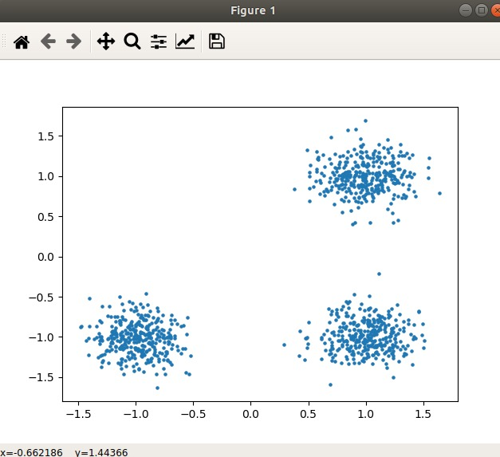
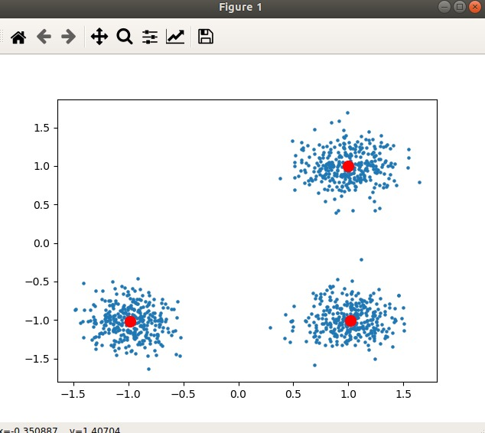
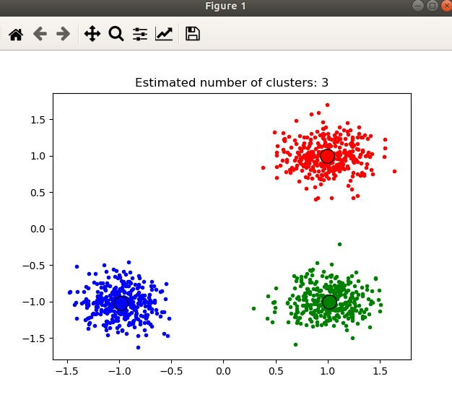
1) Raw Data
2) Get centre of clusters,
get dynamic bandwidth
3) Divide according to Bandwidth.

Slide 9
Thank you
For detailed documentation
https://documenter.getpostman.com/view/12193070/T1DsAG1H?version=latest
https://hungry-boyd-aa3248.netlify.app/

