Slide 1




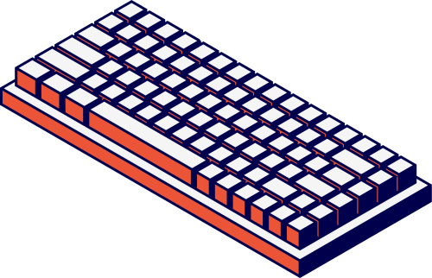
Kelompok 4
Computer
Networks
Nama Anggota
STEPHAN VIERRELIE - 2702229863
CHARIS BERLIAN - 2702235191
ABRAHAM MEIR BENLY - 2702230000
ALFRED DEXTER - 2702230045
RENDY RIADY - 2702234421
IGNATIUS KEVIN WIJAYA - 2702231464
JOSH NICHOLAS SUTANTO - 2702234825
SHERLY VENICIA - 2702226621
FERLIE HERNATA - 2702231262

Slide 2
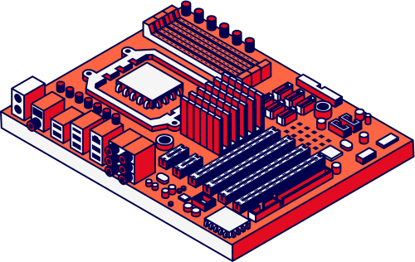
Devices, Networking Media types and Length of Media
Devices, Networking Media types and Length of Media

Slide 3
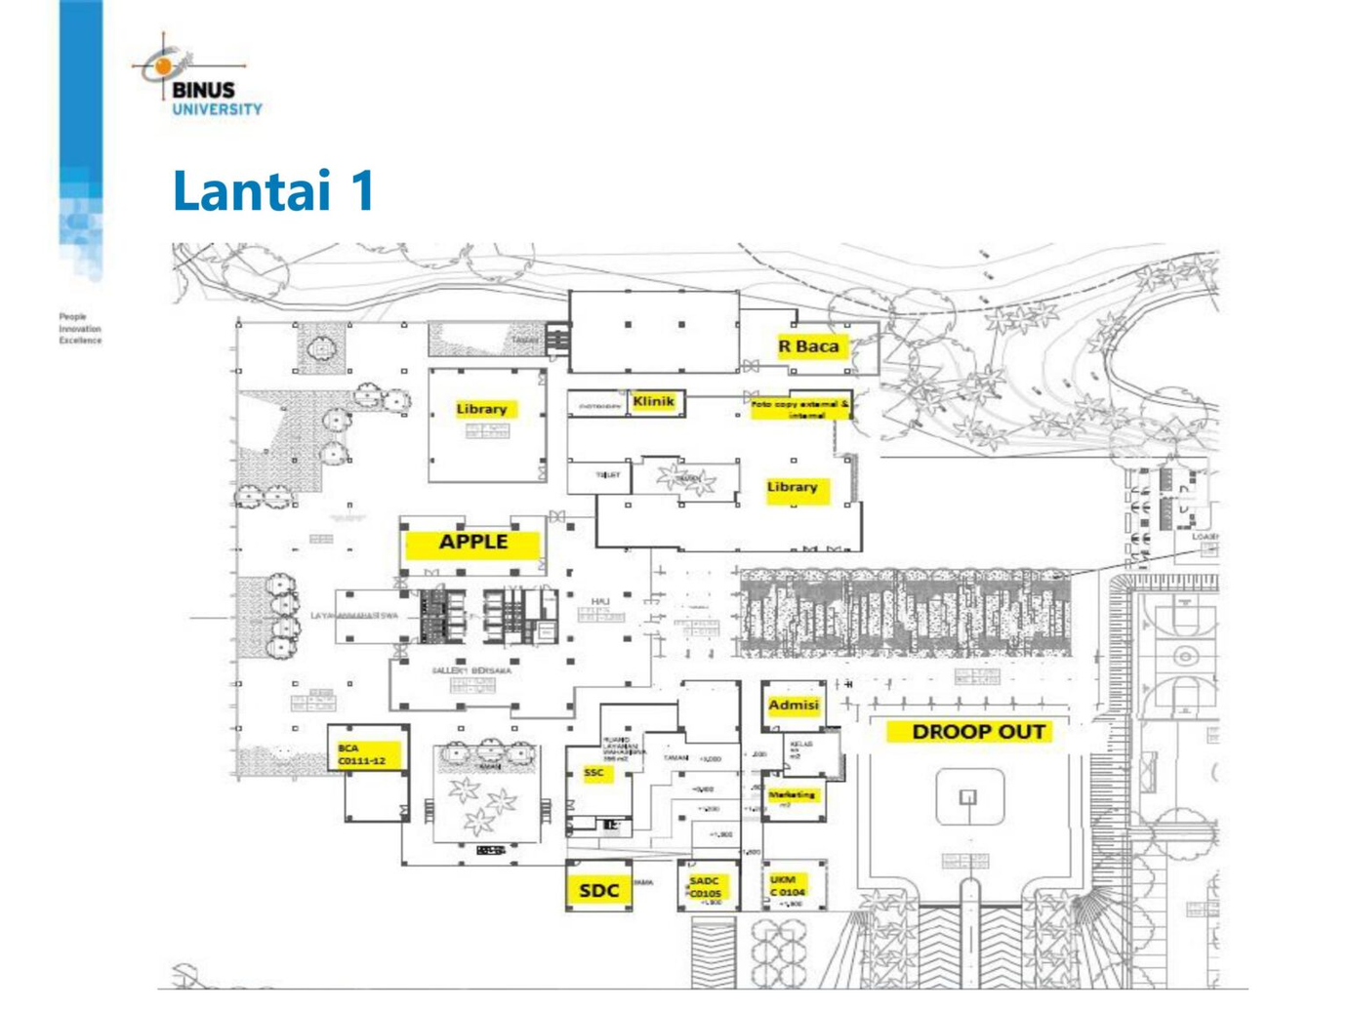




Lantai 1
Devices, Networking Media types and Length of Media
Host
Switch
Router
Switch + Router
Server

Slide 4
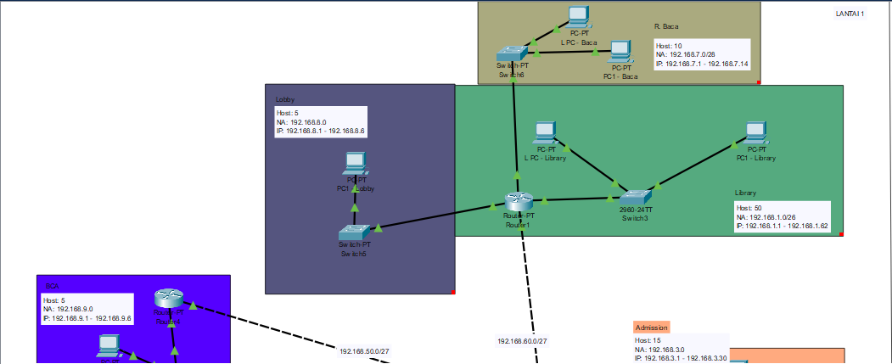
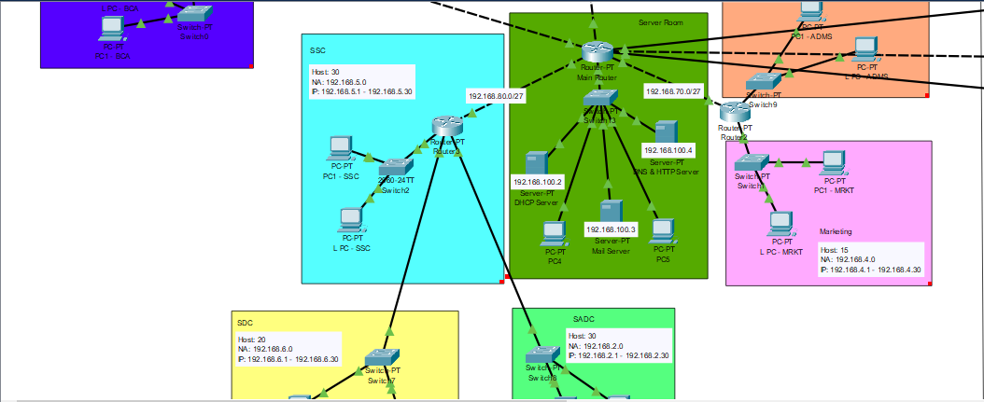
Devices, Networking Media types and Length of Media
Lantai 1
R. Baca
Server
Library
Admission
Lobby
Marketing
BCA
SDC
SSC
SADC

Slide 5
Rincian Biaya Lantai 1
Router | Router | Router | Router
Nama | Harga | Kuantitas | Total
Cisco ISR 4331 | Rp70.000.000,00 | 1 | Rp70.000.000,00
Cisco RV340 | Rp7.000.000,00 | 1 | Rp7.000.000,00
MikroTik RB4011 | Rp5.000.000,00 | 3 | Rp15.000.000,00
Total | Total | Total | Rp92.000.000,00
Switch | Switch | Switch | Switch
Nama | Harga | Kuantitas | Total
Arista 7050X-48 | Rp30.000.000,00 | 4 | Rp120.000.000,00
Cisco SG250-26 | Rp5.000.000,00 | 3 | Rp15.000.000,00
Cisco SG110-16 | Rp2.500.000,00 | 1 | Rp2.500.000,00
Cisco SG350-10MP | Rp4.500.000,00 | 2 | Rp9.000.000,00
Total | Total | Total | Rp146.500.000,00
Kabel | Kabel | Kabel | Kabel
Nama | Harga | Kuantitas | Total
Belden Cat6a STP | Rp12.000.000/305 meter | 610 meter | Rp24.000.000,00
RJ45 Connector | Rp175.000,00/50pc | 400pc | Rp1.400.000,00
Total | Total | Total | Rp25.400.000,00
Total Biaya:
Rp263.900.000,00

Slide 6
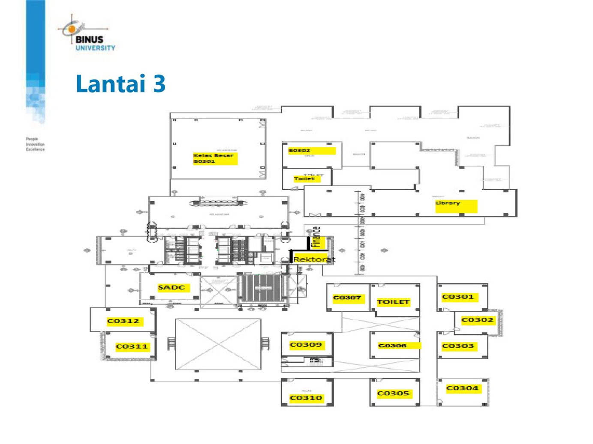
Lantai 3
Devices, Networking Media types and Length of Media
Host
Switch
Router
Main Router
Lt.1
Switch + Router

Slide 7
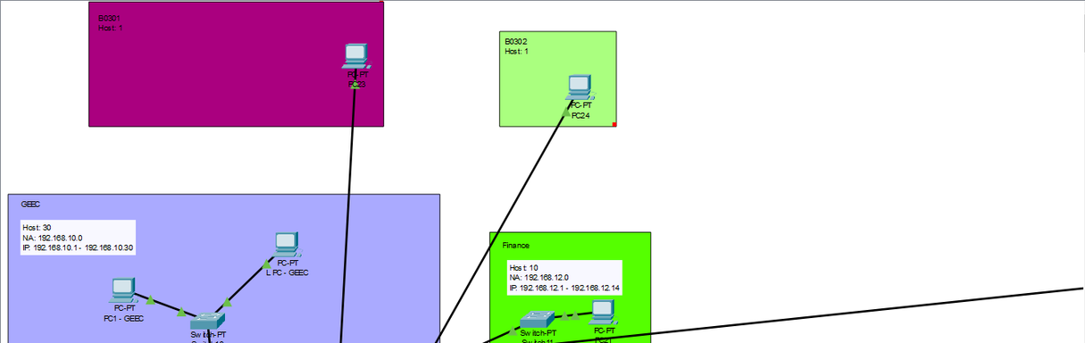
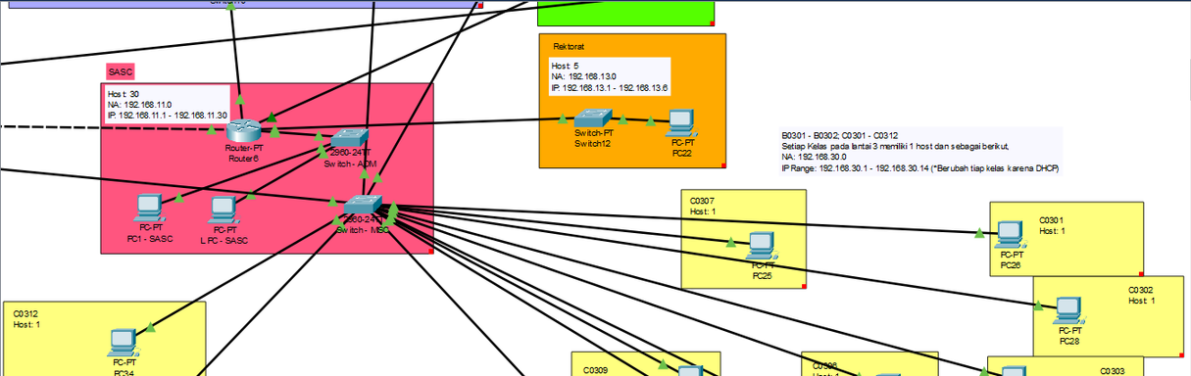
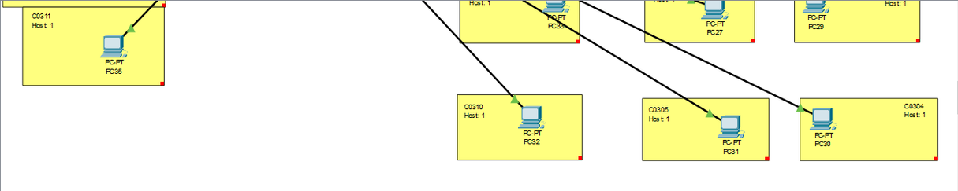
Devices, Networking Media types and Length of Media
Lantai 3
B0301
B0302
Finance
GEEC
Rektorat
SASC
Kelas (C0301 - C0312)

Slide 8
Devices, Networking Media types and Length of Media
Rincian Biaya Lantai 3
Router | Router | Router | Router
Nama | Harga | Kuantitas | Total
MikroTik RB4011 | Rp5.000.000,00 | 1 | Rp5.000.000,00
Total | Total | Total | Rp5.000.000,00
Switch | Switch | Switch | Switch
Nama | Harga | Kuantitas | Total
Arista 7050X-48 | Rp30.000.000,00 | 2 | Rp60.000.000,00
Cisco SG110-16 | Rp2.500.000,00 | 2 | Rp5.000.000,00
Cisco SG350-10MP | Rp4.500.000,00 | 1 | Rp4.500.000,00
Total | Total | Total | Rp69.500.000,00
Kabel | Kabel | Kabel | Kabel
Nama | Harga | Kuantitas | Total
Belden Cat6a STP | Rp45.000/meter | 450 meter | Rp20.250.000,00
RJ45 Connector | Rp175.000,00/50pc | 250pc | Rp875.000,00
Total | Total | Total | Rp21.125.000,00
Total Biaya:
Rp95.625.000,00

Slide 9
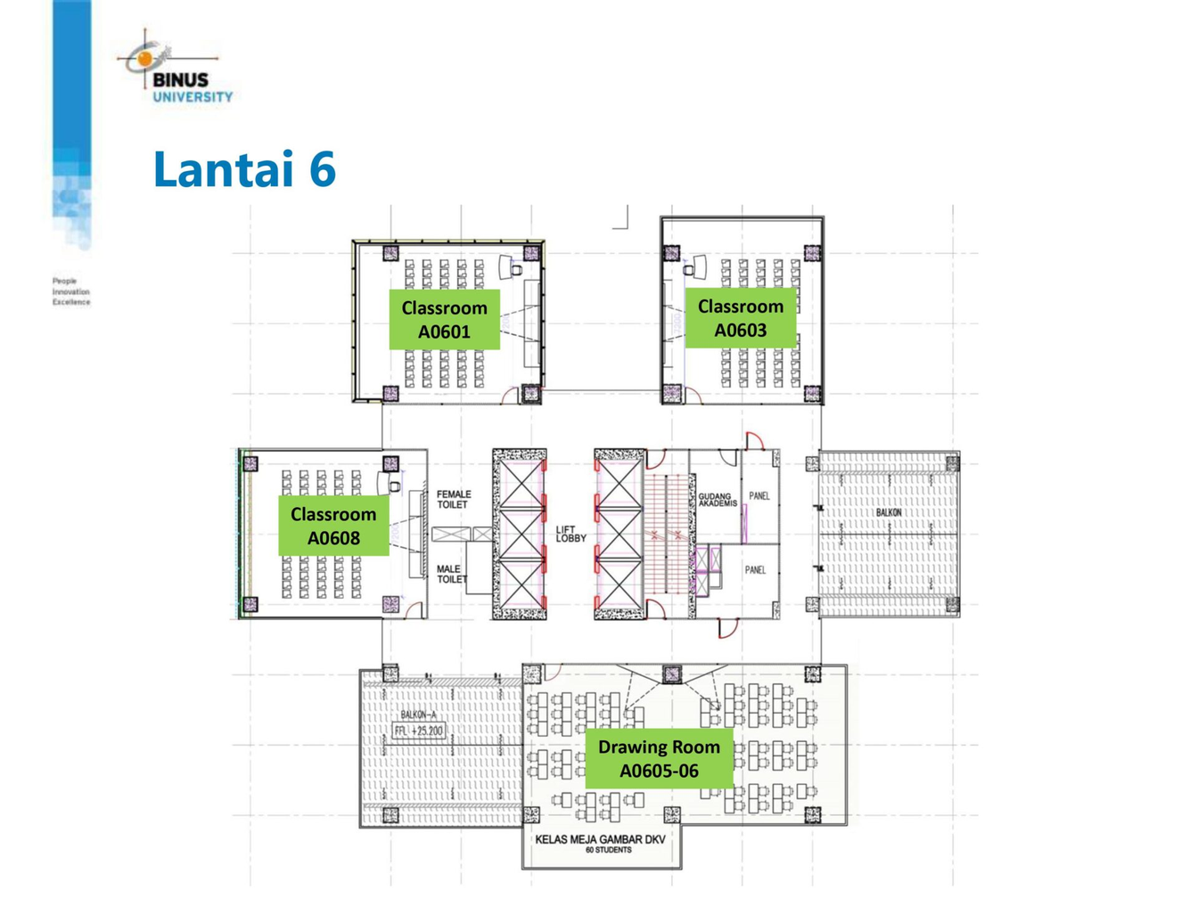
Lantai 6
Devices, Networking Media types and Length of Media
Host
Switch
Router
Switch + Router
Main Router
Lt.1

Slide 10
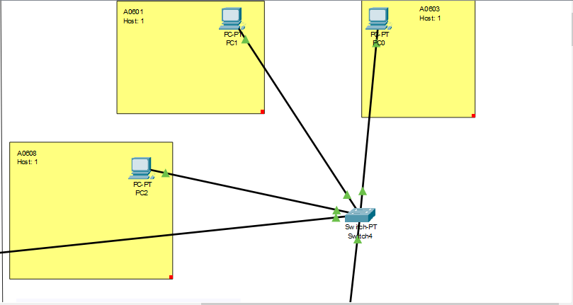
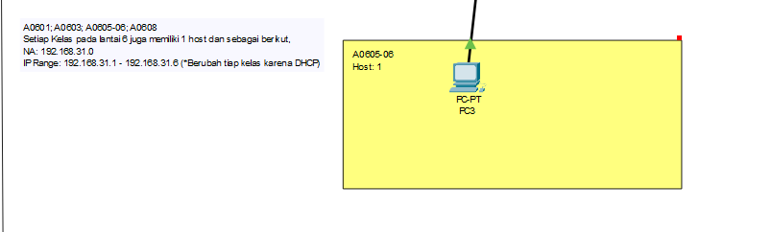
Devices, Networking Media types and Length of Media
Lantai 6
Kelas

Slide 11
Devices, Networking Media types and Length of Media
Rincian Biaya Lantai 6
Kabel | Kabel | Kabel | Kabel
Nama | Harga | Kuantitas | Total
Belden Cat6a STP | Rp45.000/meter | 100 meter | Rp4.500.000,00
RJ45 Connector | Rp175.000,00/50pc | 50pc | Rp175.000,00
Total | Total | Total | Rp4.675.000,00
Switch | Switch | Switch | Switch
Nama | Harga | Kuantitas | Total
Cisco SG350-10MP | Rp4.500.000,00 | 1 | Rp4.500.000,00
Total | Total | Total | Rp4.500.000,00
Total Biaya:
Rp9.175.000,00

Slide 12

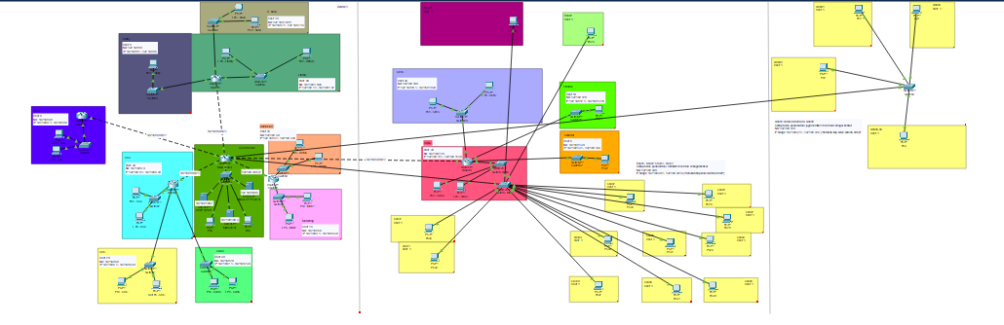
Devices, Networking Media types and Length of Media
Denah Cisco Packet Tracer
Total Biaya:
Rp368.700.000,00

Slide 13

IP Addressing and Subnetting
IP Addressing and Subnetting
VLSM

Slide 14
Lantai 1
IP Addressing and Subnetting
Ruang | Jumlah Host | Subnet Mask | Network Address | Broadcast Address | IP Range
Library | 50 | 255.255.255.192 | 192.168.1.0 | 192.168.1.63 | 192.168.1.1 - 192.168.1.62
SADC | 30 | 255.255.255.224 | 192.168.2.0 | 192.168.2.31 | 192.168.2.1 - 192.168.2.30
Admission | 15 | 255.255.255.224 | 192.168.3.0 | 192.168.3.31 | 192.168.3.1 - 192.168.3.30
Marketing | 15 | 255.255.255.224 | 192.168.4.0 | 192.168.4.31 | 192.168.4.1 - 192.168.4.30
SSC | 30 | 255.255.255.224 | 192.168.5.0 | 192.168.5.31 | 192.168.5.1 - 192.168.5.30
SDC | 20 | 255.255.255.224 | 192.168.6.0 | 192.168.6.31 | 192.168.6.1 - 192.168.6.30
R. Baca | 10 | 255.255.255.240 | 192.168.7.0 | 192.168.7.15 | 192.168.7.1 - 192.168.7.14
Lobby | 5 | 255.255.255.248 | 192.168.8.0 | 192.168.8.7 | 192.168.8.1 - 192.168.8.6
BCA | 5 | 255.255.255.248 | 192.168.9.0 | 192.168.9.7 | 192.168.9.1 - 192.168.9.6

Slide 15
IP Addressing and Subnetting
Lantai 3
Ruang | Jumlah Host | Subnet Mask | Network Address | Broadcast Address | IP Range
GEEC | 30 | 255.255.255.224 | 192.168.10.0 | 192.168.10.31 | 192.168.10.1 - 192.168.10.30
SASC | 30 | 255.255.255.224 | 192.168.11.0 | 192.168.11.31 | 192.168.11.1 - 192.168.11.30
Finance | 10 | 255.255.255.240 | 192.168.12.0 | 192.168.12.15 | 192.168.12.1 - 192.168.12.14
Rektorat | 5 | 255.255.255.248 | 192.168.13.0 | 192.168.13.7 | 192.168.13.1 - 192.168.13.6
Kelas-kelas | 13 | 255.255.255.240 | 192.168.30.0 | 192.168.30.15 | 192.168.30.1 - 192.168.30.14

Slide 16
IP Addressing and Subnetting
Lantai 6
Switch MISC - 4 host
2^h - 2 >= 4
2^h >= 6
h >= 3
n = 32 - h = 29
Subnet Mask: 255.255.255.248
Network Address: 192.168.31.0
Broadcast Address: 192.168.31.7
IP Range: 192.168.31.1 - 192.168.31.6
Switch4 (A0601) - 1 host
Switch4 (A0603) - 1 host
Switch4 (A0605-06) - 1 host
Switch4 (A0608) - 1 host

Slide 17
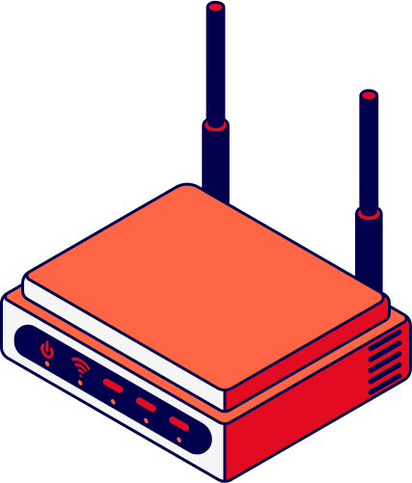
Routing
Static Routing

Slide 18
Static Routing
Routing
Router Name | Routing Protocol | Command Example
Main Router | Static Routing | 192.168.9.0/29 via 192.168.50.2
Router 1 | Static Routing | 192.168.11.0/27 via 192.168.60.1
Router 2 | Static Routing | 192.168.5.0/28 via 192.168.70.1
Router 3 | Static Routing | 192.168.7.0/28 via 192.168.80.1
Router 4 | Static Routing | 192.168.8.0/29 via 192.168.50.1
Router 6 | Static Routing | 192.168.9.0/29 via 192.168.90.1

Slide 19


Application Layer
Application Layer

Slide 20
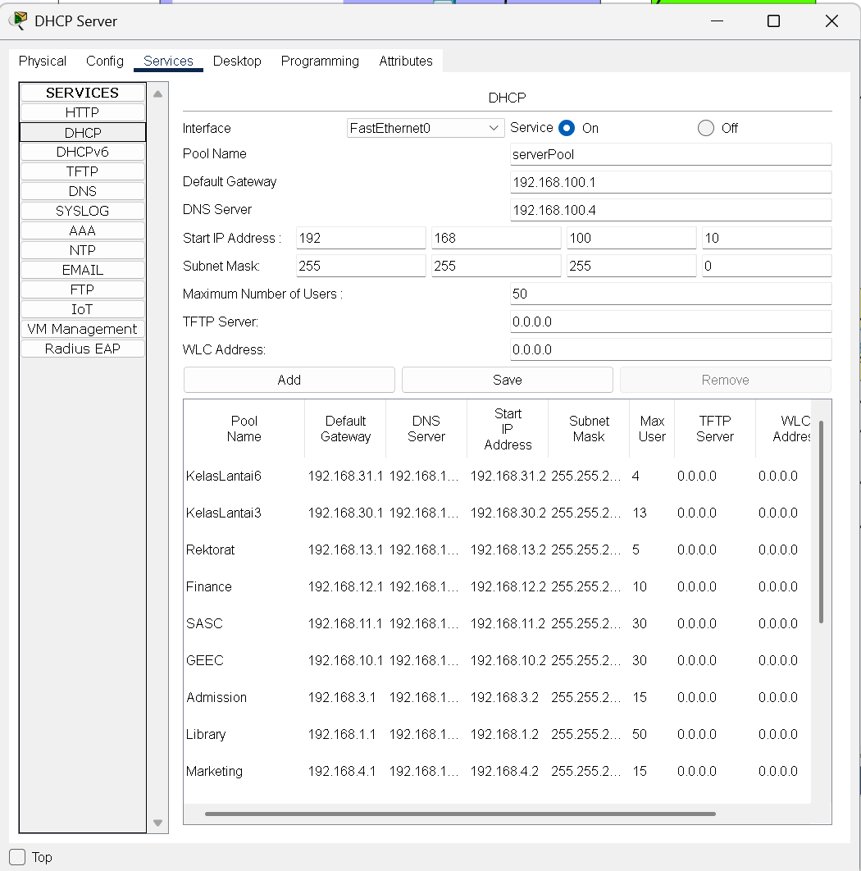
Application Layer
DHCP Testing

Slide 21
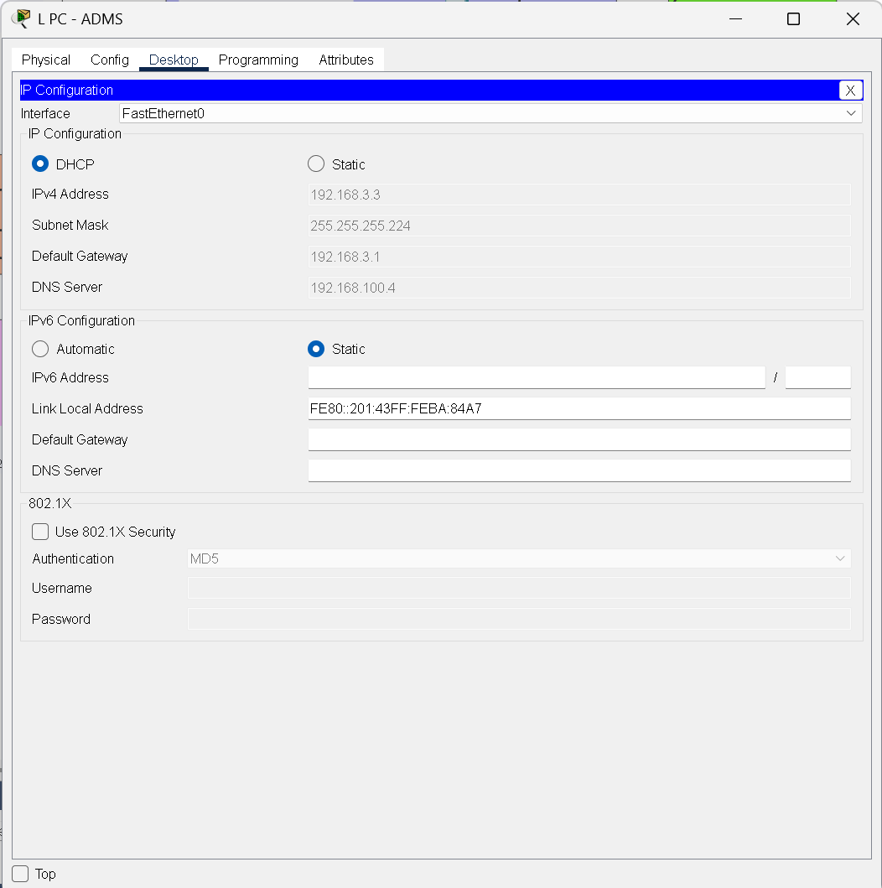
Application Layer
DHCP Testing

Slide 22
Application Layer
DNS Server
DNS (Domain Name System) server adalah sistem yang berfungsi untuk menerjemahkan nama domain (misalnya, www.google.com) menjadi alamat IP (misalnya, 142.250.190.78) yang dapat dimengerti oleh komputer.
DNS server digunakan agar pengguna tidak perlu mengingat alamat IP yang rumit. Sebagai gantinya, mereka cukup mengetikkan nama domain yang mudah diingat. DNS memungkinkan akses yang lebih cepat, nyaman, dan efisien ke sumber daya di internet.

Slide 23
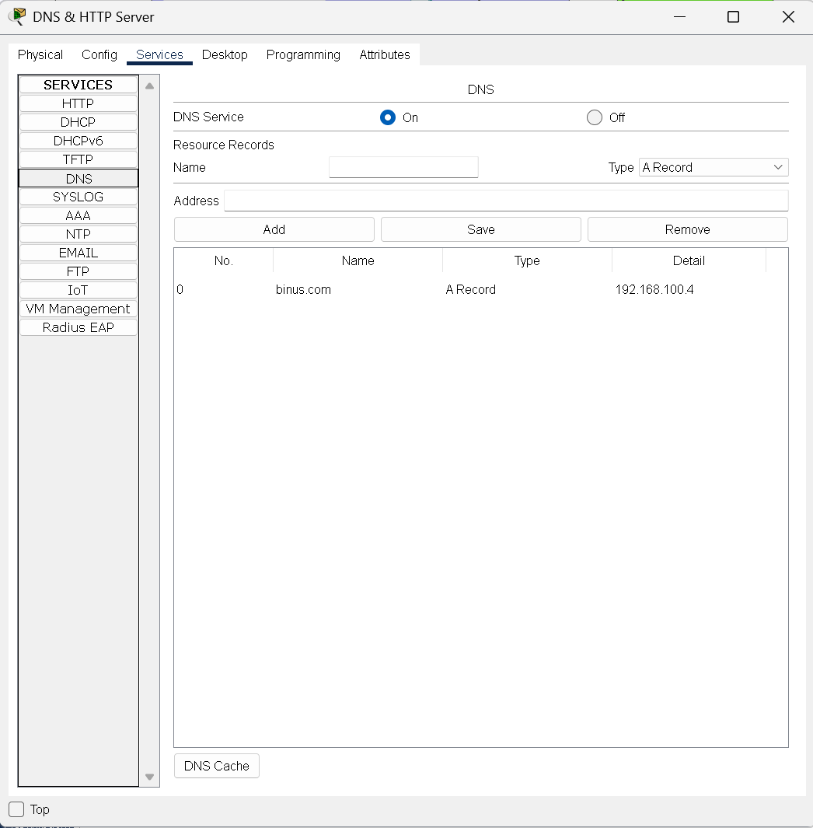
Application Layer
DNS Testing

Slide 24
Application Layer
DNS Testing

Slide 25
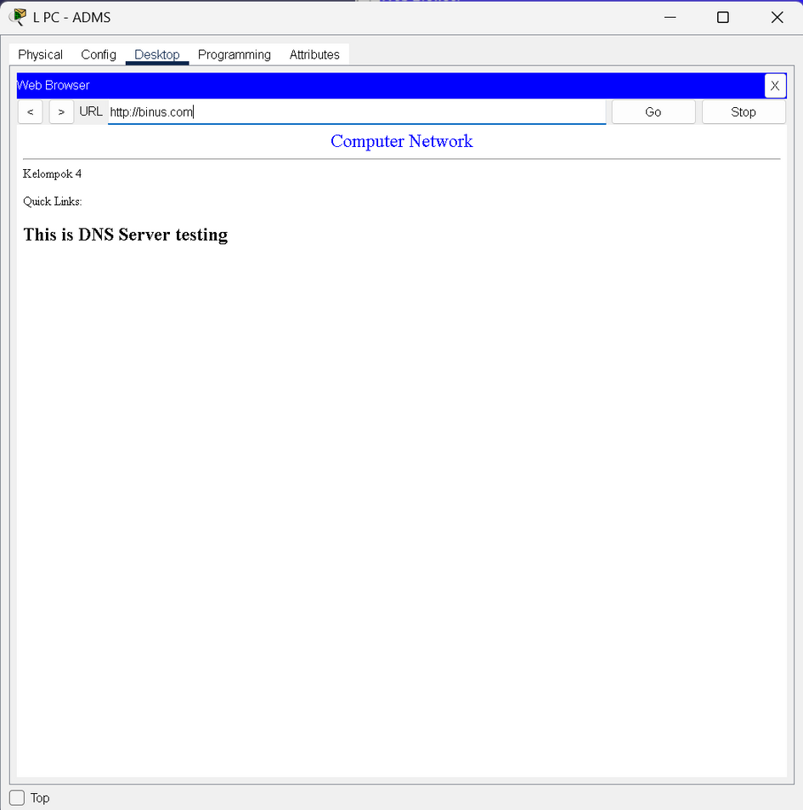
Application Layer
DNS Testing

Slide 26
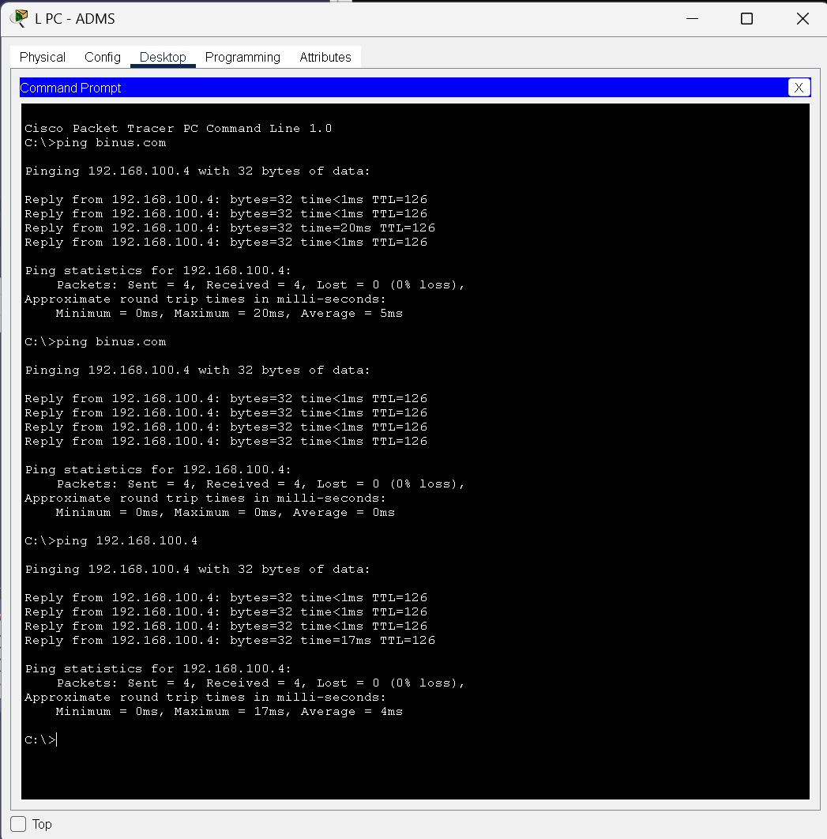
Application Layer
DNS Testing

Slide 27
Application Layer
Web Server
Web server adalah perangkat lunak atau perangkat keras yang bertugas menerima dan merespons permintaan klien (seperti browser) untuk mengakses konten web melalui protokol HTTP atau HTTPS. Perannya mencakup menyajikan halaman web, mengelola permintaan pengguna, menjalankan aplikasi web, dan memastikan keamanan data.

Slide 28
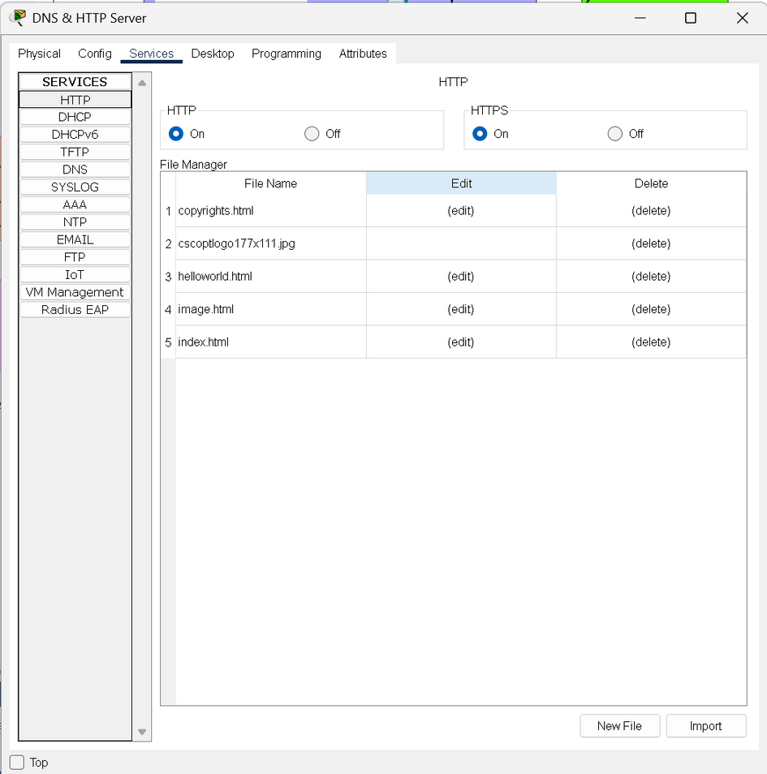
Application Layer
Web Server Testing

Slide 29
Application Layer
Web Server Testing

Slide 30
Application Layer
Mail Server
Mail server adalah sistem yang bertugas mengelola pengiriman, penerimaan, dan penyimpanan email. Mail server terdiri dari dua jenis utama: SMTP server untuk mengirim email dan IMAP/POP3 server untuk menerima email. Cara kerjanya dimulai saat pengguna mengirim email melalui klien email (seperti Gmail atau Outlook); email tersebut dikirim ke SMTP server pengirim, yang meneruskannya ke server penerima berdasarkan alamat tujuan. Server penerima menyimpan email tersebut dan memungkinkannya diambil oleh klien email penerima melalui protokol IMAP atau POP3.

Slide 31
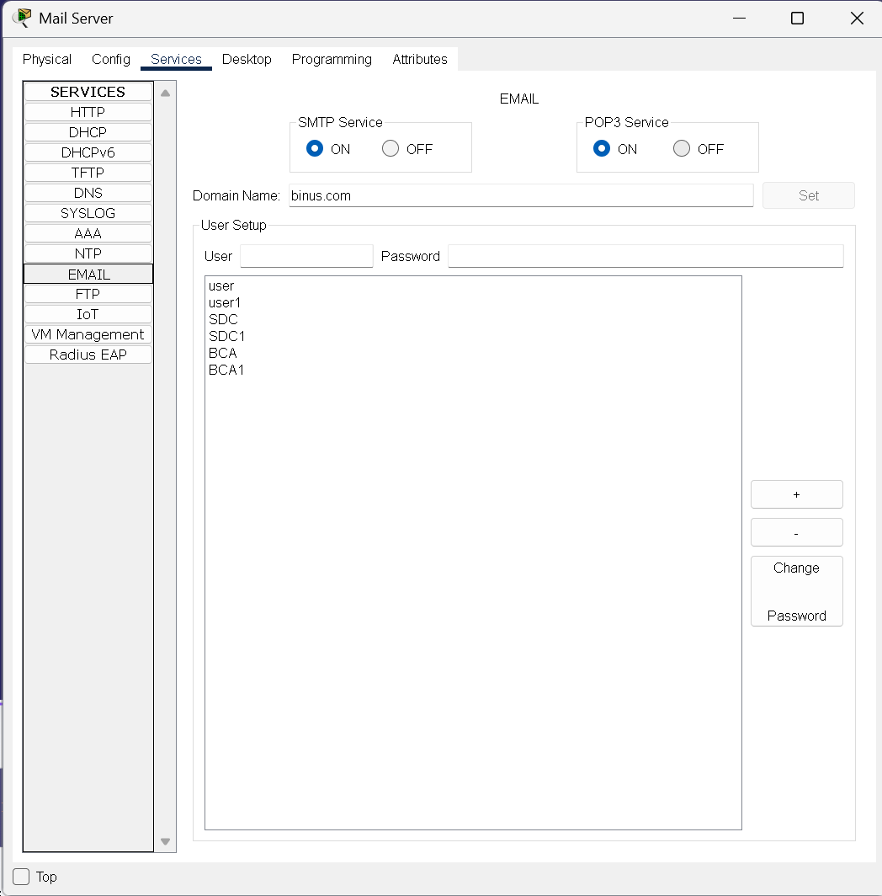
Application Layer
Mail Server Testing

Slide 32
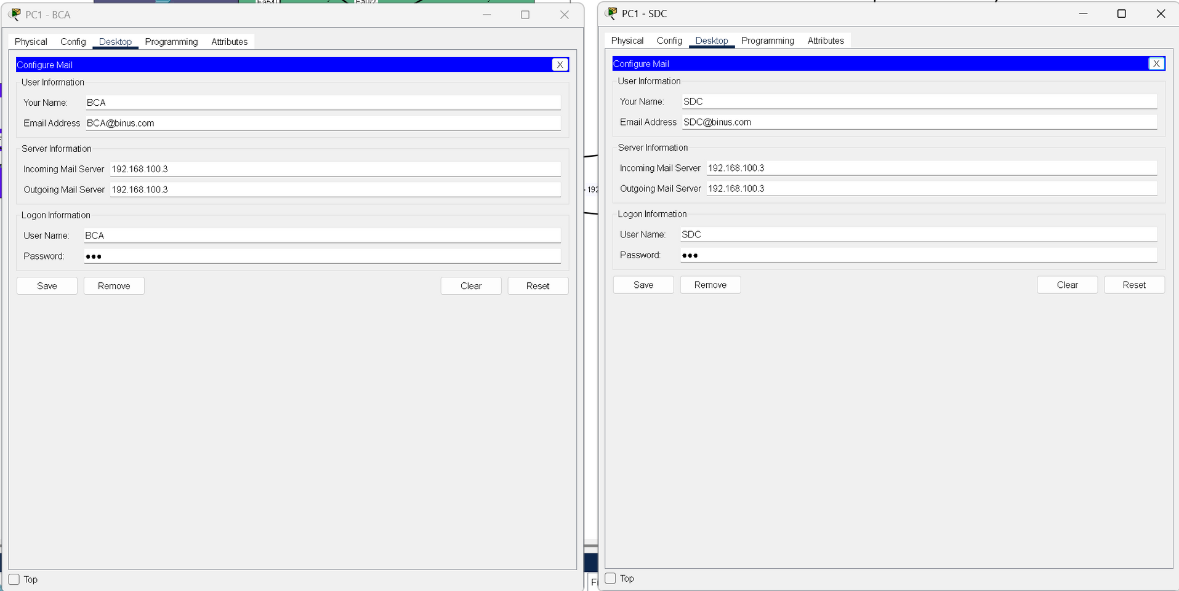
Application Layer
Mail Server Testing

Slide 33
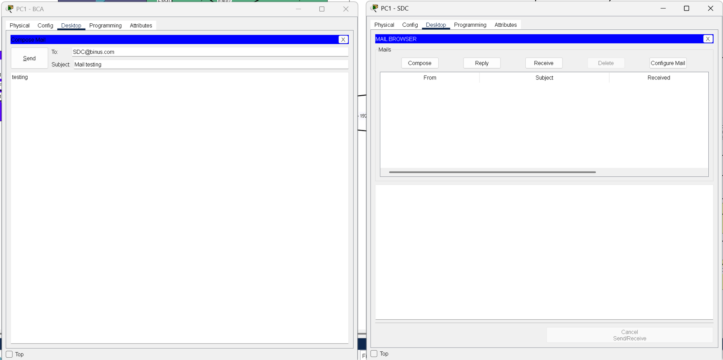
Application Layer
Mail Server Testing

Slide 34
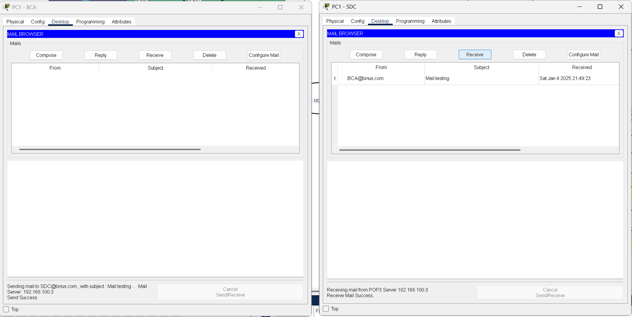
Application Layer
Mail Server Testing

Slide 35
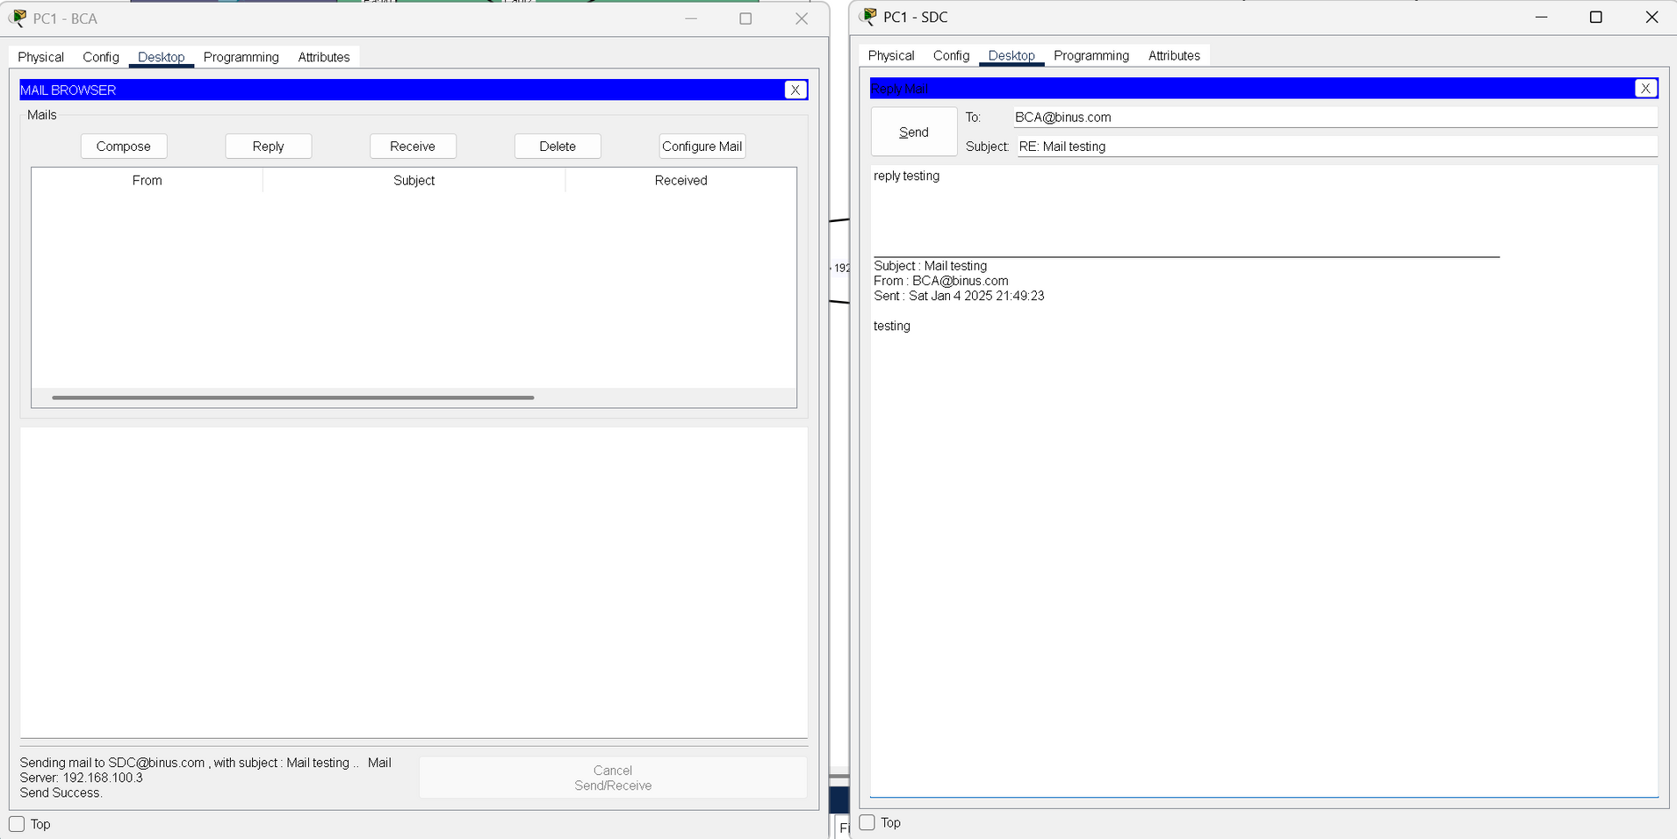
Application Layer
Mail Server Testing

Slide 36
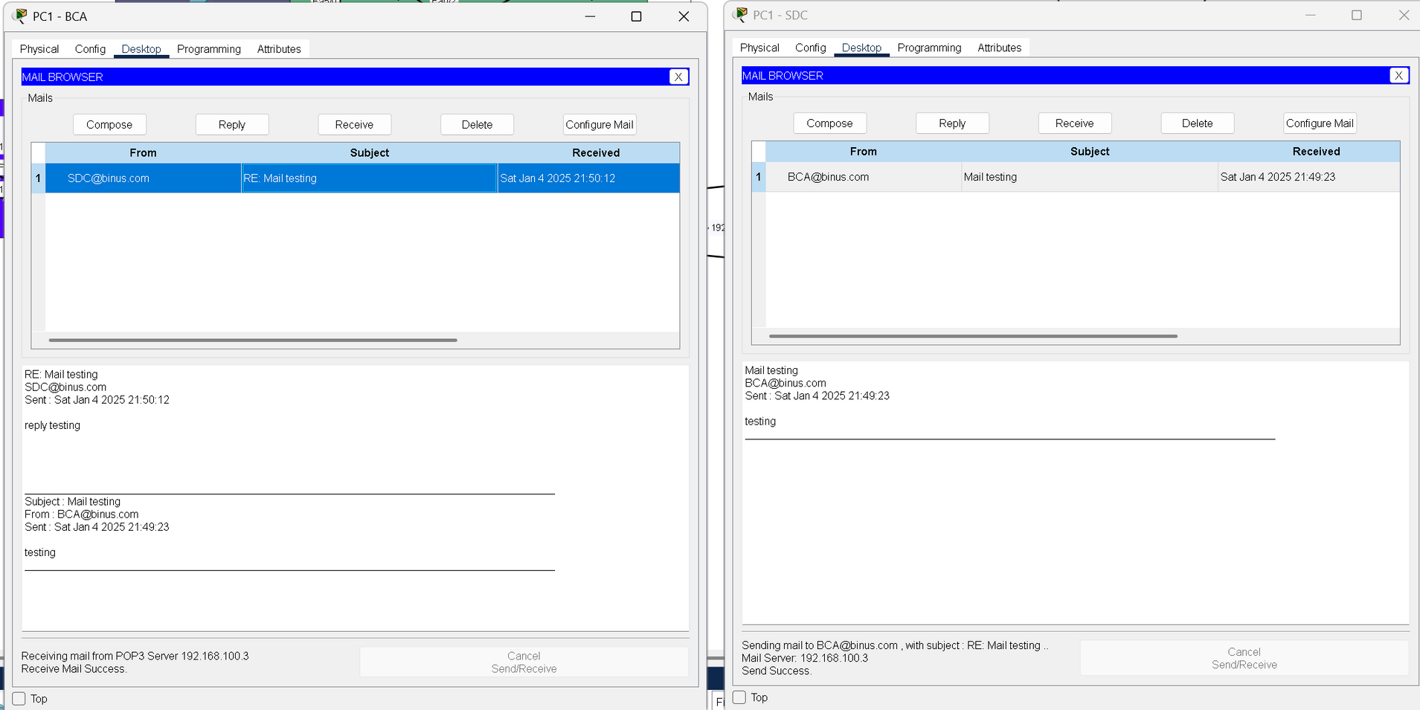
Application Layer
Mail Server Testing

Slide 37
Thank
You
Kelompok 4

