Slide 1
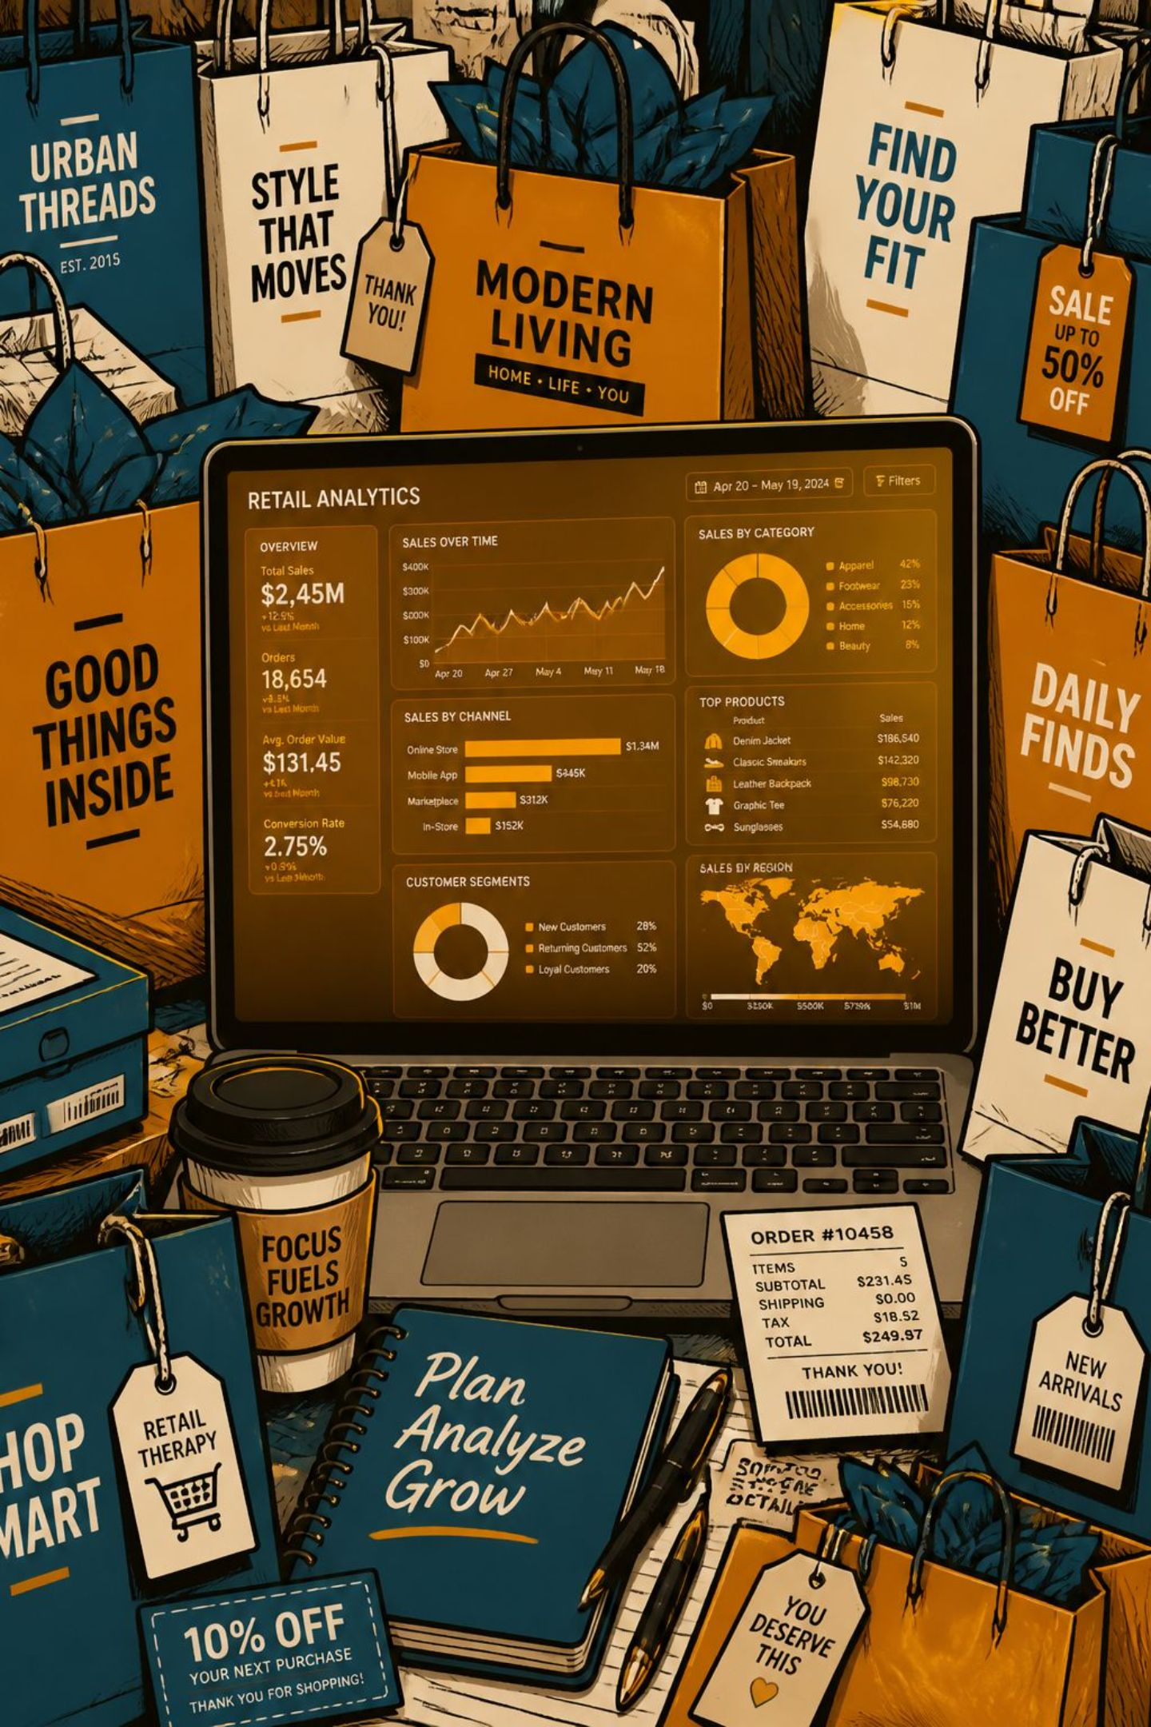
Customer Shopping Behavior Analysis
3,900 transactions · 18 features · Python · SQL · Power BI

Slide 2
Dataset at a Glance
3,900
18
Transactions
Features
37
$59.76
Missing Values
Avg. Purchase
Review Rating only
Demographics, purchase details, and shopping behavior — loaded into PostgreSQL for SQL analysis.

Slide 3

Data Preparation in Python
Clean
Imputed missing Review Ratings by category median
Standardize
Renamed columns to snake_case
Engineer
Created age_group & purchase_frequency_days
Load
Exported cleaned DataFrame to PostgreSQL

Slide 4
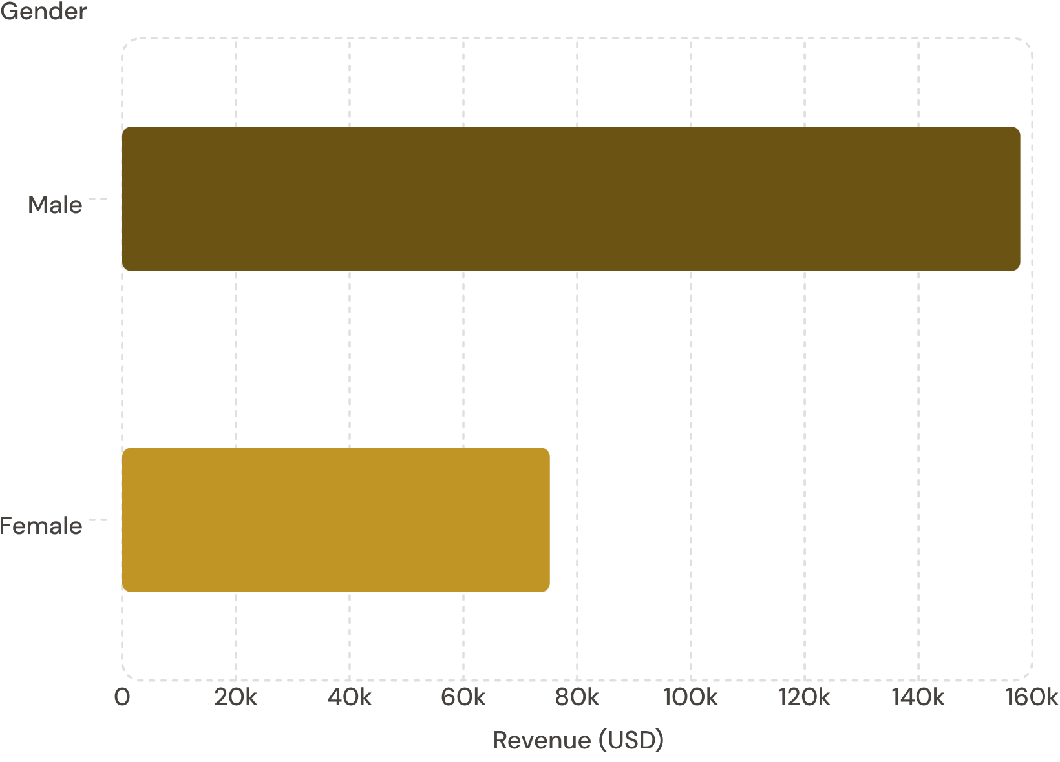
Revenue by Gender
Key Insight
Male customers generated 2× more revenue than female customers — $157,890 vs. $75,191.
Male shoppers also represent 68% of all customers (2,652 of 3,900).

Slide 5
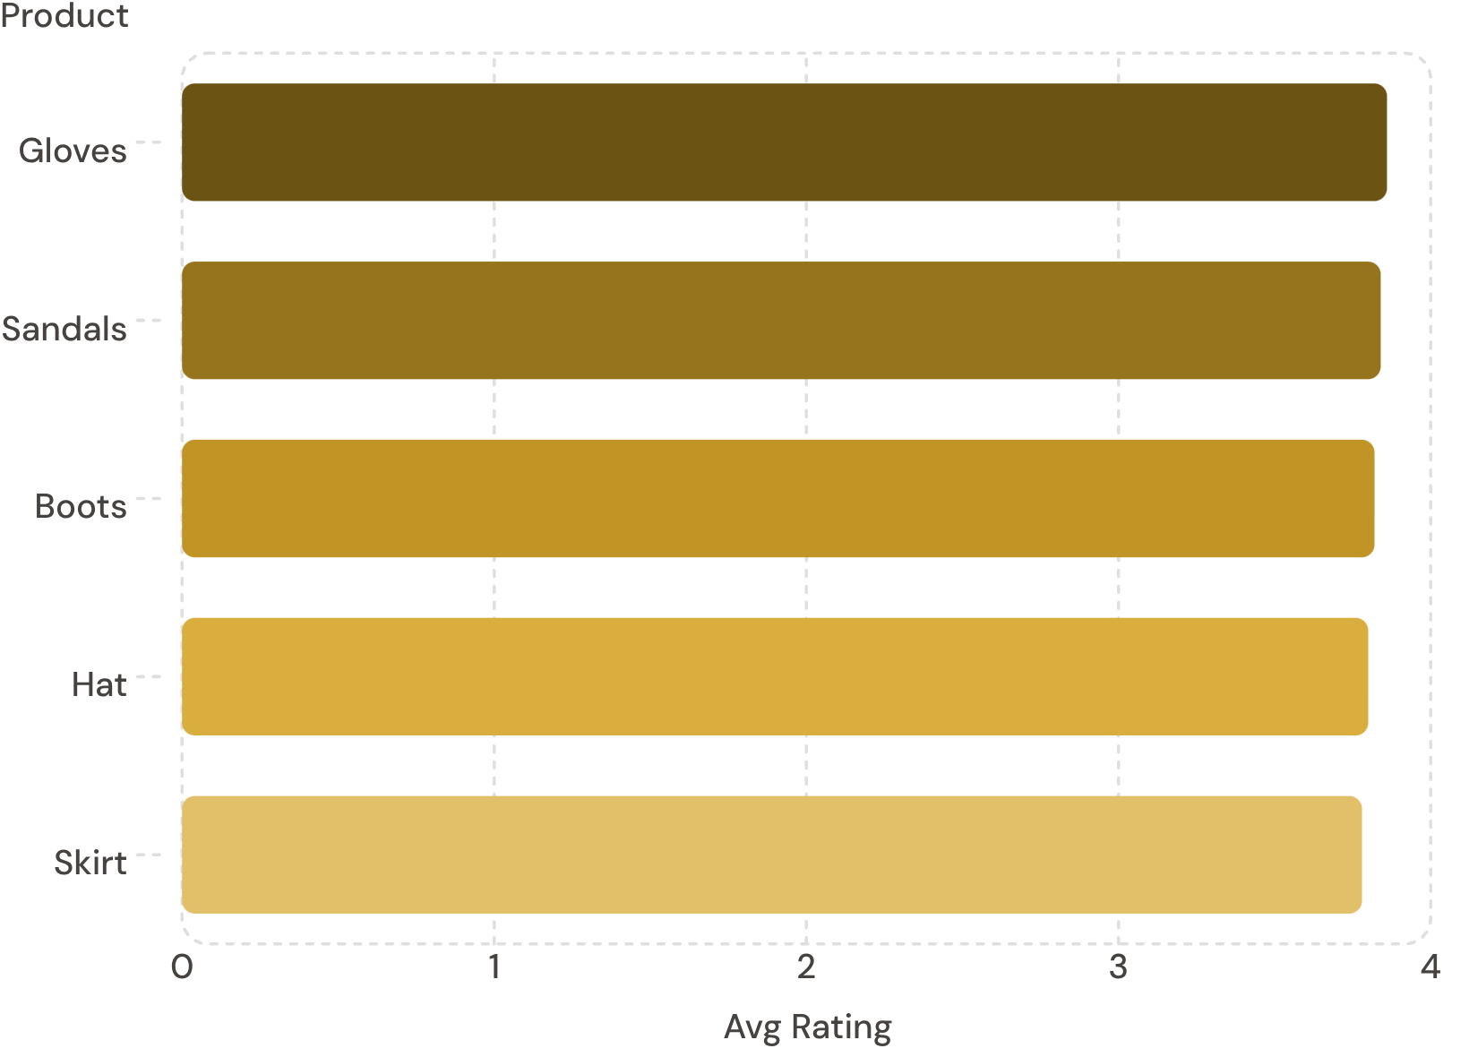

Top Products & Discount Patterns
Highest-Rated Products
Most Discounted Products
Hat
50.00% discounted
Sneakers
49.66% discounted
Coat
49.07% discounted

Slide 6
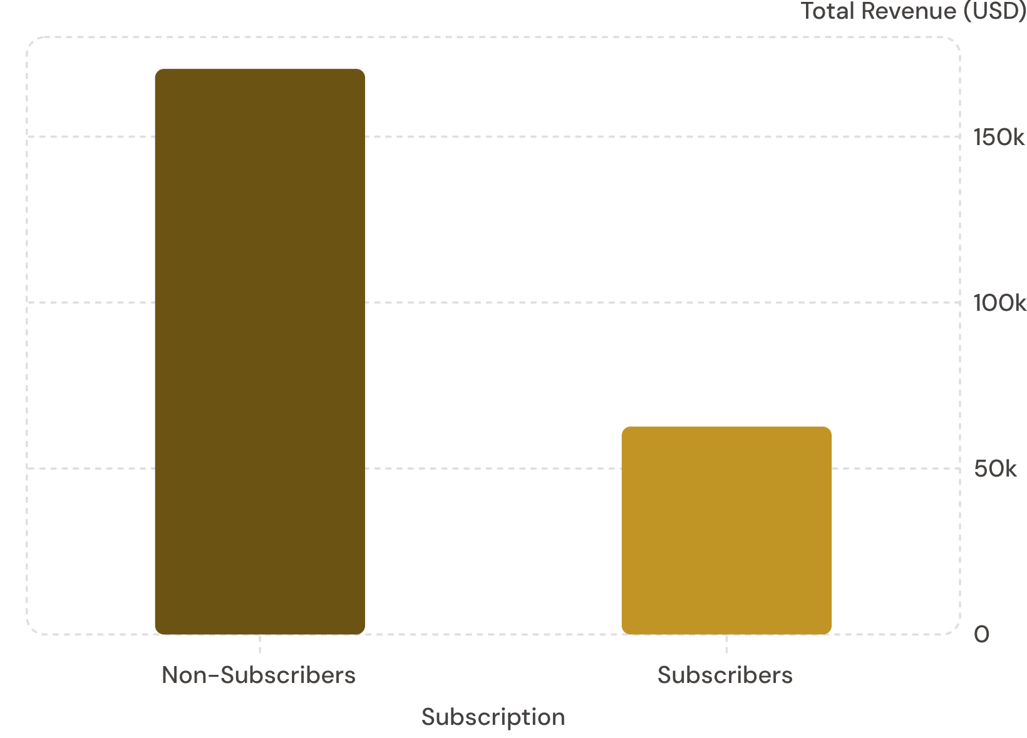
Subscribers vs. Non-Subscribers
The Gap
Non-subscribers drive 73% of revenue despite similar average spend (~$59).
Only 27% of customers subscribe — a major growth opportunity.

Slide 7

Customer Segmentation
Loyal
Returning
3,116 customers — 80% of base
701 customers — 18% of base
New
83 customers — 2% of base
958 repeat buyers (>5 purchases) are subscribed — loyalty drives subscription.

Slide 8
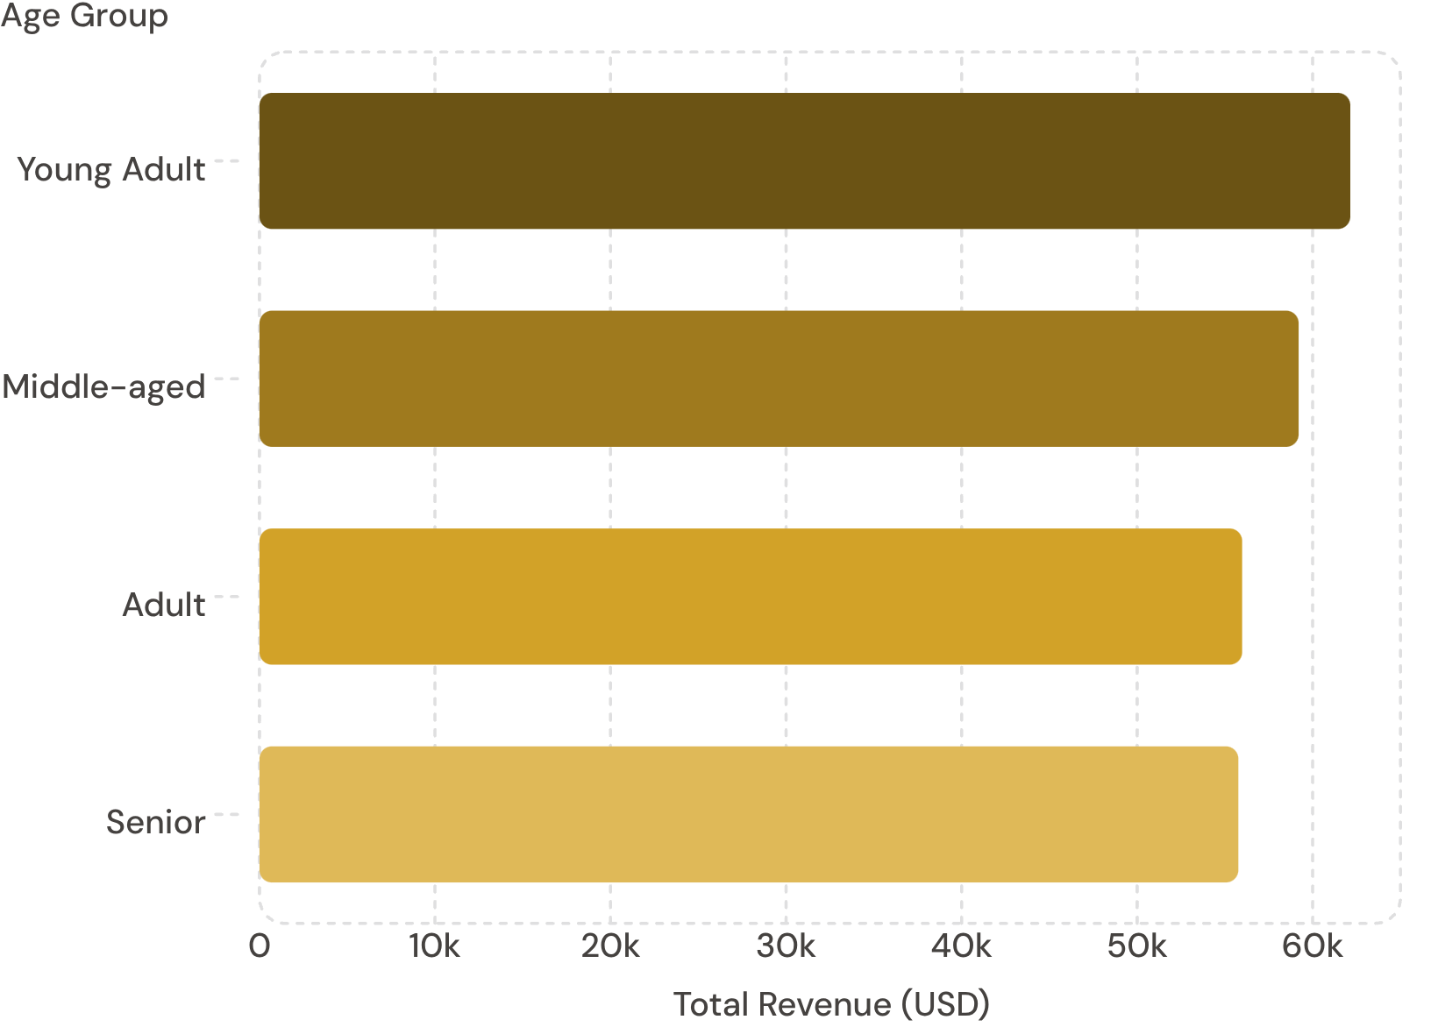
Revenue by Age Group
Key Insight
Revenue is evenly distributed across age groups — no single segment dominates.
Young Adults lead slightly at $62,143. Express shipping users spend slightly more ($60.48 vs. $58.46).

Slide 9
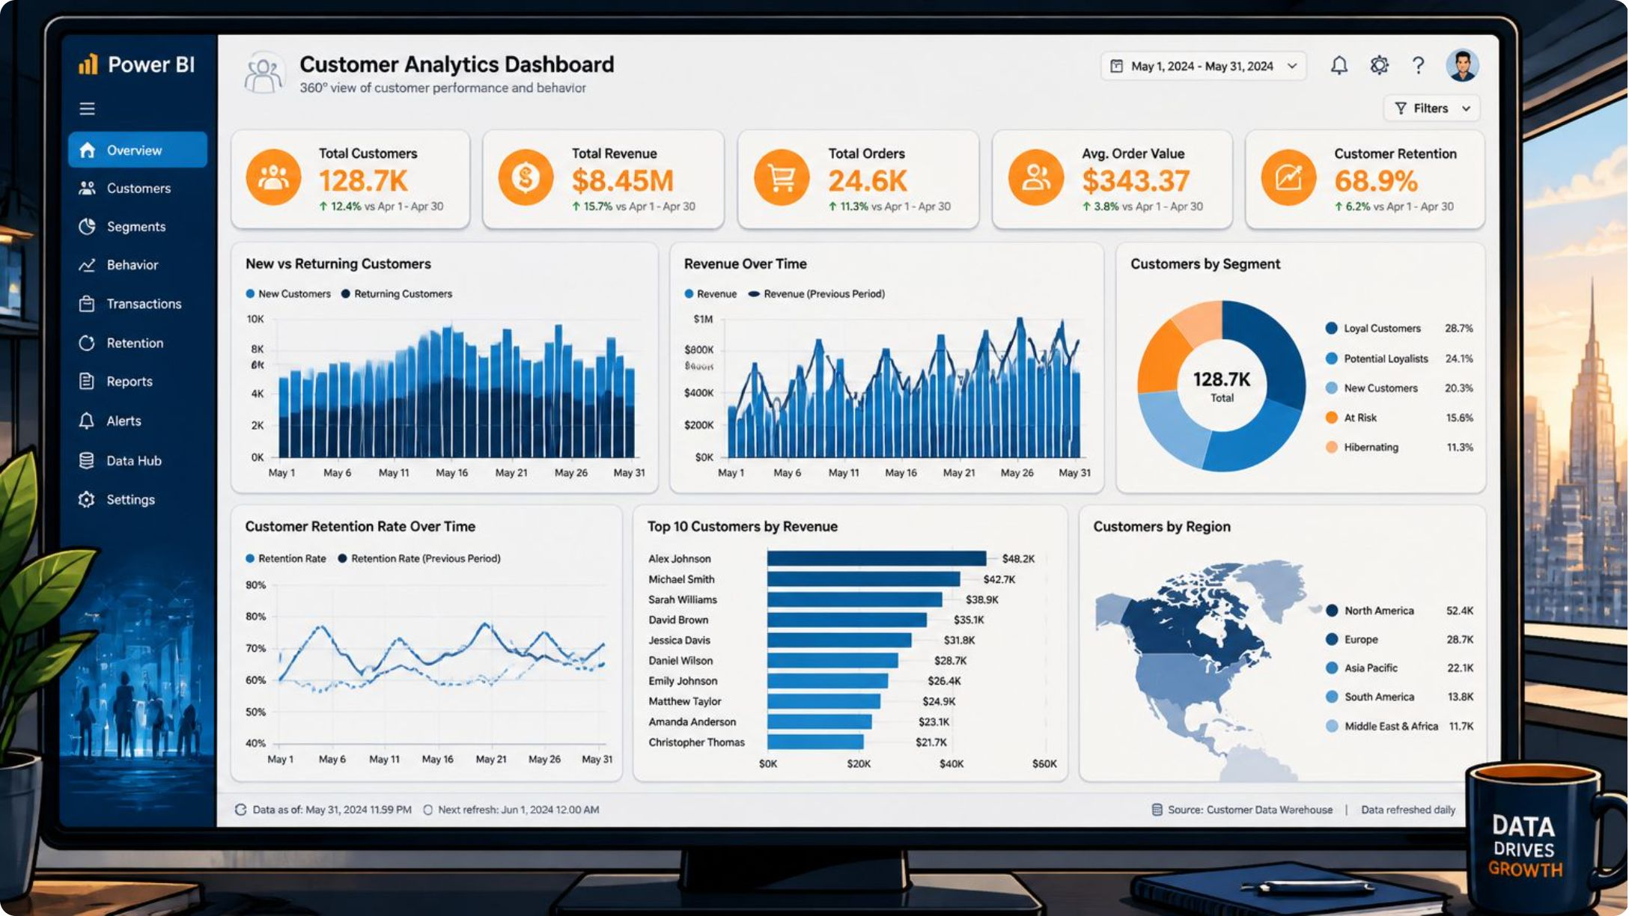

Power BI Dashboard
Interactive Overview
3.9K Customers
Avg. purchase $59.76, rating 3.75
Revenue by Category
Clothing leads at ~$100K
Filters
Subscription, Gender, Category, Shipping

Slide 10





Business Recommendations
Boost Subscriptions
Promote exclusive subscriber benefits
Loyalty Programs
Reward repeat buyers into Loyal segment
Review Discount Policy
Balance sales boosts with margin control
Targeted Marketing
Focus on high-revenue age groups & express shipping users

