Slide 1
AUTOMATED SEISMIC DATA PROCESSING
First Break Picking
Developing an automated algorithm to detect first-break arrival times in seismic traces
Team name : Teenage mutant ninja turtles
Project Team
Brunswick · Halfmile · Lalor · Sudbury seismic assets
01

Slide 2





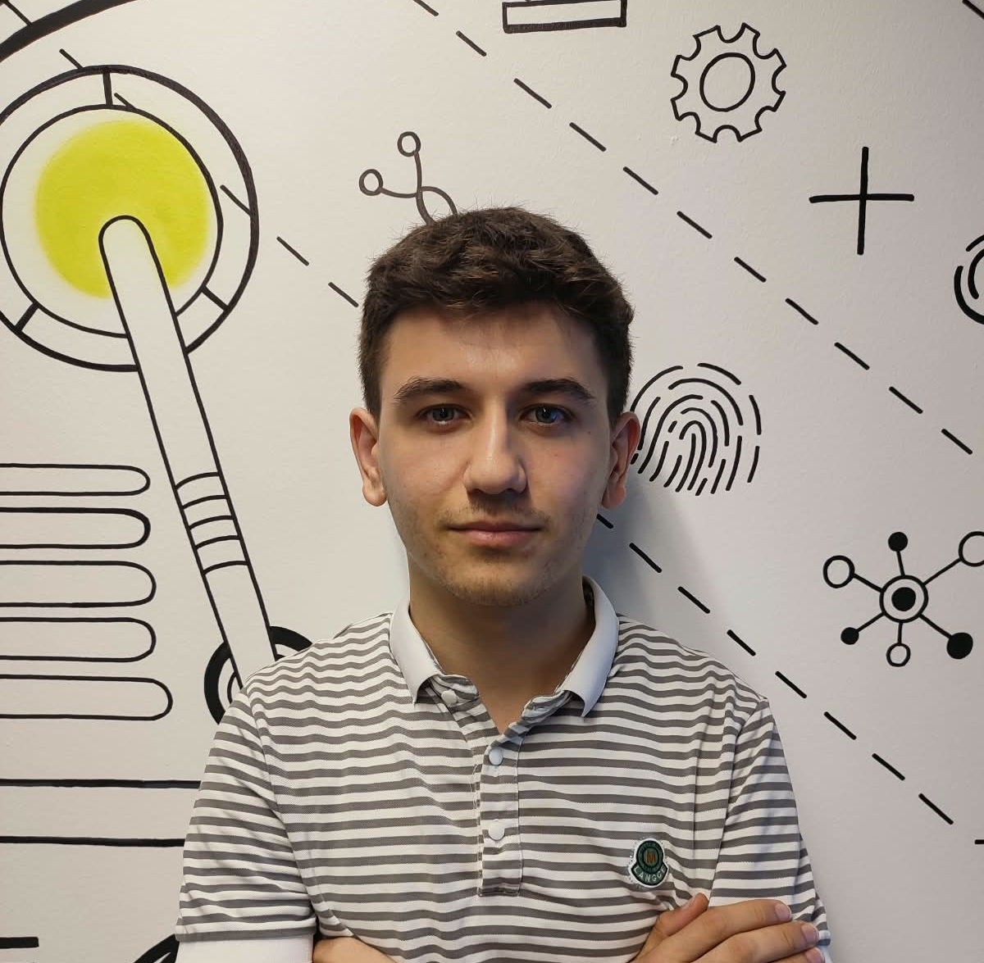
Team Contributions
Ferman Khankishiyev
Bayram Bayramov
Mahmud Ramazanov
Murad Taghizade
Avaz Huseynov
33% commits
Team Lead
Developer Lead
Developer & Researcher
Documentation Lead
Developer & Researcher
Developer & Researcher
CI
Deploy
Model Factory
Project Author
Individual Models
Model Test / Training
Unet / LightUnet Implementation
Etc
Sweep
Model Pairs
Helper Scripts
Batch Training Core
ONNX / Torchscript
Batch Training Recovery
Preprocessing Foundation
Etc
Docstring
Readme.md
Data Pipeline
EDA Datasets
Preprocessing
Preprocessing Scripts
Configuration System / Foundation
Etc
Metrics
Train Scripts
Loss Functions
Documentation
Callbacks / Trainer
MLFlow / TensorBoard
Trainer Advanced Features
Etc
Logger
Evaluation
Prediction
Visualization
Memory Utils
Export Model
EDA Datasets
Etc

Slide 3
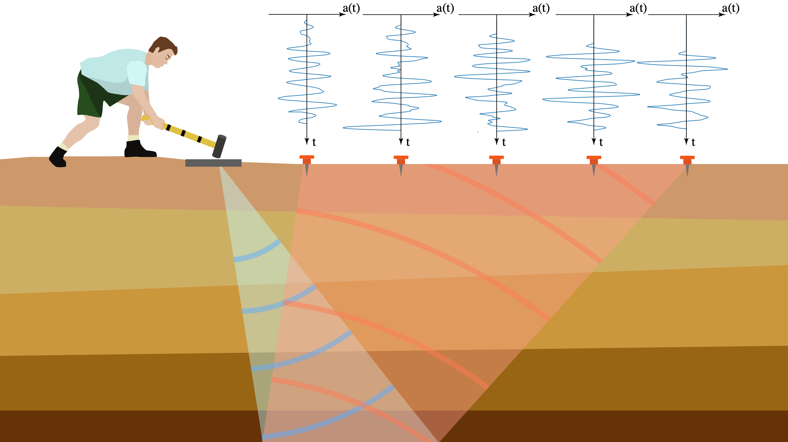
01 · INTRODUCTION
What is a first break, and why does it matter?
A “first break” is the arrival time of the initial seismic wave at a receiver. This time is the key input for building velocity models, computing static corrections, and depth-time conversions in seismic refraction and tomography studies.
First-break line
1
Traditional approach
Manual picking by geophysicists across millions of traces — a time-consuming process
2
Objective
Build an automated method that performs reliably across varying assets and signal-to-noise ratios
3
Input data
Traces from 4 real seismic assets + expert-labeled first-break times (SPARE1)
02

Slide 4
02 · BUSINESS NEED
Why does this need to be automated?
⏱
≈
$
≈
↗
$
Time cost
Subjectivity
Scalability
Value chain
Manually picking millions of traces takes weeks to months and delays project timelines.
Inconsistency between different pickers' results affects the quality of the velocity model.
Manual effort doesn't scale as new assets (Brunswick, Halfmile, Lalor, Sudbury) are added.
Faster, more accurate first breaks lead to faster statics and faster exploration decisions.
03

Slide 5
03 · DATA
Overview of the four real seismic assets
Brunswick
Halfmile
Lalor
Sudbury
3D seismic, HDF5 (Brunswick_orig_1500ms_V2)
3D seismic, with added geometry (add_geom_sorted)
3D seismic, raw z-values (raw_z_1500ms_norp_geom)
3D seismic, pre-processed
HDF5 structure · /TRACE_DATA/DEFAULT
data_array
SOURCE_X / Y / HT
REC_X / Y / HT / PEG
2D array of all recorded traces (trace count × sample count)
Shot (source) coordinates and elevation
Receiver coordinates and identifiers
SAMP_RATE / SAMP_NUM
SPARE1
SHOTID / SHOT_PEG
Sampling rate (μs) and sample count
First-break time (ms); 0 or -1 = unlabeled
Shot identifiers — used to split gathers
04

Slide 6
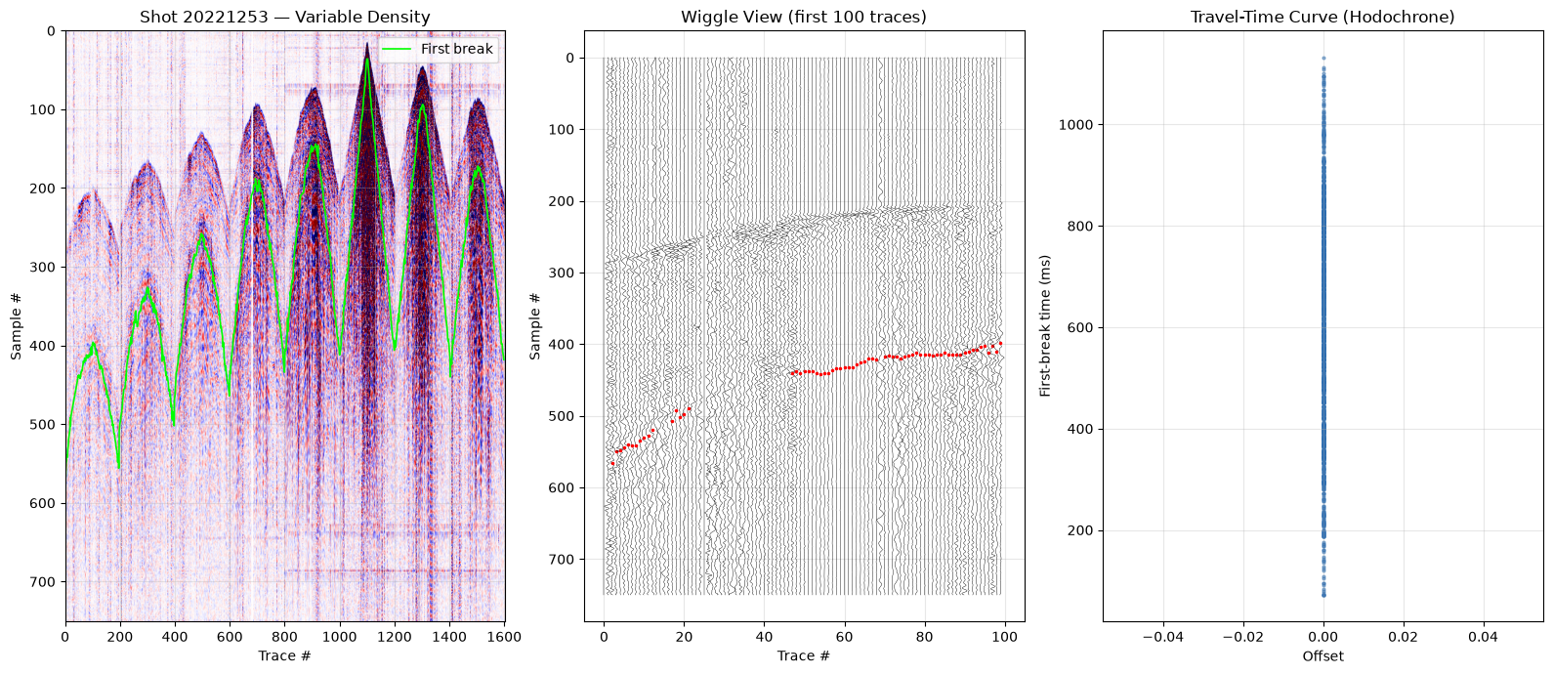
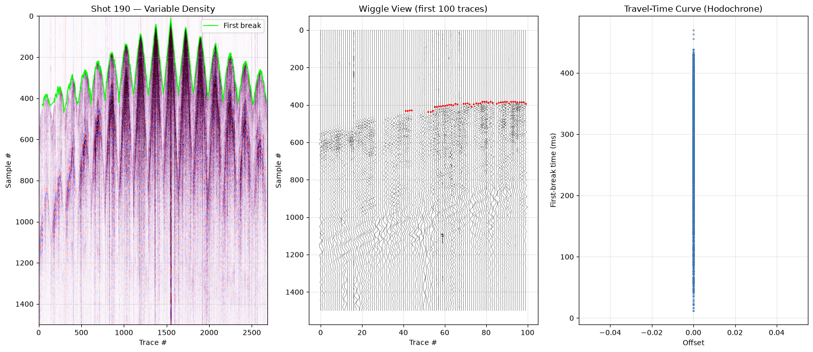
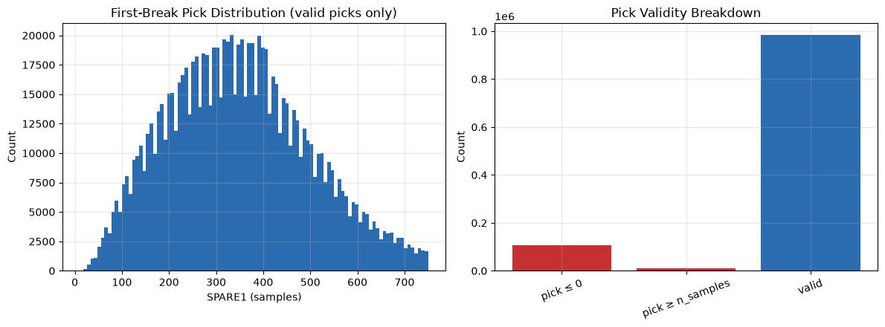
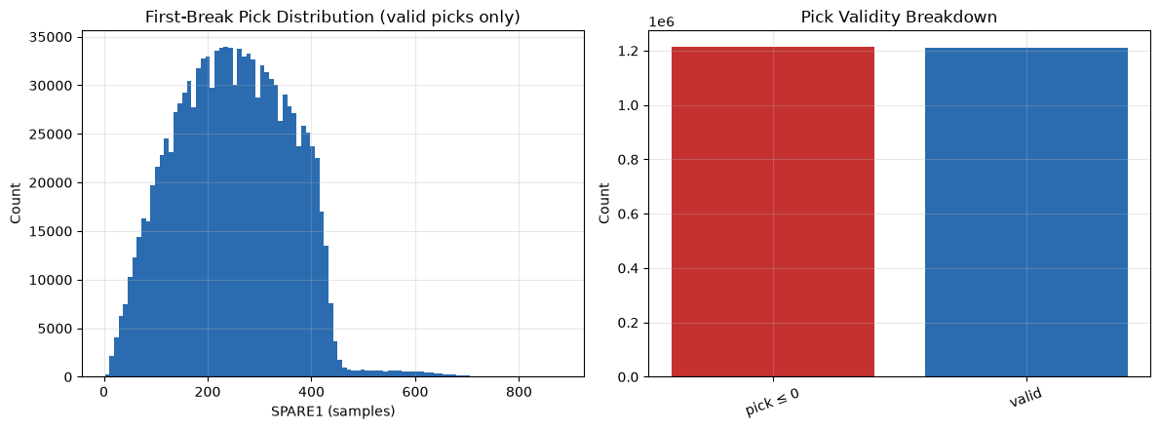
Halfmile Dataset and Distribution
Lalor Dataset and Distribution
05

Slide 7
04 · METHODOLOGY
Data preparation: splitting into gathers
Each HDF5 file stores all traces sequentially. To reconstruct a real 2D seismic image (shot gather), traces are grouped by receiver/source coordinates (SOURCE_X/Y, REC_X/Y) and SHOTID, then each gather is paired with its first-break labels (SPARE1).
01
02
03
04
05
Load raw data
Split into gathers
Align labels
Clean & filter
Train / Val / Test split
Detect unlabeled traces for masking in the loss function
We only implement in 80/10/10
Format.
Load data_array and metadata fields with h5py
Group traces by SHOTID / coordinates
High-millisecond picks are marked invalid.
06

Slide 8
08 · SOFTWARE
Software and tooling stack
Data processing
Modeling
Visualization & QC
Python, h5py
PyTorch / TensorFlow
Matplotlib
NumPy / Pandas
U-Net architecture
Interactive gather viewer
SciPy (signal filtering)
Light / Tiny / Nano U-Net variants
Jupyter notebooks
HDF5 seismic datasets
MobileUNet architecture
TensorBoard
Trace & gather preprocessing
MPS-based training
Training / validation curves
MLflow experiment tracking
Prediction & first-break QC plots notebooks
Label alignment & validation
12

Slide 9
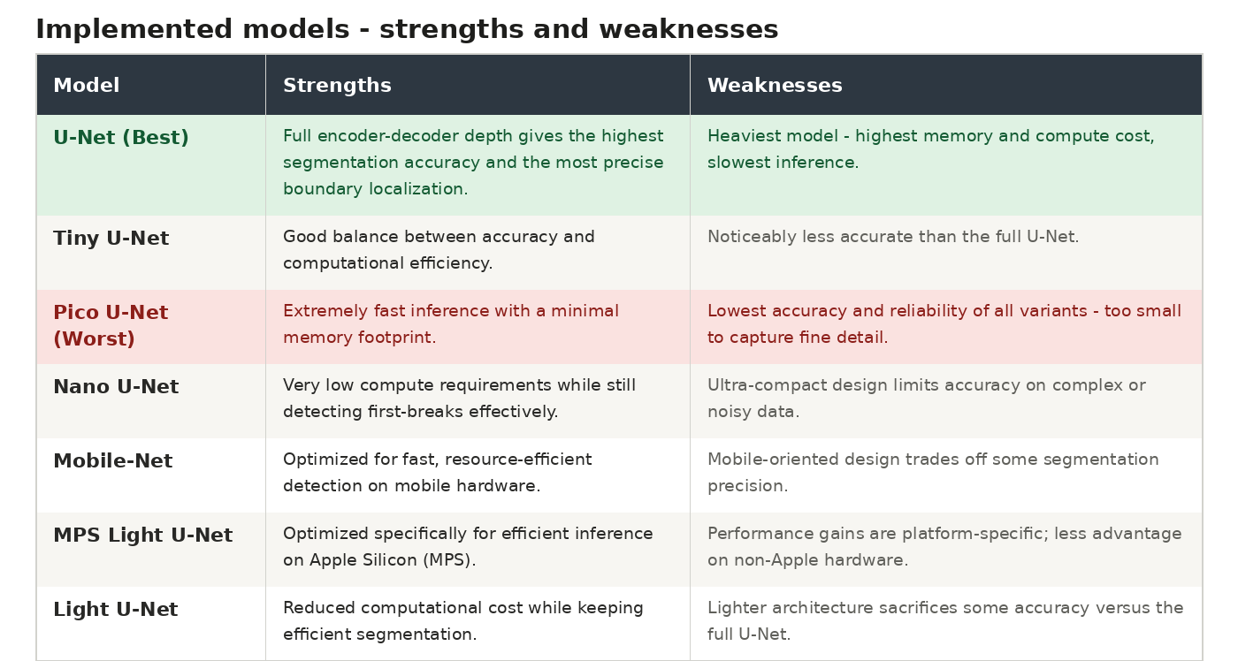
07

Slide 10
06 · EVALUATION
Metrics
Model output is compared against the expert-labeled SPARE1 times. The metrics below are computed per asset and in aggregate across all assets.
Model
System
First Break Picking
Data
IoU,F1,Accuracy,Recall,Precision,Train/Val Loss
Memory Usage &Performance
Min, Max, Mean, Std absolute error
Ratio, trace/sample count, invalid picks
Core metrics for evaluating segmentation quality and training stability.
Tracks how much memory the model uses and how fast it runs.
Summarizes the spread and average size of the timing error.
Tracks how many picks are valid versus unreliable across traces.
Note: fill in actual MAE and pick-rate figures here once validation results are available.
08

Slide 11
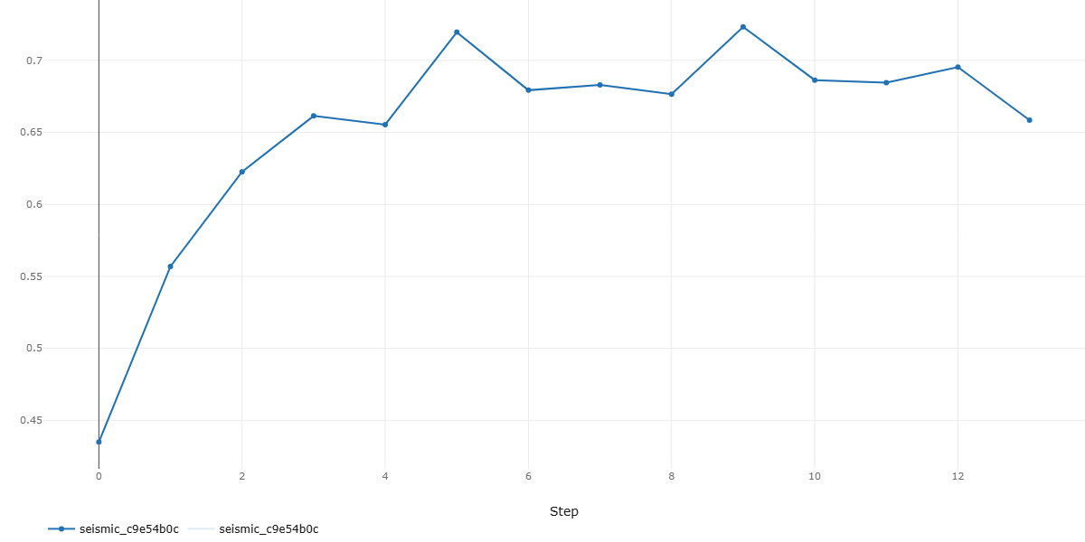
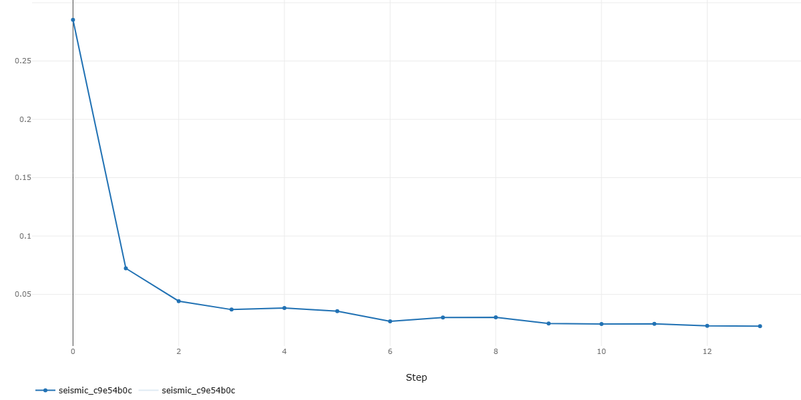
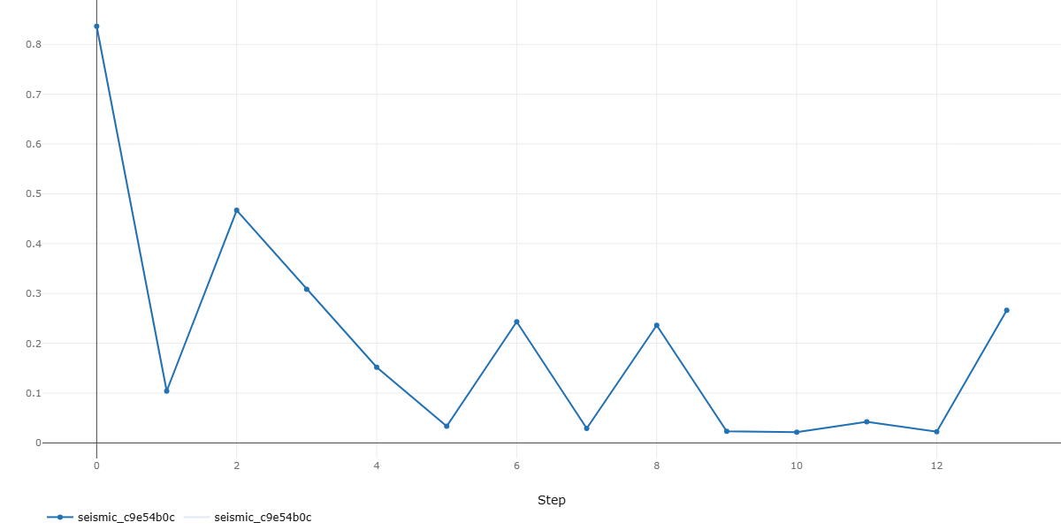
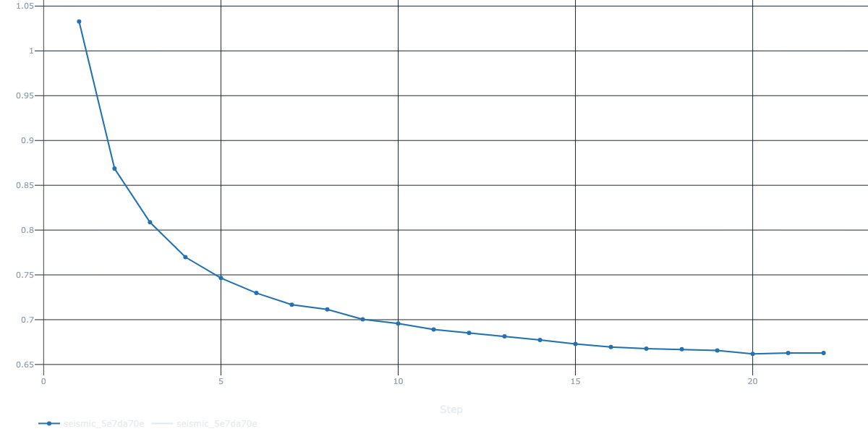
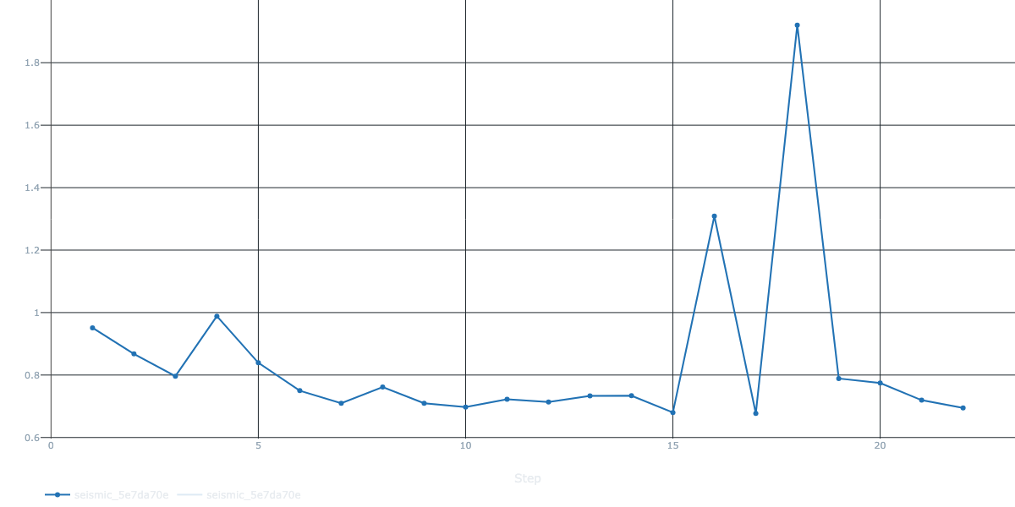
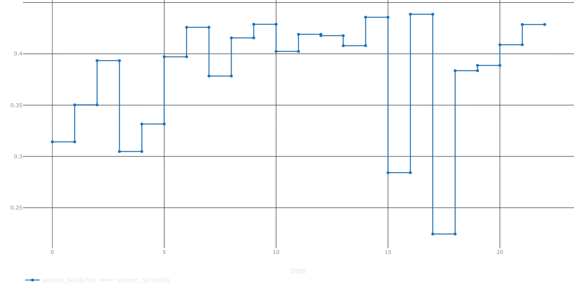
Part Of Metrics Results
Val IoU Loss U-Net
Train Loss U-Net
Validation Loss U-Net
Train Loss Pico U-Net
Validation Loss Pico U-Net
Val IoU Pico U-Net
09

Slide 12
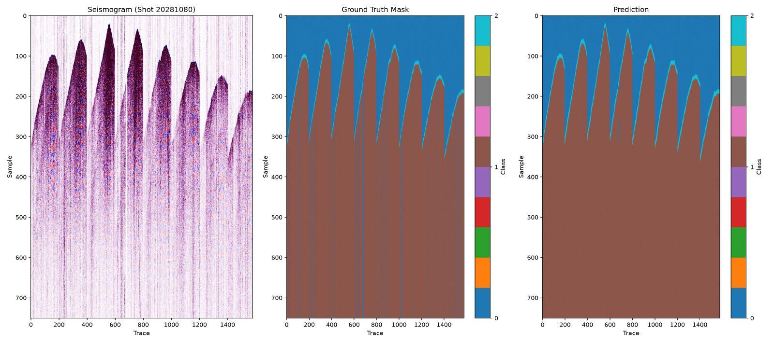
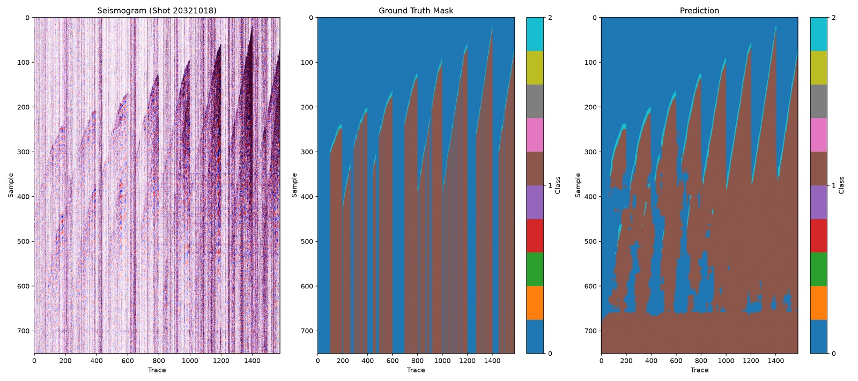
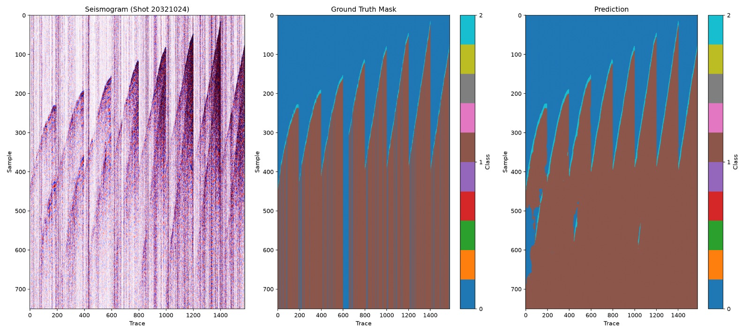
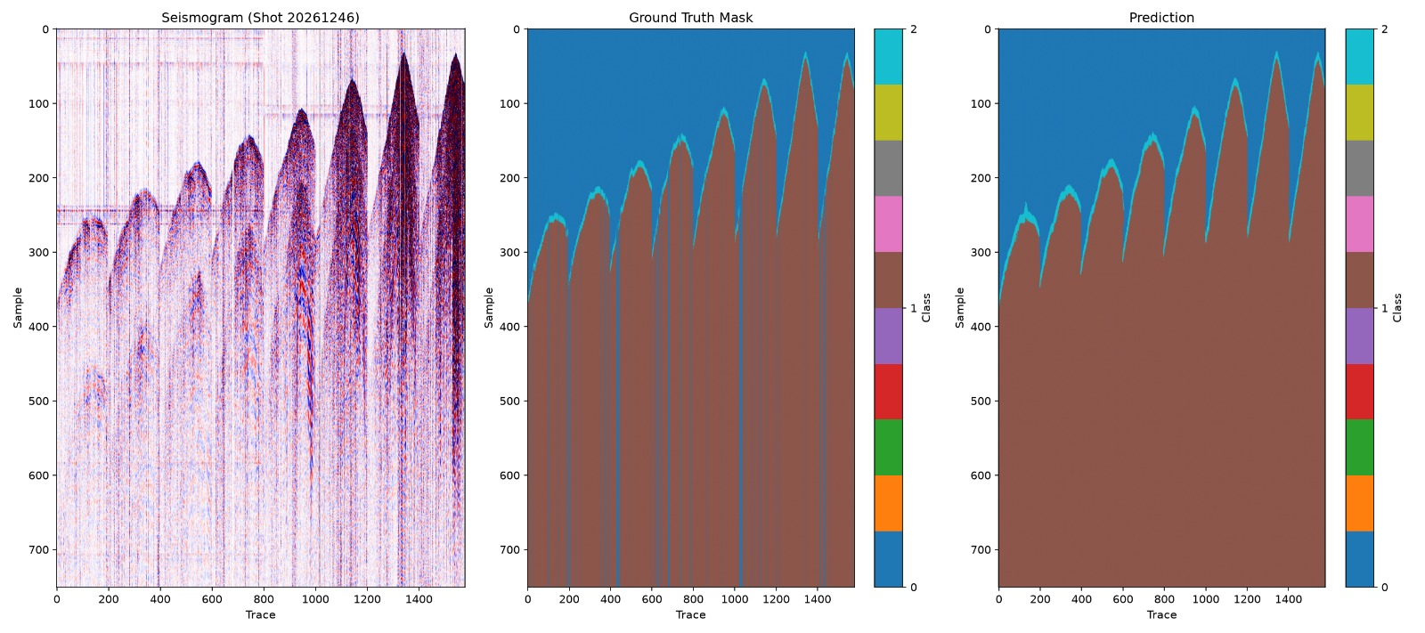
07 · RESULTS
Prediction Results (U-Net Model Best One HalfMile Dataset)
✓
10

Slide 13
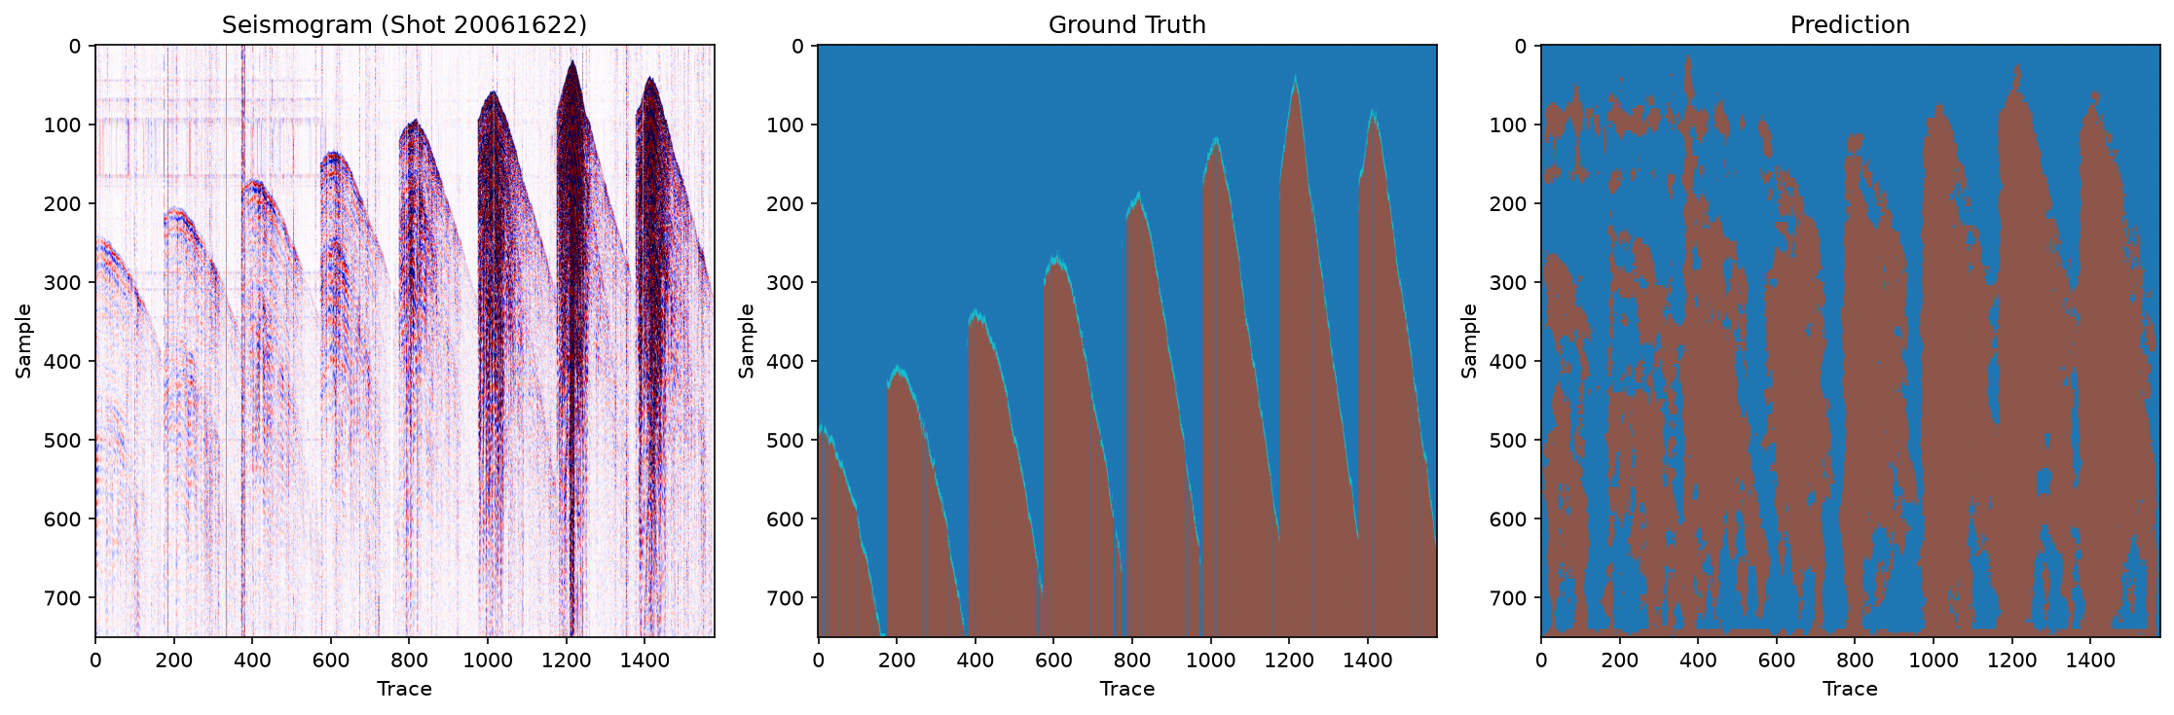
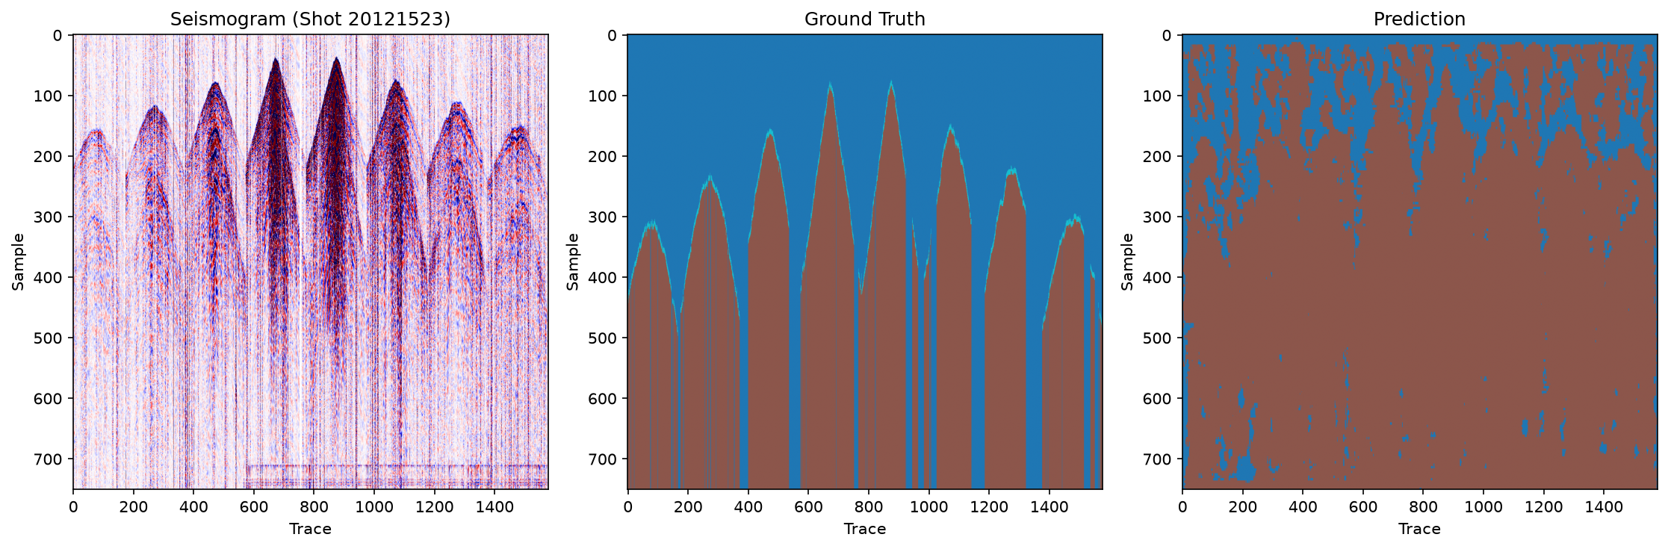
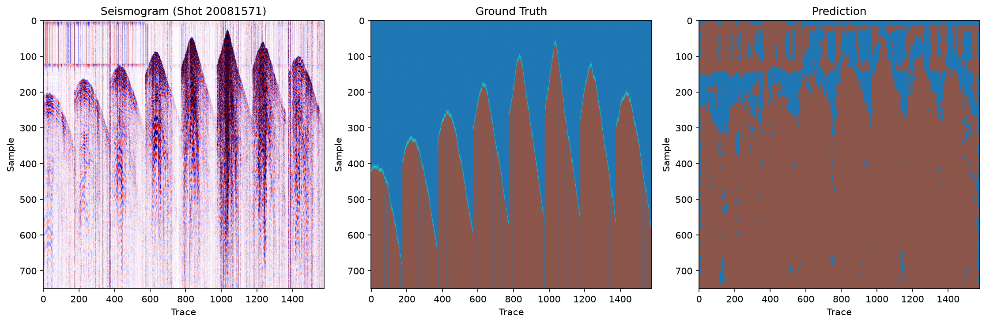
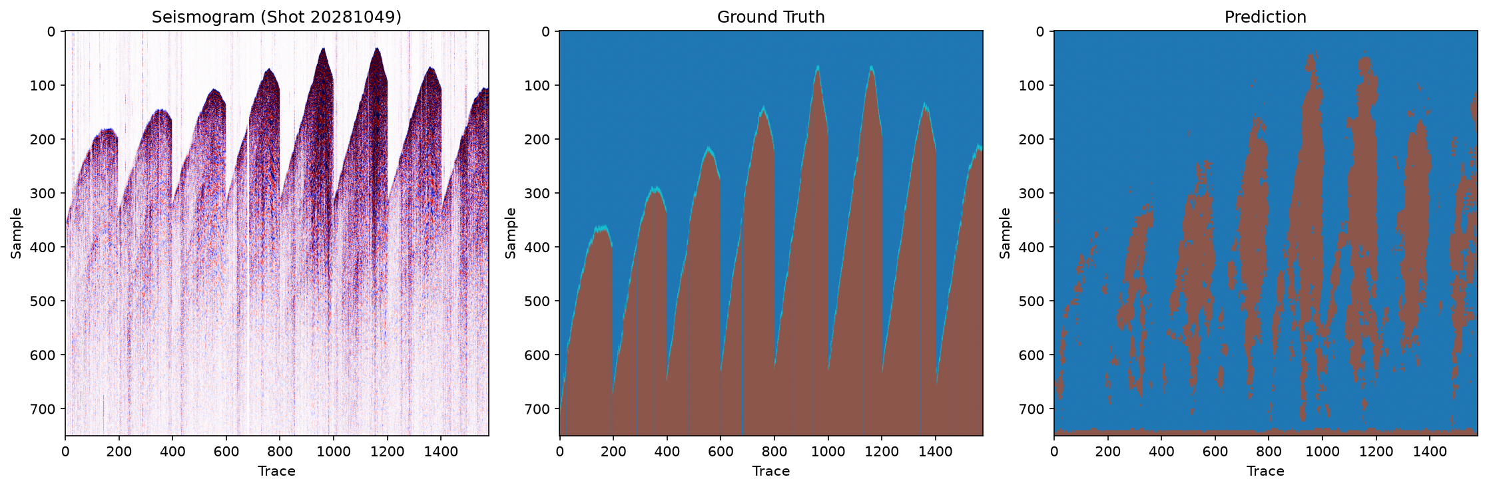
07 · RESULTS
Prediction Results (Pico U-Net Model Worst One HalfMile Dataset)
11

Slide 14
09 · Further
Limitations
Our Strengths & Improvements
Efficient Model Design: We developed and evaluated multiple lightweight U-Net-based architectures to balance model performance with limited computational resources.1D/2D CNN — per-trace time segmentation
Limited Training Resources: The required training hardware was not provided, and no dedicated compute resources were allocated for model training.
Multi-Dataset Evaluation: We worked with four real seismic datasets — Halfmile, Lalor, Brunswick, and Sudbury — providing broader evaluation across different data characteristics.
High Memory Consumption: Our models tend to retain a significant amount of memory, creating deployment and storage challenges, particularly due to the large size of the seismic datasets.
Memory-Efficient Training: We implemented chunk-based processing, optimized data loading, and lightweight configurations to handle large seismic datasets under memory constraints.
CPU Limitations: The available systems have limited CPU capacity, making frequent CPU access for processing and feeding large datasets into the training pipeline inefficient.
Multiple Model Comparison: We evaluated different architectures, including U-Net, Light U-Net, Efficient U-Net, and MobileNet-based models, rather than relying on a single model.
GPU Limitations: GPU resources were also constrained by insufficient VRAM and computational capacity. The provided A100 GPU was migrated to a 42 SM configuration, which limited the available computing power for large-scale model training.
Robust Training & Experiment Pipeline: We developed structured training, evaluation, checkpointing, logging, and experiment-tracking components to make experiments more reproducible and systematic.
13

Slide 15
11-12 · CONCLUSION
Achieved results vs. planned goals
Planned
Achieved
A single, automated pipeline across all 4 assets
Gather-based data preparation pipeline completed
Consistent accuracy across varying SNR conditions
Baseline and deep-learning models built and compared
Significantly reduce expert manual effort
Cross-asset validation results presented
Thank You!
We welcome your questions
12

