Slide 1
RASPBERRY PI AUTOMATED TRAFFIC SIGNS AND SIGNALS RECOGNITION
Fermendjin Patricia-Maria-Francesca
Gaube Robert-Gabriel
Murariu Marius-Andrei

Slide 2
Features
Sign and traffic light recognition using neural networks.
The signs supported are ‘Stop’, ‘50 speed limit’, ’70 speed limit’ and the traffic lights.
Practical demonstration using small-scale sign and traffic light models.
For each recognition print out information and execute a specific action.

Slide 3
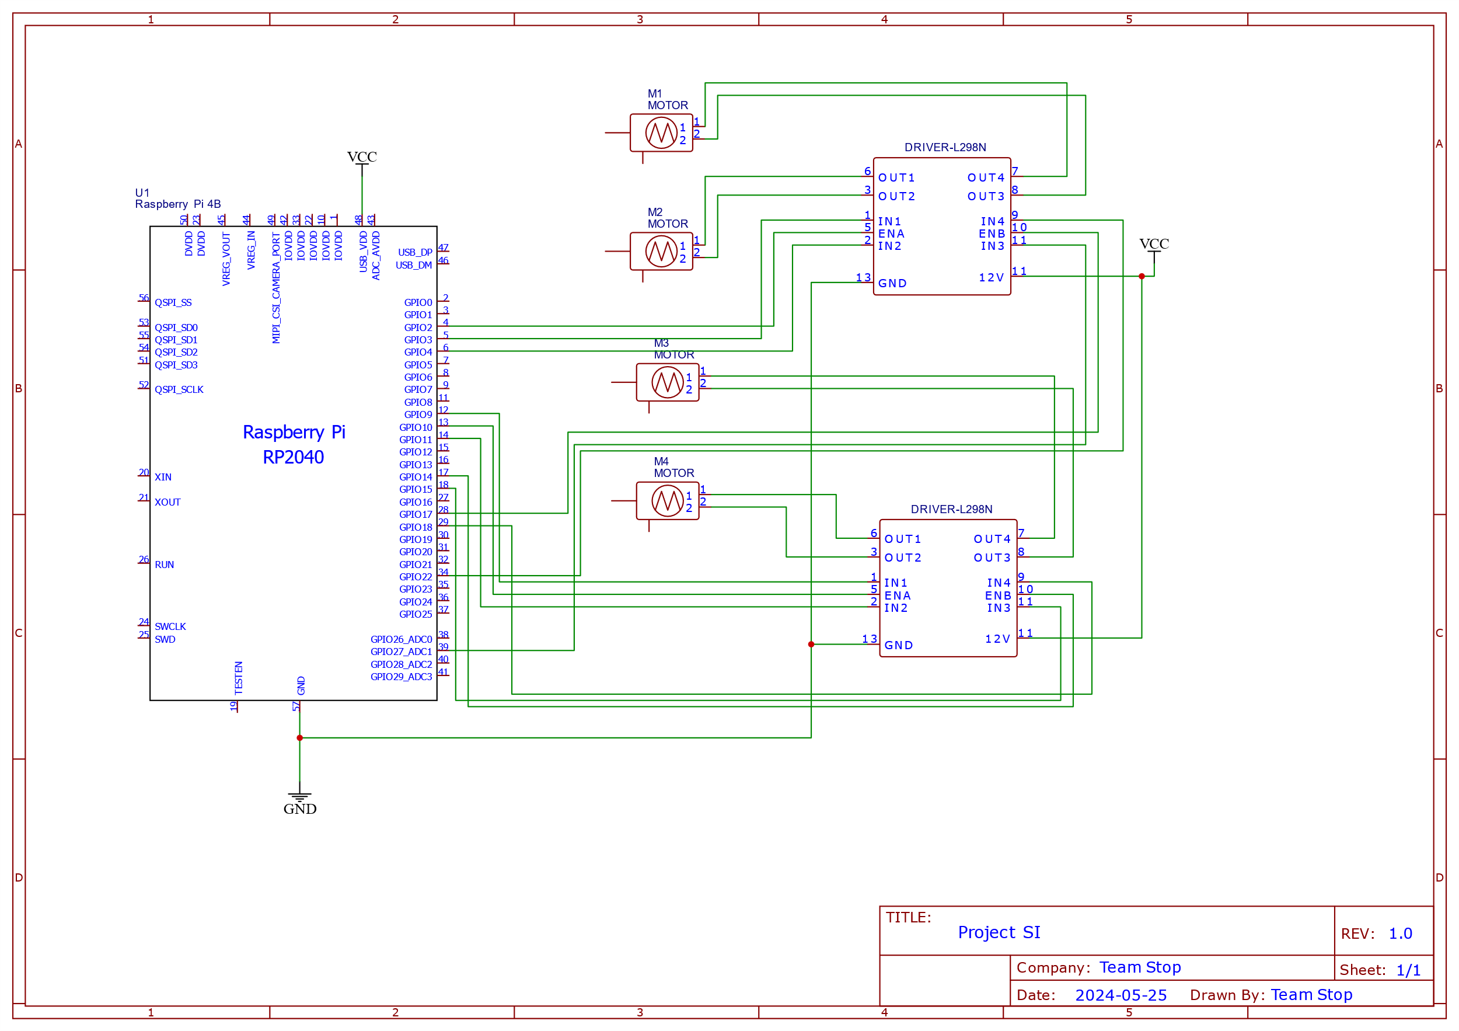
Schematic

Slide 4
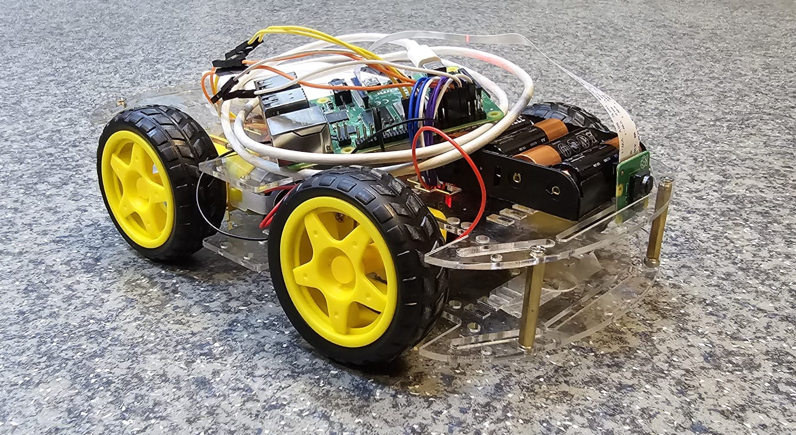
Real life circuit

Slide 5
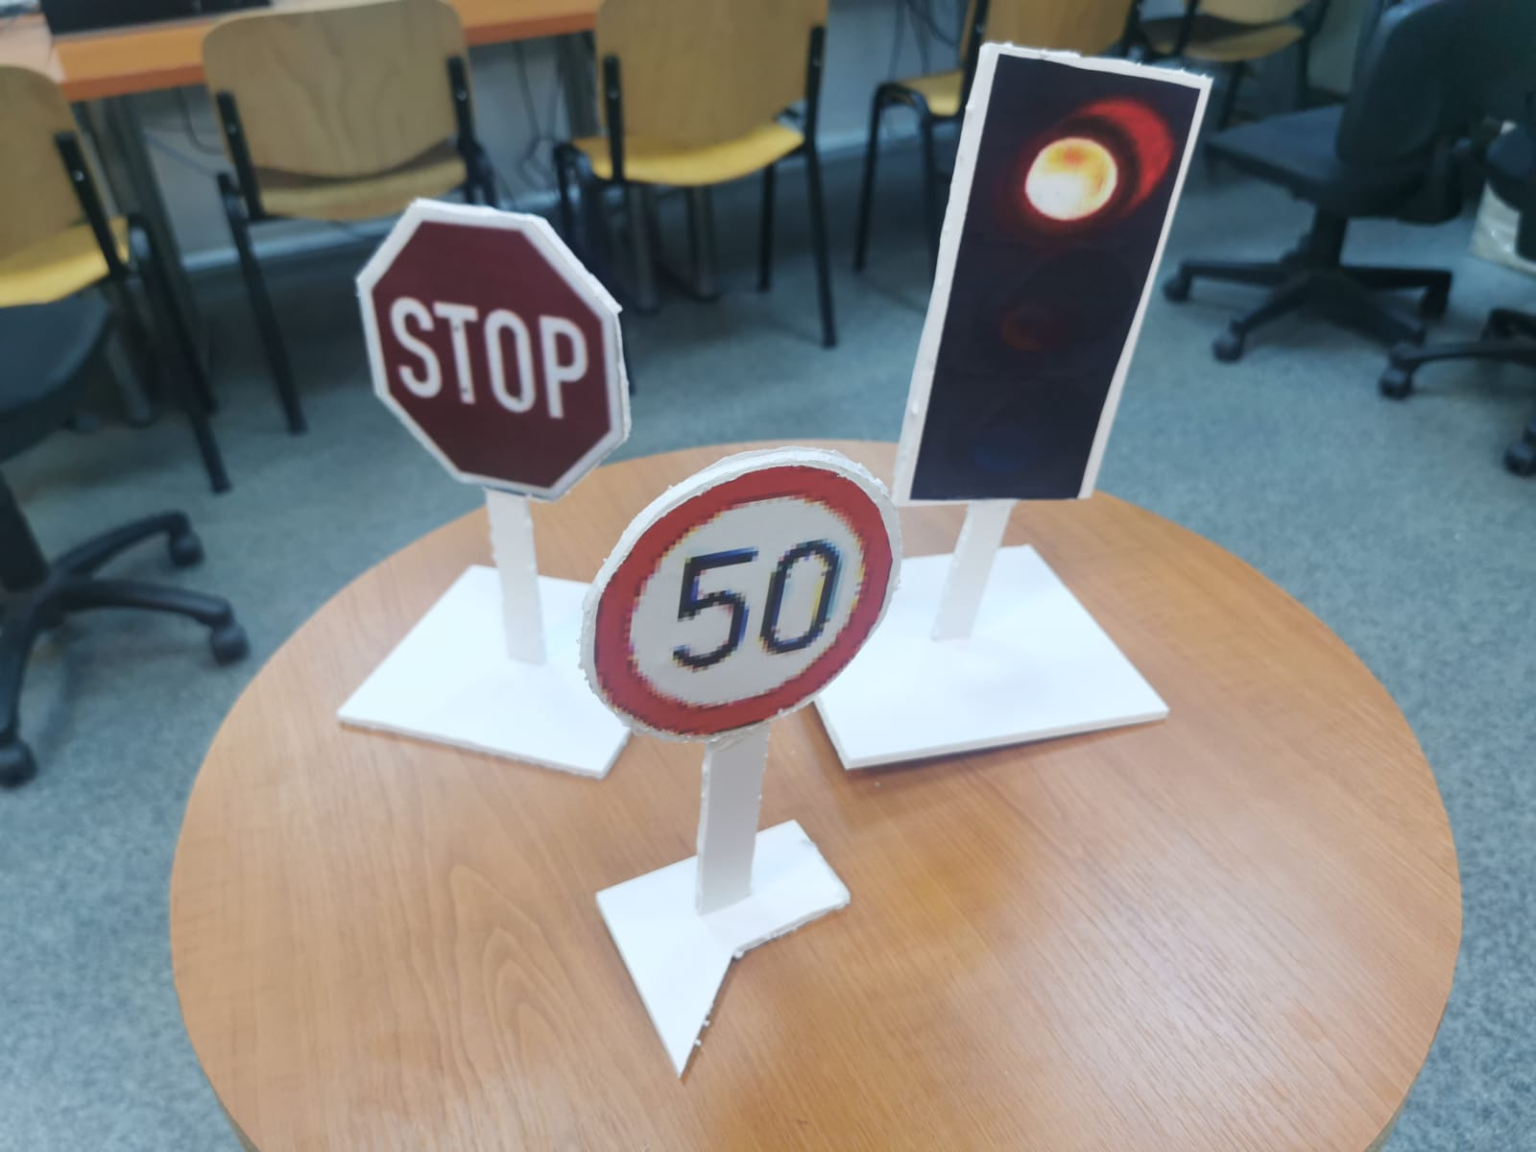
Sign and traffic light models

Slide 6
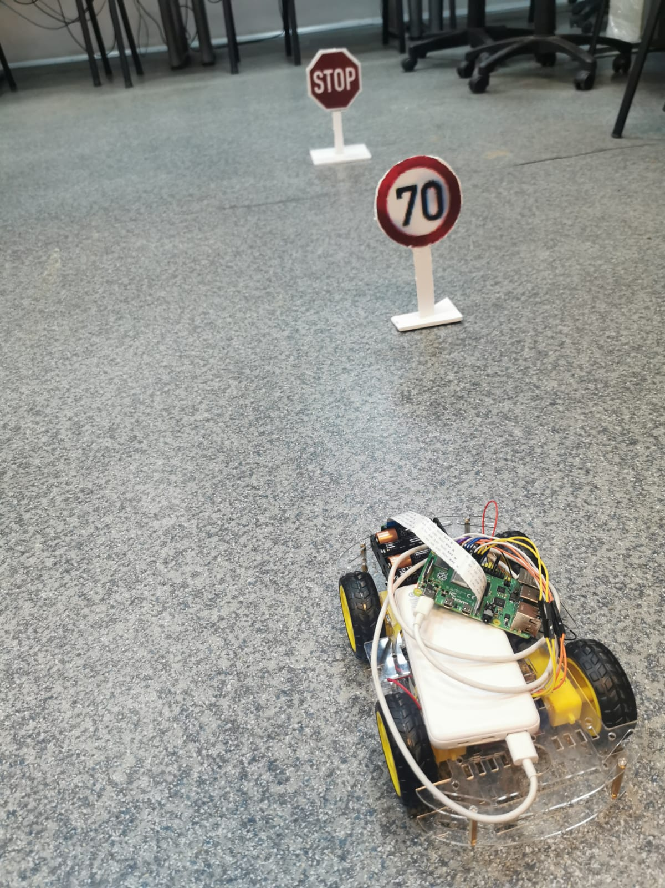
Smart car demo

Slide 7
Thank you

