Slide 1
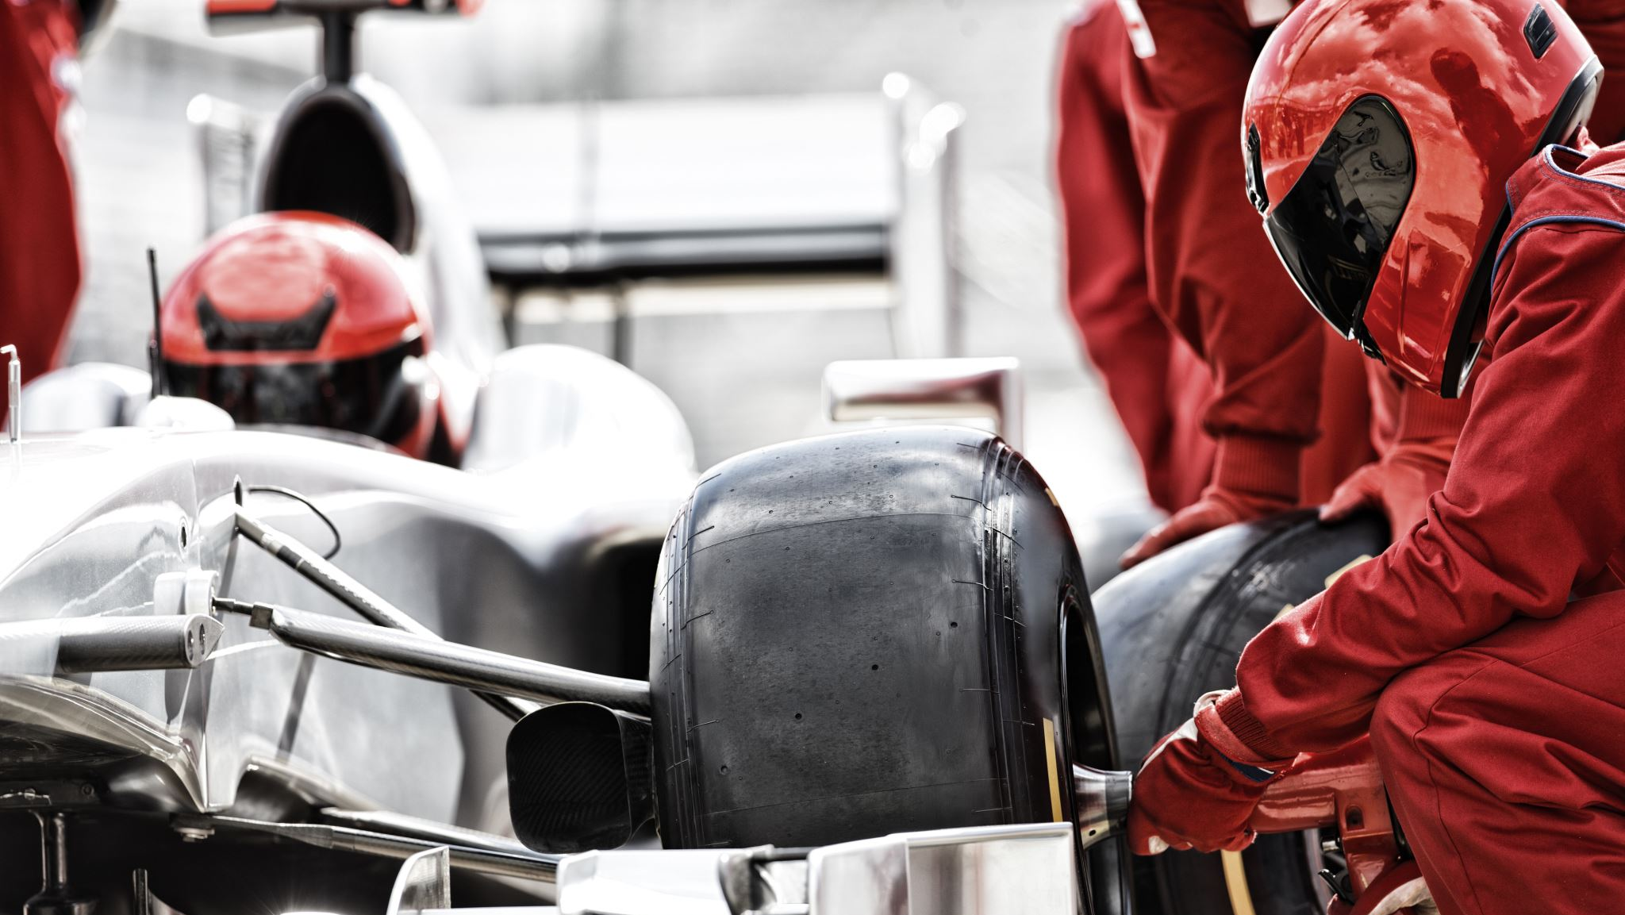
The RC Experience
spoiler: it didn’t go so well...

Slide 2
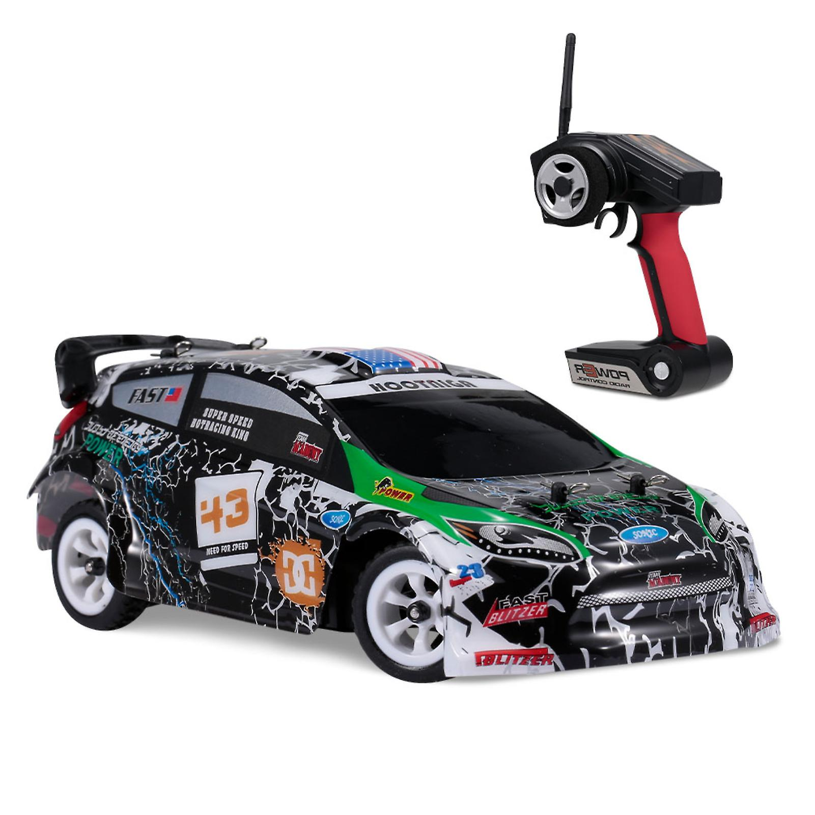





























My Vision
Style
Web Dev
Python
Mechanics
Electronics

Slide 3
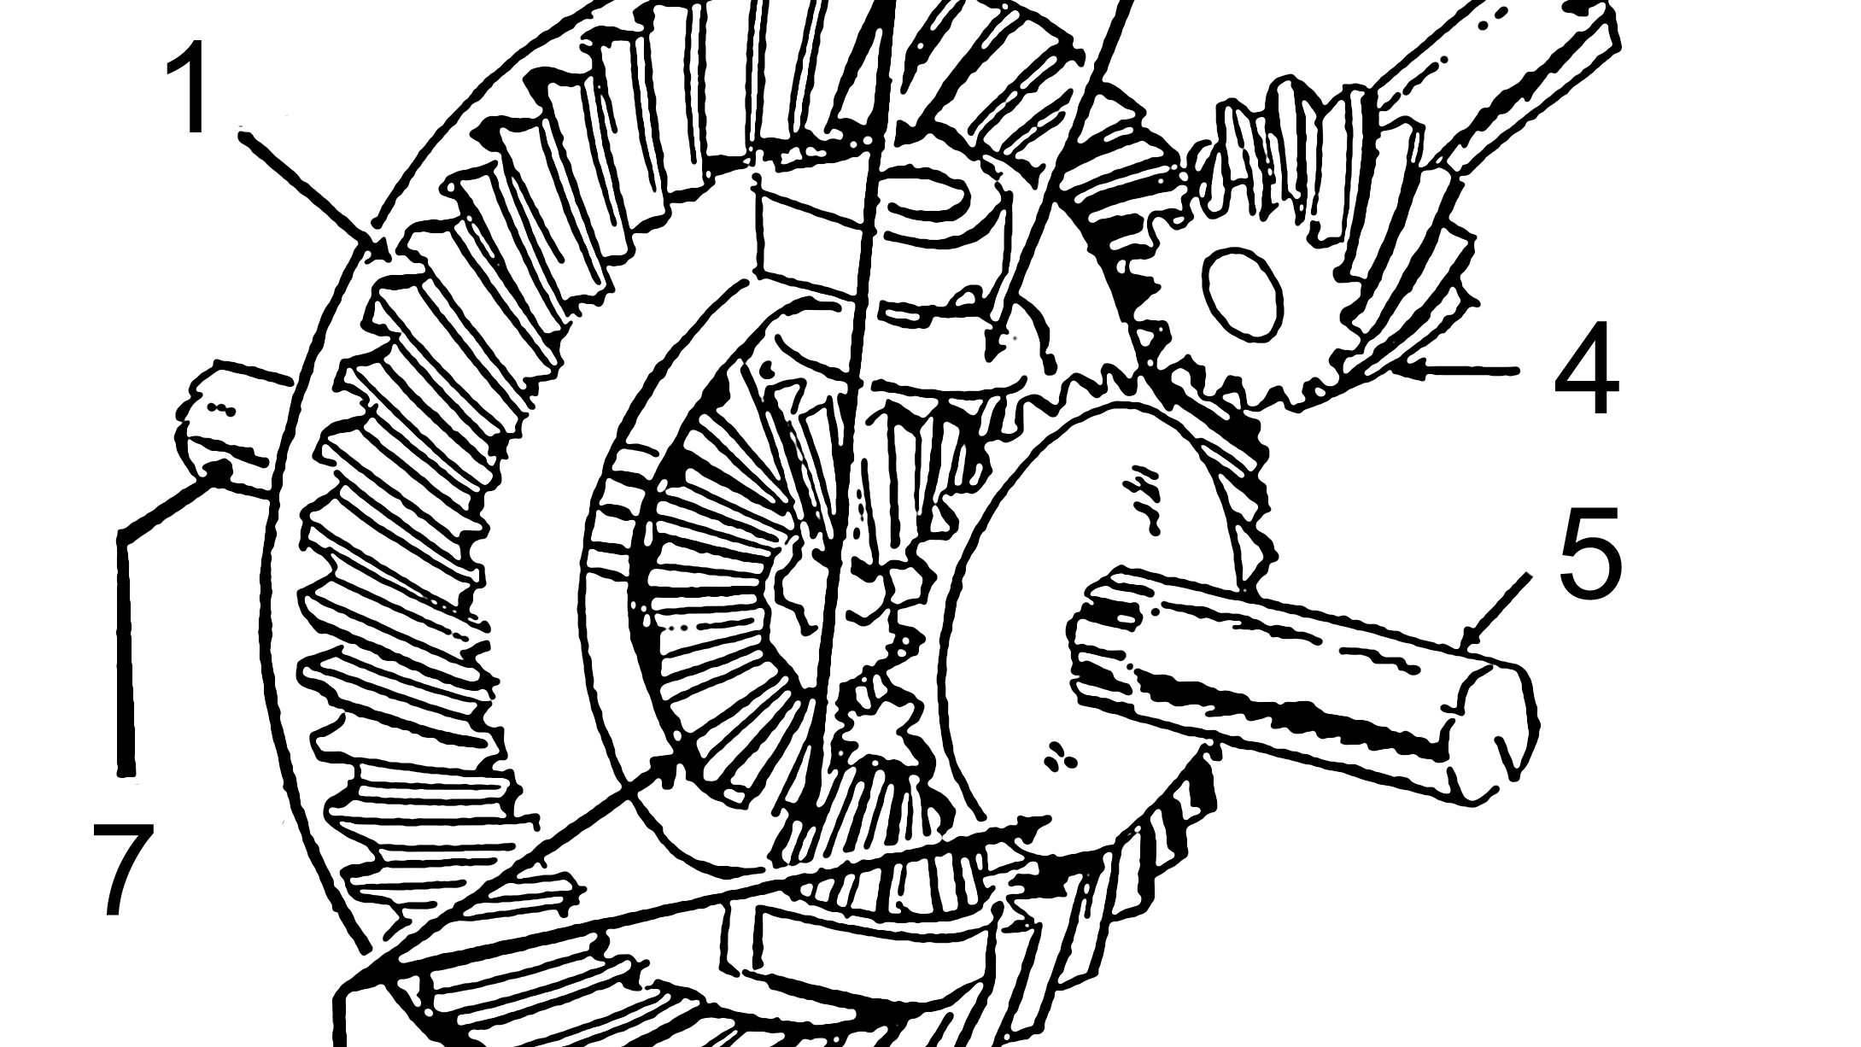

Slide 4
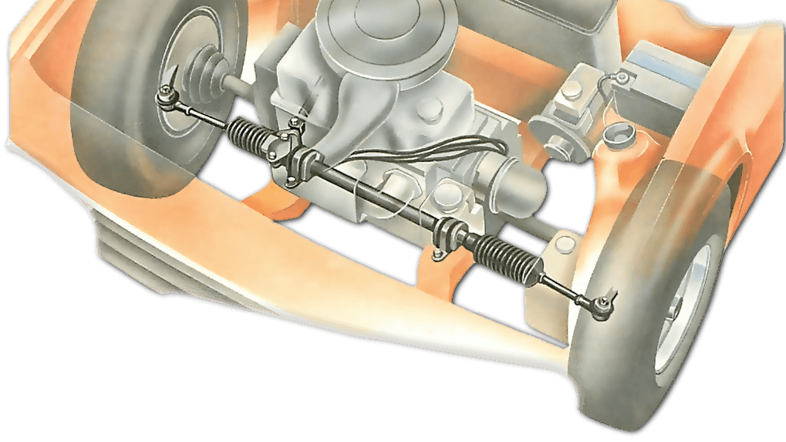

Slide 5
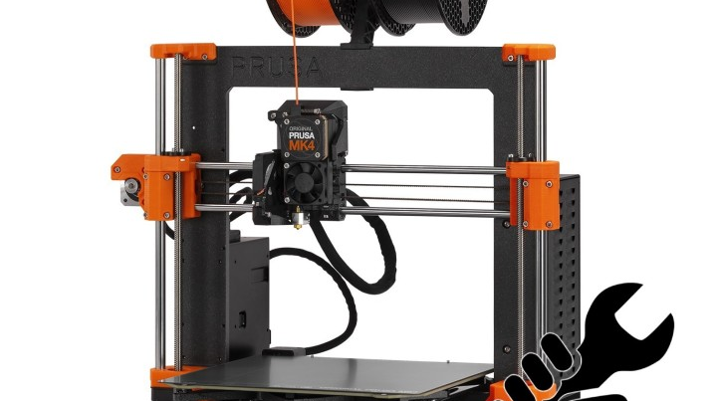

Slide 6
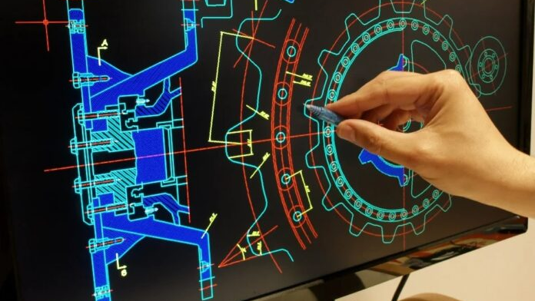

Slide 7










My Vision
Style
Web Dev
Python
Mechanics
Electronics

Slide 8
I failed.

Slide 9

Python
Unfamiliar
Made code
Didn't use it

Slide 10

Web Development
HTML
CSS
JavaScript

Slide 11
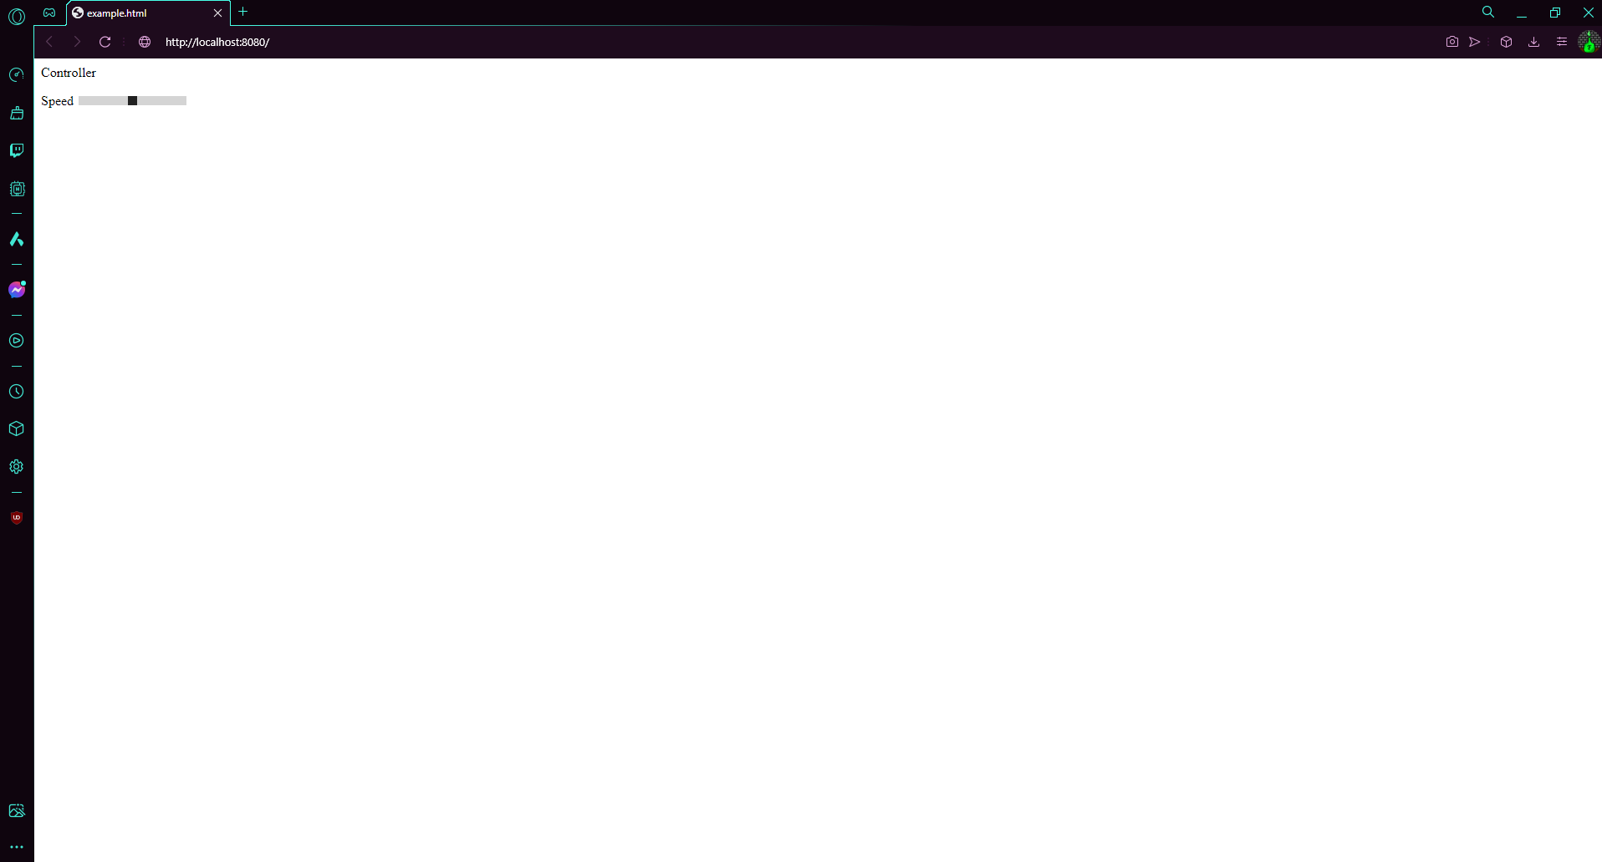
Throttle
Steering
Brake

Slide 13

Electronics
GPIO -> Transistor Switching
12Vcc -> Motor -> Switch
Resistors n stuff

Slide 14
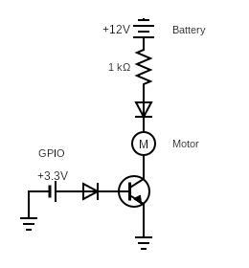

Slide 16
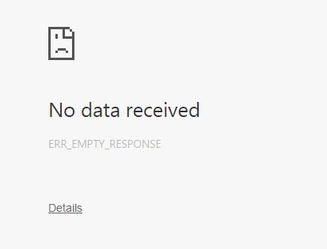

Slide 17
What I Learned
How servers work
Take care w/ bench
Research (Libraries)
Humbling

Slide 18


