Slide 2


Slide 3
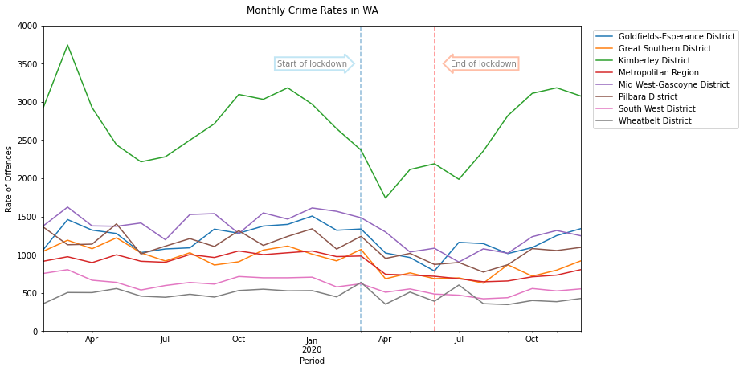
Impact of restrictions on crime in WA
34%
Mid West
14%
Wheatbelt
Majority of Regions experienced a decrease in crime rate

Slide 4
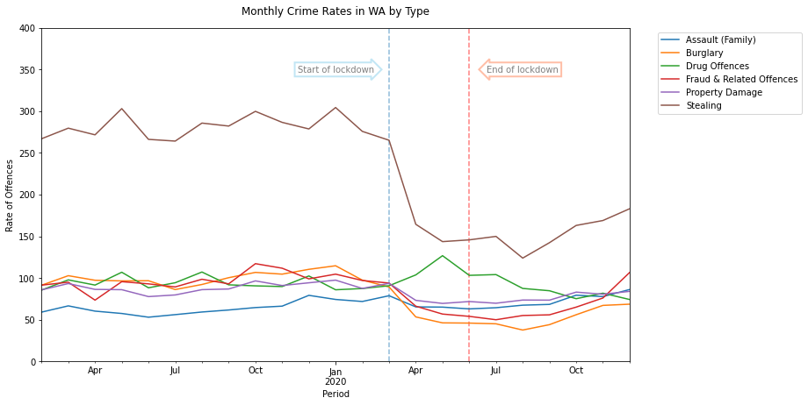
Have all types of crime decreased?
Have all types of crimes decreased?
Most crimes have decreased, stealing had decreased the most (enter %)

Slide 5
What about reports of increased domestic violence?
Selection from 200 Guardian headlines on DV and lockdown
Tuesday briefing: Domestic abuse reports surge amid lockdown
Calls to domestic abuse helpline in England up by 60% over past year
Shock new figures fuel fears of more lockdown domestic abuse killings in UK
Women killed in Spain as coronavirus lockdown sees rise in domestic violence
Fears grow for those facing domestic abuse as England enters second lockdown
Labour urges Patel to act on domestic abuse during lockdown
Lockdown may have played part in rise of domestic child killings, says Met
The worst year': domestic violence soars in Australia during Covid-19

Slide 6
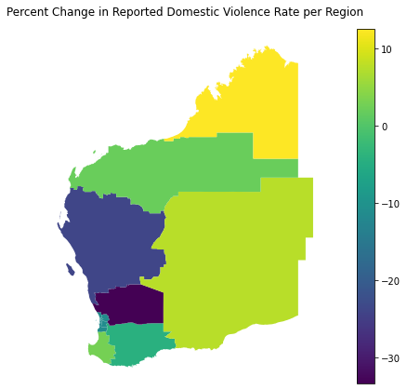
How did Domestic Violence Crime Change in Each Region?
33%
Wheatbelt
12%
Kimberly

Slide 7
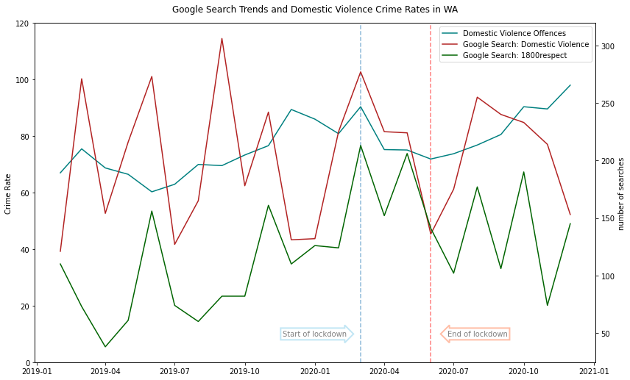
Is this the best indicator for dv?
Are there other indicators of domestic violence?
Google Search Trends
Domestic Violence (Topic)
1800respect (Term)

Slide 8
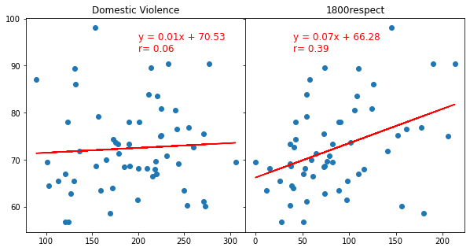
Can these be a surrogate for actual crime rates?
Weak correlation between helpline search and crime rate

