Slide 1

Fern Bradder Sri Vegunta Petra Moyle
Notes:
We first wanted to examine the effects covid related lockdowns had on domestic violence in WA since we have heard of increased trends in news headlines
After an initial search for data we could not find any recent statistics on domestic violence available to us for the WA lockdown period March to June 2020
We decided to look at crime as a whole after finding monthly statics from WAPOL

Slide 2
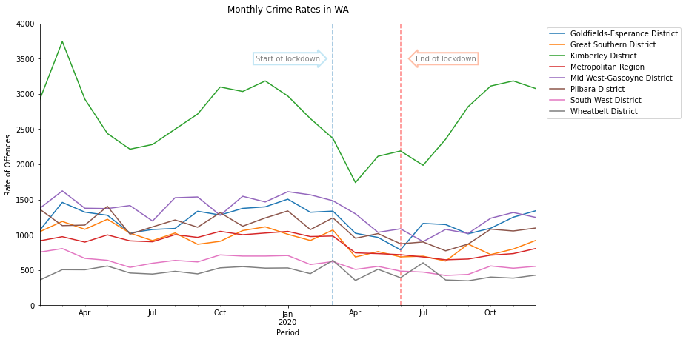
Impact of restrictions on crime in WA
34%
Mid West
14%
Wheatbelt
Majority of Regions experienced a decrease in crime rate
Calculated^{1,2}

Slide 3
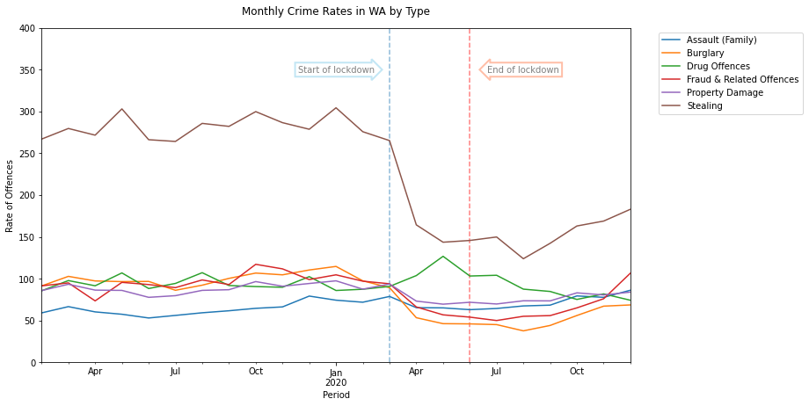
Have all types of crime decreased?
Top 6 most frequently committed crimes
Most crimes have decreased, stealing had decreased the most (enter %)
Calculated^{1,2}

Slide 4
What about reports of increased domestic violence?
Selection from 1000 Guardian headlines on DV and lockdown⁶
Tuesday briefing: Domestic abuse reports surge amid lockdown
Calls to domestic abuse helpline in England up by 60% over past year
Shock new figures fuel fears of more lockdown domestic abuse killings in UK
Women killed in Spain as coronavirus lockdown sees rise in domestic violence
Fears grow for those facing domestic abuse as England enters second lockdown
Labour urges Patel to act on domestic abuse during lockdown
Lockdown may have played part in rise of domestic child killings, says Met
The worst year': domestic violence soars in Australia during Covid-19

Slide 5
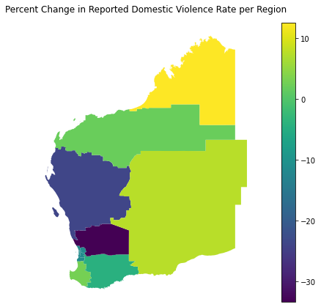
How did Domestic Violence Crime Change in Each Region?
33%
Wheatbelt
12%
Kimberly
Calculated^{1,2}
Map⁵

Slide 6

How can we better observe the problem?
52%
of people experiencing physical assault in 2018 – 2020 made a police report³
54%
of women experiencing domestic violence from a current partner sought help in 2016⁴
29%
of men experiencing domestic violence from a current partner sought help in 2016⁴

Slide 7
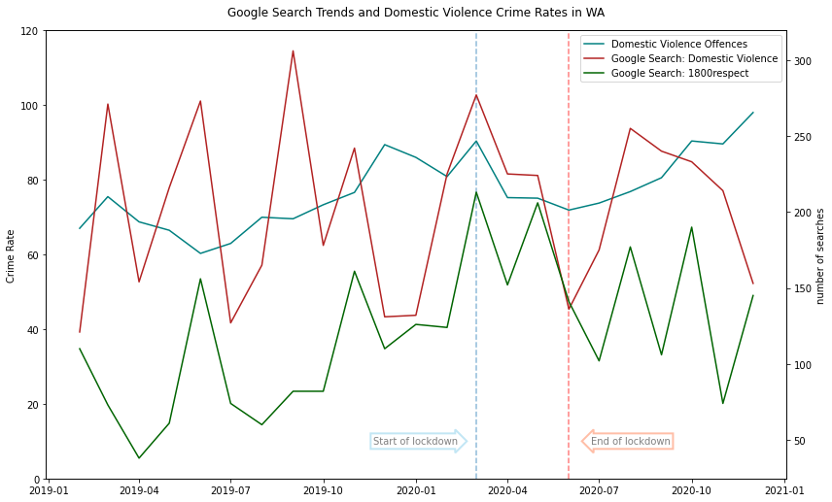
Is this the best indicator for dv?
Are there other indicators of domestic violence?
Google Search Trends⁷
Domestic Violence (Topic)
1800respect (Term)

Slide 8
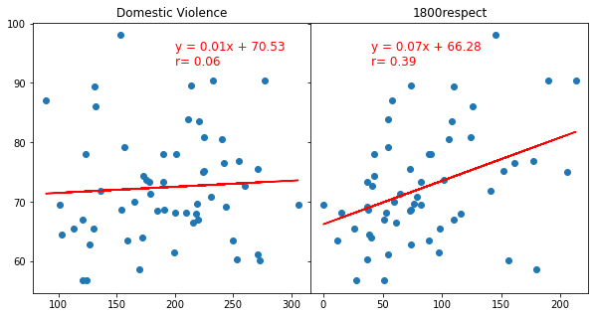
Can these be a surrogate for actual crime rates?
Weak correlation between helpline search and crime rate
Calculated^{1,2,7}

Slide 9
Sources
5. WAPOL District Boundaries - https://catalogue.data.wa.gov.au/dataset/wa-police-district-boundaries
6. The Guardian API – https://open-platform.theguardian.com/
7. Google Trends - https://trends.google.com/trends/?geo=AU
WA crime statistics - https://www.police.wa.gov.au/Crime/CrimeStatistics#/
WA Parliamentary Library - https://profile.id.com.au/wapl/population-estimate?BMID=40
ABS Crime Victimisation Report - https://www.abs.gov.au/statistics/people/crime-and-justice/crime-victimisation-australia/latest-release
ABS Personal Safety Report – https://www.abs.gov.au/statistics/people/crime-and-justice/personal-safety-australia/latest-release

Slide 10
Jupyter Notebooks

