Slide 1
RPG-Progression
Juan Fernando Almendro Martí

Slide 2
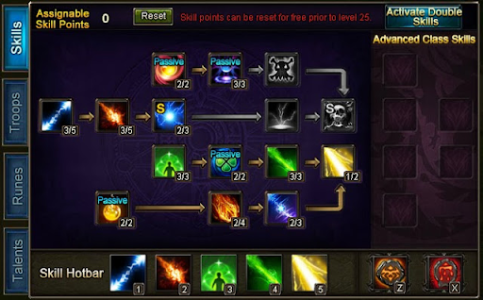
RPG Progression systems
Progression system objective
Make the player not detect the game loop
Avoid the feeling of repetition
Long-term decisions
Balanced progression

Slide 3
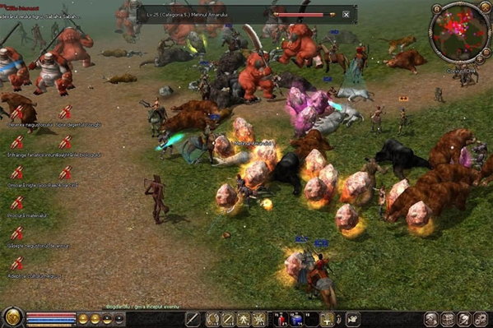
RPG Progression systems
How does a bad progression system look like?
Feeling of repetition
Skinner box
Grinding

Slide 4
RPG Progression systems
What is a progression system and why is it important?
No progression = frustration
Good progression system means an enjoyable game

Slide 5
RPG Progression systems
What does progression apport?
Feeling of having the game under control
Clear goals
Immediate and constant feedback
Balance between challange and skills

Slide 6
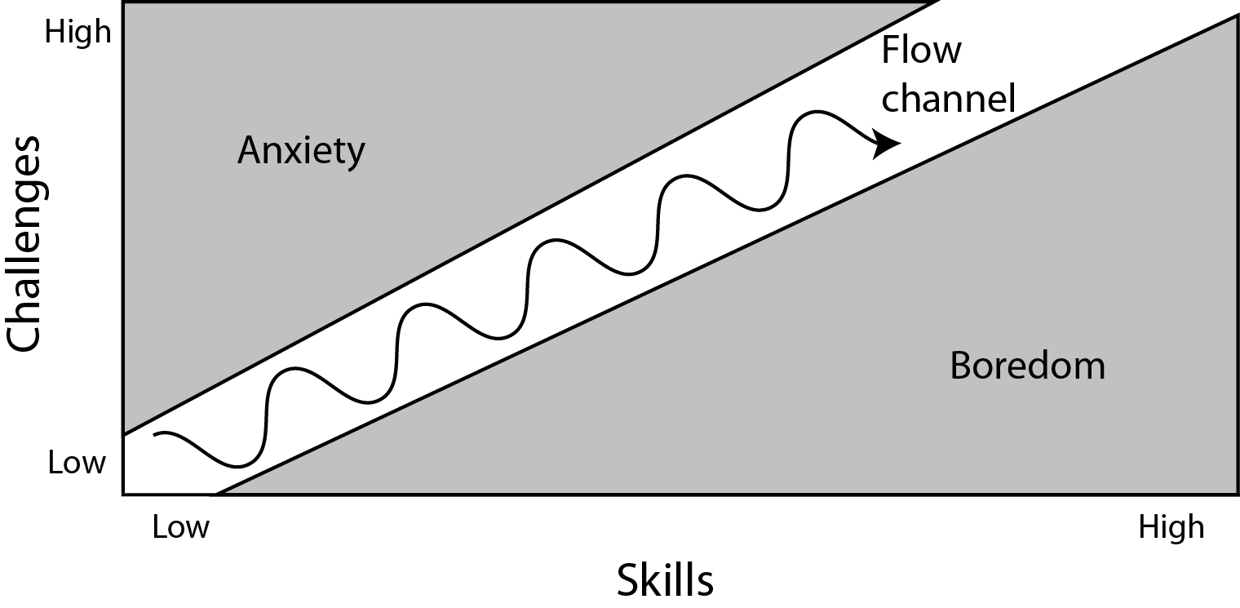
What makes a good progression system
Mistery
Mastery
Mental challenge
Narrative
Novelty
New content
Flow

Slide 7
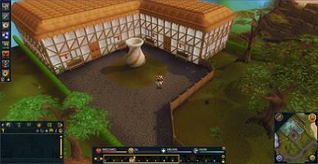
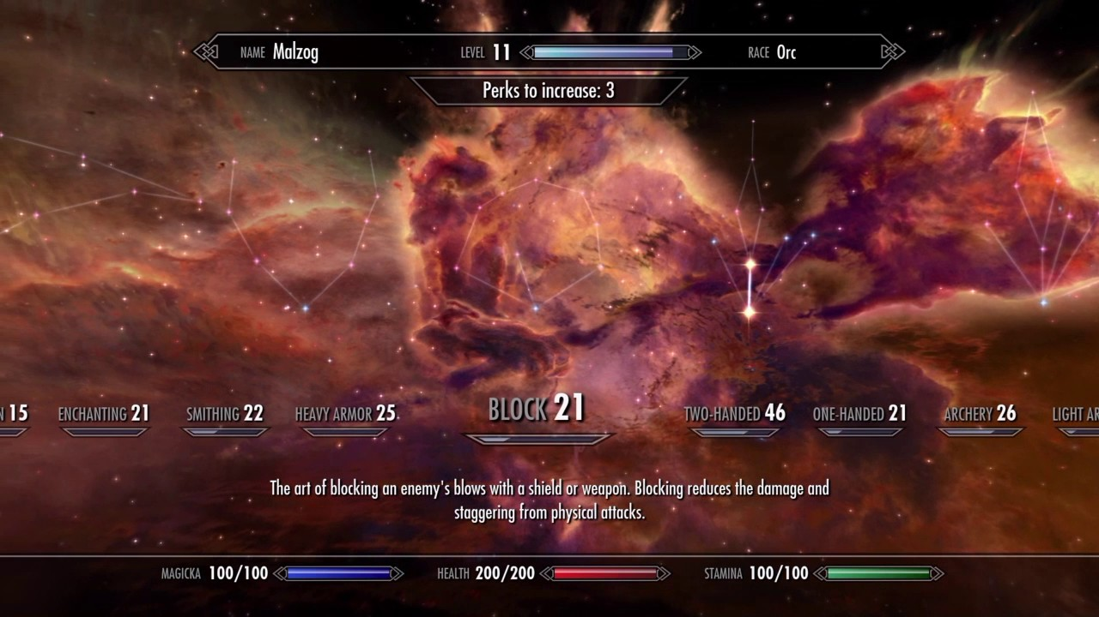
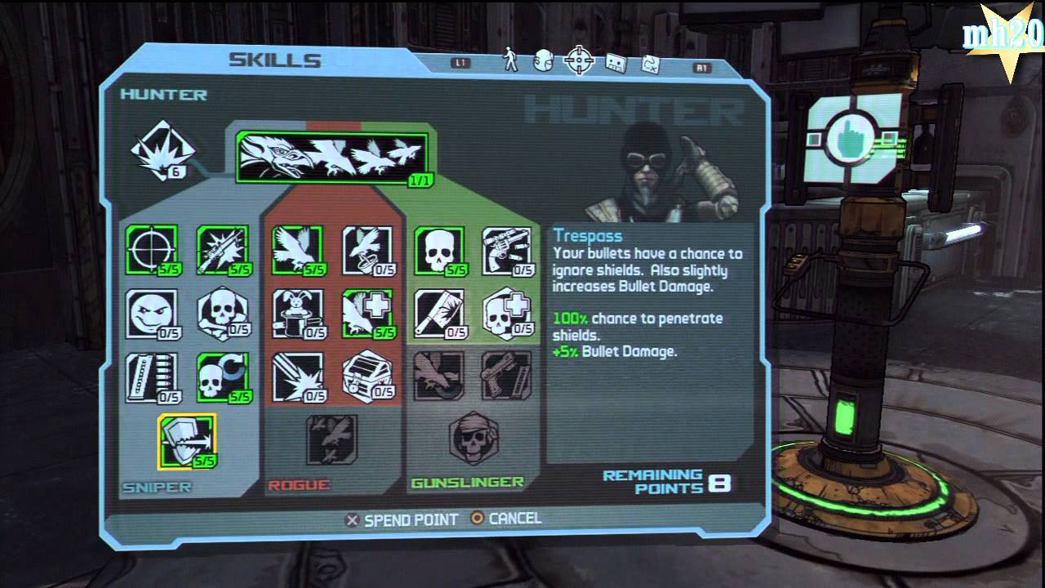
Types of progression system
Level based progression
Training/Playstyle progression
Skill points progression

Slide 8
TO DO 1
In groups, think in an RPG that you like and identify the progression elements

Slide 9
Mathematics in RPG Progression
Progression is about numbers
Most common system is “XP”
There is no only formula
Example:
points_required_to_level_up=(15*level)+(9(level-1))

Slide 10
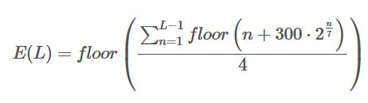
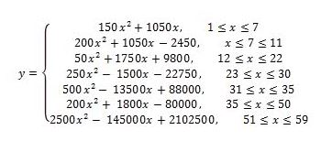
Game examples
Runescape: Diablo:
Wow

Slide 11
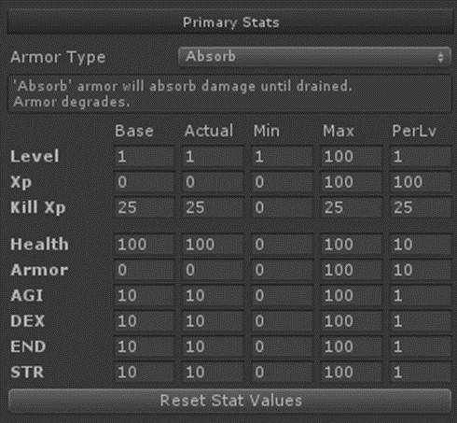
Balancing issues
A perfect balancing is almost impossible
Start from pre production
Strong testing
Game tunning

Slide 12
TODO 2
With your groups, discuss the progression that you would like to implement in your game

Slide 13
Thanks for your attention!

