Slide 1
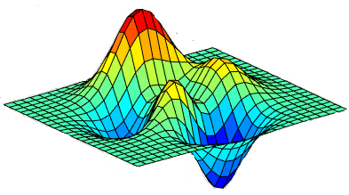
Mathematical modeling to describe 2G ethanol production processes using non-Saccharomyces and genetically modified yeasts
PhD. Candidate: Fernan David Martinez
University State of Campinas
Brazilian Biorenewables National Laboratory (LNBR)
Advisor: Aline Carvalho da Costa
Co-advisor: Jaciane Lutz Ienczak
Co-advisor: Edvaldo Rodrigo de Morais

Slide 2
Introduction
E1G
E2G
Approximately 150 tons of lignocellulosic biomass could be used to generate 49.1×10⁹ L of bio-ethanol.
20

Slide 3
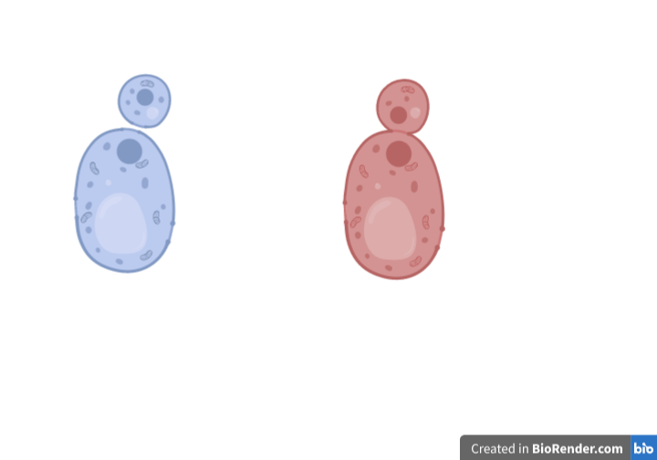
Modelling and simulation
Kinetic models unsegregated and unstructured are the most used
Ideal conditions model
Product inhibition
Substrate inhibition
(Monod, 1949)⁠
(Ghose and Tyagi, 1979)⁠
(Andrews, 1968)⁠
Substrate inhibition
Substrate inhibition
Substrate inhibition
(Edwards, 1970)⁠
(Luong, 1987; Edwards, 1970)⁠⁠
(Wayman and Tseng, 1976)⁠
20

Slide 4
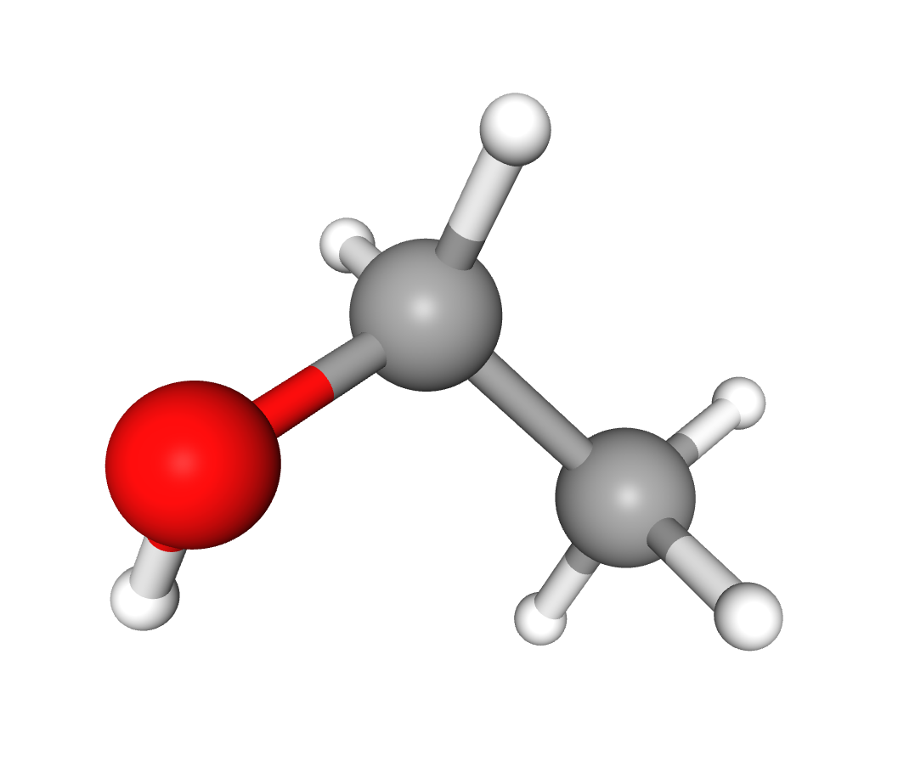
Modelling and simulation
Kinetic models unsegregated and unstructured are the most used
(Monod, 1949)⁠
(Edwards, 1970)⁠
(Edwards, 1970)⁠
(Luong, 1987)⁠
Substrate for growth
Substrate for production
Substrate for maintenance
20

Slide 5
Modelling and simulation studies
There are no models to describe fermentation process using two carbohydrates and S. passalidarum;
There are no models to recombinant S. cerevisiae with greater than two carbohydrates.
Carbohydrates | Product | Yeast | GMO | Reference
Glucose | Ethanol | S. cerevisiae | No | Ccopa Rivera et al., (2017)⁠
Sugarcane molasses | Ethanol | S. cerevisiae M30 | No | Phisalaphong et al., (2006)
Sugarcane molasses | Ethanol | S. cerevisiae | No | Andrade et al., (2007)
Glucose and fructose | Ethanol | S. cerevisiae CCA008 | No | Pinheiro et al. (2017)
Sugarcane molasses | Ethanol | S. cerevisiae | No | Ccopa Rivera et al., (2007)
Glucose and Xylose | Ethanol | S. cerevisiae 1400 (pLNH33) | Yes | Krishnan et al., (1999)
Glucose, fructose and sucrose | Ethanol | S. cerevisiae M201022 | No | Wang et al., (2004)
Xylose | Ethanol | S. stipitis NRRL Y-7124 | No | Slininger et al., 2014)
Xylose | Ethanol | S. stipitis | No | Farias et al., (2014)
Glucose | Ethanol | B. custersii CBS 5512 | No | Philippidis et al., (1992)
Glucose, celobiose and xylose | Ethanol | C. lusitaniae NRRL 5394 | No | Kwon et al., (2005)
20

Slide 6
Modelling and simulation
Differential evolution algorithm have been applied in parametric determination problems
Process | Application | Reference
Reactors and fermentation | Estimation of Monod model parameters of a bioreactor | Chiou and Wang (2001)
 | Estimation of kinetic parameters of the ethanol fermentation process | Wang et al. (2001)
 | Feed batch fermentation | Kapadi and Gudi (2004)
Thermal engineering | Optimal design of an ammonia synthesis reactor | Babu et al. (2004)
 | Optimal design of shell and tube heat exchanger | Babu and Munawar (2001)
 | Heat exchanger network design | Babu and Angira (2006)
Fuel engineering | True boiling point curve of crude oil; effect of pressure on entropy | Chen et al. (2002)
 | Estimation of optimal time of pyrolysis and heating rate | Babu and Chaurasia (2003)
 | Alkylation process optimization | Angira and Babu (2006)
Source: Dragoi, et al. 2016

Slide 7
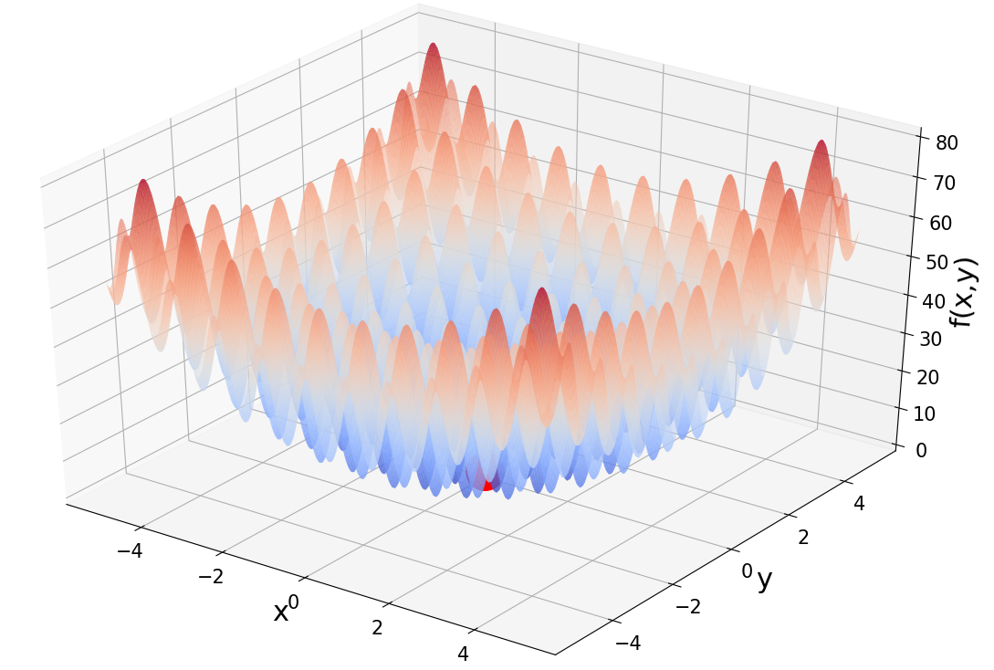
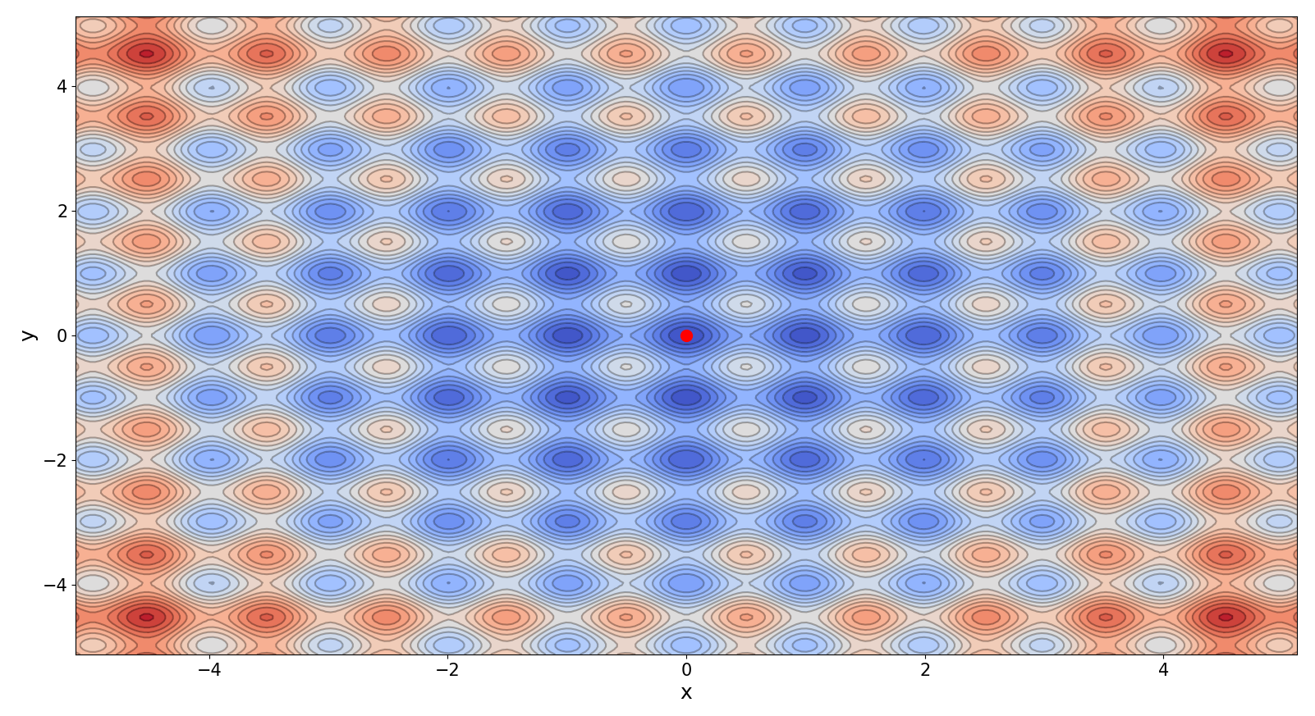
Modelling and simulation:
Differential evolution working on Rastrigin function
Global minimum
y
x

Slide 8
Modelling and simulation:
Differential evolution working on Rastrigin function
Global minimum

Slide 9
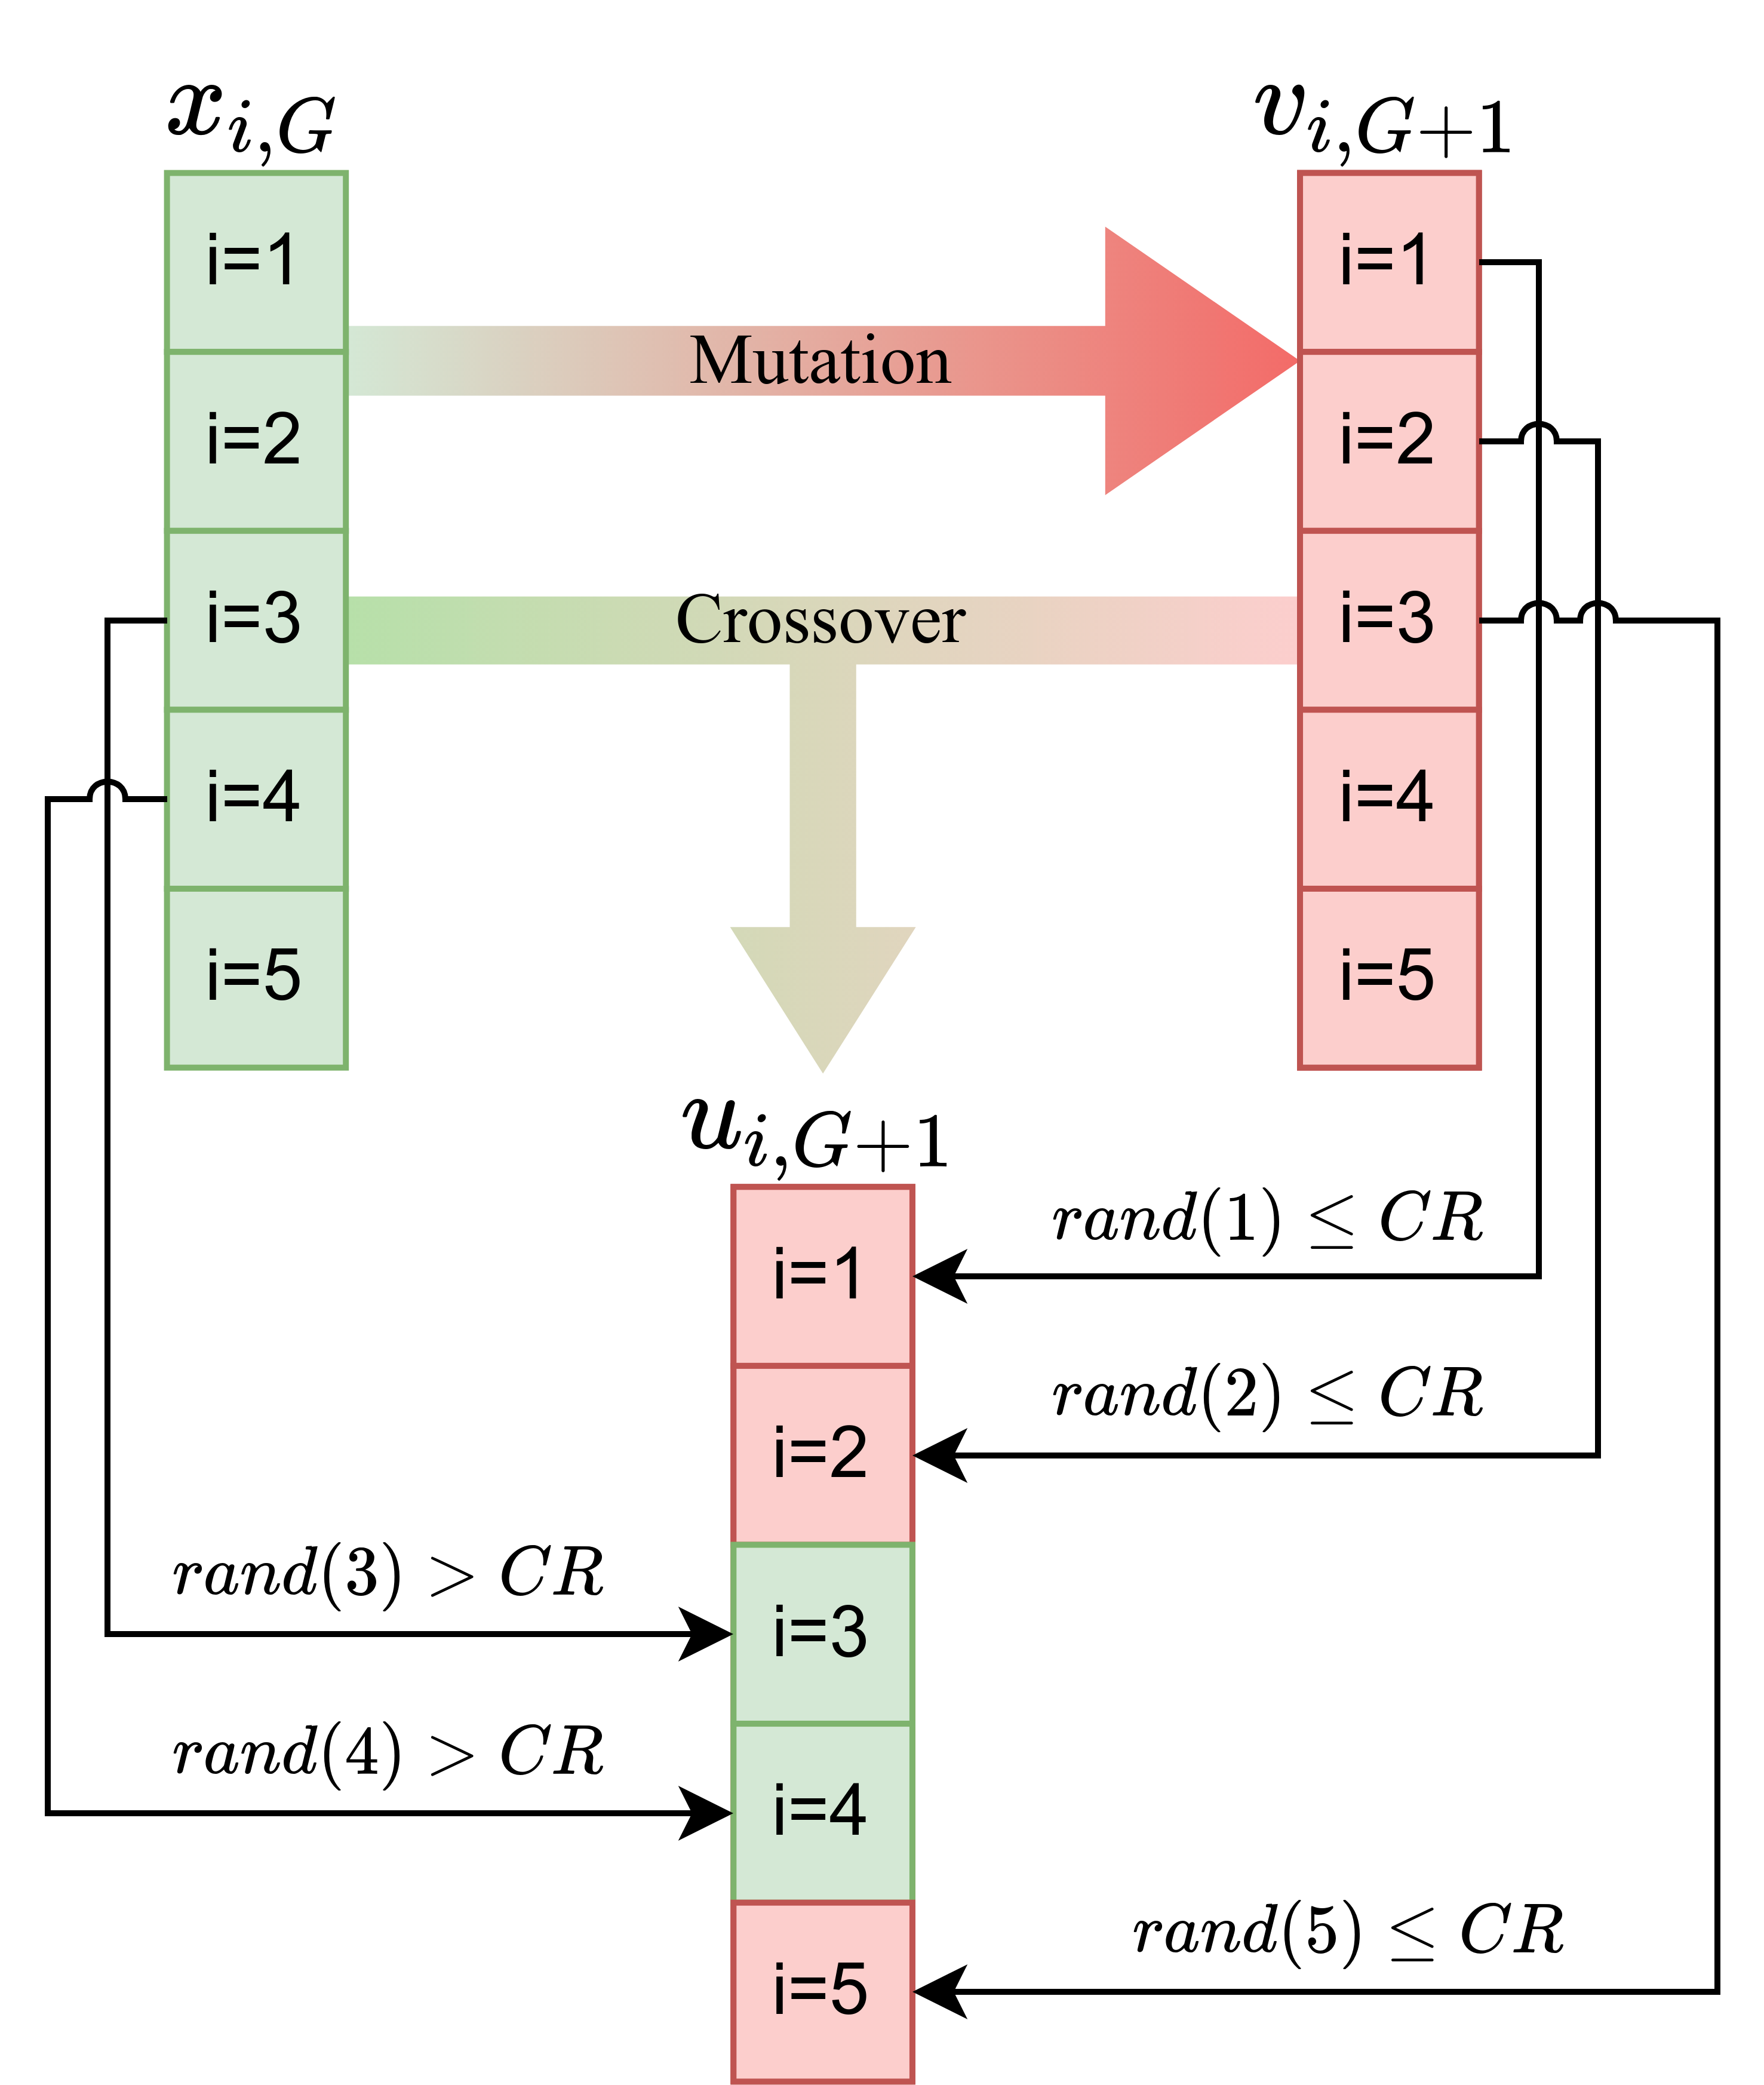
Modelling and simulation
Differential evolution
Initialization
Mutation
Crossover
Source: Storn and Price, 1997

Slide 10
Modelling and simulation
Differential evolution
Source: Storn and Price, 1997

Slide 11
Modelling and simulation
Differential evolution
https://docs.scipy.org/doc/scipy/reference/generated/scipy.optimize.differential_evolution.html

Slide 12
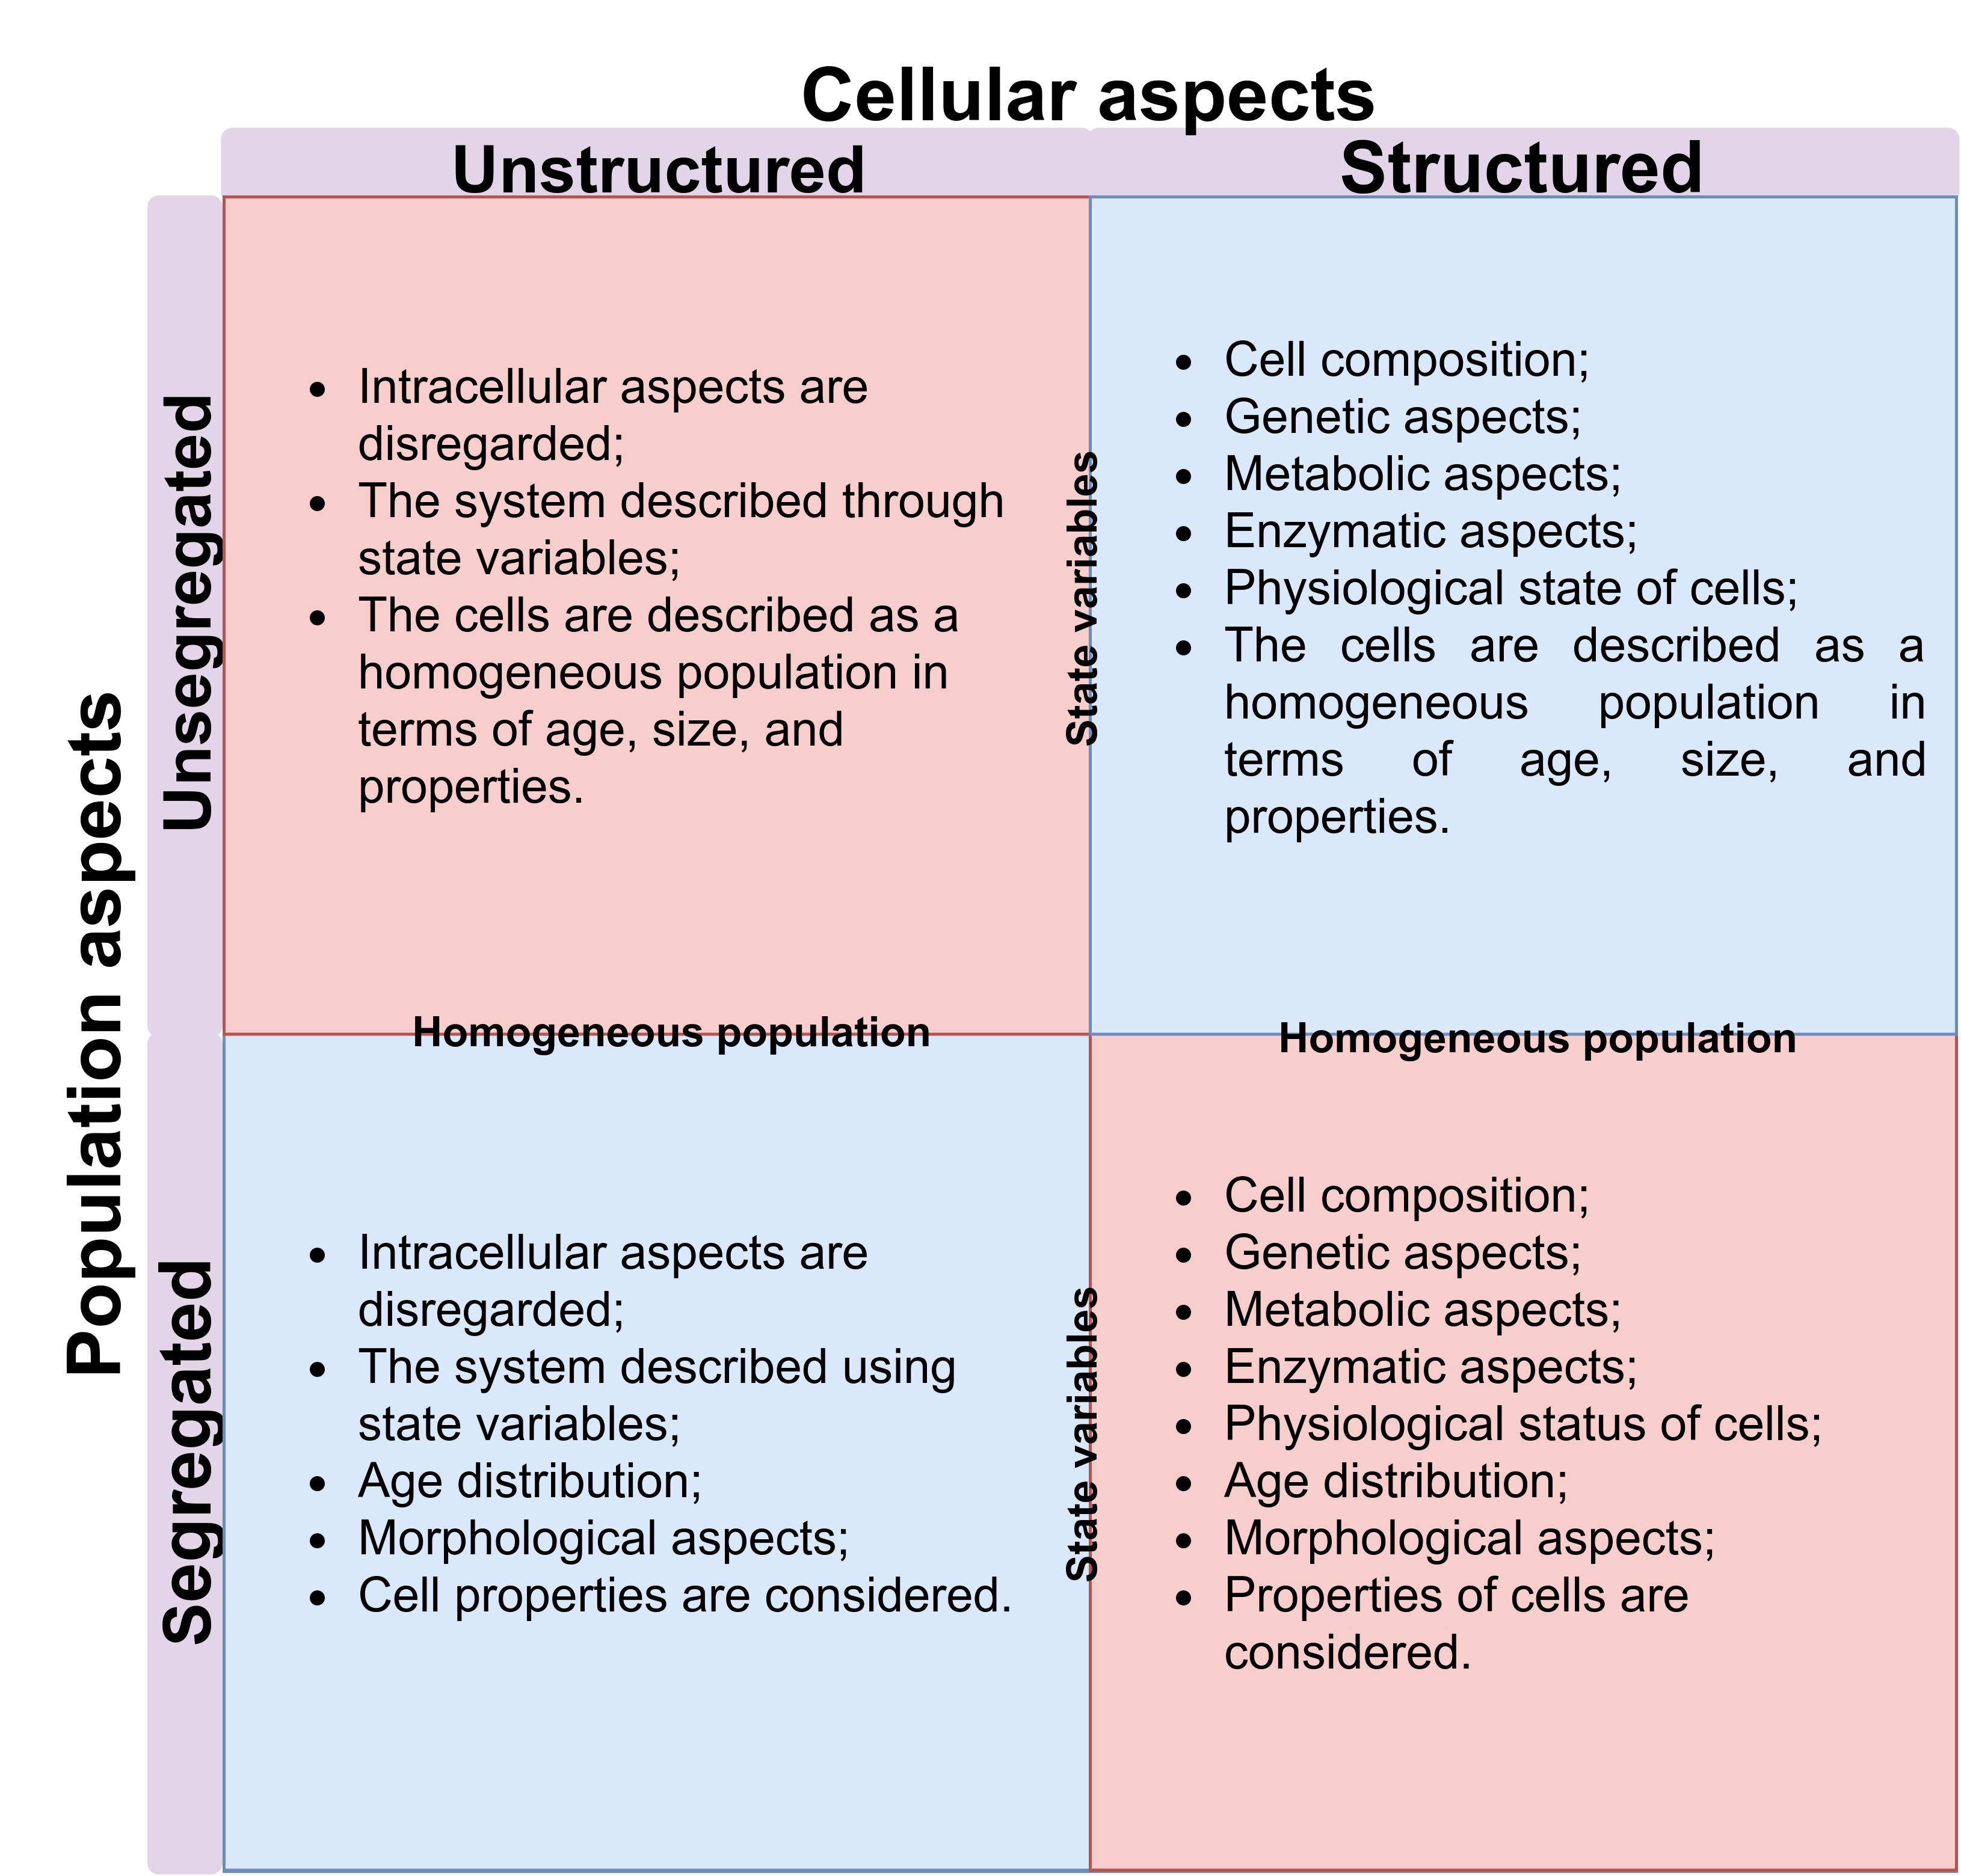
Modelling and simulation
Kind of kinetic modells

Slide 13

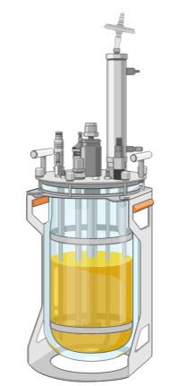
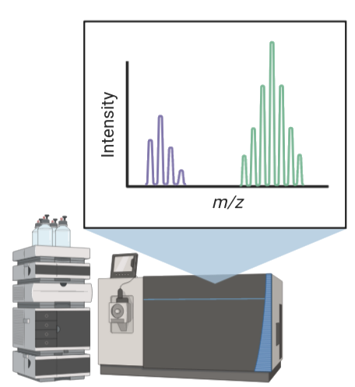
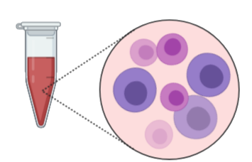
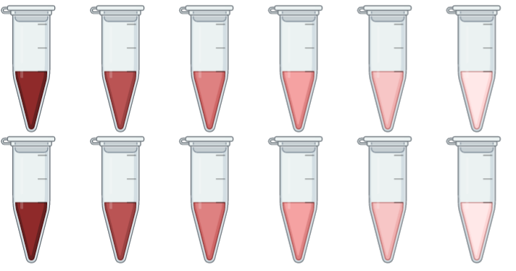

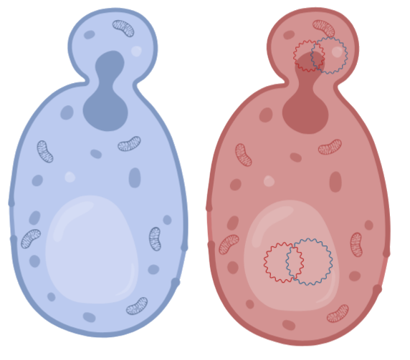
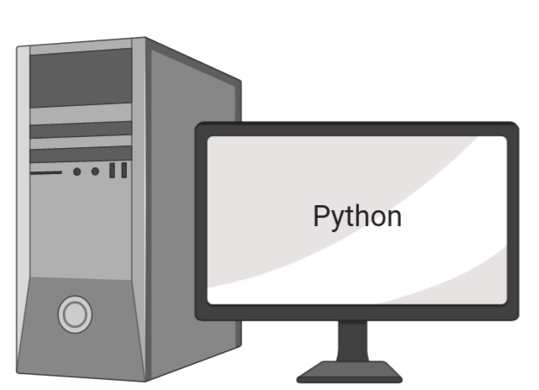
Chapter IV Materials and methods
Fermentation S. passalidarum
Culture medium (Glucose and xylose)
Stock cell -80 °C
Fermented medium
Analytical determination
Propagation
High cell density
30 °C
Data analysis
Fermentation process

Slide 14
Chapter IV Materials and methods
Kinetic model S. passalidarum

Slide 15
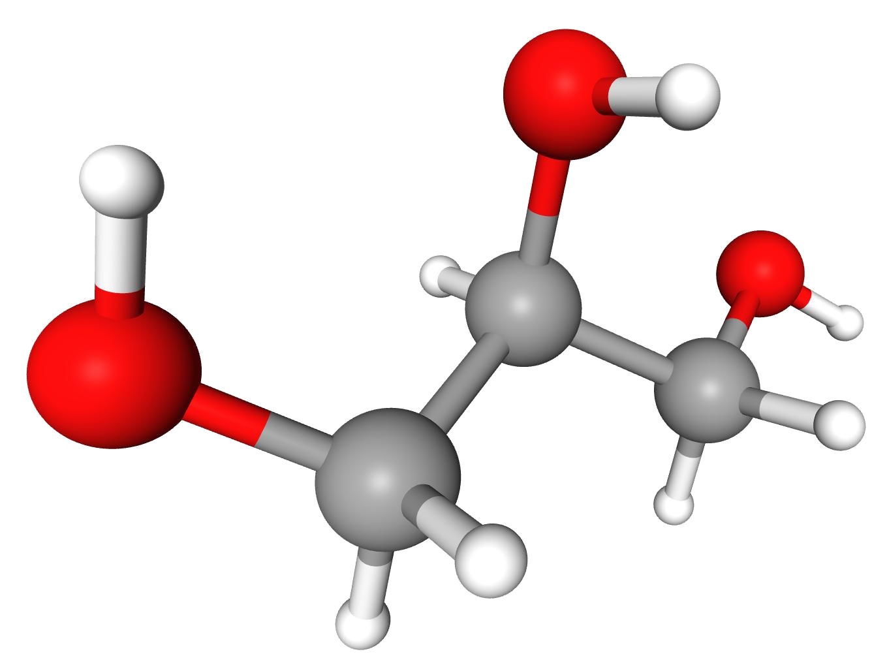
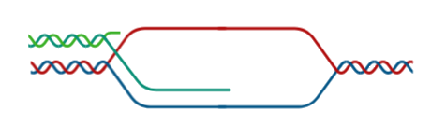
Chapter IV Materials and methods
Kinetic model S. cerevisiae MP-C5H1

Slide 16
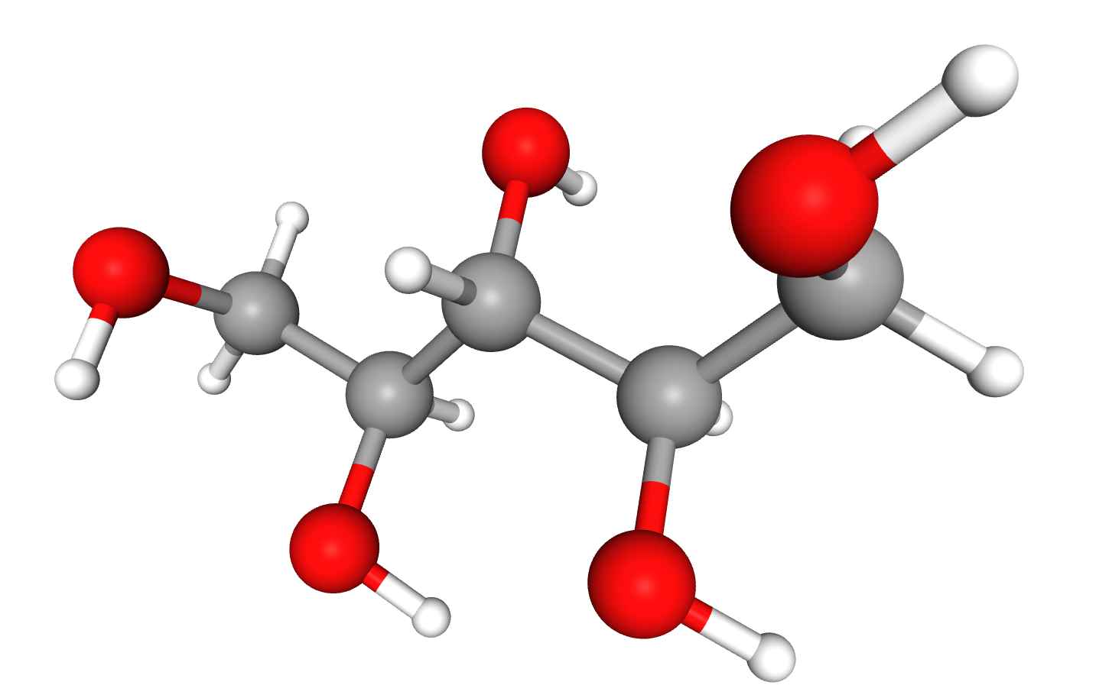
Chapter IV Materials and methods
Kinetic model S. cerevisiae MP-C5H1

Slide 17
Chapter IV Materials and methods
Likelihood confidence region
(Schwaab, et al. 2008)
Objective function

Slide 18
Chapter IV Results.
The objective function stabilized after 10⁴ iterations
S. passalidarum 20% glucose, 80 % xylose and 60 gRS·L⁻¹
S. passalidarum 60% glucose, 40 % xylose and 60 gRS·L⁻¹
S. Passalidarum 20% glucose, 80 % xylose and 90 gRS·L⁻¹
S. passalidarum 60% glucose, 40 % xylose and 90 gRS·L⁻¹
Recombinant S. Cerevisiae MP-C5H1 30 % C6, 70 % C5 and 0.28 gcell·L⁻¹
Recombinant S. Cerevisiae MP-C5H1 30 % C6, 70 % C5 and 10.95 gcell·L⁻¹
Recombinant S. Cerevisiae MP-C5H1 30 % C6, 70 % C5 and 30.25 gcell·L⁻¹
a
b

Slide 19
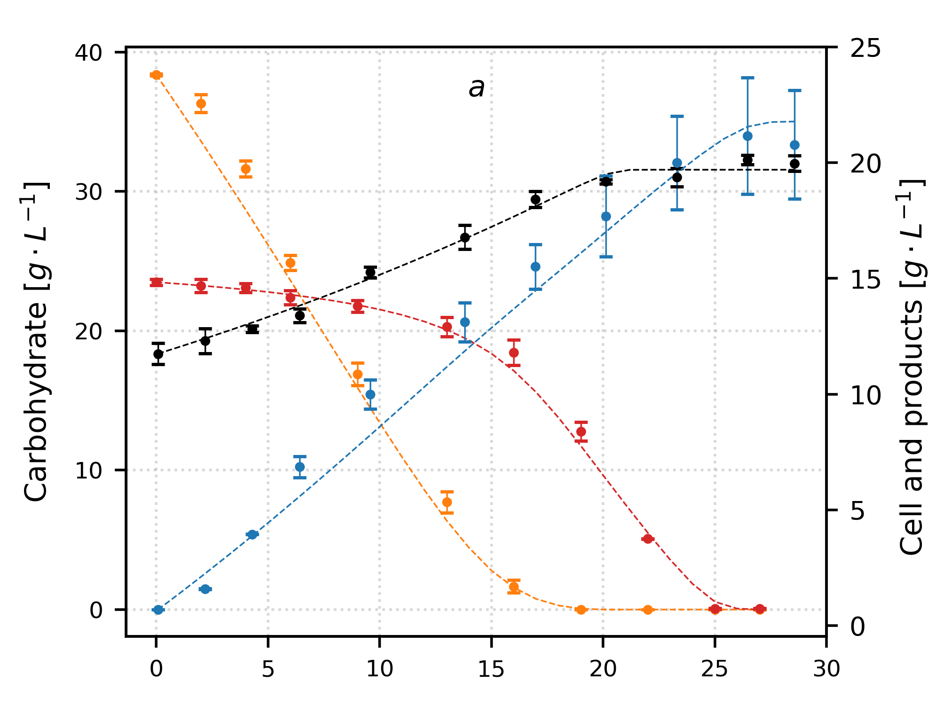
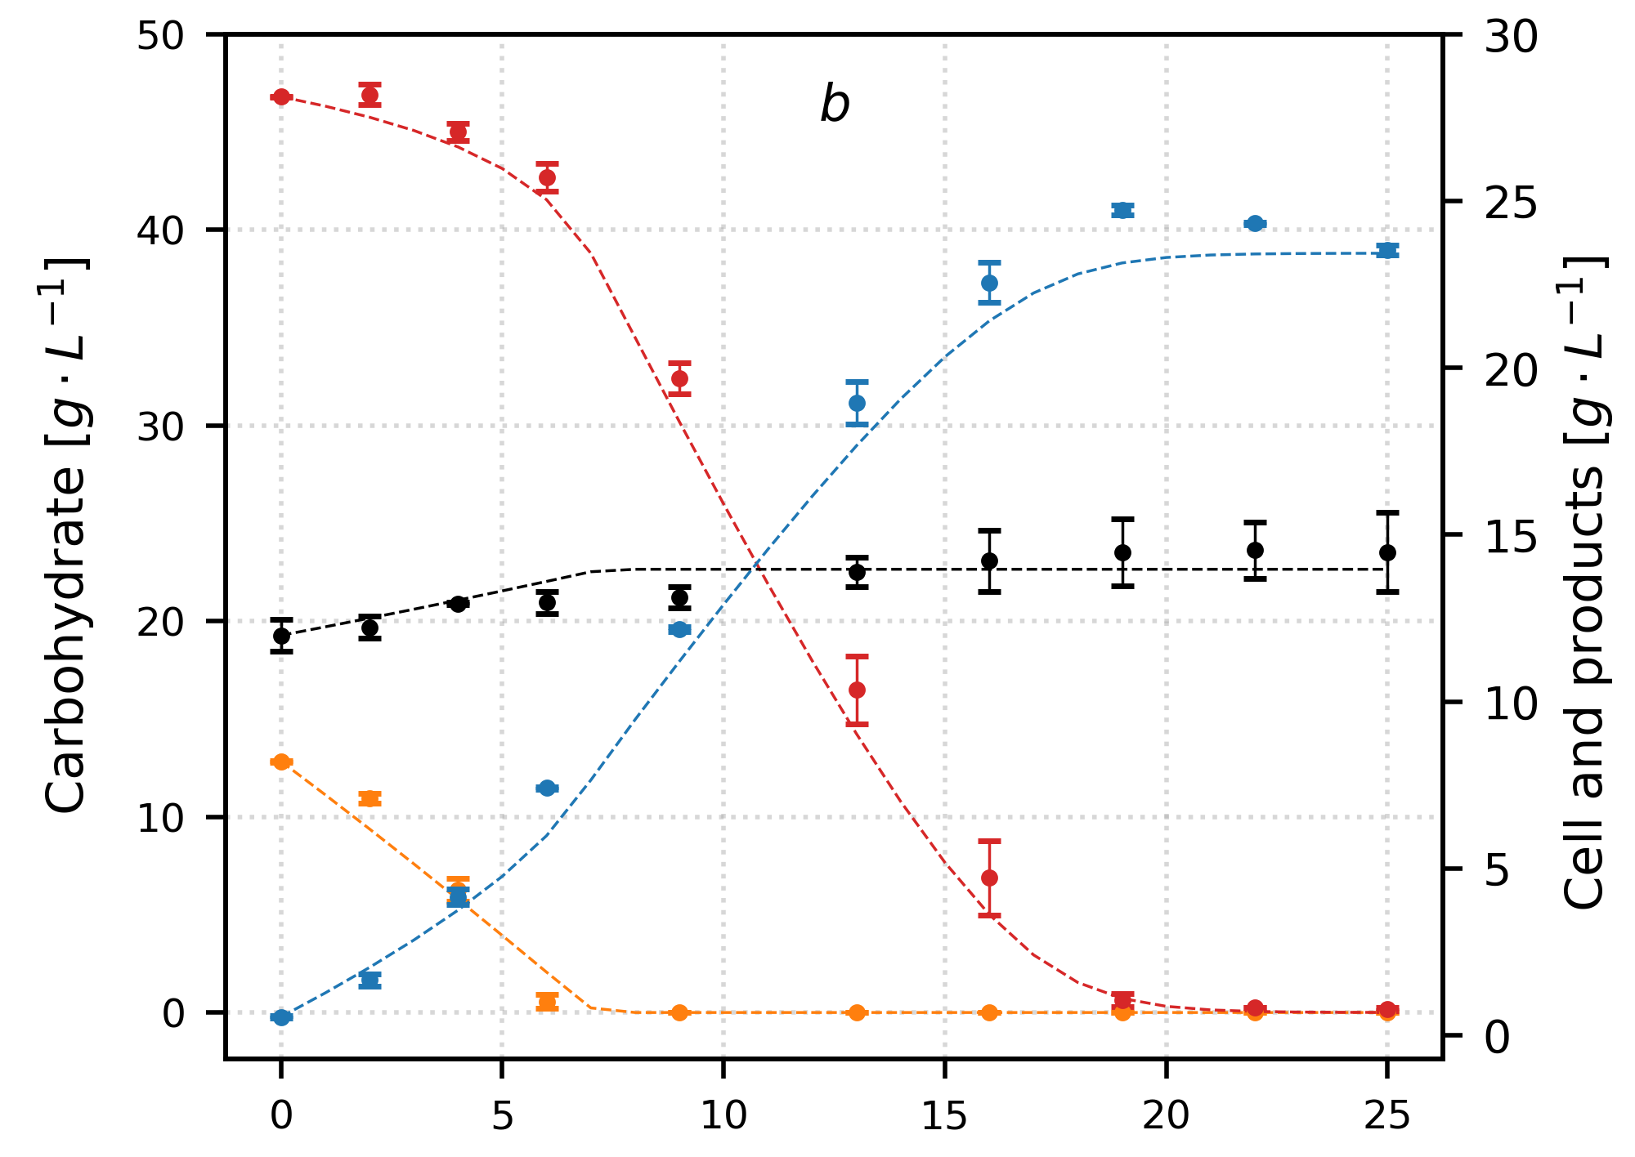
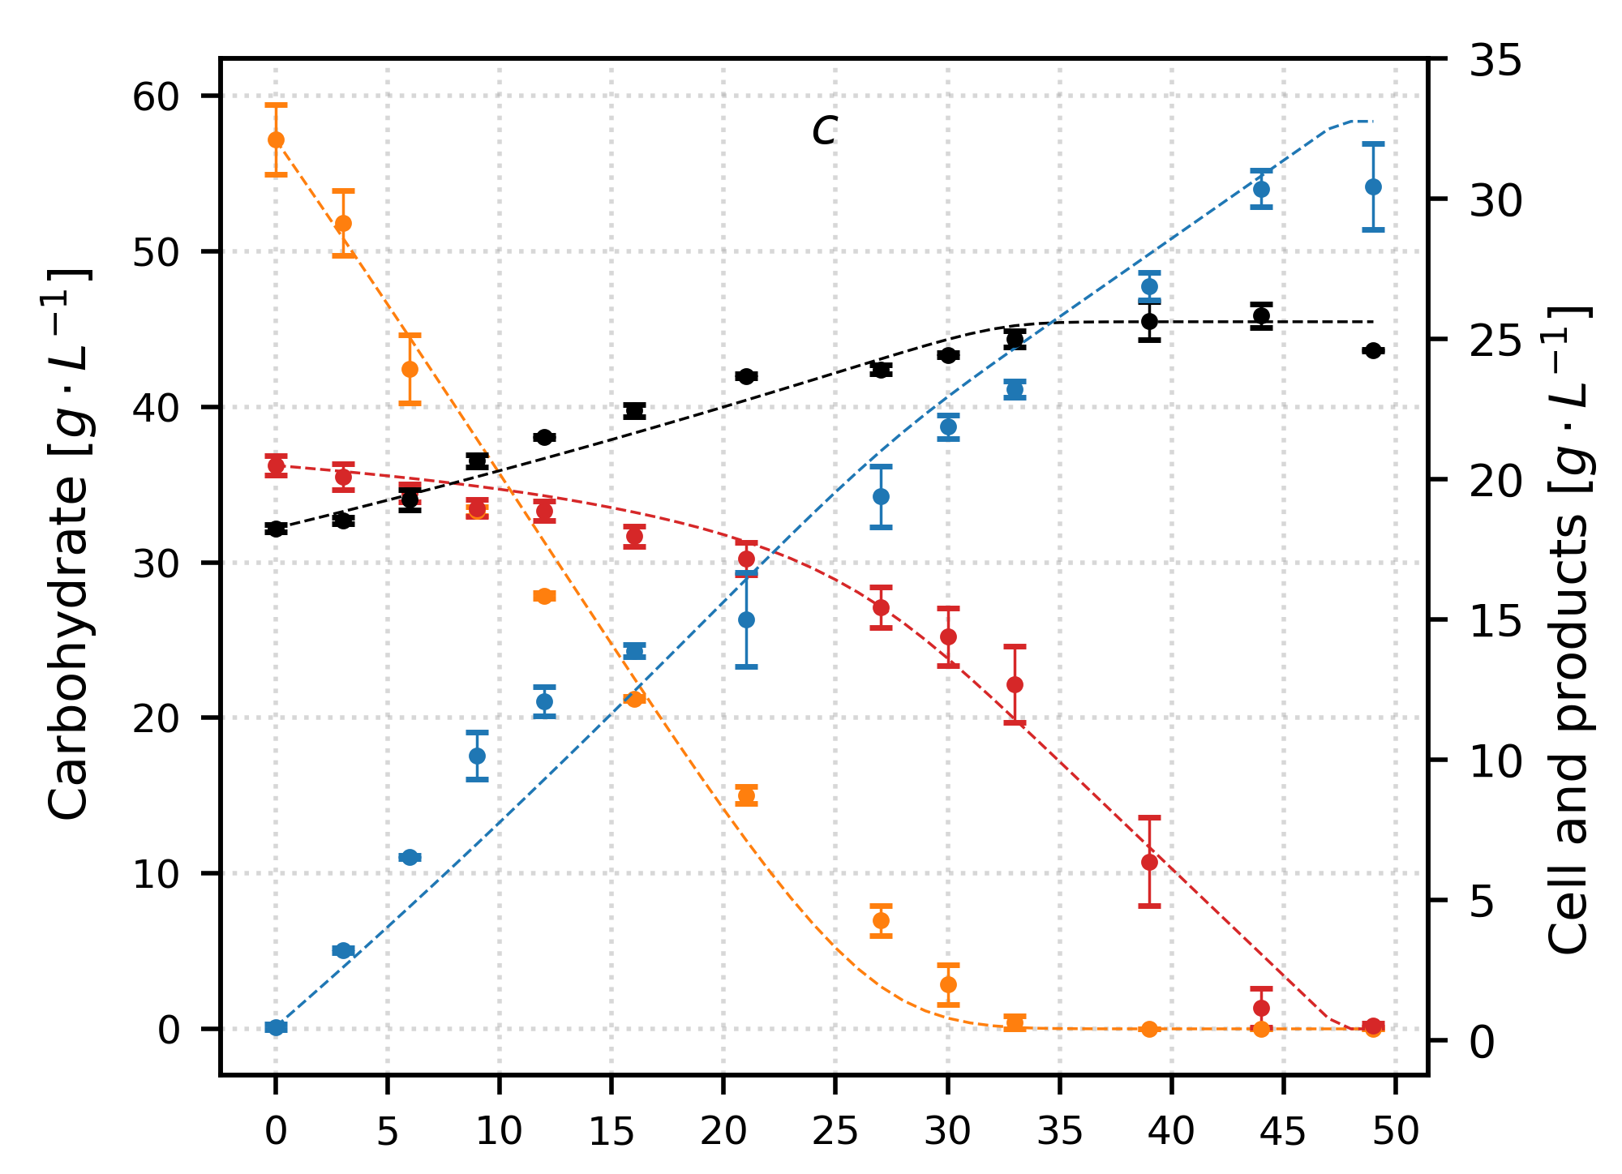
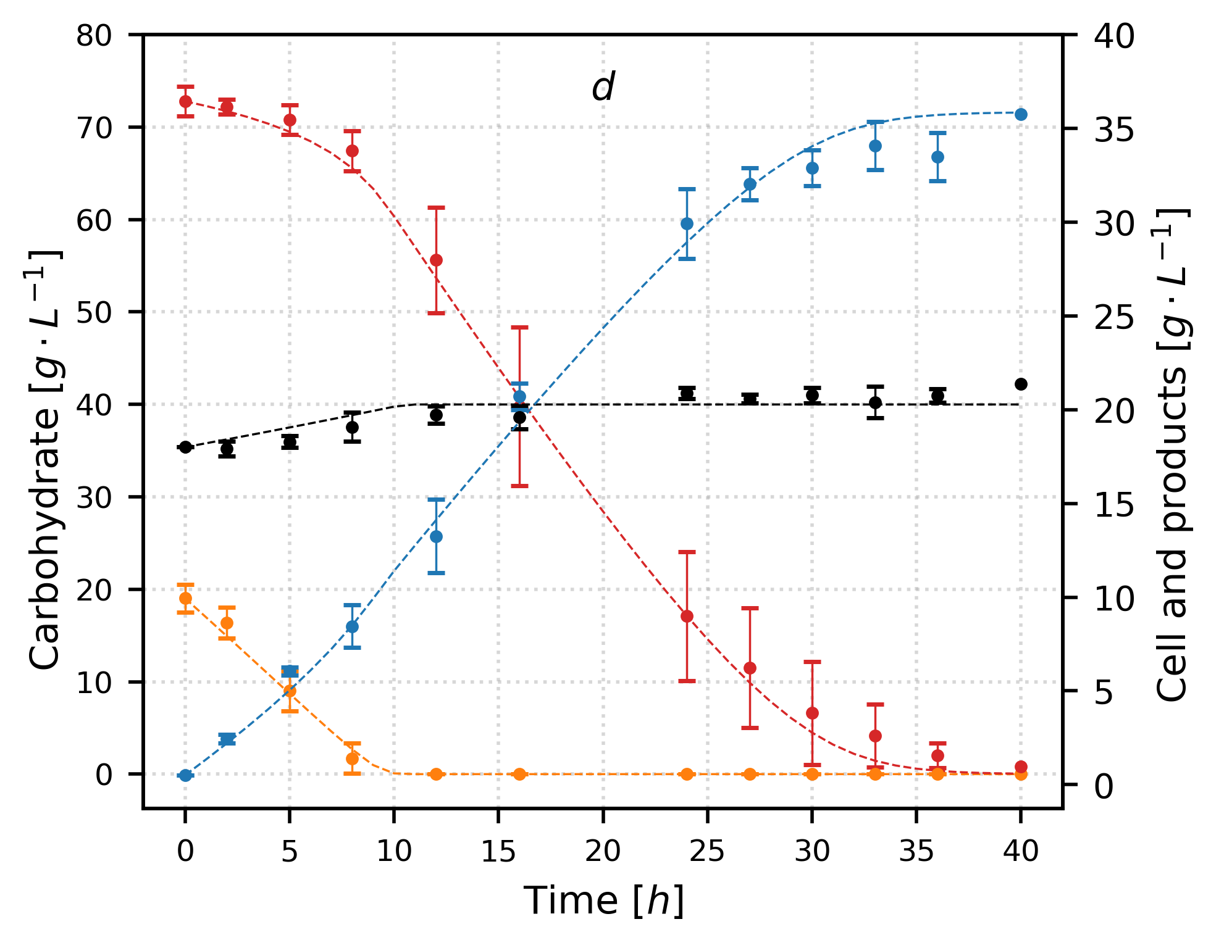
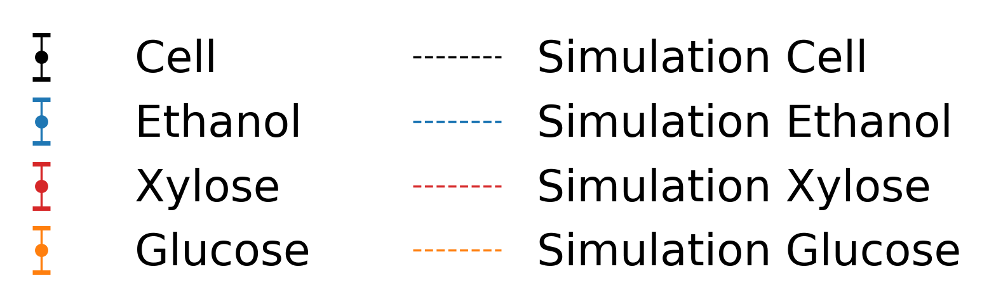
Chapter IV Results.
S. passalidarum
The model describes all fermentations carried out at different ratio C5 C6
S. passalidarum
60% glucose, 40 % xylose and 60 gRS·L⁻¹
S. passalidarum
20% glucose, 80 % xylose and 60 gRS·L⁻¹
S. Passalidarum
60% glucose, 40 % xylose and 90 gRS·L⁻¹
a
b
c
S. passalidarum
20% glucose, 80 % xylose and 90 gRS·L⁻¹
d

Slide 20
Chapter IV Results.
S. passalidarum
MOSTRAR RESULTADOS DO NOVO MODELO
MOSTRAR CÓDIGO

Slide 21







Thank you a lot!

