Slide 1

ENGI 301 Plant Water Reminder Proposal
October 4, 2020
Fernanda Lago Arroyo

Slide 2
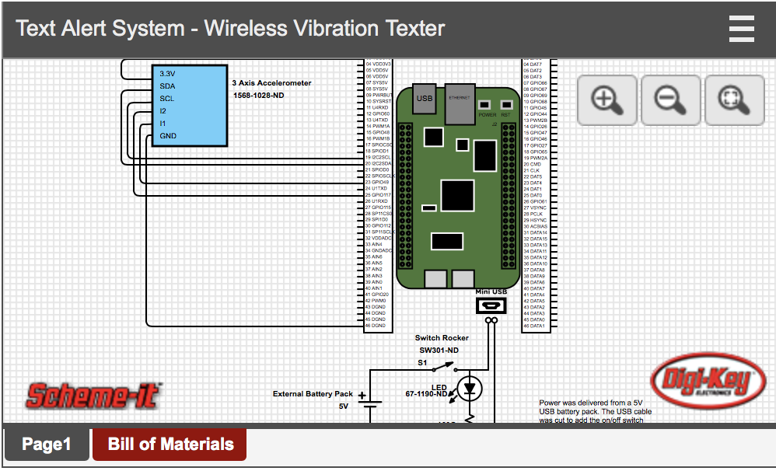
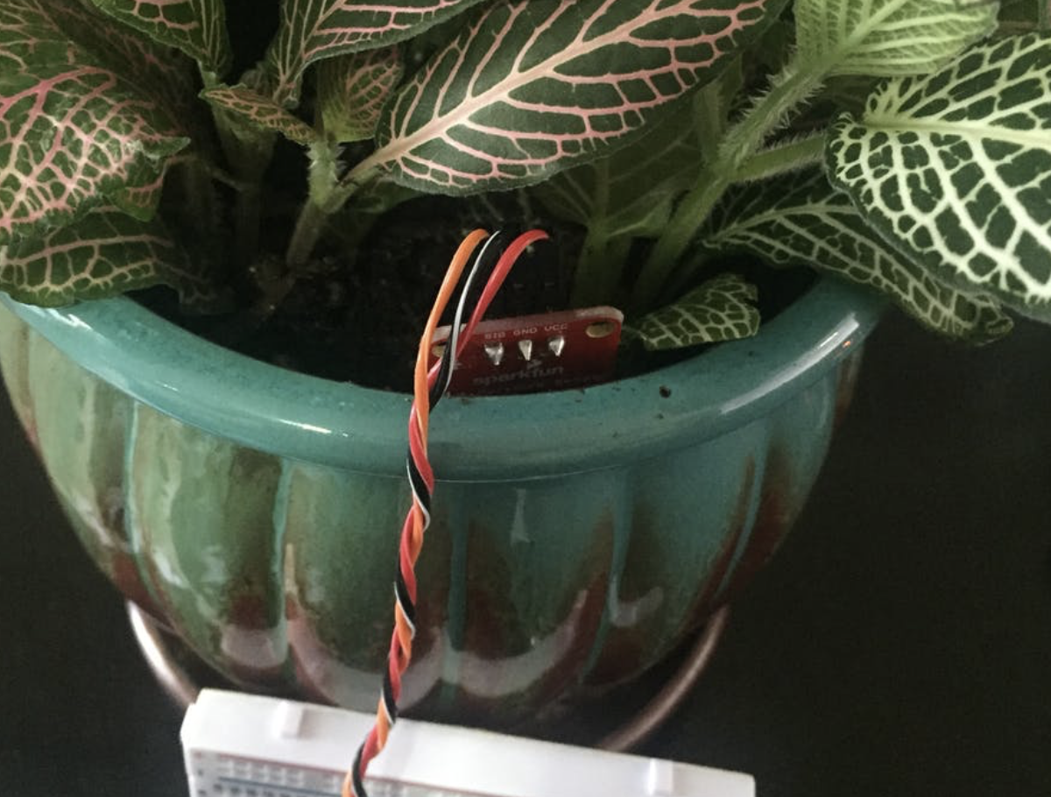
Background Information
What is being proposed?
A system that texts plant owner to remind them to water their plants and notifies them if their plants are not receiving the correct amount of sunlight
What improvements will be on existing projects?
Will send text notifications rather than email notifications
Notifications based off plants receiving appropriate water and sunlight
Suggests whether to expose or shield plant to sunlight
Will include light sensor in addition to soil humidity sensor
Will build enclosure for device
https://www.digikey.com/en/articles/how-to-make-a-beaglebone-based-appliance-notification-texter
https://www.hackster.io/MatinaStef/to-water-or-not-to-water-7204fe

Slide 3
UX Design
Steps for user interacting with device:
1. Wall plug in. Turns on device using switch, light flickers on next to switch.
2. Display outputs a message detailing how the soil humidity and light levels of the plant
3. If these are inadequate, user will receive a text.
Set up needs:
User must load phone number beforehand on laptop
User must connect device to Wi-Fi
Text message is sent twice a day if levels are inadequate

Slide 4
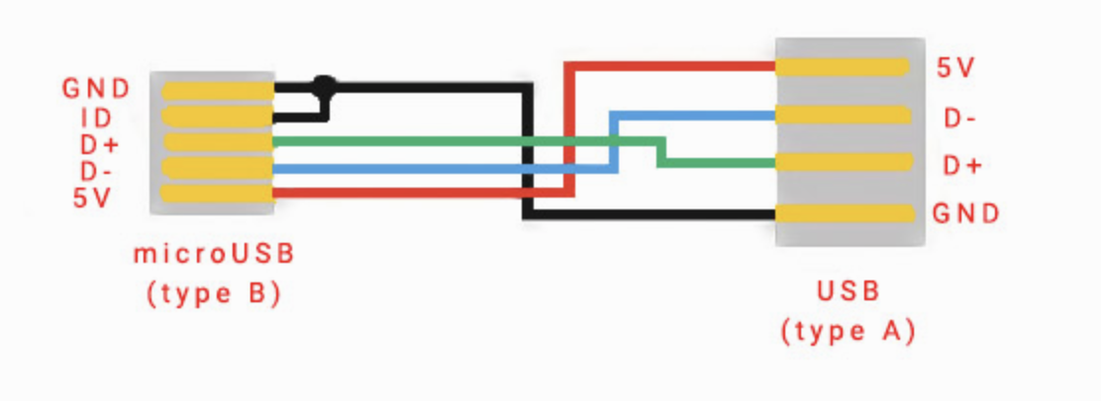
System Block Diagram
TFT LCD Touchscreen
ILI9341
SPICLK
Pocket Beagle
I2C Soil Sensor
4026
MISO
MOSI
63 VDD3V3
CS
61 GND
D/C
23 AIN0
Light Sensor
TEMT6000
51 I2C2SDA
20 GND
49 I2C2SCL
18 VDD3V3
miniUSB
USB and
WI-FI Dongle
TL-WN725N

Slide 5
Power Block Diagram
I2C Soil Sensor
Vin: 3-5 V
I = 80 mA
Light Sensor
Vout: (Analog voltage to signal pin): <6V
I = 20 mA
Pocket Beagle
Vin: USB or Cell Battery
Vout: 1.8 V (analog), 3.3 V, and SYS (switched Vin)
I = 500 mA
USB and
WI-FI Plug-in
Vin: 5V
I = 500 mA
TFT LCD Touchscreen
ILI9341
Vin: 3.3 V
I = 100mA
miniUSB
Vout: 5V

Slide 6
Components / Budget
Component | Need to Buy | Cost
Adafruit STEMMA Soil Sensor - I2C Capacitive Moisture Sensor | Yes | $7.50
TP-LINK TL-WN725N Network adapter USB 2.0 802.11n, 802.11g, 802.11b | Yes | $10.99
SparkFun Ambient Light Sensor Breakout - TEMT6000 | Yes | $4.25
TFT LCD Touchscreen ILI9341 | Yes | $ 5.99

