Slide 1
Generating Natural Language Descriptions of Trajectories Using LSTM Neural Networks
Rodolfo Corona
Rolando Fernandez

Slide 2

Introduction
Problem Description
Given a point-cloud $p∈P$ and a manipulation trajectory $t∈T$, our goal is to output a freeform Natural Language (NL) description $l∈L$ that describes the trajectory $f:T ×P →L$
Goal
Create a system that allows an agent to explain the actions it will take or that need to be performed to complete a given task, allowing for an agents actions to be better understood.

Slide 3

Introduction (cont.)
Hypothesis
Given $\left(t, p\right)∈T ×P$, a LSTM neural network architecture may be trained to sequentially generate NL descriptions that accurately describe the actions the agent performs under a trajectory $t∈T$.
Methods
Baseline model using K-Means and K-Nearest Neighbors to perform a simple lookup using known NL descriptions.
LSTM model to generate NL sequences given a $\left(t, p\right)∈T ×P$.
METEOR Sentence to Sentence evaluation tool used to measure accuracy of generated sentences against known NL descriptions.

Slide 4
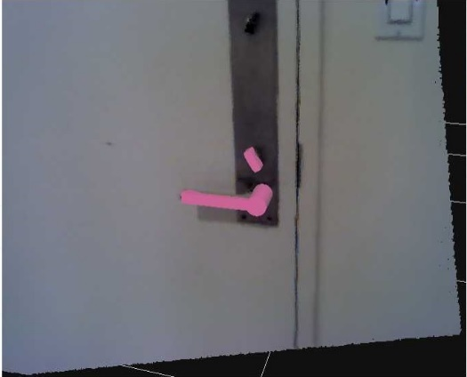
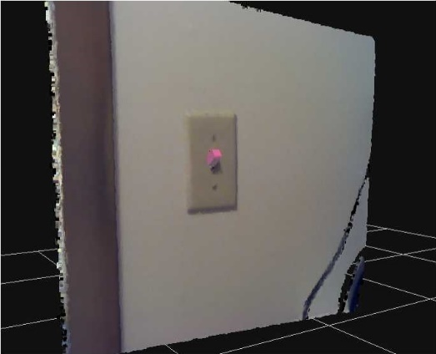
Dataset
Robobarista dataset consisting of 116 point-clouds of objects with 249 object parts and 250 natural language instructions.
Furthermore, 1225 trajectories for these objects were collected from 71 non-expert users on the Amazon Mechanical Turk.

Slide 5
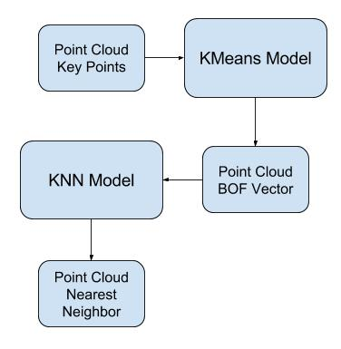

Baseline
Baseline model using only the point clouds from the dataset to perform a lookup given a $p∈P$ for the NL description of it’s nearest neighbor.

Slide 6
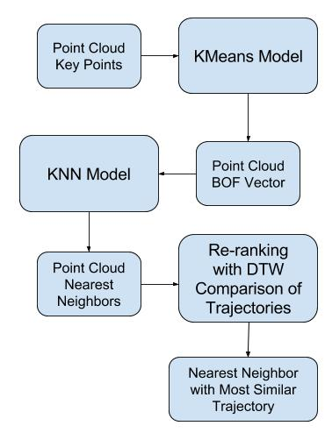

Baseline with Trajectories
Baseline Model using both the point clouds and trajectories from the dataset to perform a lookup given a $p∈P$ for the NL description of it’s nearest neighbor with the most similar trajectory from a set of the 10 nearest neighbors.

Slide 7
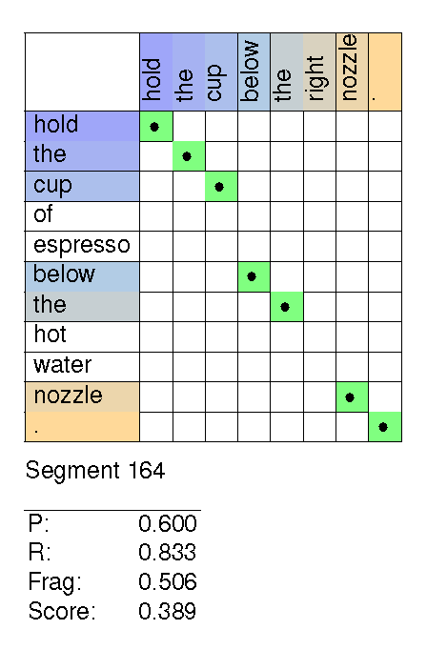
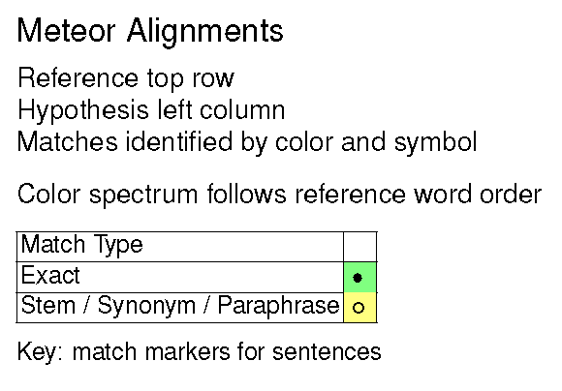
Baseline Evaluation

Slide 8
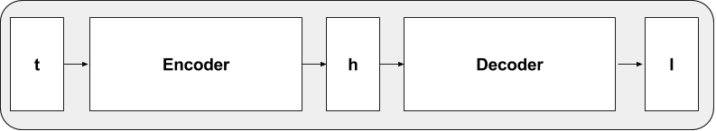
LSTM
Developed encoder-decoder LSTM framework to learn model.
Started with trajectory only architecture.

Slide 9
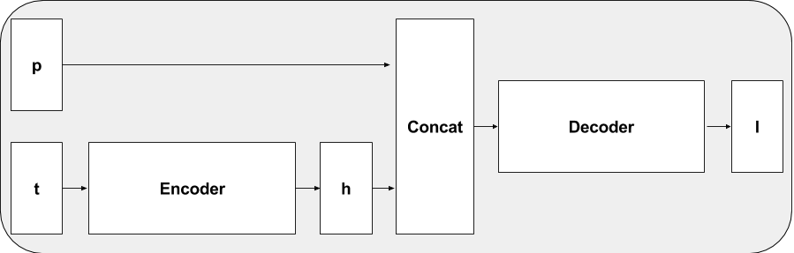
Multimodal LSTM
Encoder embeds trajectory information. Decoder generates description taking concatenation of pc BOF vector and trajectory embedding.
Tuned hyper-parameters using random search.
Each architecture was tested on a randomly chosen fold from dataset.
Best performing architecture on validation set chosen for test set.

Slide 10
Results
Model | 5-Fold Average
Baseline (PC only) | 0.144
Baseline (PC + T) | 0.153
LSTM (T only) | 0.155
LSTM (PC + T) | 0.132

Slide 11
Multimodal LSTM Examples
Multimodal LSTM | Ground Truth
Press the on the to to the temperature. | Press the button to open the lid.
Push the the handle to dispense the soap. | Turn the handle counterclockwise to unlock the cooker.
Pull the the handle to flush the water . | Pull the handle down and then towards you to open the door.
Press the rightmost knob to the the. | Press the button on top of the tank to flush.
Push the cup to the the. | Squeeze the trigger to dispense the glue.

Slide 12
Conclusion
Have begun experimenting with architectures for multimodal explainable AI system.
Current multimodal LSTM model outperformed by baseline.
Best performing model was trajectory only LSTM.

Slide 13
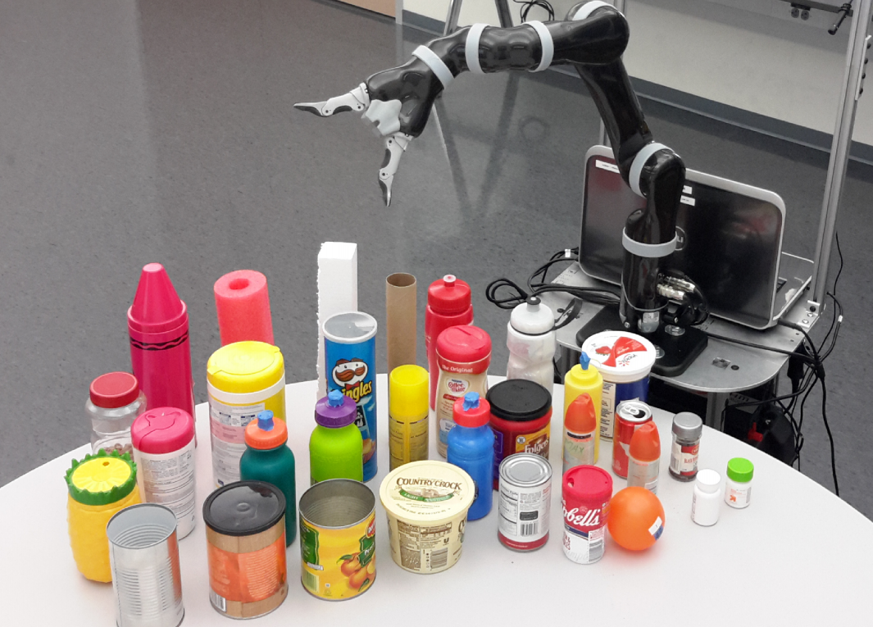
Future Work
BWI has collected multimodal data using Kinova robot arm.
Modalities include haptic, visual, and auditory information.
Will experiment further with NN architectures and embeddings (CNNs, Word2Vec, etc.).
(Sinapov et al. 2016)

