Slide 1

DriverPass System Overview
Prepared by: Fernando Rivas
Notes:
Today, I’m walking you through the DriverPass system design at a high level. The goal is to make it easy for customers to buy a training package, schedule driving lessons, and practice for the written exam online. We’ll also cover how staff can manage schedules and customer accounts. This presentation focuses on the parts that matter most to you as the client.

Slide 2

System Requirements
• Customers can create an account, log in, and manage their profile.
• Customers can purchase lesson packages and schedule/reschedule driving lessons.
• Customers can take online practice tests and view results/progress.
• Staff can manage users, packages/pricing, instructor availability, and reports.
• Quality goals: secure access, reliable uptime, and fast performance on web/mobile.
Notes:
These are the key things the system must do. On the customer side, it supports account access, buying a package, scheduling lessons, and practicing for the exam. On the staff side, it supports managing packages, schedules, and basic reporting. We also call out quality expectations: the system should be reliable, easy to use on phones and computers, and protect customer information.

Slide 3
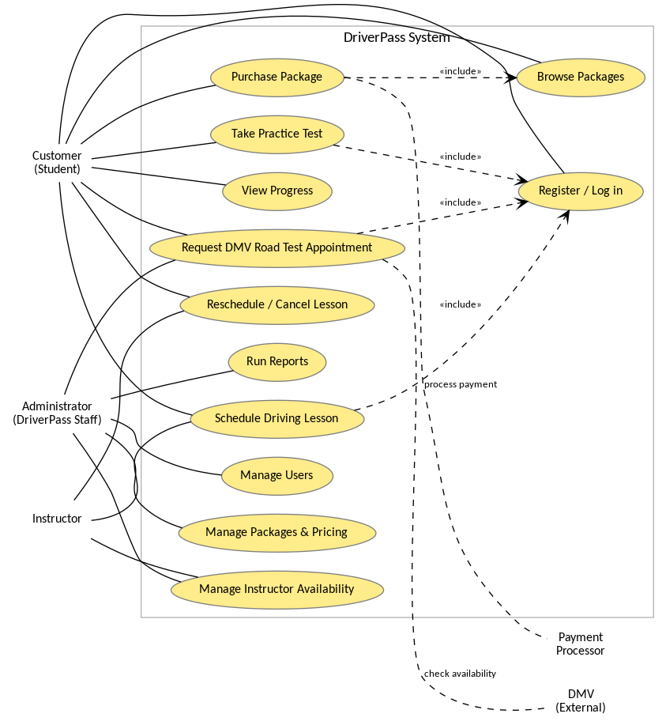
Use Case Diagram
Notes:
This picture shows the main groups who use DriverPass and the main actions they need. Customers can log in, browse and buy packages, schedule or reschedule lessons, and take practice tests. Staff can manage users, pricing, instructor availability, and run reports. We also show connections to outside services like payments and the DMV where needed.

Slide 4
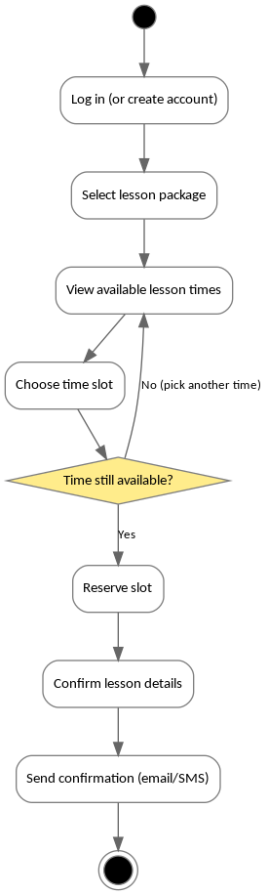
Activity Diagram
• Log in (or create an account)
• Pick a package
• See open lesson times
• Choose a time and confirm
• System reserves the slot and sends a confirmation
Notes:
This slide shows the step-by-step flow for scheduling a driving lesson. A customer logs in, chooses a package, views available times, and confirms a slot. The system checks that the slot is still open, reserves it to avoid double-booking, and then sends a confirmation message. This supports DriverPass’s need for easy self-service scheduling while keeping staff workload lower.

Slide 5
Security
• Secure logins with strong passwords (and optional multi-factor for staff).
• Role-based access: customers see only their data; staff access is limited by job role.
• Encrypted connections (HTTPS) and encryption for sensitive stored data.
• Payments handled by a trusted payment provider (no card numbers stored in DriverPass).
• Audit logs and regular backups for troubleshooting and recovery.
Notes:
Security is built into the design. Customers and staff must sign in, and the system only shows what each role is allowed to see. Data is protected during transmission and in storage. For payments, the safest approach is to use a payment provider so DriverPass doesn’t keep credit card numbers in the system. We also keep logs and backups so issues can be investigated and data can be restored if something goes wrong.

Slide 6
System Limitations
• Requires an internet connection; no offline mode for customers.
• Lesson slots depend on real instructor/vehicle availability—popular times may fill up.
• If the DMV or payment provider is down, related actions may be delayed.
• Some advanced reports and optional features may be delivered after the core system.
Notes:
Every system has boundaries. DriverPass is web-based, so customers need internet access. Lesson availability is limited by instructor and vehicle schedules, so the system can’t create slots that don’t exist. If outside services like the DMV or a payment provider have downtime, those parts of the experience may be temporarily unavailable. Finally, some advanced reporting or optional enhancements may be delivered after the core scheduling and practice features are in place.

