Slide 1
Papers Thesis
Main Ideas

Slide 2
The demand for AI skills in the labor market Alekseeva, L., Azar, J., Giné, M., Samila, S., & Taska, B. (2021). The demand for ai skills in the labor market. Labour Economics, 71, 102002. https://doi.org/10.1016/j.labeco.2021.102002
Objective: Explore the adoption and impact of AI technology on the US labor market from 2010-2019, focusing on wage premiums and job dynamics.
Methodology:
Analysis of online job vacancies data collected by Burning Glass Technologies to track AI skill demands.
Task-based framework to anticipate firm’s tendencies towards automation and AI skill demand.
Demand Growth:
AI skill demand quadrupled from 2010 to 2019, with a considerable spike in recent years.
High demand observed in IT, followed by architecture, engineering, and scientific sectors.
Wage Premium:
AI skills command an 11% wage premium within firms, and 5% within the same job title.
Firm Dynamics:
Larger, R&D-intensive firms are more likely to require AI skills.
Implications:
Urgent need for policy adjustments to steer education and labor markets in line with evolving skill demands.
Workers advised to enhance AI-related competencies for future job prospects.

Slide 3
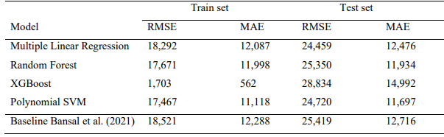
Analysing the gender pay gap in IT through salary prediction: a data driven approach Brandwijk, M. (2021). Analysing the gender pay gap in it through salary predic- tion: A data driven approach [Doctoral dissertation, Tilburg Univer- sity].
Objective: Establish variables influencing IT specialists' salaries and analyze gender pay gap with the goal to devise a predictive model for optimal salaries using various regression techniques.
Methodology:
Analyzing influence of demographics, job experience, and expertise on IT specialists' salaries.
Comparison of different regression techniques to build a predictive model for optimal salaries.
Key Variables Influencing Salary:
Seniority level of the job, years of work experience, and age were identified as the most significant variables influencing salaries.
Gender pay gap more pronounced among older, experienced individuals holding senior positions.
Regression Analysis Outcome:
No distinct superiority observed among the regression techniques (Multiple Linear Regression, Random Forest Regression, Support Vector Regression).
XGBoost performed the best on training data, although it indicated room for error reduction.
Findings on Job Expertise:
Job position and expertise in specific programming languages did not showcase significant impact on salary determination.
Recommendations for Future Research:
A deeper exploration of expertise-salary relationship and further analysis on the potential of various regression techniques for improved prediction accuracy.

Slide 4
R-squared is more informative than SMAPE, MAE, MAPE, MSE and RMSE in regression analysis evaluation Chicco, D., Warrens, M. J., & Jurman, G. (2021). The coefficient of determi- nation r-squared is more informative than smape, mae, mape, mse and rmse in regression analysis evaluation. PeerJ Computer Science sity].
Background:
Supervised Machine Learning: Focus on regression analysis, where a continuous independent target is predicted using a set of predictor variables.
Existing Metrics: Utilization of metrics like MSE, RMSE, MAE, and MAPE, which suffer from limitations regarding their range and interpretability.
Objective:
Metric Analysis: Analyzing the effectiveness of R-squared and SMAPE metrics in assessing regression analyses.
Focus: Understand the performance and reliability of the two metrics in various use cases, including real medical scenarios.
Methodology:
Mathematical Analysis: Deriving the mathematical properties of R-squared and SMAPE.
Comparative Study: Empirically comparing R-squared and SMAPE in different scenarios to determine their performance.
Findings:
R-squared Metric: Found to be more informative and reliable compared to SMAPE, avoiding the interpretability issues associated with other metrics such as MSE, RMSE, MAE, and MAPE.
SMAPE Metric: Demonstrated to be less reliable than the R-squared metric in predicting the majority of elements in a ground truth group correctly.
Recommendation:
Standard Metric for Regression Analysis: The study suggests the adoption of the R-squared metric as a standard measure for evaluating regression analyses across various scientific domains.
Contribution:
Metric Evaluation: This study fills a gap in the supervised machine learning field by proposing a more reliable standard metric for regression analysis.
Real-world Implication: Demonstrates the applicability and reliability of the R-squared metric in real medical scenarios, indicating its practical utility.

Slide 5
STEM Jobs See Uneven Progress in Increasing Gender, Racial and Ethnic Diversity
Fry, R., Kennedy, B., & Funk, C. (2021). Stem jobs see uneven progress in
increasing gender, racial and ethnic diversity. Pew Research Center, 1–
28 https://www.pewresearch.org/science/wp-content/uploads/sites/16/2021/03/PS_2021.04.01_diversity-in-STEM_REPORT.pdf
Underrepresentation in STEM Workforce
Black and Hispanic Workers: Remain underrepresented in the STEM workforce, despite growth in computing jobs.
Women: Varyingly represented; predominant in health-related jobs but scarce in physical sciences, computing, and engineering sectors.
STEM Degree Attainment
Unpromising Trends: Current trends indicate that the representation gaps might not narrow substantially soon.
Black and Hispanic Adults: Less likely to earn STEM degrees, continuing to hold a lesser share of STEM graduates compared to their population share.
Women: Though earning the majority of undergraduate and advanced degrees, they lag in fields like engineering and computer science where their workforce representation is low.
Workforce Statistics (2017-19)
Hispanic Workers: Comprise 17% of all employment but only 8% in STEM; a slight growth of 1% in STEM since 2016.
Black Workers: Hold 11% of all jobs yet make up only 9% of STEM occupations, with even lower representation in fields like engineering and architecture.
Diversity Efforts and Economic Implications
Efforts to Increase Diversity: Existing but challenged by the deep-rooted representation gaps.
Economic Benefits: STEM jobs tend to offer higher pay, and growth in this sector is expected to outpace non-STEM jobs.
Education and Long-term Outlook
Higher Education: Essential for STEM jobs, with 67% of STEM workers holding at least a bachelor's degree, mainly in a STEM field.
Representation in Education: The future of STEM workforce diversity is intrinsically linked to representation in educational institutions nationwide.

Slide 6
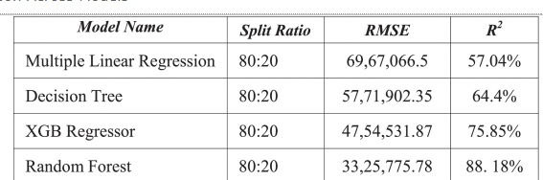
A Non-Linear Approach to Predict the Salary of NBA Athletes using Machine Learning Technique
Jain, A., Jain, S., Pancinovia, N. M., & George, J. P. (2022). A non-linear
approach to predict the salary of nba athletes using machine learn-
ing technique. 2022 International Conference on Trends in Quantum
Computing and Emerging Business Technologies (TQCEBT), 1–5 https://ieeexplore.ieee.org/document/10041664
Background
NBA's escalating business dimensions demand data-driven player selection and salary negotiations.
Existing studies predominantly rely on linear models for salary predictions, often overlooking potential non-linear relations between variables.
Objective
To leverage machine learning for predicting NBA players’ salaries with enhanced accuracy using nonlinear regression models, focusing on the Random Forest Regressor.
Methodology
Utilized various machine learning algorithms including Multiple Linear Regression, Decision Tree, XGB Regressor, and Random Forest.
Evaluation based on R-squared and RMSE values.
Findings
Multiple Linear Regression: Limited with a 57% R-squared value; violated assumptions due to strong correlations between variables.
Decision Tree: Improved accuracy at 64%, acknowledging non-linear relationships.
XGB Regressor: Leveraged ensemble learning with a 75.85% R-squared value.
Random Forest: Emerged superior with an 88.18% R-squared value, demonstrating the effectiveness of non-linear models in capturing intricate patterns.
Conclusion
Random Forest Regressor outshines in predicting NBA salaries, emphasizing the role of non-linear relationships between player attributes and their salaries.
Previous season performance statistics, particularly the fantasy points (54% feature importance), emerged as pivotal in predicting current year salaries.
Future Direction
Delve deeper with richer datasets, exploring neural networks for long-term salary projectionIncorporate diverse features like marketing skills and team dynamics for refined predictions.
S. Joshi, A. V. (2020). Machine learning and artificial intelligence, 247.
The study advocates for a non-linear approach in NBA salary predictions, opening avenues for nuanced, data-driven strategies in player negotiations and team building, with a spotlight on the untapped potential of non-linear regression models.

Slide 7
Machine Learning and Artificial Intelligence BOOK
Joshi, A. V. (2020). Machine learning and artificial intelligence, 247.
https://link.springer.com/book/10.1007/978-3-030-26622-6
Introduction
Objective: Simplify ML and AI concepts to bridge theory and practical application.
Audience: Individuals with basic undergraduate math and statistics knowledge.
Challenges Addressed
Complexity: Makes graduate-level concepts accessible.
Resource limitations: Addresses the gap in existing materials that are either too deep or too superficial.
Misunderstanding: Avoids oversimplification to prevent misconceptions and potential hazards.
Book Approach
Balanced content: Harmonizes theory and intuitive explanations.
Unified view: Offers a one-stop solution for frequently encountered AI and ML concepts.
Interconnectivity: Helps in logically connecting scattered concepts with their theoretical roots.
Benefits
Wider reach: Facilitates understanding for a broader audience.
Resource for developers: Aids in informed AI application development.
Confidence building: Prepares readers to approach new concepts with a strong foundational understanding.
Next Steps After Reading
Big Data: Learn technologies like Hadoop and Spark for big data applications.
Specialized areas: Explore fields such as computer vision or robotics for focused applications.
Conclusion
Magic of integration: Stresses the remarkable outcomes of applying individual trivial-seeming technologies together.
Passing the excitement: Aims to transfer the author's passion for the subject to the readers through a balanced approach to learning

Slide 8
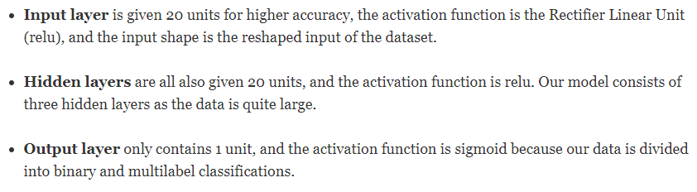
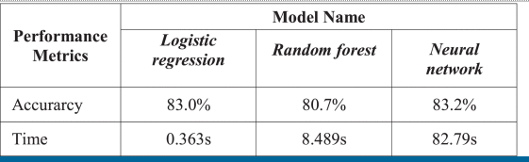
Machine Learning Models for Salary Prediction Dataset using Python
Kablaoui, R., & Salman, A. (2022). Machine learning models for salary prediction dataset using python. 2022 International Conference on Electrical and Computing Technologies and Applications (ICECTA), 143– 147. https://doi.org/10.1109/ICECTA57148.2022.9990316
CLASIFICATION (LOG REG, ANN, RF)
IF SALARY IS > OR < 50,000 € (AVG. HOUSEHOLD INCOME PER YEAR)
DATA PROCESSING: NORMALIZATION – BINARY ENCODING – ONE-HOT
2 SPLIT: TRAIN AND TEST (80:20)
FEATURES (8 + 1): age, work sector, education, marital status, occupation, gender, hours per week, and country + SALARY
ANN STRUCTURE (CLASSIFICATION – dropout 0.3, Adam:000,1 , 10 epochs):
Results:

Slide 9
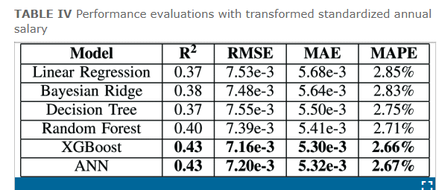
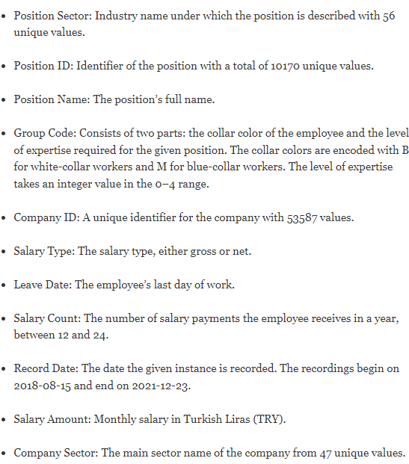
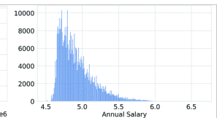
Salary Prediction via Sectoral Features in Turkey
Ş. Demir İnan Özer, B. Ülke, F. Serhan Daniş and G. Keziban Orman, "Salary Prediction via Sectoral Features in Turkey," 2022 International Conference on INnovations in Intelligent SysTems and Applications (INISTA), Biarritz, France, 2022, pp. 1-6, doi: 10.1109/INISTA55318.2022.9894130.
Dataset: 500196 and 11 respectively.
main challenges are due to the heterogeneity, dirtiness, and complex nature of the studied data
Inflation Adjustment
Logarithmic Transformation
Algorithms: Linear Regression, Bayesian Ridge, Decision Tree, XGBoost, ANN, etc.
Best Performers: XGBoost and ANN.
Inflation: No significant impact.
Log Transformation: Positively influences salary estimation.
Decision Tree: Notably improved with training data enhancements.
Residual Analysis: Models over/underestimate extreme salary values.
Latent Variables: Likely presence affecting the results.
Data Preprocessing: Reduce loss of valuable information.
Individual Sector Models: For refined forecasting.

Slide 10
Salary Prediction in the IT Job Market with Few High-Dimensional Samples: A Spanish Case Study
Martín, I., Mariello, A., Battiti, R., & Hernández, J. A. (2018). Salary pre-
diction in the it job market with few high-dimensional samples: A
spanish case study. International Journal of Computational Intelligence
Systems, 11(1), 1192–1209 https://doi.org/10.2991/ijcis.11.1.90
Random Forest and “ensembles” methods perform better among several regression and classification algorithms for predicting the salaries of job offers in the information technology

Slide 11
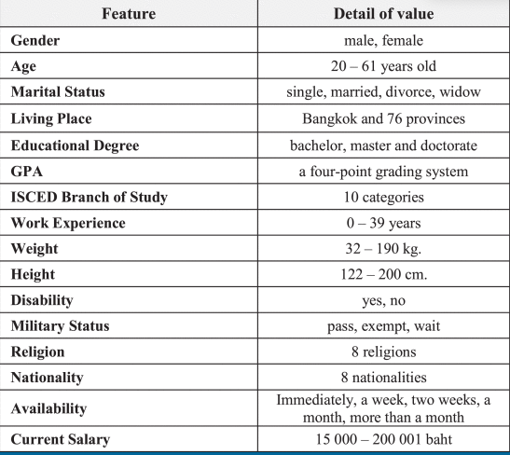
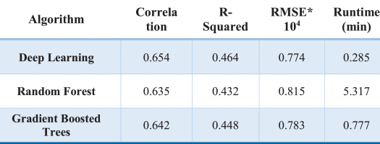
Salary Predictor System for Thailand Labour Workforce using Deep Learning
P. Viroonluecha and T. Kaewkiriya, "Salary Predictor System for Thailand Labour Workforce using Deep Learning," 2018 18th International Symposium on Communications and Information Technologies (ISCIT), Bangkok, Thailand, 2018, pp. 473-478, doi: 10.1109/ISCIT.2018.8587998

Slide 12
Statistical Machine Learning Regression Models for Salary Prediction Featuring Economy Wide Activities and Occupations
Matbouli, Y. T., & Alghamdi, S. M. (2022). Statistical machine learning regression models for salary prediction featuring economy wide activities and occupations. Information, 13(10)
https://www.mdpi.com/2078-2489/13/10/495
Survey data
MLR, ANN, BGPR → ANN very good in R2

Slide 13
National Basketball Association Player Salary Prediction Using Supervised Machine Learning Methods
Özbalta, E., Yavuz, M., & Kaya, T. (2022). National Basketball Association Player Salary Prediction Using Supervised Machine Learning Methods. In Intelligent and Fuzzy Techniques for Emerging Conditions and Digital Transformation: Proceedings of the INFUS 2021 Conference, held August 24-26, 2021. Volume 2 (pp. 189-196). Springer International Publishing.
https://scholar.google.com/scholar?hl=en&as_sdt=0%2C5&q=National+Basketball+Association+Player+Salary+Prediction+Using+Supervised+Machine+Learning+Methods&btnG=
3 diff regressions and XGBoost

