Slide 1


Bank

Slide 2

Context
The data is related with direct marketing campaigns of a Portuguese banking institution. The marketing campaigns were based on phone calls. Often, more than one contact to the same client was required, in order to access if the product (bank term deposit) would be or not subscribed.

Slide 3


Objective
Predict/classify if the client will subscribe or not to a term deposit.

Slide 4
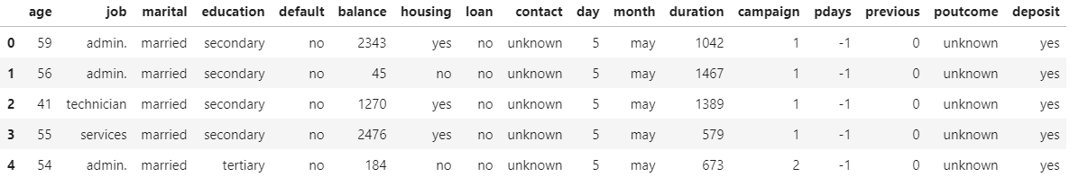


Data
11,162 Observations 17 Features

Slide 5

Initial Data Exploration

Slide 6
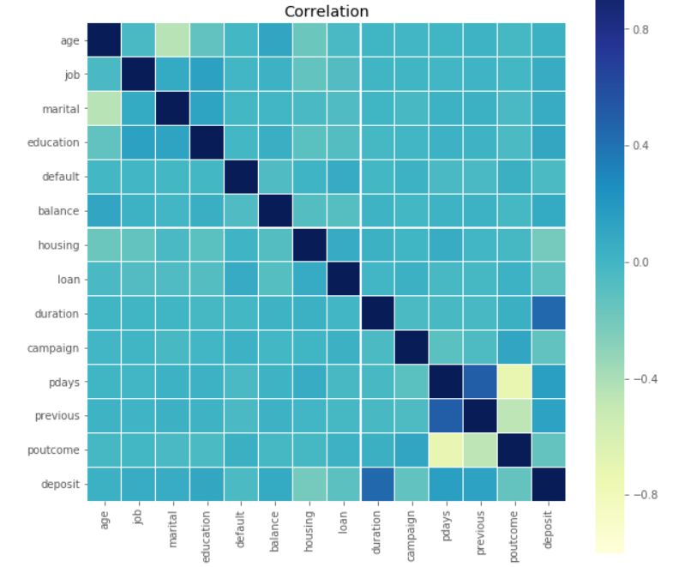
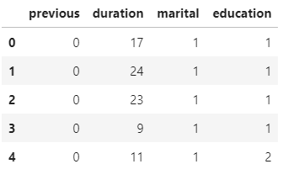
Correlation and Feature selection

Slide 7
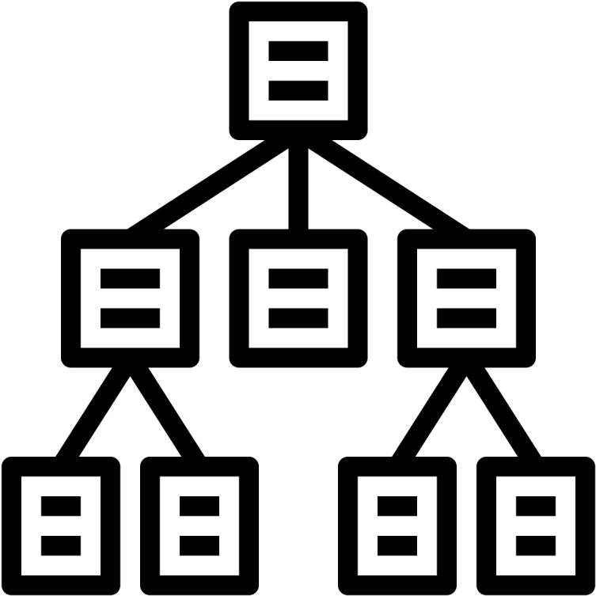
Decision Tree

Slide 8
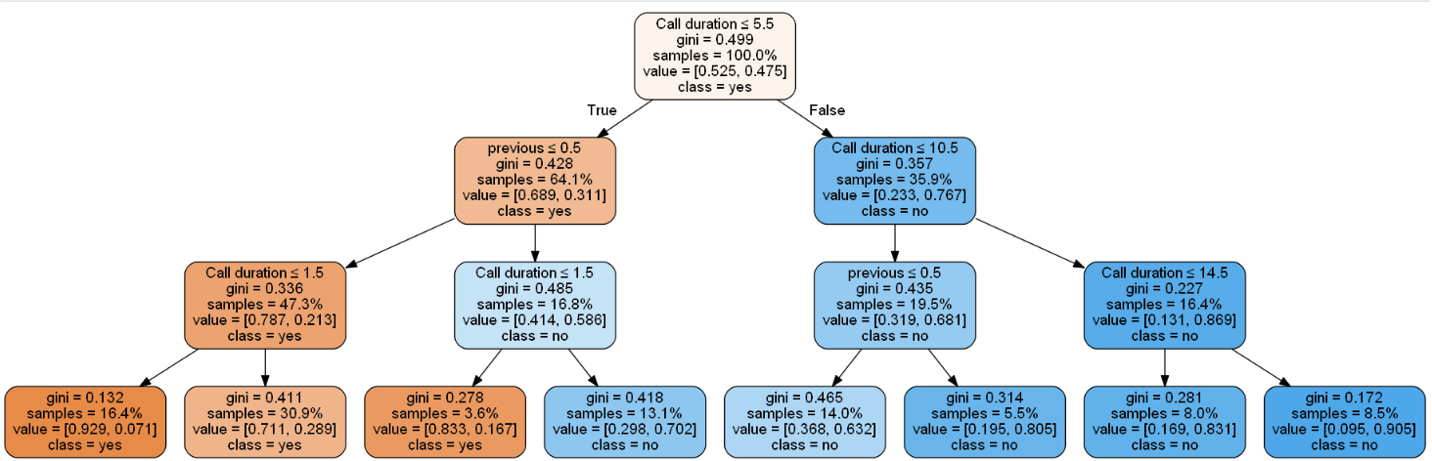
Depth 3
Training Score: 0.77
Testing Score: 0.76

Slide 9
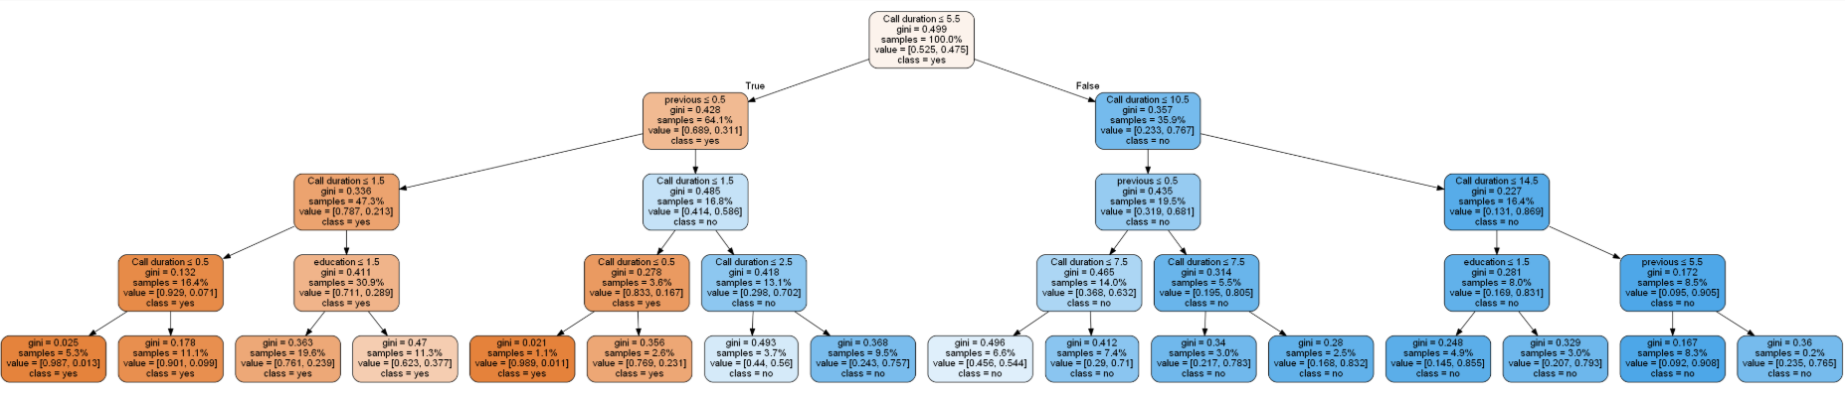
Depth 4
Training Score: 0.77
Testing Score: 0.77

Slide 10

Without Depth limit
Training Score: 0.80
Testing Score: 0.75

Slide 11
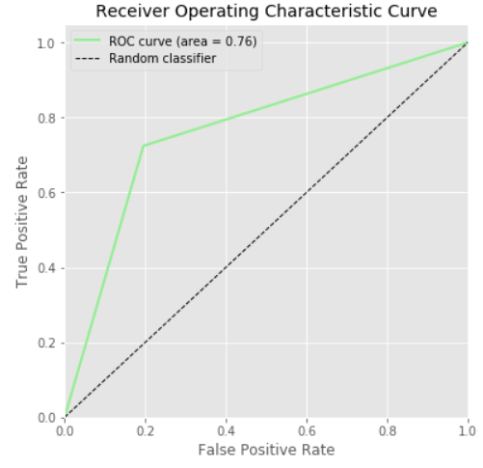
Entropy criterion - Depth 3
Training Score: 0.77
Testing Score: 0.76

Slide 12
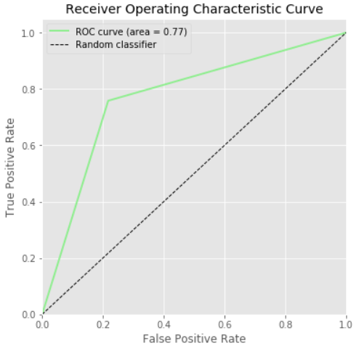
Bagging

Slide 13
Random FOREST - Depth 3

Slide 14
Adaboost classification
TRAINING SCORE: 0.77
TESTING SCORE: 0.76

Slide 15
Conclusions and recommendations
The shorter the call duration, bank can sign up more clients to term deposits.
Duration call can have bias.
Good data cleaning = Good Feature importance
More depth levels to our decision tree doesn't mean better results.
Good Training score != Good Test score (Bias)
Interest rate?

