Slide 1
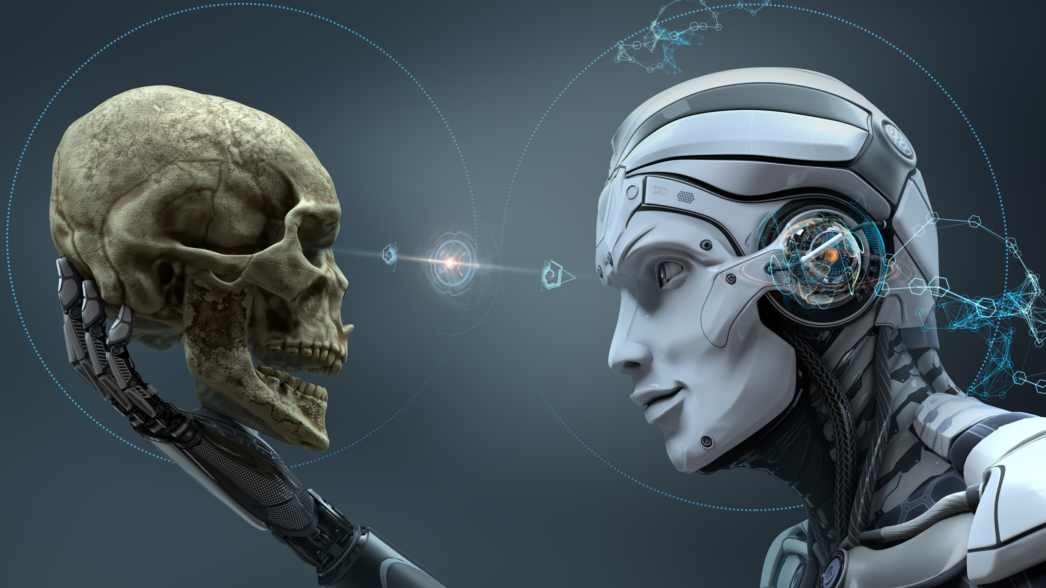
Convolutional Neural Network
Fernando González
20170085
Machine Learning Models

Slide 2



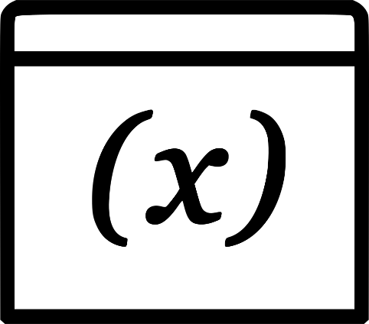
Dataset – CIFAR 10
1. Airplane ✈
2. Automobile 🚗
3. Bird 🦜
4. Cat 🐱
5. Deer 🦌
6. Dog 🐶
7. Frog 🐸
8. Horse 🐴
9. Ship 🛥
10. Truck 🚚

Slide 3

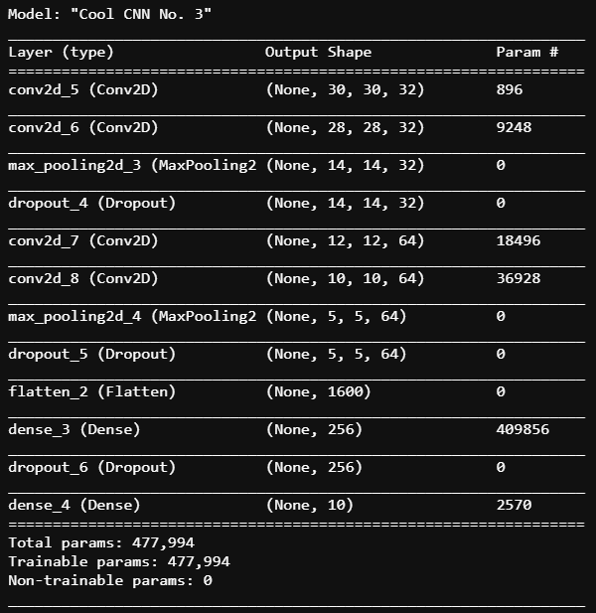
CNN Architecture
4 Conv. Layers
2 Max Pooling (2,2)
Conv. Activation: RELU
Optimizer: SGD

Slide 4
Training the Model
Batch Size: 32
Epochs: 100
Train in 50,000 samples
Validate on 10,000 samples
Test Accuracy: 80%
Test Loss: 0.66
Time: 5 hours 40 min

Slide 5
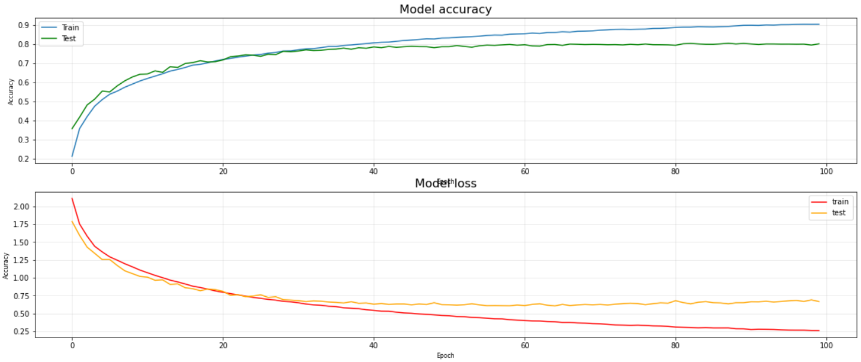
Accuracy & Loss Model

Slide 6
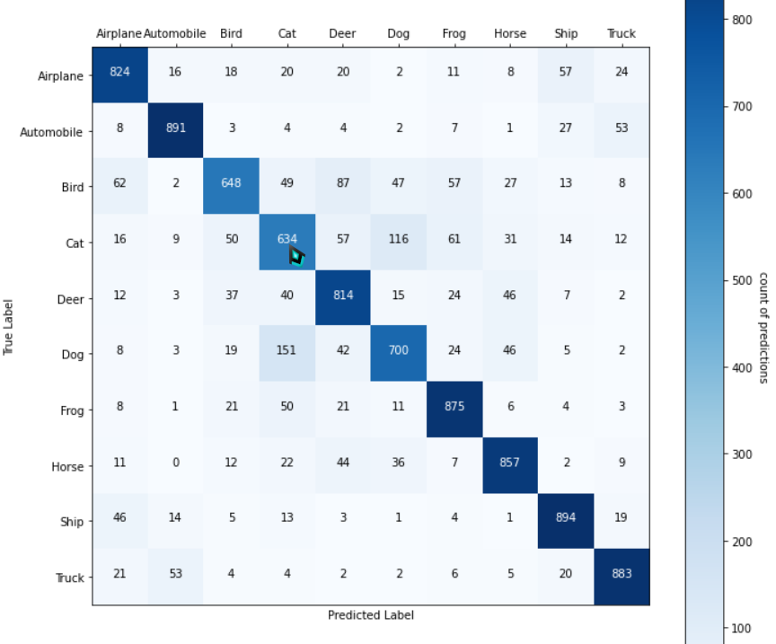
Confusion Matrix

Slide 7
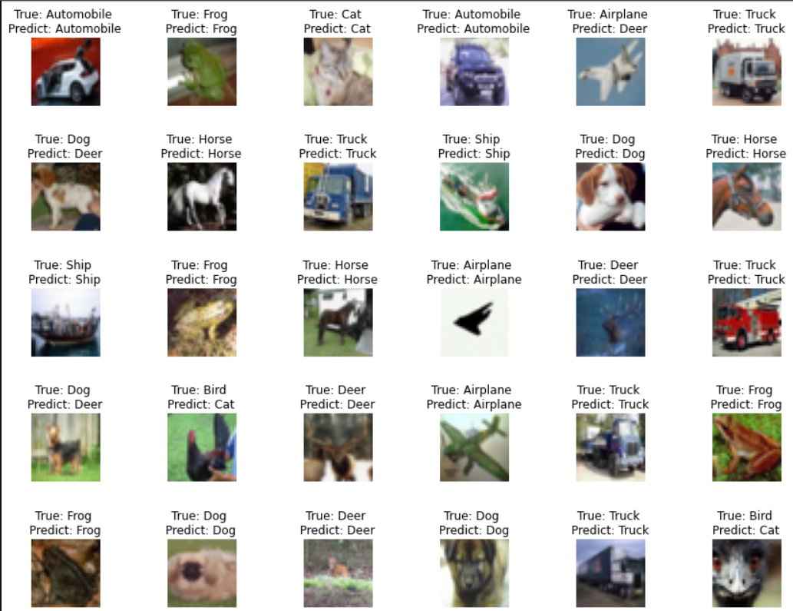
Check Predictions

Slide 8
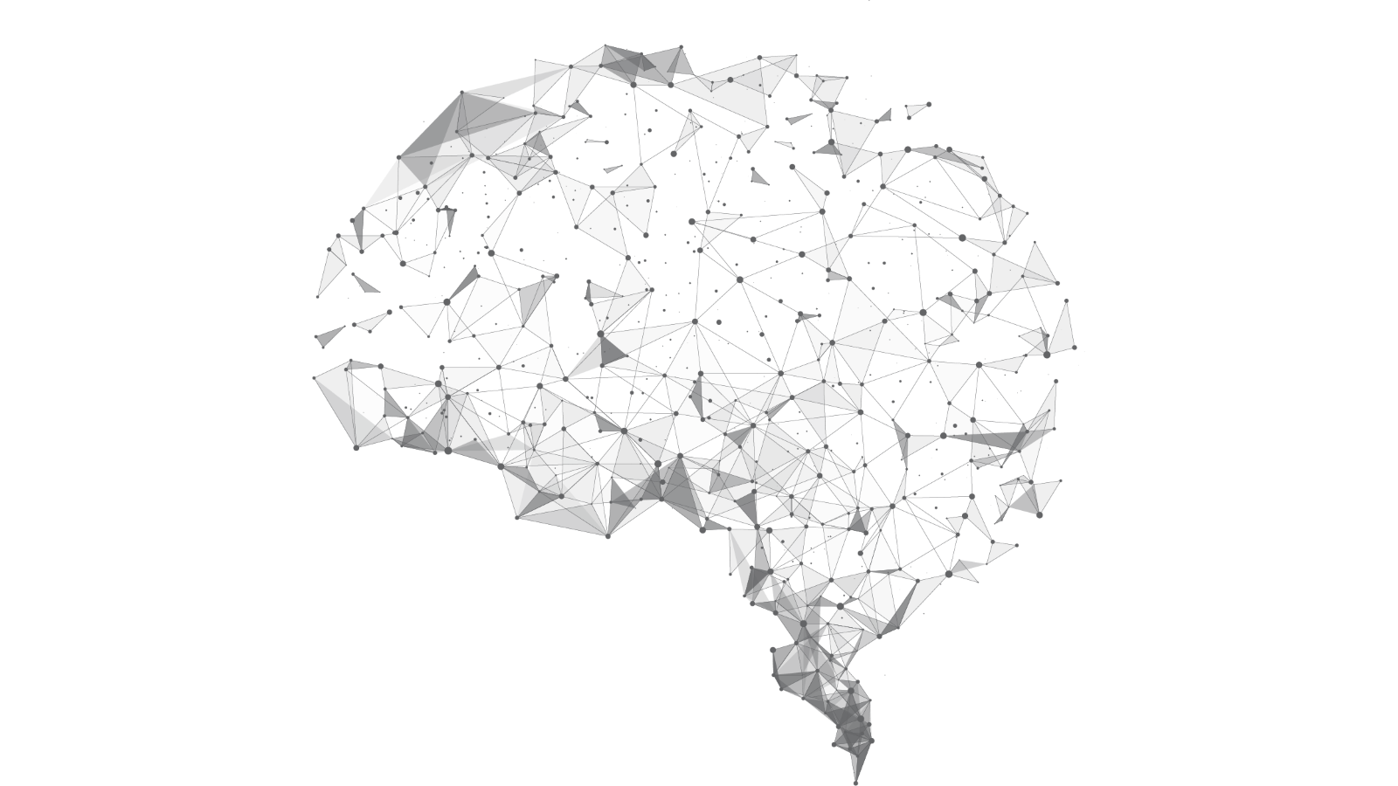
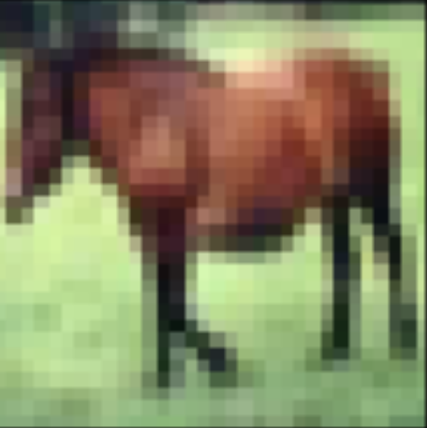
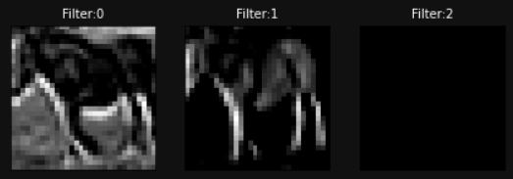
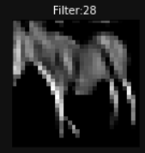
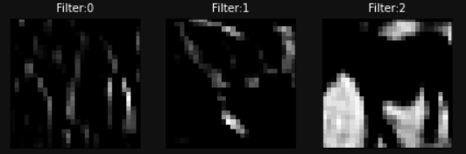
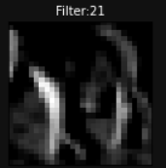
Feature Map
1st Layer
Contours
Figure
Background
Depth (3D)
Horse
2nd Layer
Edges
Contours
Light
Front Light

Slide 9
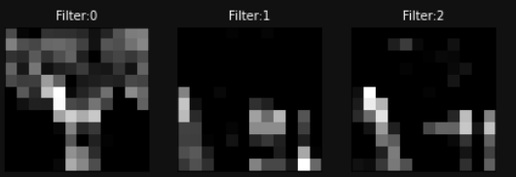
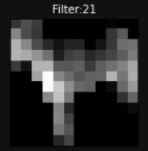
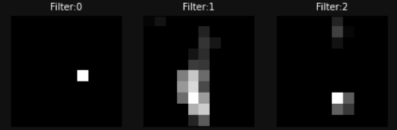
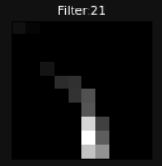
Feature Map
3rd Layer
Leg
Background
Background
Figure
Horse
4th Layer
Eye
Leg
Ear & eye
Leg

Slide 10
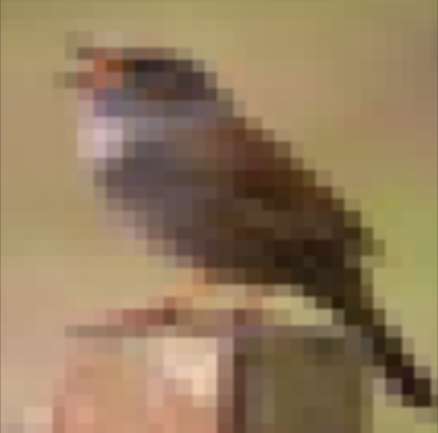
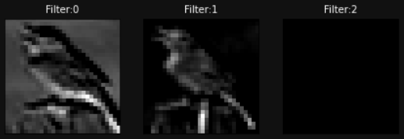
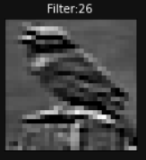
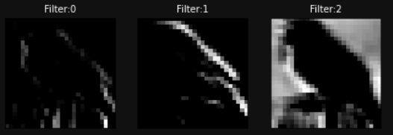
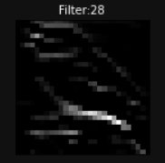
Feature Map
1st Layer
Contours
Figure
Background
Depth (3D)
Bird
2nd Layer
Edges
Back-Light
Light
Contours

Slide 11
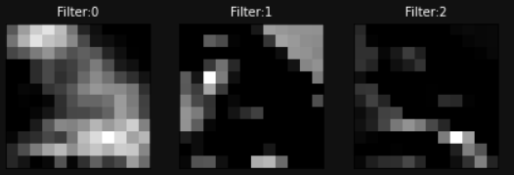
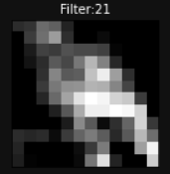
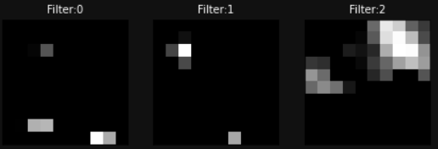
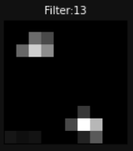
Feature Map
3rd Layer
Figure
Contours/Figure
Bird
4th Layer

Slide 12
Conclusions & Recommendations
More convolutional layer != Better results
The feature maps closer to the input of the model capture a lot of fine detail in the image
The feature maps closer to the output of the model, show less and less detail.
Normalize data
More Epochs can drive to Overfitting
Use another optimizer
Use another activation function

Slide 13
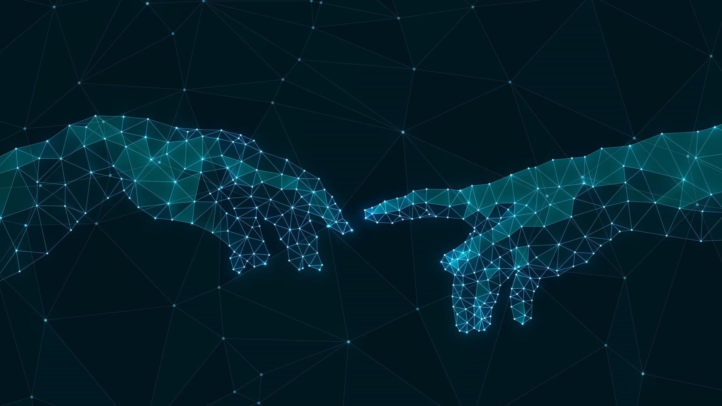
Thanks!

