Slide 1
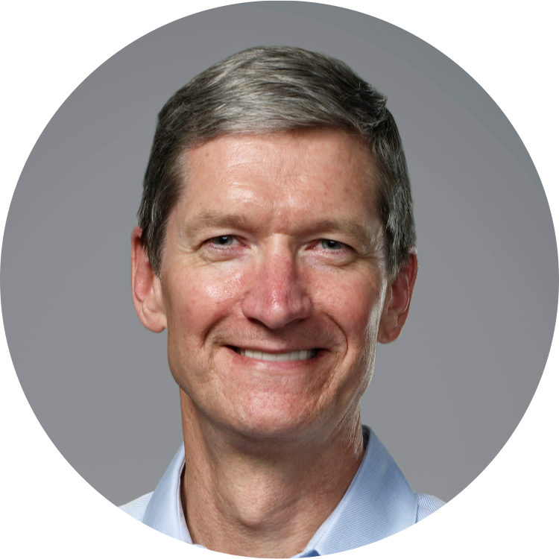
MERRY CHRISTMAS
Hope you are having a great time Tim Cook

