Slide 1

Decision Trees
Fernando Carazo Melo
PhD in Artificial Intelligence and Computational Biology
fcarazo@tecnun.es

Slide 2
Tree-based models are a class of nonparametric algorithms that work by partitioning the feature space into a number of smaller (non-overlapping) regions with similar response values using a set of splitting rules.
Predictions are obtained by fitting a simpler model (e.g., a constant like the average response value) in each region. Such divide-and-conquer methods can produce simple rules that are easy to interpret and visualize with tree diagrams.
As we’ll see, decision trees offer many benefits; however, they typically lack in predictive performance compared to more complex algorithms like neural networks
owever, future chapters will discuss powerful ensemble algorithms—like random forests and gradient boosting machines—which are constructed by combining together many decision trees in a clever way.

Slide 3
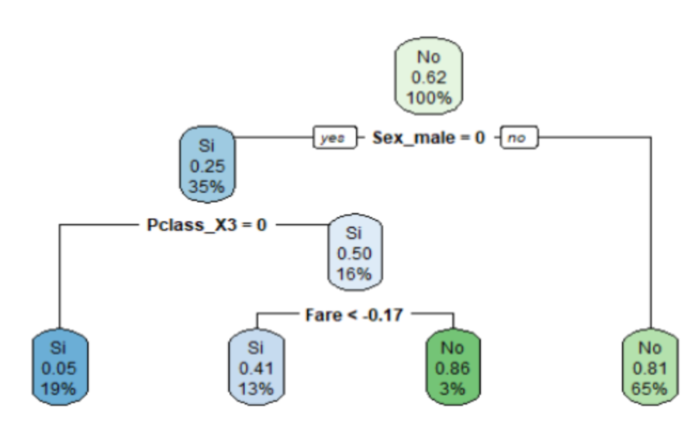
Decision Trees
There are many methodologies for constructing decision trees but the most well-known is the classification and regression tree (CART) algorithm proposed in Breiman (1984).
After all the partitioning has been done, the model predicts the output based on (1) the average response values for all observations that fall in that subgroup (regression problem), or (2) the class that has majority representation (classification problem).

Slide 4
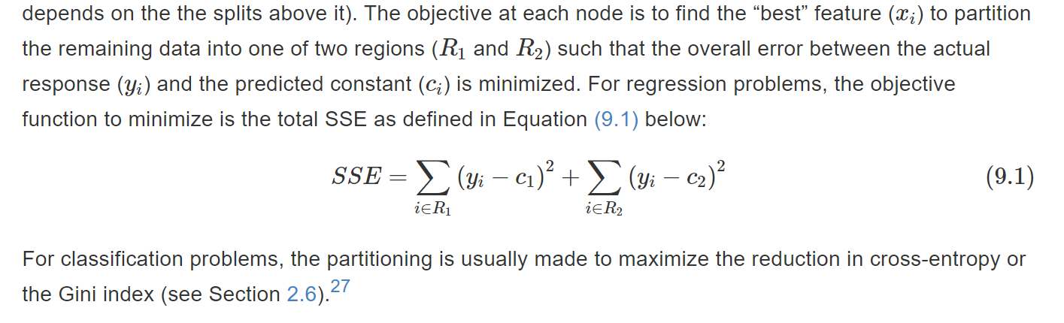
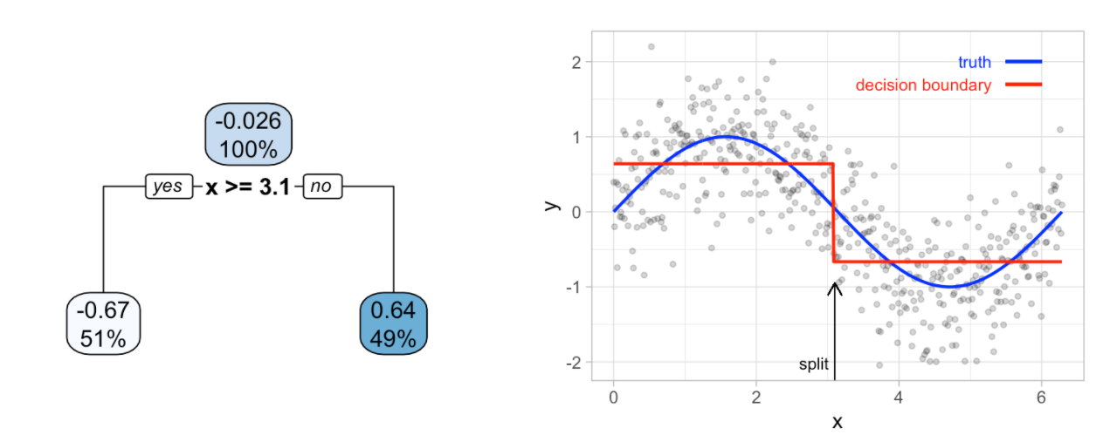
Regression

Slide 5
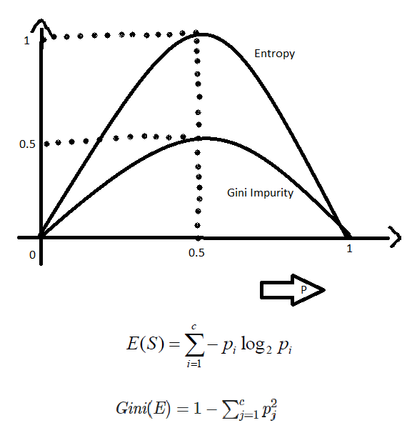
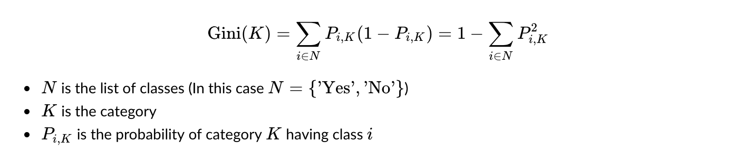
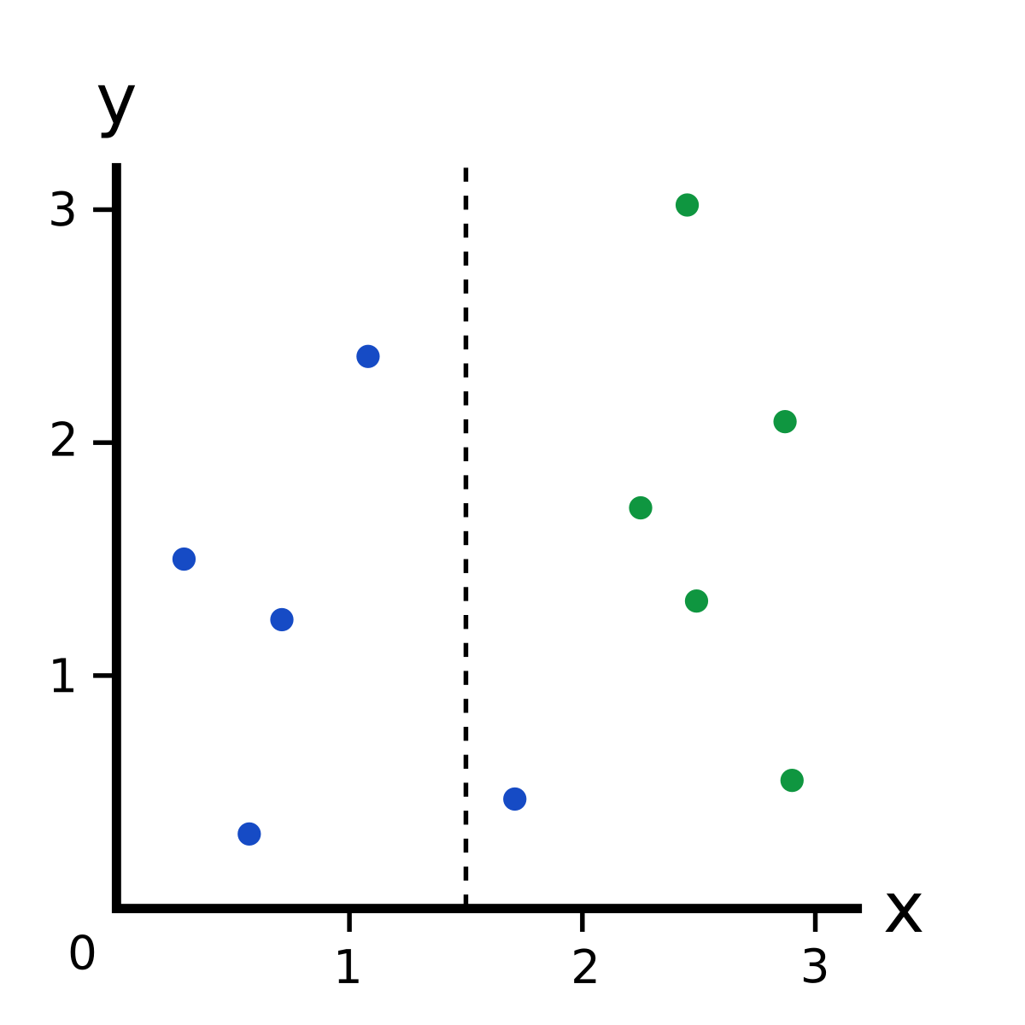
Classification

Slide 6
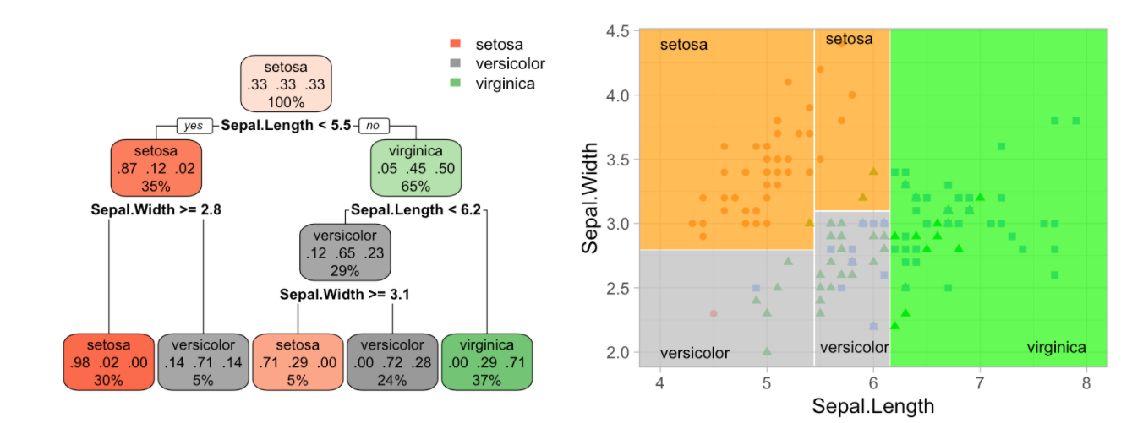
Decision Trees for classification

Slide 7
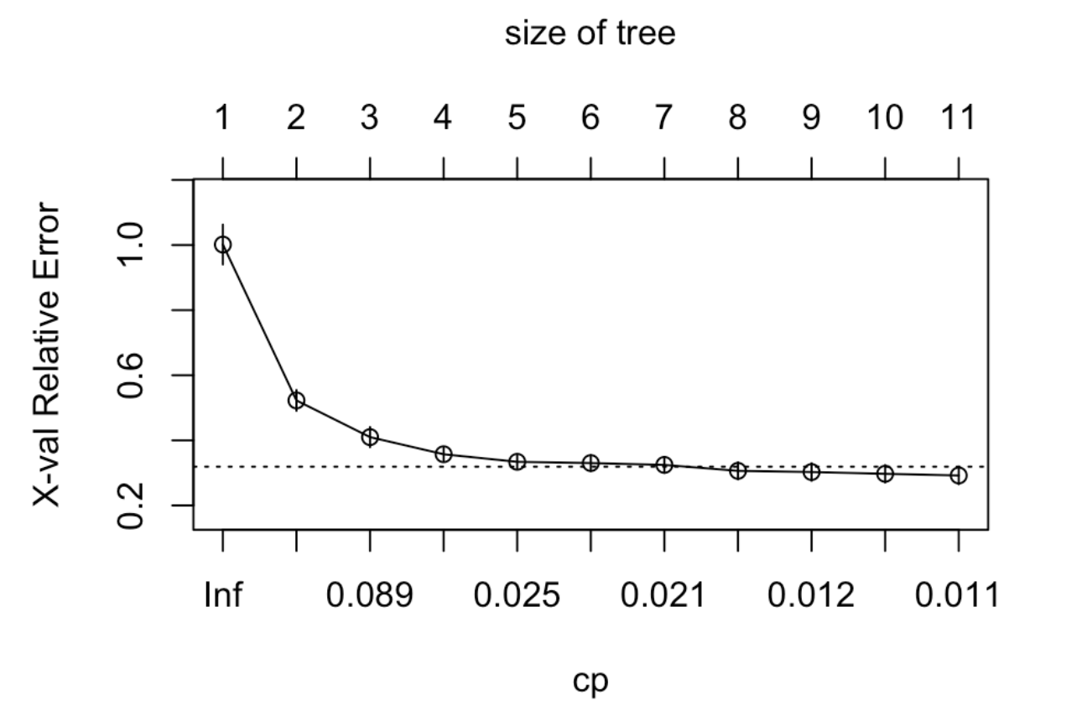

Slide 8
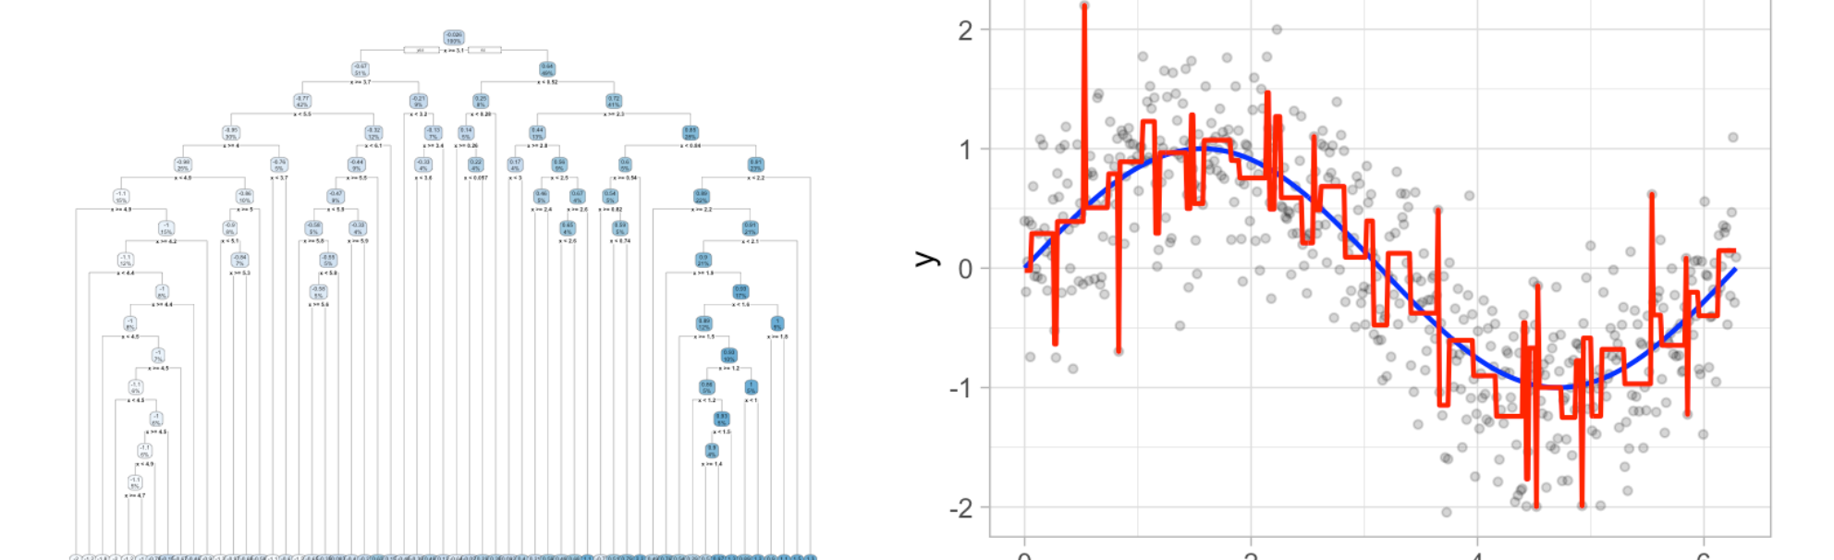
How deep?
This leads to an important question: how deep (i.e., complex) should we make the tree? If we grow an overly complex tree as in Figure 9.6, we tend to overfit to our training data resulting in poor generalization performance.
To find this balance, we have two primary approaches: (1) early stopping and (2) pruning.

Slide 9
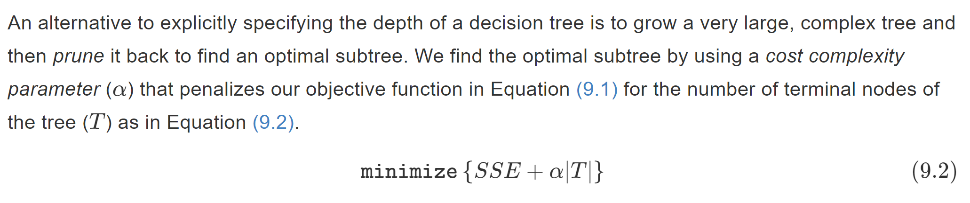
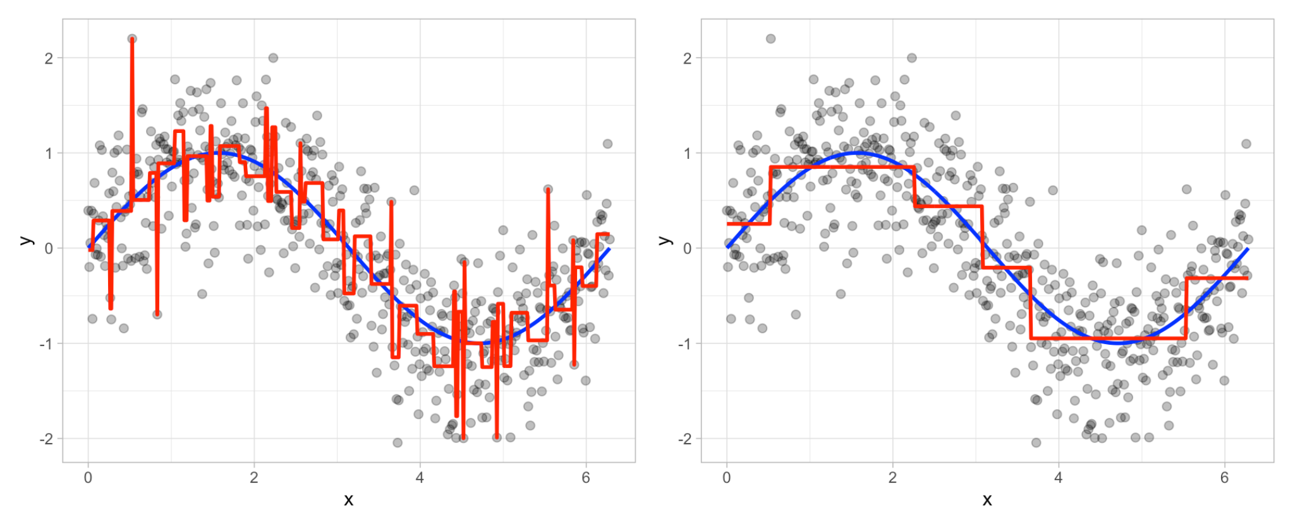
How deep?
This leads to an important question: how deep (i.e., complex) should we make the tree? If we grow an overly complex tree as in Figure 9.6, we tend to overfit to our training data resulting in poor generalization performance.
To find this balance, we have two primary approaches: (1) early stopping and (2) pruning.

Slide 10
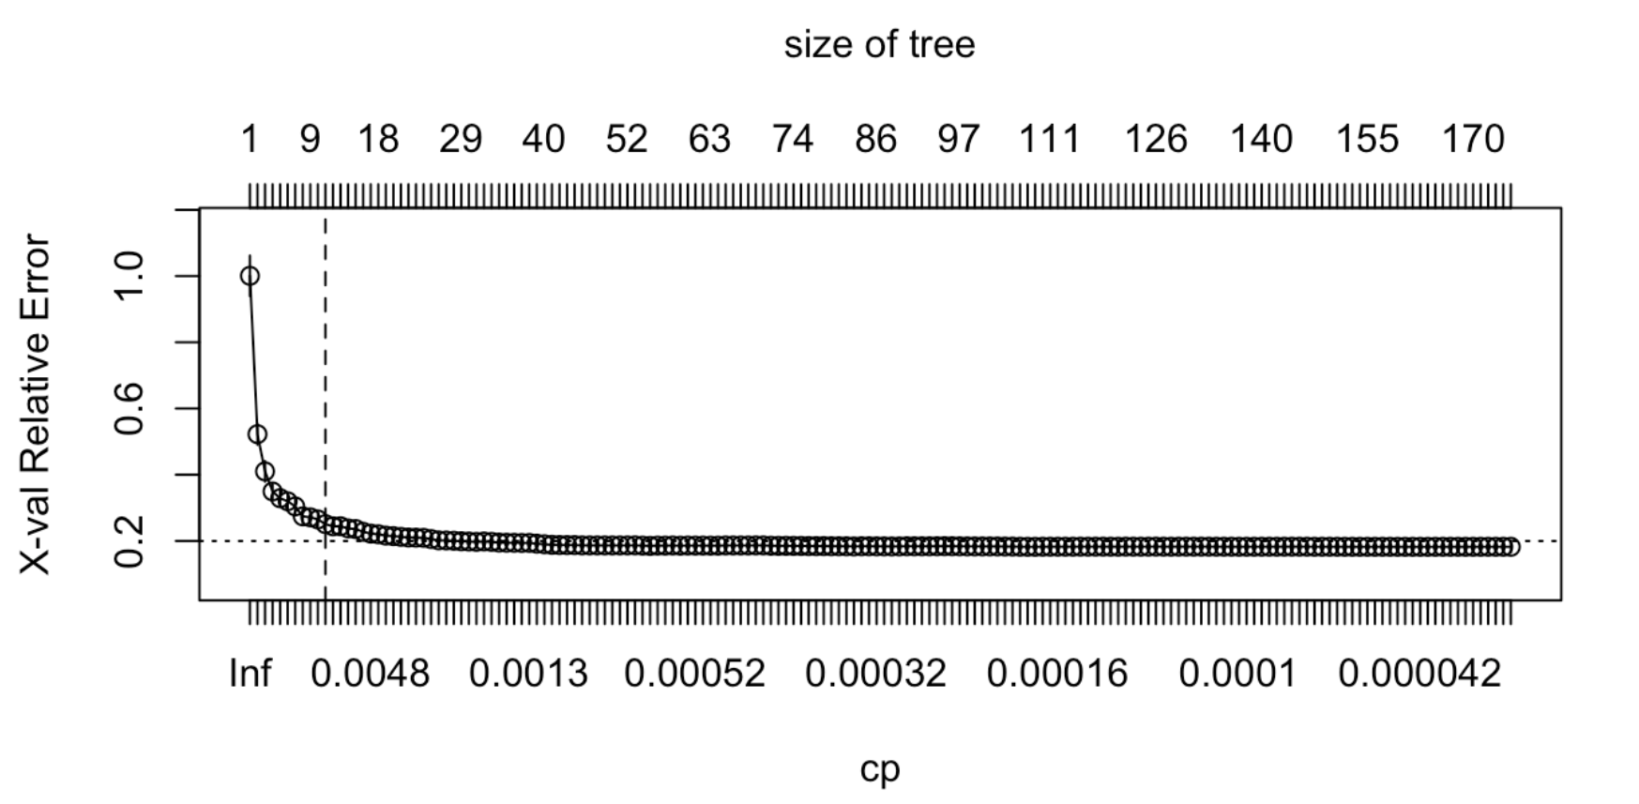

Slide 11
Decision Trees
Fernando Carazo Melo
PhD in Artificial intelligence and Computational Biology
fcarazo@tecnun.es

