Slide 1

Java-based PVR Software for Linux

Slide 2

A PVR is a Personal Video Recorder
Some notable examples:
  Tivo
  ReplayTV
A PVR usually performs two basic functions:
  Allows a user to pause and rewind live television
  Records, stores, and auto-expires programs from television
PVRs are commonly set-top boxes that stay up 24/7

Slide 3
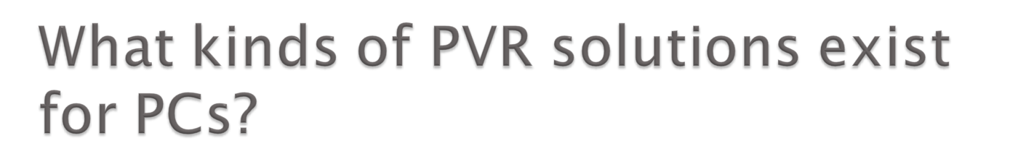
For Windows:
  Windows Media Center Edition
  BeyondTV
  SageTV
  Meedio / Yahoo! Go
For Linux:
  MythTV
  Freevo
  LinuxMCE
For Mac:
  myTV.PVR

Slide 4

Lack of platform independence (All!)
Lack of automatic commercial skipping (Windows MCE, Tivo, Freevo, BeyondTV)
Stability issues (MythTV, BeyondTV)
Lack of content portability (Windows MCE, Tivo)
Complex setup (Meedio, MythTV, LinuxMCE)
Clumsy GUI (SageTV, MythTV, Freevo)
Limited extensibility (MythTV, MCE)
No console-based utilities

Slide 5

Of the open source PVR applications, MythTV…
  Has the most features
  Appears to be the most widely adopted
Unfortunately, it has several drawbacks:
  Closed-minded developers (Opposition to Refactoring)
  Poor design (UI, Database, System Architecture)
  Bound to QT3 library; incompatible with QT4
  No source branching (SVN frequently broken)
  Reduces dependencies by re-inventing the wheel
  Slow (playback + TV listing interface)

Slide 6

Aims to be a better alternative to MythTV
Aims to implement/support majority of features that are present in MythTV
Aims to be much easier to install and configure than any existing open source solution
Primary development language – Java
Heart of the system – VLC
GUI platform – Java3D
Database platform – MySQL 5.0+

Slide 7

Architecture Goals
  Embrace change - requirements are dynamic, so source code and design must also be dynamic
  Use checked interfaces – exploit extra work the compiler can do for us
  Don’t reinvent the wheel – less code we write means less testing and less maintenance
  Delegate responsibility for external modules – code we’re not responsible for should remain unchanged
Usability Goals
  Stability isn’t a luxury – PVR systems are expected to be up 24/7, with minimal downtime
  Easy things don’t have to be limited – just because users want something easy doesn’t make them stupid

Slide 8

Future expansion to other OSes, if desired
Checked language
  Exceptions instead of segmentation faults
  Stricter limits on what’s passable vs. C or C++
  Less chance of memory leaks
  Simpler threading
Well-designed API architecture, as compared to QT, C++ STL, or .NET
Classes loaded dynamically, allowing:
  Updates during runtime
  Load-as-needed for smaller memory footprint

Slide 9

Nearly platform independent – supports:
  Linux
  Windows
  OS X
  BeOS
  BSD
  Windows CE
  Solaris
Already has preliminary support for:
  Countless video formats
  V4L & DVB
  Recording
  Streaming
  Integration into other programs through libVLC

Slide 10

Platform independence – graph-based rendering will utilize whatever graphics acceleration is available
Object-oriented vs. procedural approach to graphics (i.e. more abstraction that JOGL)
New IO (NIO) support for texturing!
Allows us to add eye-candy to interface later
Allows us to take advantage of the GPU for intensive tasks:
  De-interlacing
  Advanced filtering
  MPEG Decoding (esp. for HD-size frames)

Slide 11

mySQL is one of the most popular open source database systems in Linux
Stored procedure support
  Most major functionality for computing schedules, schedule conflicts, etc. can be written as stored procedures
  Stored procedures are stored and optimized in the database, to provide faster query results.

Slide 12

VLC is a native application written in C and C++
Java interfaces native applications and libraries via the Java Native Interface (JNI)
Unfortunately, the JNI has the following drawbacks:
  Native module crashes cause JVM crashes
  Native modules limit platform independence
  Exception handling is tricky from the native side

Slide 13

A major design goals is stability
We chose Java because it would allow us to be fault tolerant to crashes in certain threads
We are also trying to interface with native code (i.e. VLC)
Conundrum: crashes in native code will bring system down
Solution: intercept a crash in native code and hand over control to Java with an exception – JNIFault!

Slide 14

JNIFault is a feature of LegendTV that adds fault tolerance to native invocations
JNIFault prevents the operating system from killing LegendTV when a native module incurs a fault
JNIFault can be used to allow LegendTV to:
  Catch native faults as exceptions
  Unload only the affected module
  Log the fault / send error report to development team
  Attempt to re-load the module and re-start its task without affecting the rest of the system.

Slide 15

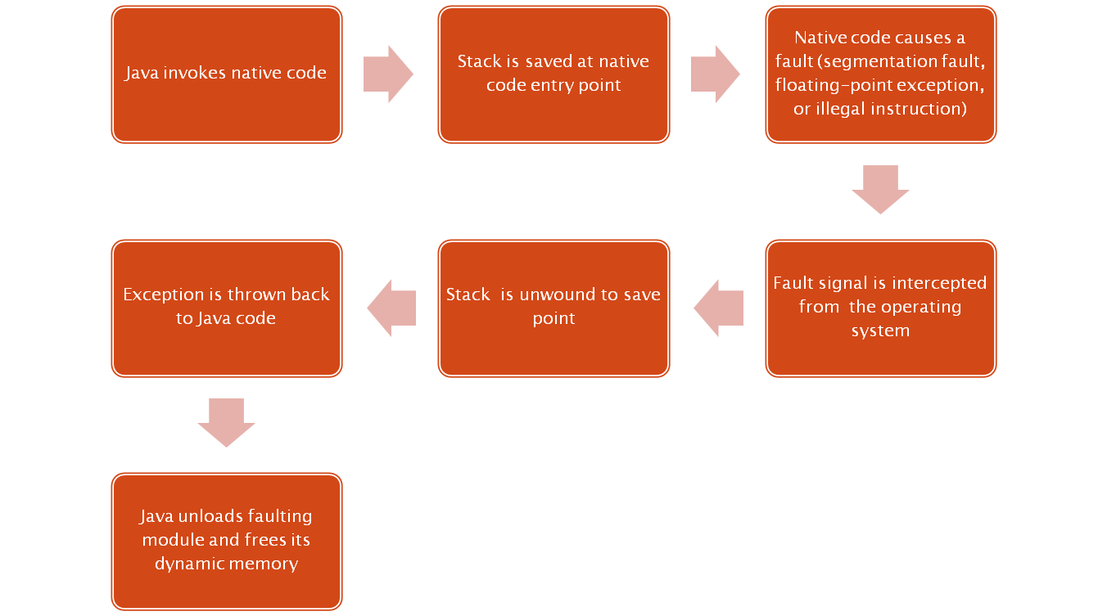

Slide 16
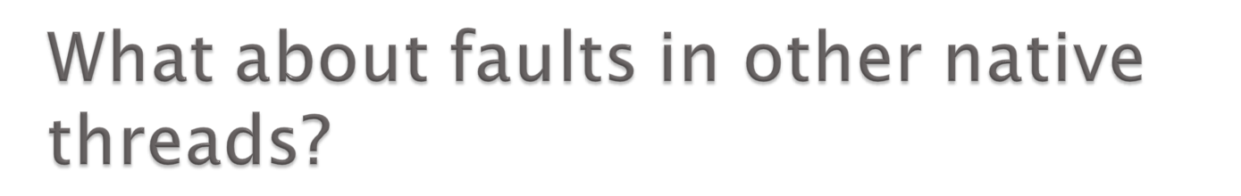
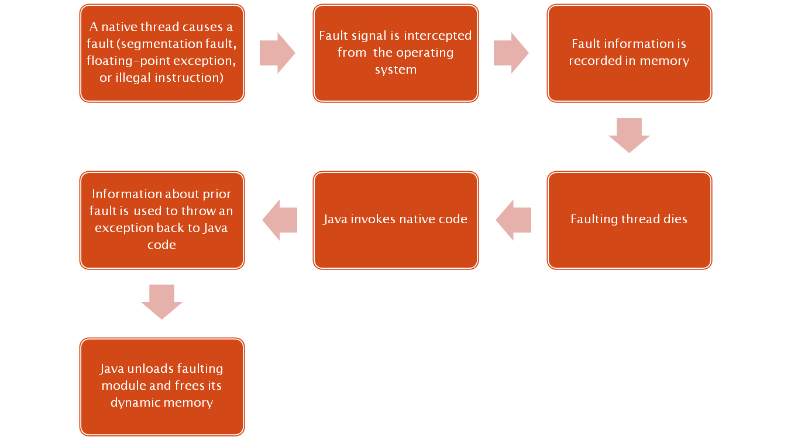

Slide 17



Slide 18

The project has recently begun!
Check out the project on Google Code:
  http://code.google.com/p/legendtv/
The project needs:
    For release 0.1 – Developers experienced with:
      Java
      SQL / Database Architecture
      VLC
    For release 0.2:
      Graphic designers / artists
      Developers experienced with Java3D / OpenGL / video filtering/processing
    For release 0.5 – experienced PHP & HTML developers
  Users with PVR hardware

