Slide 1
Supermarket Checkout Simulation
Analyzing and Optimizing Checkout Lanes Using Python
Presented by: Fernando Chikanda
Camira Chissico
Helder alisio

Slide 2
Objectives and key features
To simulate and optimize the checkout process in a supermarket setting.
Multithreading for parallel processing
Simulating both self-checkout and traditional lanes
Randomized customer behavior

Slide 3
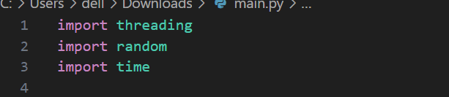
Imports and Libraries
Imports:
- threading for multithreading
- random for simulating customer processing times
- time for simulating delays

Slide 4
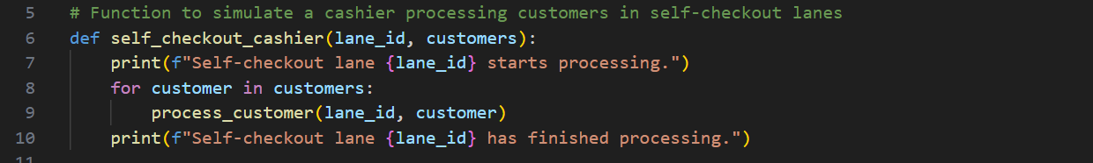
Customer and Processing Functions
Customer Processing Functions:
- self_checkout_cashier(lane_id, customers): Simulates self-checkout lane
- traditional_cashier(lane_id, customers): Simulates traditional lane
- process_customer(lane_id, customer): Simulates processing a customer with random time delays

Slide 5
Main Function Overview
Main Function Tasks:
- Initialize variables (number of customers, lanes)
- Shuffle and divide customers among lanes
- Create and start threads for each lane
- Wait for all threads to complete

Slide 6
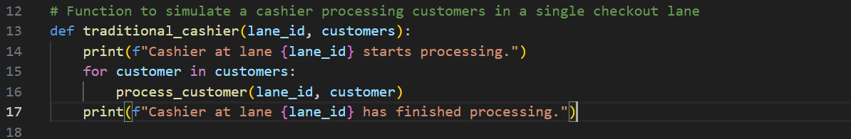
Main Function Details
Variable Initialization:
- num_customers: Total number of customers
- num_self_checkout_lanes: Number of self-checkout lanes
- num_traditional_lanes: Number of traditional lanes
Customer Distribution:
- Randomly shuffle customers
- Divide customers among lanes using list slicing

Slide 7
Thread Management
Thread Creation:
- threading.Thread for creating threads
- start() method to begin execution
Thread Synchronization:
- join() method to ensure main thread waits for all threads

Slide 8
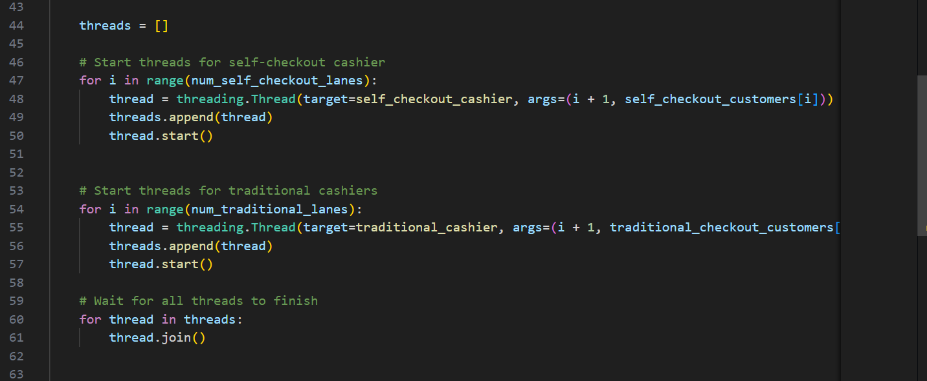

Slide 9
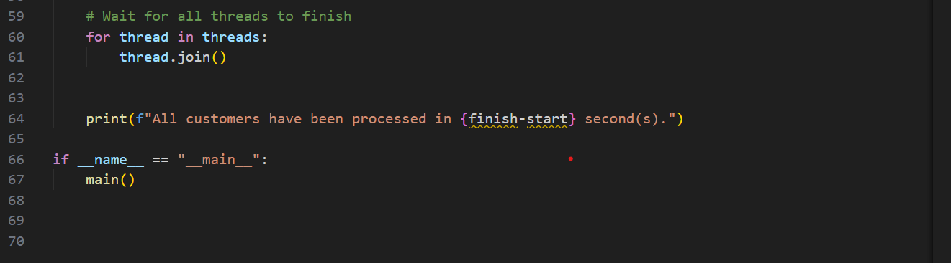
Execution Control
if __name__ == '__main__': Block
- Ensures the main function runs only when the script is executed directly

Slide 10
Were is this algorithm used in Real-World Applications?
Use Cases:
- Retail checkout efficiency analysis
- Queue management optimization
- Performance metrics tracking
- Event management

Slide 11
Potential Improvements
Enhancements:
- Realistic customer behavior models
- Advanced queue management algorithms
- Graphical user interface (GUI) for visualization
- Scalability for large-scale simulations

Slide 12
Conclusion
Summary:
- Simulates and optimizes supermarket checkout lanes
- Utilizes multithreading for parallel processing
- Practical tool for improving operational efficiency

