Slide 1
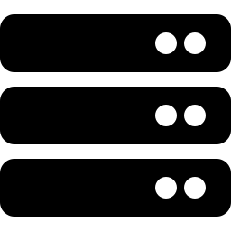
BLOCKZILLA
Edge Infrastructure for Superteam Hubs
Give every builder in your space zero-rate-limit RPC, live gRPC & shred streams, and full-archive indexing — the same infra stack that funds and market makers pay $30k+/year for.
COHORT 0 · 2026

Slide 2

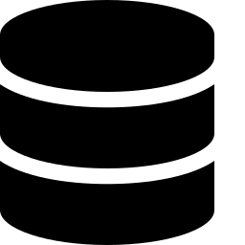

Every serious builder hits the same wall
Advanced infra exists on Solana — it just isn’t affordable outside a handful of funds and market makers.
Rate-limited RPC
Free/public RPC throttles exactly when a bot, indexer, or dApp needs to scale — capped requests, dropped calls, unreliable under load.
Gatekept real-time data
Live gRPC and shred streams run $120–500/mo and up. Fine for a funded team, out of reach for a solo builder or student cohort.
No affordable history
Full archive access means renting 100Gbit infrastructure or paying five figures a year in storage and bandwidth — so almost nobody keeps it, and nobody can query it.

Slide 3
One node replaces an infra budget most builders never get
Component | What a Blockzilla node gives you | Market equivalent (2026)
Local RPC | 0 rate-limit, dedicated node access | ~$500/mo (business plan)
gRPC stream | Live Yellowstone-grade stream, included | $120–500/mo
Shred stream | Jito-grade shred access, included | ~$1,000/mo
Archive / history | Full historical data, local & queryable | ~$20k/yr storage + ~$100k/yr bandwidth
Fast indexer | Jetstream-style indexing, no rented rig | $1.5–3k+/mo dedicated 100Gbit infra
$30,000+
in yearly infrastructure value, included in one node — no rate limits, no metering, no rented hardware.
Estimates from public 2026 pricing (Helius, Triton, Chainstack, Shyft, Solana Tracker). Actual value varies by workload.

Slide 4





What plug-and-play infra unlocks in your hub
The same access, in the hands of your builders instead of a fund’s trading desk.
AI training & agents
Trading bots & vaults
New indexing products
Train and evaluate models on raw shred-level data most labs never get to see.
Sub-second local execution, no rate-limit risk at the moment it matters most.
Launch institutional-grade data services on top of your own node.
Real fund backtests
A way in for junior devs
Depth even top teams skip
Hedge funds & institutions validate strategies on complete, real history.
Hands-on time with infra normally reserved for funded teams — the line that gets interviews.
Advanced devs reach data that even their own employers won’t bother storing.

Slide 5
Two ways to run it — one way to get support
DIY / Self-hosted
Blockzilla Subscription
Free
~€200–250/mo*
Configure your own gRPC / shred stack
You own maintenance, updates, uptime
Data gaps and downtime are possible
No shared support channel
Plug-and-play — connects straight into the Blockzilla network
Cohort 0 Telegram support, all hub operators
30% referral fee on every node you help sell
*Pricing indicative — confirm final terms before sharing externally.

Slide 6


Give your hub Solana’s edge
One node. Zero rate limits. A builder community with the same tools as the funds they compete with.
Cohort 0 Telegram support
cheron.augustin@gmail.com

