Slide 1

Analysis reports for
Workplace satisfaction survey dataset

Slide 2

Background of the survey
The survey was conducted by interviewing 82 employees of company XYZ between 4.9.2023 and 22.9.2023.
Each employee was sent the survey via email. Answering the survey was compulsory.
The survey was conducted in order to get a better idea of the general wellbeing of the employees in the company.
All the participants got a Tesla for their effort.

Slide 3
Variables of the survey
Variables | 1 | gender (1 = male, 2 = female)
 | 2 | age (years)
 | 3 | relationship status (1 = single, 2 = not single)
 | 4 | education (1 = primary school, 2 = secondary school graduate, 3 = bachelor level, 4 = master level)
 | 5 | years of service (the number of years the person has been working for the company)
 | 6 | salary (€/month)
 | 7 | satisfaction with management (scale 1 – 5; 1 = very unsatisfied, 5 = very satisfied)
 | 8 | satisfaction with colleagues (scale 1 – 5; 1 = very unsatisfied, 5 = very satisfied)
 | 9 | satisfaction with work environment (scale 1 – 5; 1 = very unsatisfied, 5 = very satisfied)
 | 10 | satisfaction with salary (scale 1 – 5; 1 = very unsatisfied, 5 = very satisfied)
 | 11 | satisfaction with tasks (scale 1 – 5; 1 = very unsatisfied, 5 = very satisfied)
Categorical variables: gender, family, education
Variables using opinion scale: satisfaction with management, colleagues, work environment, salary, tasks
(In this Likert scale (1-5) number 3 means neutral)
Numerical variables: age, years of service, salary

Slide 4
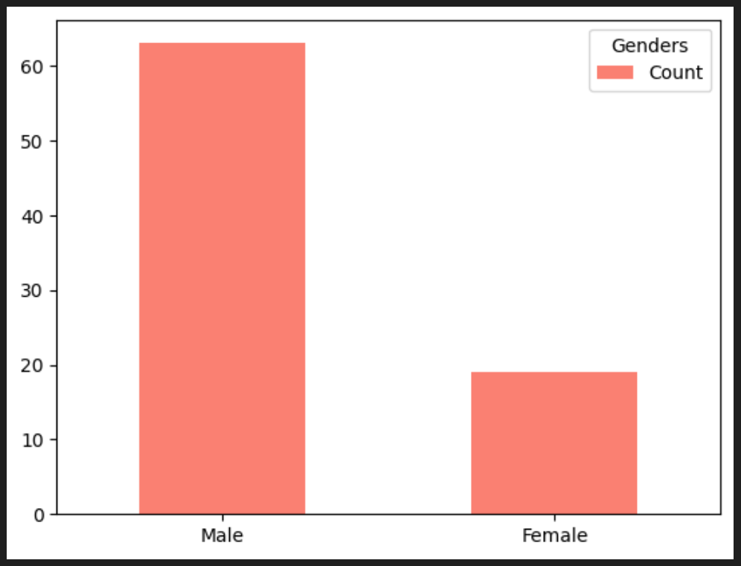
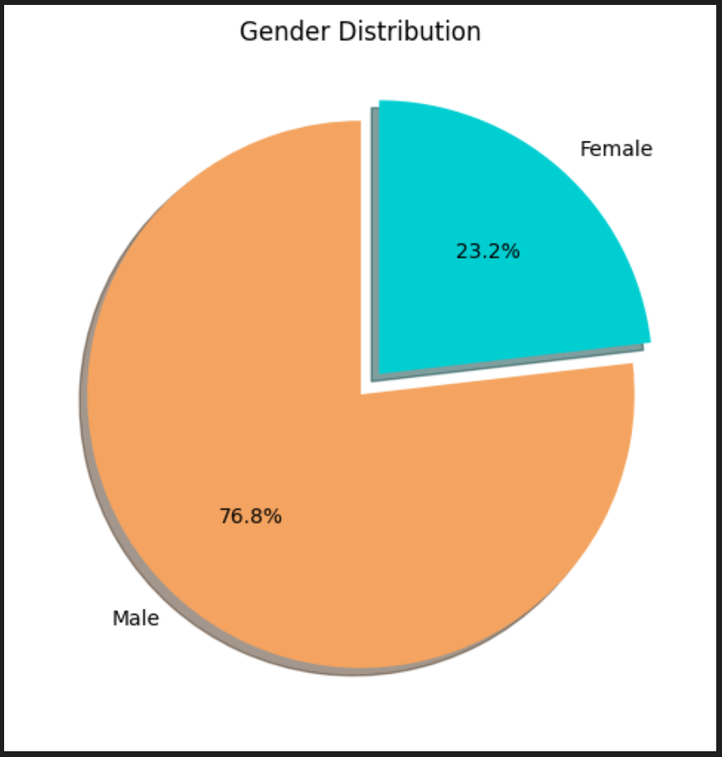
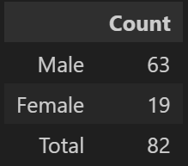
Gender distribution in the company
The male to female ratio in the company is rather shocking, no matter how you look at it. Female employees represent less than a quarter - 23,2% - of the whole workforce.
However, non-binary identities were excluded in the survey.

Slide 5
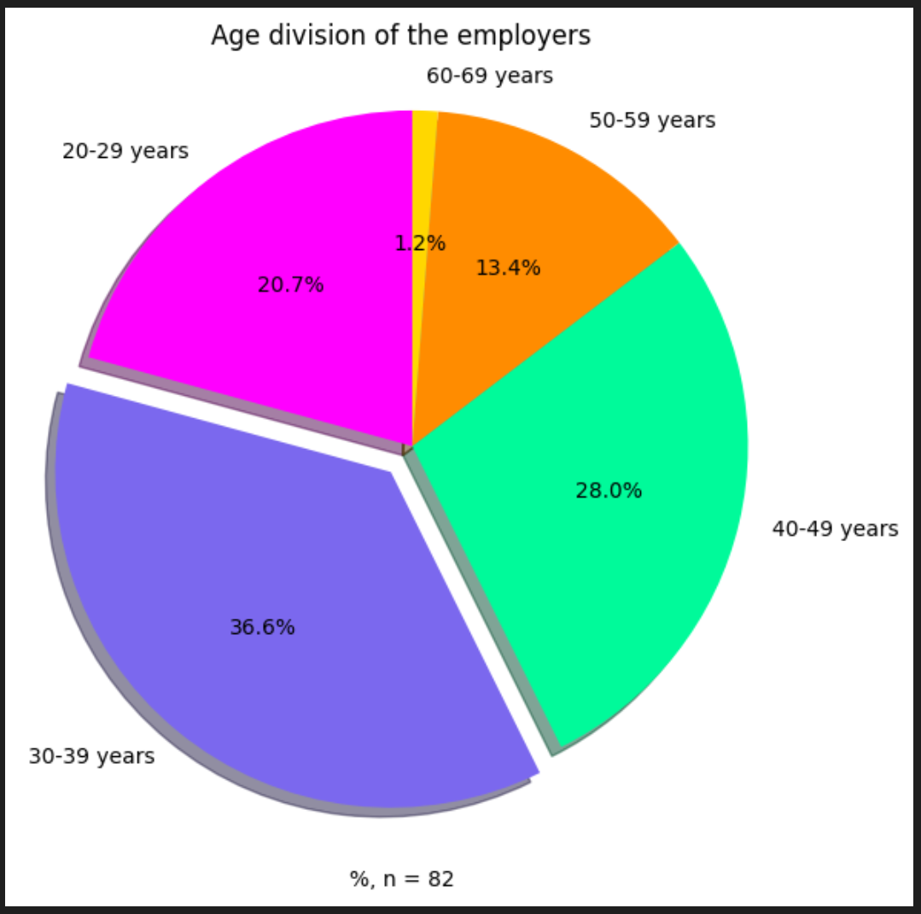
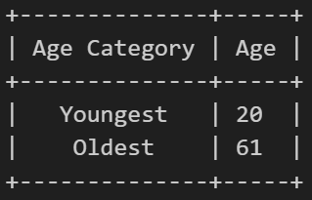
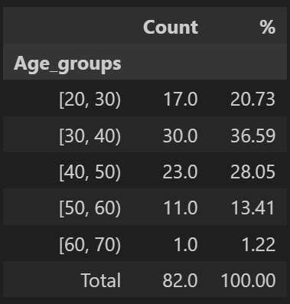
Age distribution in the company
The age distribution of the employees is rather large, the youngest employee being 20 years old and the oldest 61 years old.
It would seem that there is only one imminent retirement looming among the employees.
The vast majority of the workforce is aged 30 to 40, so one should hope they will stay at the company for a very long time.

Slide 6
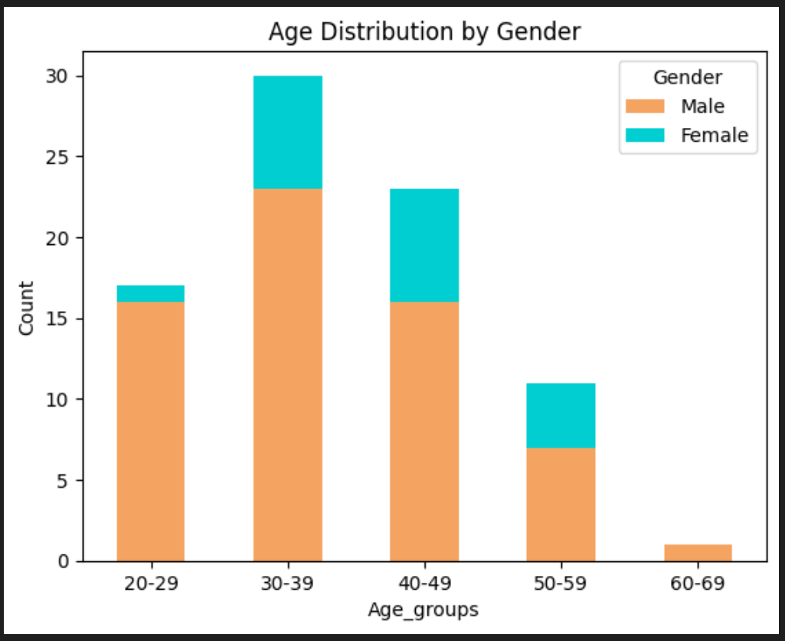
Age groups and genders within them
The male employees form the vast majority of every single age group in the company. The management should look into employing more females. However, the sheer number of male workers may also deter female applicants.
The majority of female employees are in the age brackets from 30 to 49, so there is a chance they will stay at the company for the next twenty or so years.

Slide 7
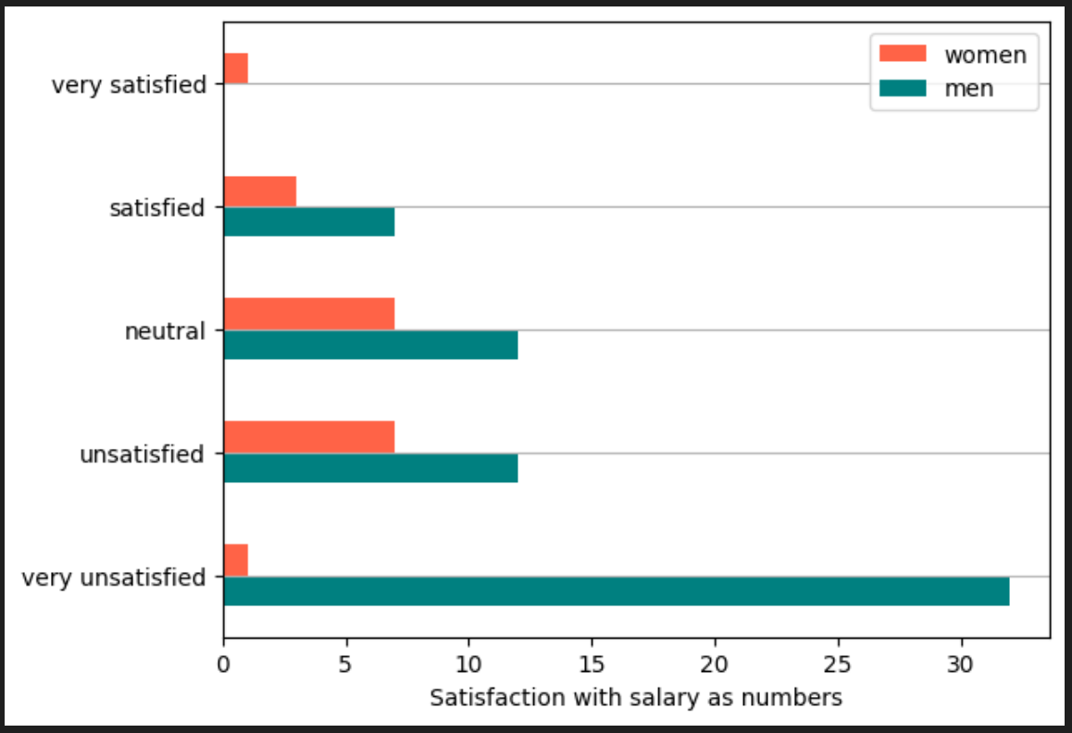
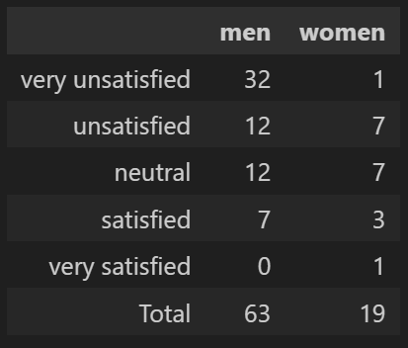
Gender differences in salary satisfaction
By looking at these numbers one could easily assume that the female employees are more satisfied with their salaries than males. However, the graph is somewhat misleading simply due to the small number of female workers.

Slide 8
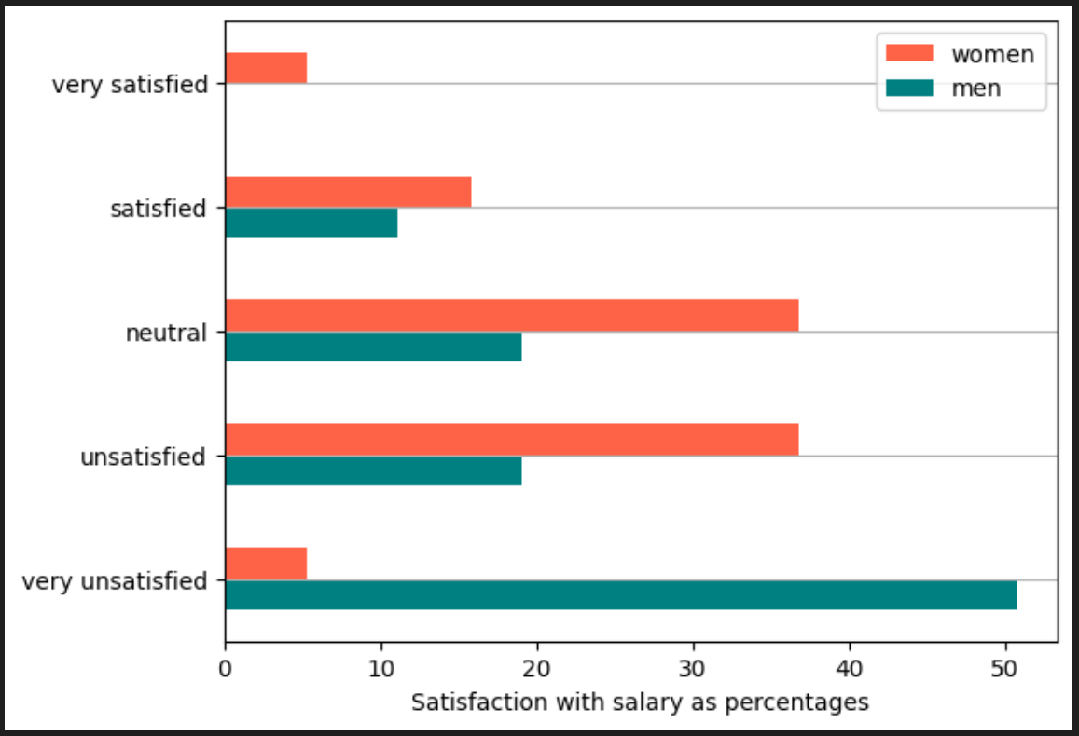
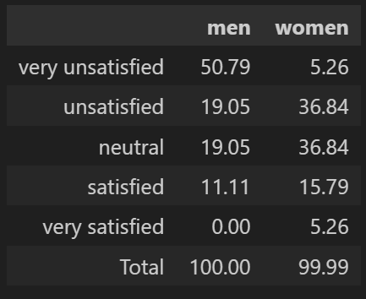
Gender differences in salary satisfaction continued
This table and graph show the same results in percentages. As one can see, the percentage of female employees unsatisfied with their salary is far greater than that of the male employees.
The p-value for this test was ~0.0045 which indicates a rather significant level of dependency between the variables 'gender' and 'sat_salary'.

Slide 9
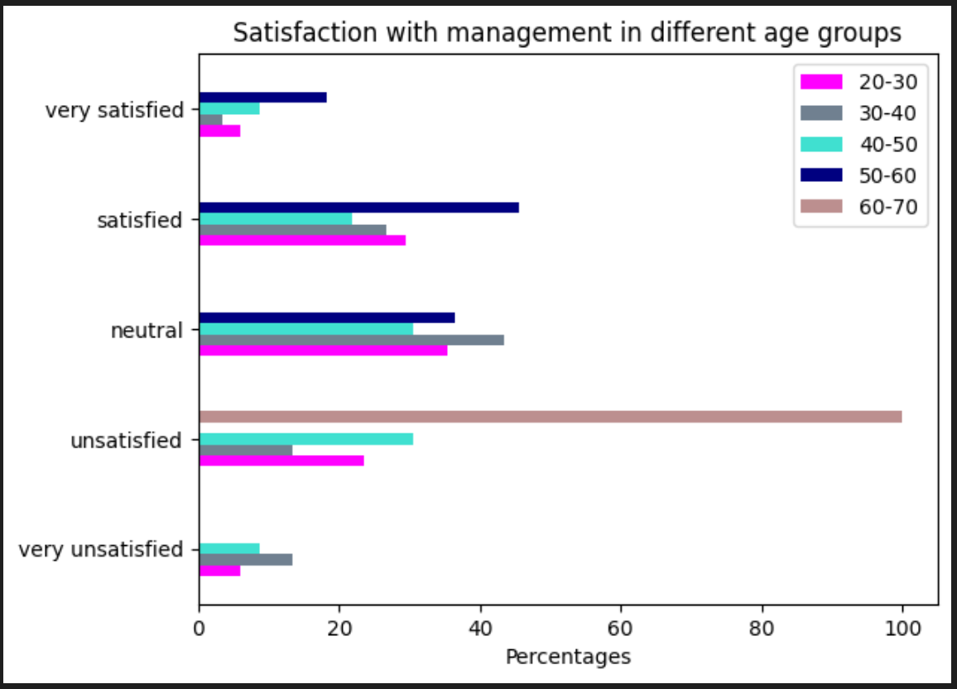
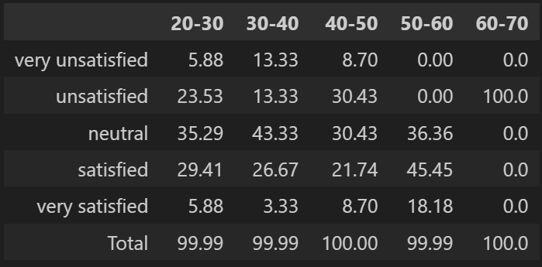
Management satisfaction in age groups
The employees aged 50 to 60 seem to be the happiest with the management. Not a single member in this age group expressed dissatisfaction with management.
The very unsatisfied lot on the other hand are the employees aged 20 to 50.
The 100% dissatisfaction with management is due to the response of one sole employee of that age group in question (60-70).
The p-value for these variables is 2.9, so there is no statistical dependence between them at all.

Slide 10

Exploring Employee Satisfaction and Salary Distribution: A Comprehensive Analysis (Salary and sat_salary)

Slide 11
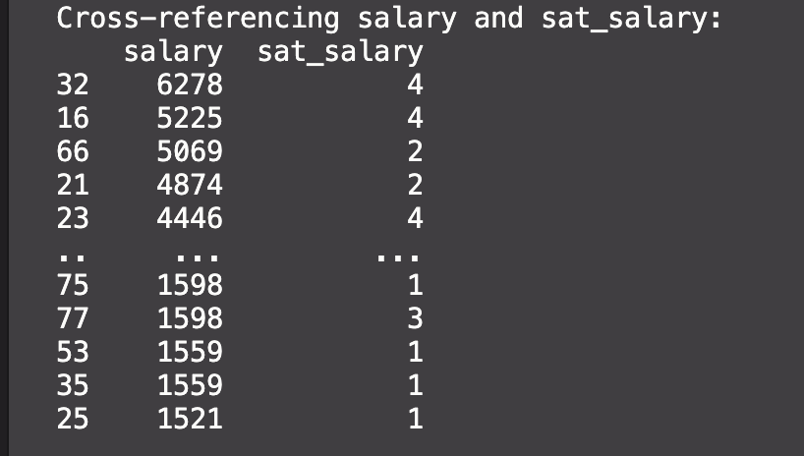
Cross-referencing Salary and Job Satisfaction
A side-by-side comparison of employee salaries and their corresponding job satisfaction levels.
Employees with higher salaries tend to report higher job satisfaction, as indicated by the positive trend between salary and sat_salary.
This comparison reveals a correlation between salary and satisfaction of the salary.
While there are exceptions, such as individuals with lower salaries reporting high job satisfaction, the overall trend suggests that compensation plays a significant role in job satisfaction.

Slide 12
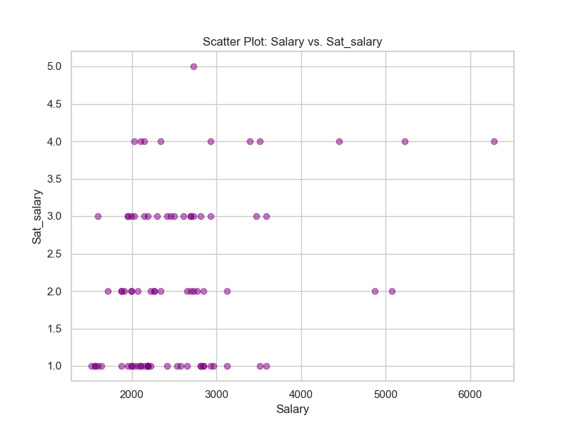
Exploring Salary and Satisfaction
A scatter plot illustrating the relationship between employee salaries and their satisfaction levels with their salaries.
Based on the survey, it is my belief that there is no clear linear correlation between salary and satisfaction. This suggests that while salary alone may not determine satisfaction, it plays a role.
A significant portion of employees with varying salary levels report varying satisfaction levels.

Slide 13
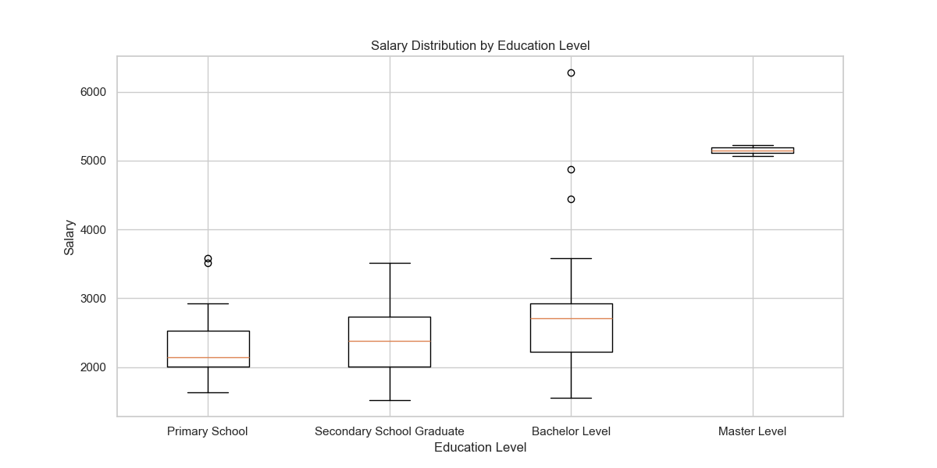
Salary Distribution by Education
A box plot showcasing how employee salaries vary across different education levels.
Bachelor-level education appears to have the widest salary distribution, with both high and low salary earners.
Primary school-educated employees generally earn lower salaries.
Secondary school graduates have a broad salary distribution also. This indicates that salary disparities exist even among employees with similar educational backgrounds.

Slide 14
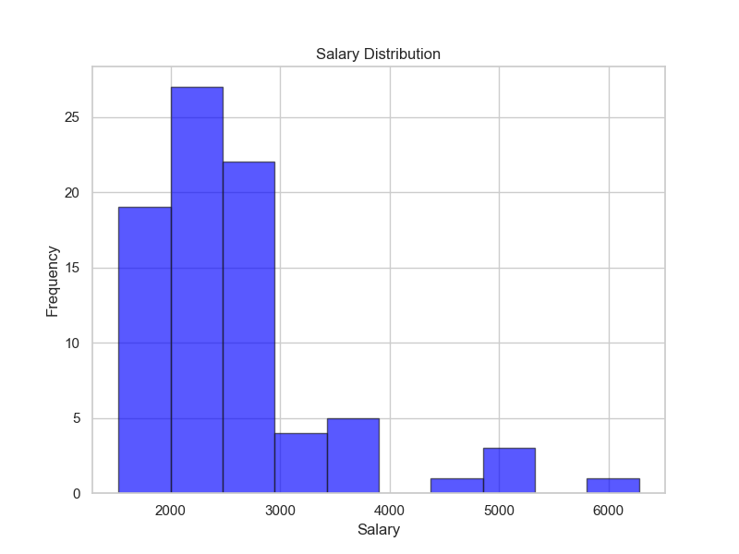
Overall Salary Distribution
A histogram displaying the overall distribution of employee salaries within the dataset.
The majority of employees fall within the salary range of 2000€ > 3000€.
Only a small percentage earns more than 4000€.
There are almost as much as employees who earn under 2000€ as there are employees who earn more than 3000€.

Slide 15
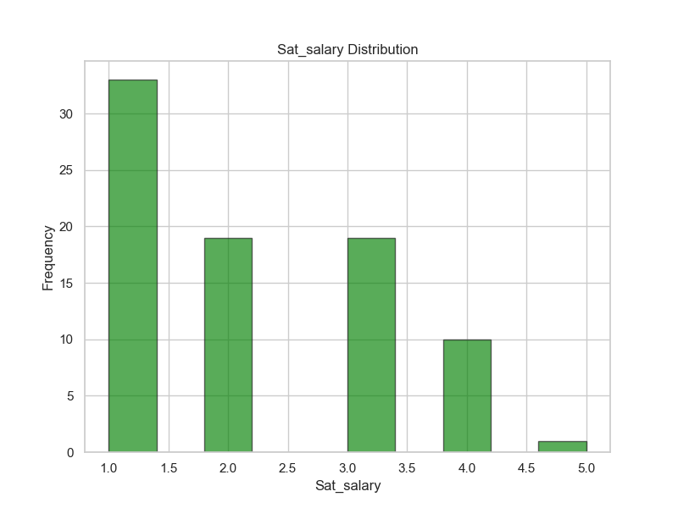
Satisfaction with Salary Distribution
A histogram revealing the distribution of employee satisfaction levels with their salaries.
The distribution indicates that a considerable number of employees are neutral or dissatisfied with their salaries.
The histogram highlights a substantial number of employees who fall into the 'Neutral' satisfaction category, suggesting room for improvement in addressing salary satisfaction.
A concerning observation is the significant proportion of employees who are extremely dissatisfied with their salaries. This is a red flag that needs attention -> could have repercussions in the near future, potentially leading to increased turnover rates and a negative impact on employee morale and productivity.
To ensure the organization's long-term success and employee retention, it's imperative to address the concerns of dissatisfied employees and explore ways to enhance salary satisfaction.

Slide 16
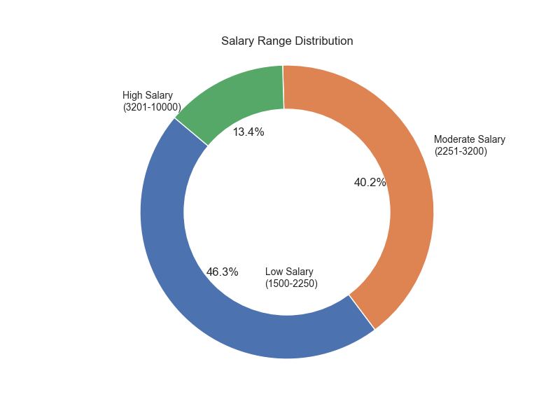
Employee Salary Ranges
A pie chart depicting the distribution of employees across various salary ranges.
The 'Moderate Salary' range appears to be the most common among employees, indicating that the organization might have a balanced approach to compensation.
These salary ranges were used based on Elinkeinoelämä valtuuskunta (EVA).
The 'Low Salary' range, representing whooping 46,3%, suggests that some employees may be earning below industry standards, warranting a review of compensation practices.

Slide 17

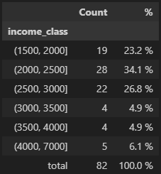
Salary Structure
As we can see from the two tables, our salary expenses are pretty reasonable.
Most of our employees earn less than 3000€ / month with the minimum salary being 1521€
Median salary of 2320€ means that half of our employees earn less than that, and half earn more. But from those who earn more, only 15% earn more than 3000€ / months.

Slide 18
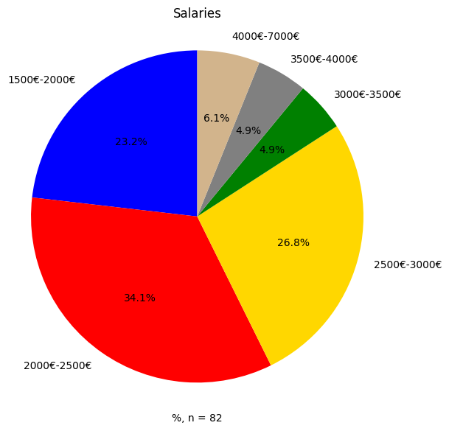
Salary Structure
Here’s an another way to look at the salaries.
Again we see that 50% of the employees earn less than 2500€ a month.
Also only 15,9% of the employees earn more than 3000€ a month.

Slide 19

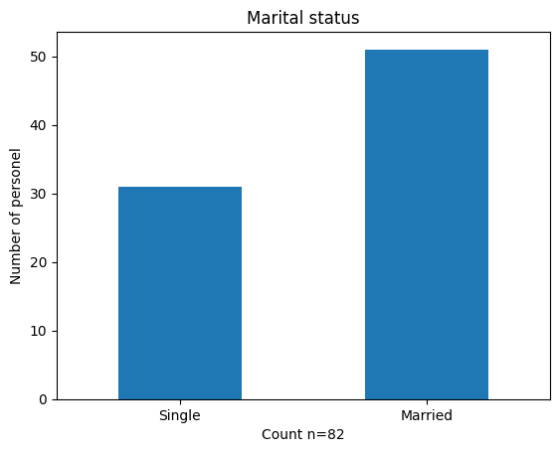
Marital status
Here we see how many of our employees are married and how many are single.
Most of our employees are married.

Slide 20
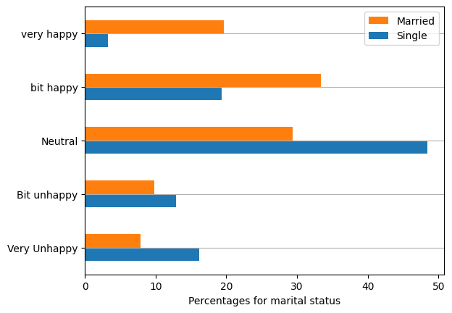
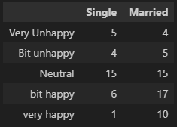
Working environment and marital status
Most of the personnel who are very happy with their working environment are married.
Despite this, the p-value is 0,076 and thus there doesn’t seem to be any strong correlation between marrital status and happiness with the working environment
With larger dataset we might be able to confirm the dependancy, but with only 82 participants we cannot say for sure that there is a dependancy between marital status and happiness with working environment.

Slide 21
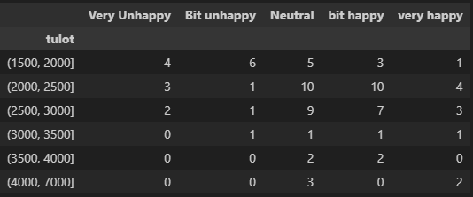
Working environment and salary
Looking at the salary groups and how happy they are with their working environment, the personnel who earn more than 3000€ do seem to be happier with the environment.
The p-value of 0.39 also tells us that there is no dependancy between these two values.

Slide 22
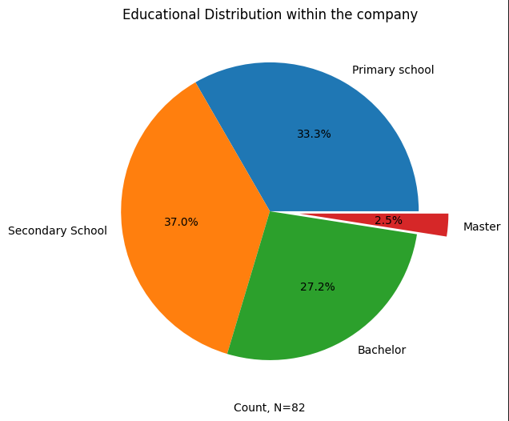

Educational distribution in the company
We can see that the educational backgrounds in the company are pretty even excluding Master's degrees. Current hypothesis is that the company as a workplace is not interesting among the people holding a Master's degree or that they seek for more challenging work tasks somewhere else. This could be investigated further with different surveys or perhaps analyzing SAT variables together with education.
Also, from a total of 82 employees we can see that one has no education at all.
Major part of the workforce in the company consists of people without a higher education

Slide 23
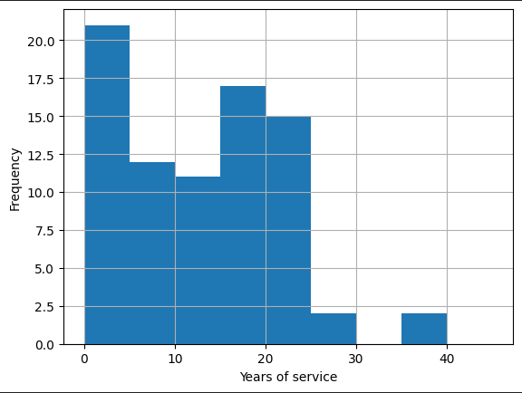
Job longevity (Years of service)
We can see that the workforce majorly consists of people with somewhere between 0 to 5 years of service. The second major part is people with a stunning 15 to 25 years of service.
It is my belief that the company is easily approachable for people with less experience in the field.
At the same time looking at the people who have been in the company for 15 to 25 years would suggest that some company principles such as culture, work environment etc. Encourage longevity withing the workforce.

Slide 24
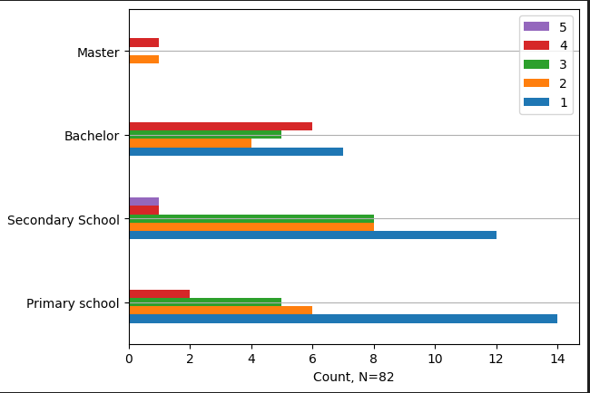

Salary satisfaction by education
Among primary school-educated employees, salary dissatisfaction is significantly higher.
At the same time, it seems like this also branches out to secondary school educated employees
On higher education levels this seems to even out a little bit

Slide 25
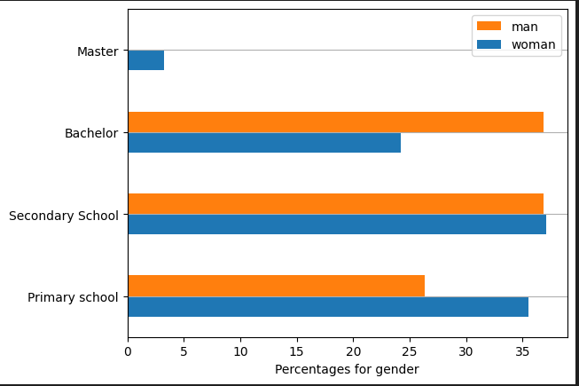
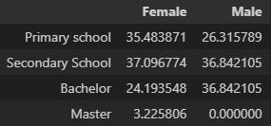
Educational background by gender
It seems like inside the company only females hold a Master's degree while men have none.
At the same time, we can see that males in the company have significantly more Bachelor's acquired than females

Slide 26
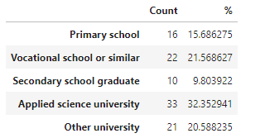
**Tästä eteenpäin Tommin slideja, deletoidaan**
Based on the survey the SOMETHING levels of the empolyees are distributed based on the percentage table shown here.
More analysis/explanation goes here…
Or maybe better to use percentages in this case….

Slide 27
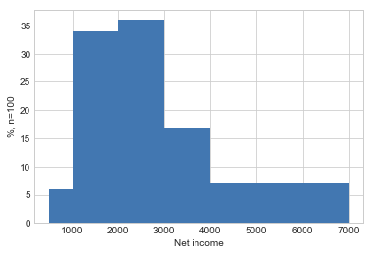
Background analysis (Net house income variable)
Since boxplot does not describe the customer net house income fully the histogram of that variable is provided here. The income classes used where
500 - 1000
1000 – 2000
2000 – 3000
3000 – 4000
4000 – 7000
We can see that about 70% of our curtomers net house income is between 1000 and 300 euros and also 3000 – 4000 e net income is rather common.
Maybe some suggestions based on your findings… (no need now for this course!)

Slide 28
Analyzes two qualitative variables
Maybe there are some variable pair of variables 1-7 that provide meaningful background information for the business already
However, remember that your boss is most interested in findings with variables 1-7 together with variables 8 and 9!
Here I will report analysis between variables gender and education… Which does not have much if any meaning for the business here … but just for the illustration.
… So it is your job to analyze something interesting for your boss!!

Slide 29
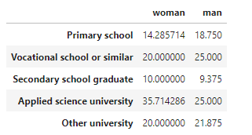
Analyzing dependency between variables gender and education
Note! This slide is just for illustration
Actually we did not find anathing interesting here that should be actually reported!
It is your job to find something meaningful for the business with the dataset used for the Project Work!!
Here we analyze, whether there is dependency between variables gender and education.
Out of all women, 14.3% of them has their highest education level as primary school. This is bit less than for men.
The respective values seem to be rather close in all the educational levels and we suspect there is no dependency between the variables
This was tested with Chi2 test which gave us the p-value of 0,85 which tell us that there is no dependency between the two variables.

Slide 30
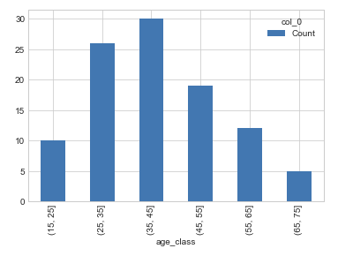
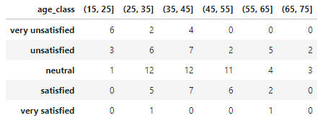
Analyzing dependency between age_groups and sat_price_level
The figure here shows the the age classes that we used in our analysis – the counts are shown also
The crosstabulation is given in the table on the right
Based on the cross tabulation it seems that for example that our youngest customers and mostly unsatisfied or even very unsatified with our price levels.
…
We suggest that we make a campaign for our youngest customers of some kind…

Slide 31
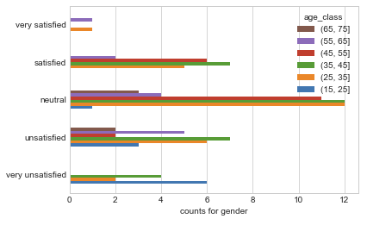
Analyzing dependency between age_groups and sat_price_level
We made a proper test for these variables. The p-value for the test was ~0.0036 so the level of dependency between the two variables is statistically significant.
By examining the data we can see that, for example, our youngest customers are the most unsatisfied age group what comes to the price level.
…
…

Slide 32
Continue with your other findings
When you are done with analysing and you have done this powerpoint accordingly, make the Project work video where you discuss this PowerPoint and especially your findings clearly.
Remember to see the Project Work guidelines fully for other things to be discussed on the video also!!

