Slide 1

Autonomous Quadruped
Team13:Iron Dog
Professor: Dr. Markus Ryll
Group member: Yang Xu, Xinwen Liao, Guanran Pei, Zihao Wang

Slide 2
Catalog:
Perception
Path Planning
Controller

Slide 3
Perception
Depth iamge
Depth_image_proc
Point cloud
Octomap
Occpancy Grid

Slide 4
Path Planing
Occupancy Grid
Map_saver
Move_base
Cost Map
Path
.yaml files

Slide 5
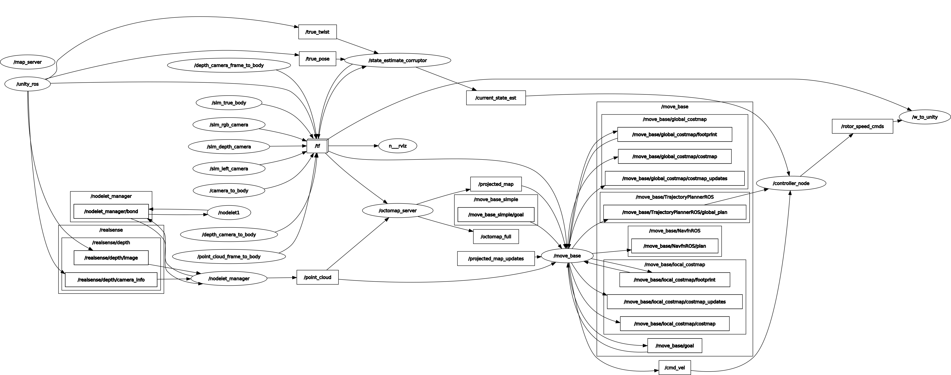
Controller

Slide 6
Controller
Time based Control
Different time point are set to change the direction,
so that the robot can walk through the road.
Signal based Control
Topic to subscribe:
move_base/TrajectoryPlannerROS/global_plan
current_state_est
cmd/vel
Current_goal
Calculate the difference in x and y

Slide 7
Problem and future
Problem:
Can't climb the steps.
The controller can't follow up the trajectory well.
Because of unknown part in the map, we need to click the 2D Nav Goal 2 times
Future
If possible, can we get the urdf of the robot? This way all joints of the robot can be controlled.
2.We should read more control books. The hardest part in this project is controller. By now we had no enough knowledge to deal the problem well.
3.We should read the orb_slam's or other vslam's code. The robot has rgb camera, but we don't know how to use it.

Slide 8
Thank you!

