Slide 1

OBAFEMI AWOLOWO UNIVERSITY, ILE-IFE
Online Library
Management System
A web-based catalogue and circulation system for the
Hezekiah Oluwasanmi Library
GROUP
Group 4, Part 1, 22 members
COURSE
SEN 106 / SEN 216, Introduction to Web Technologies
LIVE
library.appmd.dev · api.library.appmd.dev
Notes:
Good morning. We are Group 4. Our project is an online library management system for the Hezekiah Oluwasanmi Library. Both halves are live and we will show them running.

Slide 2
THE PROBLEM
Everything is on paper, and nothing is searchable
The Hezekiah Oluwasanmi Library holds one of the largest collections in West Africa. Finding a book still means walking to the shelf. Borrowing is recorded in a ledger, so no one can answer a simple question without opening a book of records.
What the system replaces
Card catalogue
Full-text search over 223 titles
Paper ledger
1
Is it available?
A loan row, timed to the second
The catalogue cannot say. A student walks to the shelf to find out.
Shelf walk
Live availability before you leave your room
2
Who has it?
Manual audit
Loans live in a ledger. Tracing one book means reading pages by hand.
Overdue computed from the clock
3
What is overdue?
Verbal reminder
Email and push sent automatically
Nobody knows until a ledger is audited, so fines go uncollected.
2
Notes:
The library is not short of books. It is short of answers about them.

Slide 3
WHAT WE BUILT
A catalogue and a circulation desk
The system manages the physical collection. It never stores or serves book content: it tracks where each physical copy is and who is holding it.
1
Search the catalogue
2
Borrow and return
3
Reserve a title
Title, author, ISBN and subject, with typo tolerance. Open to the public, no login.
A librarian issues a copy at the desk. Limits and loan periods follow the member category.
When every copy is out, a member joins a queue and is told when one comes back.
4
Save a title
5
Members and roles
6
Notifications
A private reading list. It reserves nothing and only the member can see it.
Member, librarian and administrator. Every permission is re-checked on the server.
Due dates and reserve alerts by email and push, queued through an outbox.
3
Notes:
Scope discipline mattered. We were tempted to add PDFs. We did not: this is a system for a building full of physical books.

Slide 4
THE STACK
Every technology, and what each one is for
Back end
Front end
Platform
Go 1.27
HTML5
Docker
One static binary. Concurrency is in the language, which borrowing needs.
Semantic elements and real form controls.
Multi-stage build to a 15.5 MB scratch image.
GitHub Actions
PostgreSQL
CSS3
Test, scan, migrate, build, deploy, smoke.
Row locks and transactions. A loan's correctness depends on them.
Custom properties, flexbox and grid. One responsive layout.
Render
Runs the API. Ohio, US East.
pgx
JavaScript
Neon
Postgres driver and connection pool.
Fetch and DOM. No framework: the course examines this directly.
Managed Postgres. us-east-1.
Upstash
Managed Redis. us-east-1.
Redis
OpenAPI 3.0.3
Vercel
Rate-limit counters only. A cache, never a store of record.
The contract the interface is written against.
Serves the front end at the edge.
Cloudflare
Argon2id
Open Library
DNS and TLS for appmd.dev.
Password hashing, memory-hard at 64 MB.
Book cover images, fetched by ISBN.
Resend
Transactional email from the verified domain.
JWT HS256
Schema.org
Firebase FCM
Access tokens, with the algorithm pinned.
Structured data describing the site as a Library.
Push notifications to registered devices.
govulncheck
Dependency vulnerability scanning in CI.
4
Notes:
Every choice answers a requirement. Go for the concurrency, Postgres for the locks, Redis only as a counter we can afford to lose. Firebase is here for push and nothing else.

Slide 5
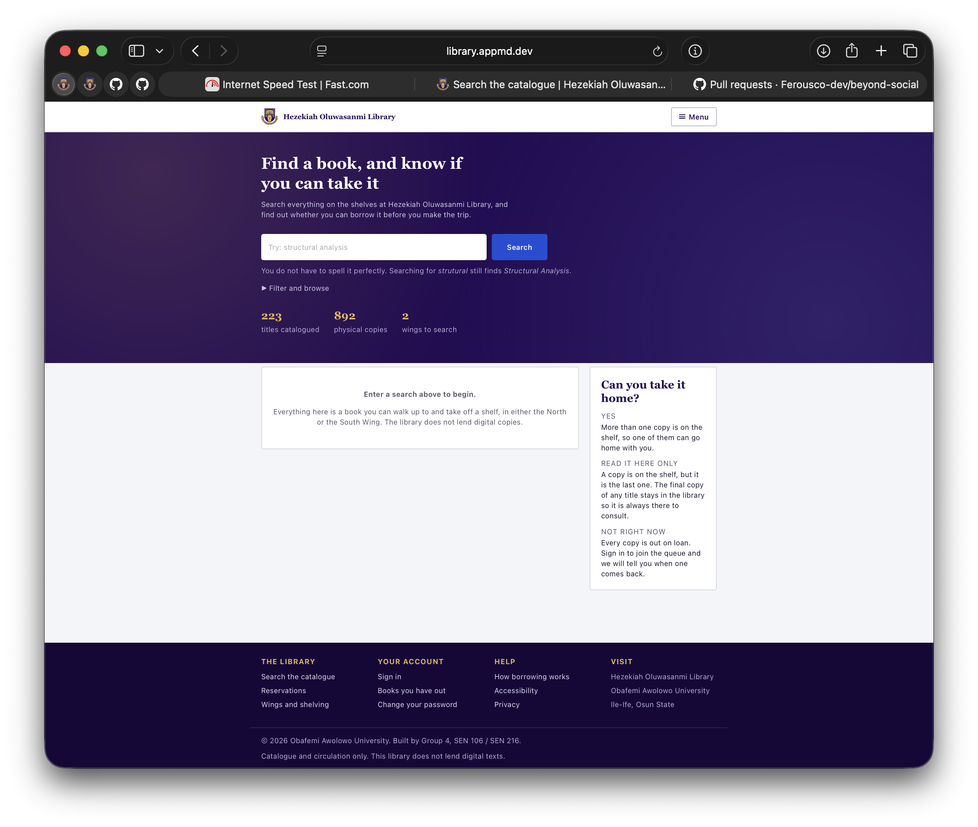
THE CLIENT
The catalogue page, explained
Hand-written HTML, token-based CSS and JavaScript work together in every screen.
Semantic structure
Shared CSS tokens
Native header, navigation, main content and footer give the page a clear structure.
The purple and gold palette, spacing and type remain consistent across the interface.
Labelled search form
Responsive layout
The search field and button use a real form so readers can search by keyboard.
CSS grid and flexbox keep the search, results and legend readable from phone to desk.
Filter and browse
DOM-rendered results
The expandable filter keeps the first view simple and provides a focused way to browse.
JavaScript creates result content safely with textContent instead of innerHTML.
Availability language
One API module
The legend explains whether a copy can go home, stays in the library or is on loan.
The search action uses one async module for requests, token renewal and errors.
Footer navigation
Accessibility built in
Library, account and help links stay available at the end of every page.
Words support colour, controls work by keyboard and reduced-motion settings are respected.
5
Notes:
This slide uses a live screenshot of the HOL catalogue page. The callouts connect the visible interface to the HTML, CSS, JavaScript and accessibility decisions described in the original client slide.

Slide 6
SYSTEM DESIGN
How a request travels through the system
Following one action end to end: a member presses Borrow, and a due-date reminder arrives three days later.
Browser
Cloudflare
Render
Postgres
Why an outbox
HTML, CSS and
JavaScript
DNS and TLS
for the domain
The Go binary,
one container
Locks, rows,
the truth
The loan and the intention to notify are written in one transaction. Neither can exist without the other.
Redis
rate limits only
The worker re-reads the database before sending, so a reminder queued last night for a book returned this morning is marked superseded and never sent.
Outbox
Worker
Resend
Firebase
The intention is written
in the SAME transaction
Wakes every 30s and
re-checks the database
Email to the member's
real address
Push to any device
they registered
6
Notes:
The two halves are deliberately separate. A slow mail provider cannot delay a borrow, and a failed send cannot roll back a loan.

Slide 7
ARCHITECTURE
A layered monolith, deployed as one binary
Browser
HTML, CSS, JavaScript. Renders results and collects input. Trusted with nothing.
Dependencies point one way
A layer may call the one beneath it and never the one above. The domain package at the centre imports nothing from this project at all, so the library's rules can be tested without a database, a server or a network.
Handler
Parses HTTP, validates shape, checks the token. No library rules live here.
Service
The library's rules: who may borrow, how many, for how long, what is overdue.
Why not microservices?
Borrowing touches the copy, the loan and the member in one atomic step. Split across services that becomes a distributed transaction. One database and one transaction is not a compromise here; it is the correct design.
Repository
SQL, transactions and row locks. The only layer that knows Postgres exists.
7
Notes:
If asked why not microservices: borrowing is a single transaction across three tables. Splitting it trades a database guarantee for a distributed one.

Slide 8
DATA MODEL
The member record, and what it deliberately holds
type Member struct {
// --- identity ---
ID string
Identifier string // matric or staff no., UNIQUE
Email string // citext: Ada@ and ada@ are one
Faculty, Department, Level string
// --- entitlement ---
Role Role // checked on the SERVER
Category *MemberCategory // null for staff
Status UserStatus // suspended cannot sign in
// --- credentials ---
PasswordHash string // Argon2id. Never sent.
MustChangePassword bool // travels in the token
TokensInvalidBefore time.Time
// --- provenance ---
IsSynthetic bool // simulator-created
CreatedAt, UpdatedAt time.Time // TIMESTAMPTZ
}
Identity
The id is a UUID, not a running number: a sequential id invites walking the list. Email is citext, so Ada@ and ada@ are one person and cannot register twice.
Credentials
TokensInvalidBefore voids every session issued before a password change. It is stamped in the same statement as the new hash, so a refresh arriving mid-change cannot slip through.
8
Notes:
The comments in this file are the design record. Each field is here for a reason we can state.

Slide 9
BORROWING BEHAVIOUR
Entitlement is data, not scattered conditionals
// What a category is allowed to do.
const (
Undergraduate MemberCategory = "undergraduate"
Postgraduate MemberCategory = "postgraduate"
Staff MemberCategory = "staff"
)
// Limits live in one table, not in the handlers.
var Terms = map[MemberCategory]LoanTerm{
Undergraduate: {MaxLoans: 2, Days: 14},
Postgraduate: {MaxLoans: 4, Days: 21},
Staff: {MaxLoans: 6, Days: 28},
}
type Loan struct {
CopyID, UserID string
BorrowedAt, DueAt time.Time
ReturnedAt *time.Time // nil means still out
// Note what is ABSENT: no IsOverdue flag.
// Overdue is DueAt < now, computed on read.
}
Loan entitlement
Undergraduate
2 books · 14 days
Postgraduate
4 books · 21 days
Staff
6 books · 28 days
No IsOverdue column
A stored flag is only true until the clock moves past it. Overdue is derived on every read, so it can never be stale.
9
Notes:
A stored overdue flag needs a job to keep it true. A derived one cannot be wrong.

Slide 10
BOOK AND COPY
A book is a title. A copy is an object on a shelf.
This distinction runs through the whole system. You cannot borrow a book, you borrow one numbered copy of it, and that copy is the thing that has a location and a state.
Book, the title
Copy, the physical object
Shares one call number, LIB 001. Holds the ISBN, the author and the subject. It is a description, and it is never on a shelf.
Has its own accession number, unique across the whole library. It has a state: available, on loan, reserved, lost or withdrawn.
Last-copy retention: the final copy stays in the building
5 copies, 3 free
2 copies, 1 free
1 copy, 1 free
2 borrowable
0 borrowable
1 borrowable
One is held back for reading inside the library.
That free copy is the last one. It stays.
A single circulating copy is lent, or nobody could read it.
10
Notes:
Retention begins at two circulating copies. The middle case is the one examiners ask about: two copies with one free lends nothing, because that free one is the last. A single circulating copy is lent, because holding it back would put it beyond everybody.

Slide 11
CONCURRENCY AND IDEMPOTENCY
What happens when the same request arrives twice
Two students pressing Borrow at once, and one student pressing Save five times because the network is slow, are the same problem wearing different clothes. Both are answered in the database, never in the application.
Borrowing must happen at most once
Saving may happen any number of times
Twenty simultaneous requests for one available copy:
Twenty simultaneous saves of one title by one member:
20
1
19
20
0
1
sent
created, 201
refused, 409
sent
errors
row stored
A partial unique index refuses the second one. Not a check, which could be raced.
ON CONFLICT absorbs the repeat, so the client never has to ask first.
Idempotency is not applied everywhere. It is a question asked of each action: if this arrives twice, should the second one change anything?
Borrow a copy
No, at most once
A second loan on one copy is impossible. Refused with 409.
Return a copy
Yes
The loan is already closed. Saying so again changes nothing.
Save or unsave a title
Yes
A second tap means what the first meant. One row either way.
Send a notification
Yes
The worker re-reads the database, so a stale intention is superseded.
Apply a migration
Yes
Recorded once, and CI refuses a commit that edits an applied one.
Every figure and every row above was exercised against the production database before this slide was written.
11
Notes:
The point: we did not make everything idempotent. We asked the question per action, and borrowing answers it differently from the rest. Borrowing must happen at most once, so a repeat is refused; saving is safe to repeat, so a repeat is absorbed. Both were measured, not assumed.

Slide 12
SECURITY
Security decisions we can defend
1
Argon2id password hashing
2
Roles checked on the server
Memory-hard at 64 MB with a fresh salt per password. Chosen over bcrypt because a GPU cannot parallelise it cheaply.
The browser hides buttons for convenience only. Every request re-checks the role, so a crafted request gains nothing.
3
Rate limiting on sign-in
4
Sessions that can be revoked
Five attempts per account per minute and 120 per IP. Per-account, so one attacker cannot lock a whole faculty out.
Refresh tokens are stored hashed and rotated on use. A password change voids every session issued before it.
5
Parameterised SQL throughout
6
Secrets never in the repository
No query is built by joining strings, so a title containing a quote is data and never becomes syntax.
Configuration comes from the environment. The repository has been checked, and holds no key.
12
Notes:
Two independent adversarial audits were run against the codebase. Twelve of our twenty-seven defects came from them.

Slide 13
TIME AND PERFORMANCE
Two problems that only appear at scale
Time: stored in UTC, shown in Lagos
Indexing, measured with EXPLAIN ANALYZE
Every instant is stored as TIMESTAMPTZ in UTC and rendered in Africa/Lagos for the reader. A due date is an instant, not a wall-clock reading, so it means the same thing whatever machine computes it.
Search performance was measured before and after, on real data, not guessed at.
Title search
51.5 ms before
21.9 ms after
The trap this closed
Our container ships without timezone data. Loading Africa/Lagos failed silently and every displayed time fell back to UTC, one hour early. We compile the timezone database into the binary.
Member lookup
22.5 ms before
3.1 ms after
Trigram indexes for fuzzy title search; a partial index for open loans, which is the only slice ever queried.
13
Notes:
If asked how we know an index helped: EXPLAIN ANALYZE before and after, on the real dataset.

Slide 14
THE SIMULATOR
Proving the system works when nobody is watching
An empty database proves nothing. We built a simulator that behaves like a library day: members register, borrow, return late, and reserve titles that are out.
What it is
What it is not
A client that calls the public API exactly as a browser would. It has no special access, so anything it does, a student could do, which is what makes its results evidence.
It is not a seeding script writing rows into the database. Every record it makes is flagged synthetic, and it refuses to touch a real borrower's loan.
Live in production now
223
892
99
86
252
332
titles
copies
members
loans
authors
subjects
14
Notes:
The catalogue holds real bibliographic data from Open Library, not invented titles.

Slide 15
VERSION CONTROL AND DELIVERY
Nothing reaches production by hand
Work is tracked in Git on GitHub. Every push runs the same pipeline, and a failure at any stage stops the deployment.
Test
Scan
Migrate
Build
Deploy
Smoke
101 tests
across 4 levels
Dependency
vulnerabilities
Applied files
cannot change
Docker image,
15.5 MB
Render, only
if all passed
Health, docs
and CORS live
Git discipline
Migrations are immutable
Why smoke tests
33 commits, each one message describing why the change was made, not what the diff shows.
The pipeline refuses a commit that edits an already-applied migration, because production has already run it.
A green test suite proves the code compiled. Only a request to the live URL proves the system is actually serving.
15
Notes:
Automatic deploys from the dashboard were turned off deliberately, so the only route to production is through the pipeline.

Slide 16
DEPLOYMENT
Live, on a custom domain, with documentation
Addresses
Where the data lives
API
api.library.appmd.dev
Application
Render, Ohio (US East)
Swagger docs
api.library.appmd.dev/docs
Database
Neon Postgres, us-east-1
OpenAPI spec
api.library.appmd.dev/openapi.yaml
Cache
Upstash Redis, us-east-1
Front end
library.appmd.dev
DNS and TLS
Cloudflare, global edge
Documented API
Encrypted in transit
Known limit
The OpenAPI file is compiled into the binary, so the documentation cannot drift away from the server that serves it.
TLS certificate issued by Google Trust Services and valid to December 2026. Plain HTTP is redirected, never served.
The free tier sleeps when idle, so the first request after a quiet period takes a few seconds. A scheduled ping keeps it warm.
16
Notes:
Have the Swagger page already open in a second tab before the defence begins.

Slide 17
TESTING AND DEFECTS
Twenty-seven defects found. Twenty-seven closed.
No single technique found more than half of them. That is the finding we would defend hardest.
12
7
3
2
2
1
adversarial audit
checklist review
first real database run
EXPLAIN ANALYZE
concurrency test
unit test
Four levels of testing
Coverage where it counts
The lesson
Unit tests for the library's rules, integration tests against a real Postgres, contract tests against the OpenAPI file, and system tests against the deployed URL.
94.7% on the domain package, which holds the borrowing rules. 83.6% on authentication. Coverage is highest where a mistake would be most expensive.
Our worst defects passed their own tests. A fake database cannot execute SQL, so a test written against one can confirm a rule the real system never enforces.
Group 4 · SEN 106 / SEN 216 · Obafemi Awolowo University, Ile-Ife
17
Notes:
Close on this: 105 planned test cases, 27 defects, all closed and recorded with the technique that found each one.

Slide 18
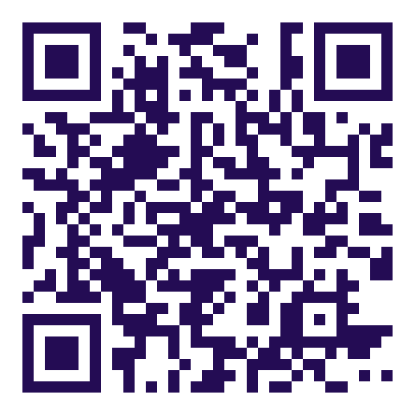
Thank you
We are happy to take questions, and to show any part of it running.
Ibrahim Aliyah Oiza
SEN/2025/076
Olawale Ibrahim Eniola
SEN/2025/109
Fagbemiro Ibukunoluwa Ayodeji
SEN/2025/071
Ige Tobiloluwa Ayodeji
SEN/2025/079
Adebayo Malik Ayobami
SEN/2025/008
Akinwunmi David Temidayo
SEN/2025/042
Ojewole Darasimi Johnson
SEN/2025/098
Abdul Raheem Abdul Raheem Olawale
SEN/2025/003
Oresajo Oluwaferanmi Idunnuoluwa
SEN/2025/120
Bello OluwaseounTimofe Emmanuel
SEN/2025/145
Onigbinde Goodluck Jesse
SEN/2025/116
Ejeh Chibuikem Philemon
SEN/2025/066
Adeneye Adebisi Crystal
SEN/2025/017
Adegbola Paul Temitope
CSCS/2025/022
Oti Chiagoziem Evans
SEN/2025/123
Elusanmi Ayomide David
SEN/2025/068
Mogaji Toyosi Ebenezer
SEN/2025/089
Amure Oluwatobiloba David
SEN/2025/045
Scan to open the library
library.appmd.dev
Ayodeji Oluwakorede Ifeoluwa
SEN/2025/054
Alabi Flavour Olatomiwa
SEN/2026/043
Asante William Jesutofunmi
SEN/2025/047
ADEBAYO Honour Oluwafadeyemi
SEN/2025/007
SEN 106 / SEN 216 · Obafemi Awolowo University, Ile-Ife
api.library.appmd.dev/docs
Notes:
Leave this up for questions. Invite them to scan during the presentation rather than after it: a room of examiners searching the live catalogue is the strongest thing we can show.

