Slide 1

Puzzle Game
By: Daniel Lee, Edward Larbi and Feroze Attai

Slide 2
Framework Benefit(s)
Gave us a close glimpse of how processes of developing software can be in the real world
Highlighted/enhanced team members’ characteristic(s) along with strengths and weaknesses
New but familiar hence, a great learning experience
Depending on how the work was formulated and divided among team members, the project can be easier to plan accordingly to a schedule

Slide 3
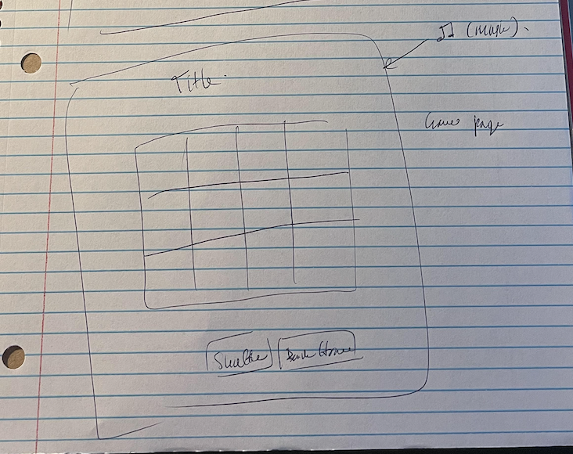
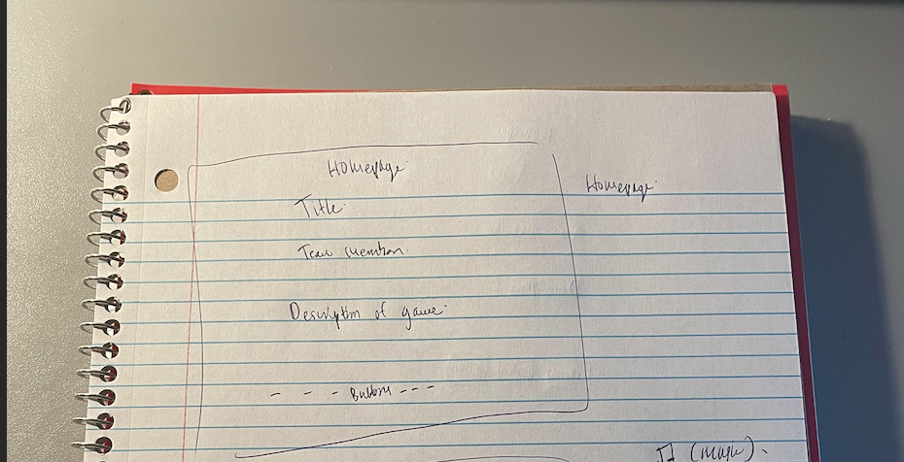
Sketch for UI Interface
Sketch for the Gamepage
Sketch for the Homepage

Slide 4
User
Problem: Essentially, solving the puzzle back to its original form
Requirements
Input(s) | Output(s)
Queue to start/play the game | Stating if won || lost
Queue to navigate back to the homepage
Shuffling the game board
Controlling the puzzle

Slide 5
Design
Simple design through HTML, Javascript and CSS
Design features were emphasized around physical appearance to make the game look child friendly and, the game itself to replicate the design that was provided by the professor, as much as possible

Slide 6
Design (cont.) UML class diagram
Play() button
User
User
User
fifteenhome.html
fifteen.html
scramble()
for loop()

Slide 7
Testing
Test plan is to basically go through the homepage and then show the process of the game
Certain bugs were autoplay for the audio, it did not work optimally in google chrome, however, succeeded in working as expected in safari
Edward will explain the code portion
Feroze will show a demo of the program

Slide 8
THANK YOU FOR A GREAT SEMESTER!

