Slide 1
robotic follower
Andrey Pak
Donatas Kozlovskis
Enric Cornellà
Fernando Garcia
Igor Péric
Notes:
Ferran

Slide 2
OVERVIEW OF CURRENT PROGRESS
Done
State Machine
In progress
Improvement of arrow detection
To do
History of detections
Configuration of parameters by file
Wifi and battery installation
IR Camera and diodes installation
Neural Network implementation
Sign improvement
Collision detection
Neural Networks Data acquisition
Notes:
Ferran

Slide 3
MODULE INTEGRATION
VISION
Sign detection
STATE MACHINE
Switching from state to state
MOTOR DRIVER
Low level control
Computing wheel speeds
Sign classification
Reading encoders
Odometry computation
Notes:
Igor

Slide 4
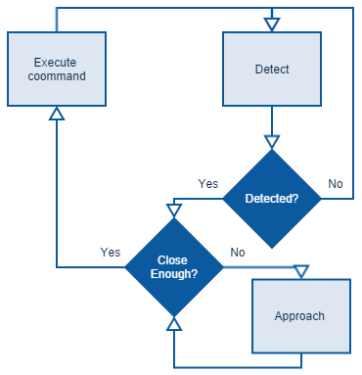
State Machine
States of the system:
IDLE
WIGGLING
APPROACHING_SIGN
EXECUTING_COMMAND
MARCHING_FORWARD
Notes:
Igor

Slide 5
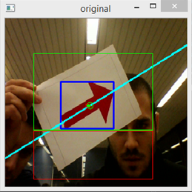
VISION MODULE IMPROVEMENT
Perceptive region
Green area
Proximity region
Red area
New way of computing arrow angle
Notes:
Enric

Slide 6


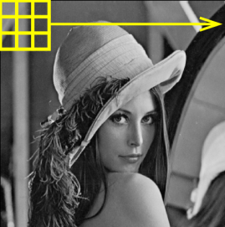
Invariant (HU) moments
Statistical moments invariant to scale and rotation
Could serve as very good shape discriminators if fed as input to neural network
Perspective still remains a problem
Notes:
Igor

Slide 7













Neural networks
We don’t have to hand-engineer importance of features
Model done automatically
Input can be color image, grayscale image or set of selected features
Training computationally expensive
Run on more powerful PC
Classification after training fast
Can be run on Raspberry Pi
Notes:
Ferran

Slide 8
RECENT DEVELOPMENT CONCLUSIONS
We had a demo with our supervisor
The frame rate limits the speed of the vehicle -> 5fps
Move the camera to higher position:
Solve perspective issue
Accuracy of angle detection
Notes:
Enric

Slide 9
Thank you for attention!

