Slide 1
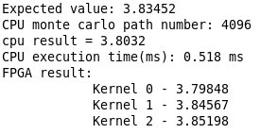
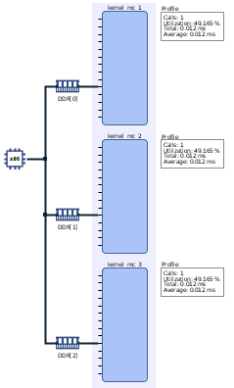
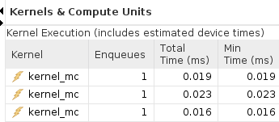
FPGA-based Acceleration of Option Pricing Kang Gao & Zhiqiang Que, Imperial College London
Plan: Based on Vitis quant finance library, evaluate performance boosting of Monte Carlo method for option pricing.
Finished the performance comparison between pure C++ implementation and FPGA accelerated implementation. FPGA achieves around 26.8x acceleration.
Learned how to use Vitis Accelerated libraries for practical applications.
CPU (ms) | FPGA(ms) | Speedup
0.518 | 0.0193 | 26.8

