Slide 1
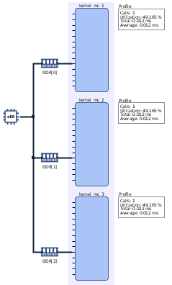
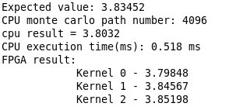
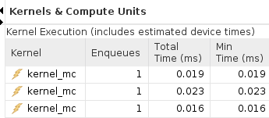
FPGA-based Acceleration of Option Pricing Zhiqiang Que & Kang Gao, Imperial College London
Plan: Based on Vitis quant finance library, evaluate performance boosting of Monte Carlo method for option pricing.
Finished the performance comparison between pure C++ implementation and FPGA accelerated implementation. FPGA achieves around 25x acceleration.
Learned how to use Vitis Accelerated libraries for practical applications.

