Slide 1
Human - Computer Interaction 2019/2020 yourBestLive
Giuliano Abruzzo 1712313
Francesco Carpineti 1683418
Jacopo Ferraro 1708198
Federico Gioia 1702089

Slide 2
Overview
Introduction to yourBestLive;
Requirements analysis:
Competitors;
Questionnaire.
Task Analysis: HTA & STN;
Mockups;
Prototype 1;
Heuristic Evaluation and Prototype 2;
Think Aloud Session;
Controlled Experiment;
Future Works.

Slide 3
Introduction to yourBestLive (1)
yourBestLive is a mobile app whose purpose is to create a network based on love for music with the aim of promoting musical events and sharing the experiences gained by various musicians. This application wants to act as an intermediary between clubs and new emerging artists allowing all the users to increase their visibility, to expand their range of action finding new places to play and to be always updated on events and opportunities that surround them.

Slide 4
Introduction to yourBestLive (2)
Discover new clubs in my city
Get info and reviews of clubs
Save my favorite clubs
Sponsor clubs paying money
Contact clubs using telephone number and social networks

Slide 5
Competitors Analysis (1)
 | SongKick Concerts | BandsInTown Concert | ILive Music
Find clubs | ✗ | ✗ | ✓
Sponsor clubs | ✗ | ✗ | ✓
Save favorite clubs | ✗ | ✗ | ✗
Review clubs | ✗ | ✗ | ✗
Contact a club | ✗ | ✗ | ✓
Clubs geo-location | ✗ | ✓ | ✓
Download | 1M+ | 5M+ | 10K+

Slide 6
Competitors Analysis (2)
Competitor: SongKick Concerts
It allows to buy tickets for concerts and to save concerts calendar, so it is a good app with respect
to the standard user, but it’s not useful for musicians and club owners. Our app aims to make
musicians and club owners’ lives easier, allowing them to find clubs and/or sponsor specific clubs.
Competitor: BandsInTown Concert
It allows to find nearby events and also to add them into the app, but it does not allow to find clubs
near you in order to know them more (read the music genre played, see which types of band they
accept,…). Our app also covers this aspect.
Competitor: ILive Music
This app is more oriented to musicians and club owners with respect to the previous ones because
club owners can share their music events and musicians can apply for them, but it does not allow to
write reviews, add favorite clubs and contact clubs directly through social media accounts, phone,
email and so on. As we wrote in the previous slides, these features are present in yourBestLive.

Slide 7
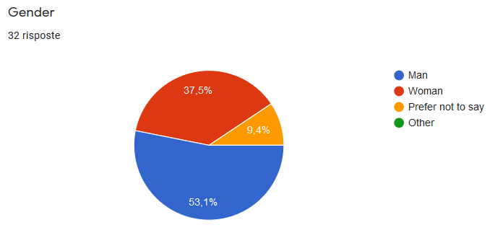
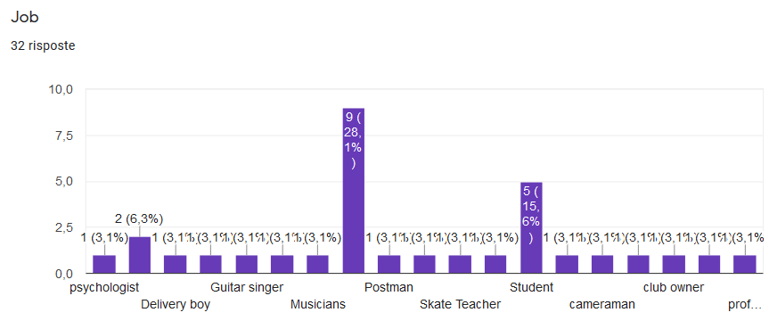
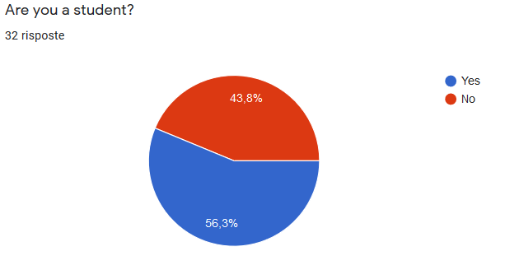
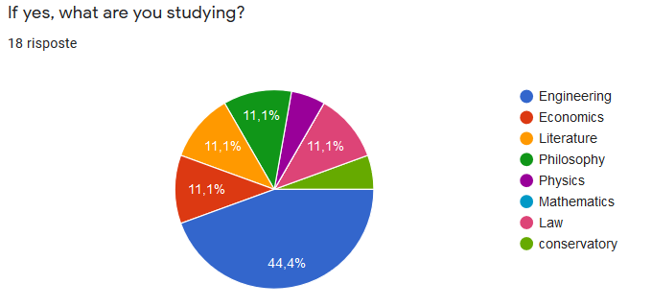
Questionnaire analysis (1)

Slide 8
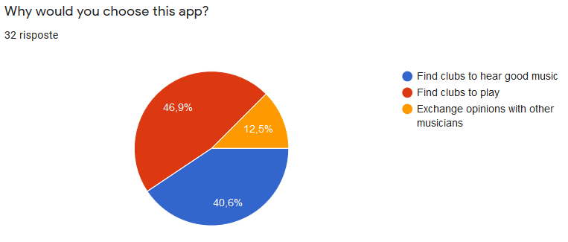
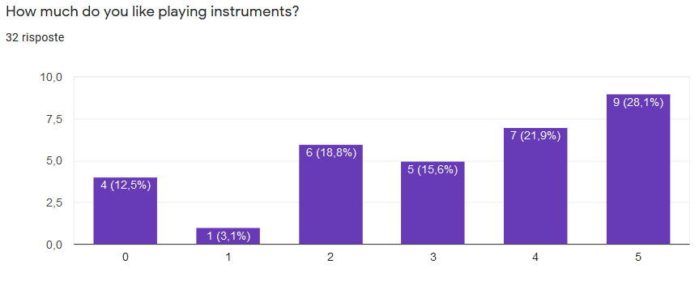
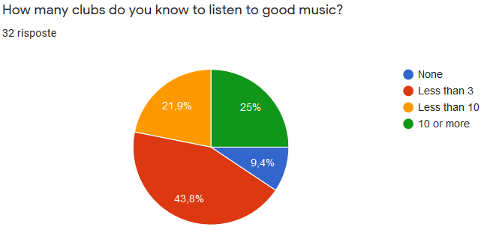
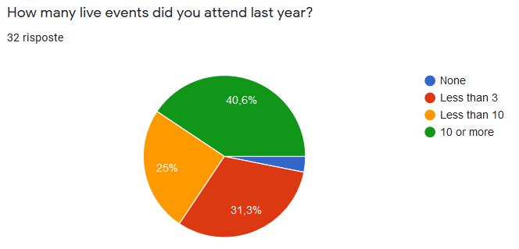
Questionnaire analysis (2)

Slide 9
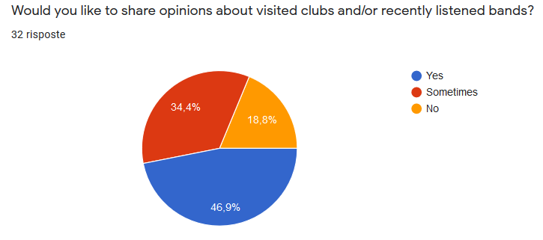
Questionnaire analysis (3)

Slide 10
Questionnaire analysis: conclusion
After collecting these results, we understood some information that we will now list here:
Users has an age which ranges from 18yo to beyond 50 and, thus, their occupation can vary from student positions to several jobs, related and not related to music, so the application has a good level of audience;
Users more prone in using the app are the ones who can play instruments, as we expected;
The app received a good feedback from standard users too, who want to attend several music events with friends and share opinions about such events.
The questionnaire also contained an open question about app features wanted by users.

Slide 11
User Analysis
Age: 18-60
Gender: equally distributed
Location: Italy
Technology: a smartphone with GPS and Internet connection
Work hours: it depends on the user
Club owner: usually, from late afternoon to closing time;
Musician: during concert hours, hence from after lunch to after dinner (depending on the event owner’s will);
Standard user: any work hours (depending on job position).
Family: anyone
Passion: love for music and for sharing opinions about it
Qualification: any, from secondary school to PhD

Slide 12
PERSONAS (1)
FABIO
Fabio is a 23yo student of engineering in computer science, who loves music and has a small band with his friends. He often uses 4G connection for connecting to the internet, from his mobile phone. His dream is to become a famous guitarist and singer to play and sing, one day, in front of thousands of people. He would like to transform his passion into a real job. He has only vintage outfits because he loves 80s rock scene.
GUITARIST

Slide 13
PERSONAS (2)
CIRO
Ciro is a 44yo man from Naples whose favorite music is metal. During his youth, he worked for several years as a waiter in bars, pubs and restaurants, saving money for opening, one day, his own club, having the possibility to personalize it with respect to his tastes. Now, he wants his club to be the most popular in the city so he needs a way to do it properly, without wasting money.
CLUB OWNER

Slide 14
PERSONAS (3)
TULLIA
Tullia is a 25yo Political Sciences offsite student at Sapienza University of Rome. She loves indie pop music that is gaining popularity in the capital of Italy and her favorite artist is Gazzelle. She has a lot of friends with whom she likes to go out for assisting to concerts and to share opinions about artists. She usually go out on weekends only, because she is busy during the week to study for exams. She uses the mobile phone a lot because she follows artists’ pages on social media, especially Instagram to be updated on their last videos.
CUSTOMER

Slide 15
SCENARIOS
Fabio has just finished his summer exam session and wants to play with his band in city clubs to have fun and earn some money. He has to ask for each club to play in it (along with payment methods, cachet,...) but this requires a lot of time. His band needs an easy-and-fast solution. He usually uses phone calls to get in contact with clubs, but always struggles to find the correct numbers, losing time.
Ciro is a rock music lover and recently opened a new club in the city center. However, he needs it to be more famous as the number of customers is still quite low. A sponsor method would be the best for him, possibly in a place where rock musicians see his club. However, Ciro is not a good mobile phone user so he needs an easy way to reach his goals, possibly through a user-friendly interface. Musicians often contact his club by phone as he does not update the Facebook page since some time.
Tullia wants to organize her weekend with friends but has no idea on where to go. She would like to hear some live music but she is tired of going always to the same clubs. She needs a way to easily search for new ones which respect her music tastes and that are not excessively far from where she lives. In order to see which artists play in nearby clubs, she follows Facebook pages but often they are not updated properly.

Slide 16
Task analysis : HTA & STN
These are the main tasks:
Add a club to the app;
Promote a club;
Add a club to favorites;
Review a club.

Slide 17
Task analysis : HTA (Add a club)
0. Add a club
Plan 0: 1 – 2 – if wanted 3 – 4 - 5
1. Go to register club page
2. Insert required info
3. Insert optional infos
4. Insert rating
5. Submit
Plan 2: 2.1 – 2.2 – 2.3 in any order
Plan 3: 3.1 – 3.2 – 3.3 in any order
2.1 Insert name
2.2 Insert address
2.3 Insert city
3.1 Insert contact info
and payment methods
3.2 Insert band type and genre of music played
3.3 Insert review

Slide 18
Task analysis : STN (Add a club)
Insert data
Fill required fields
Go to logged home
Go to add club page
Start
Login
Home
Add a Club
Confirm club to add
Finish
Club created
Show login form
Show home page
Show add club form
Fill optional fields

Slide 19
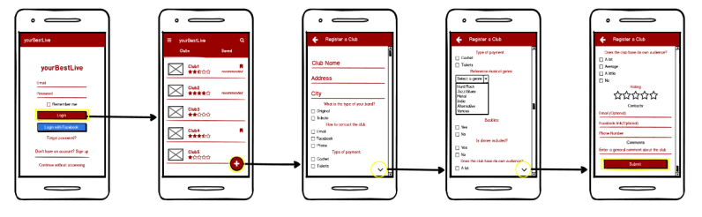
Mockups: Add a club

Slide 20
Prototype 1
The first prototype has been developed following the mockups presented above and also the HTAs and STNs of the single tasks. Moreover, some secondary features were implemented, like donating to app developers and remove ads (paid).

Slide 21
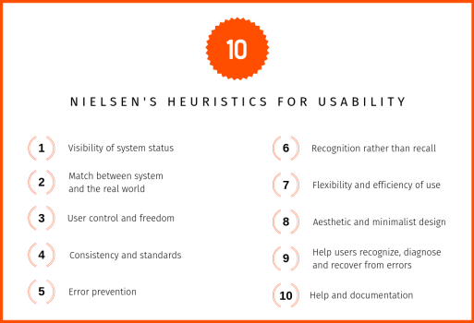
Heuristic Evaluation (1)

Slide 22
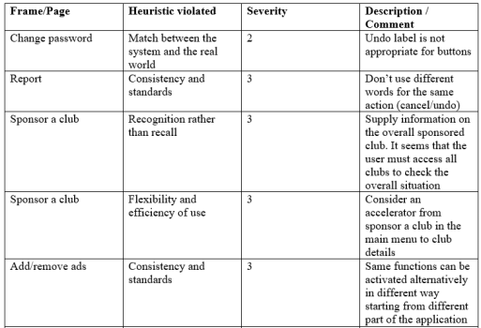
Heuristic Evaluation (2)
The ‘severity’ number identifies:
0 – I don’t agree that this is a usability problem at all;
1 – Cosmetic problem only;
2 – Minor usability problem;
3 – Major usability problem;
4 – Usability catastrophe.

Slide 23
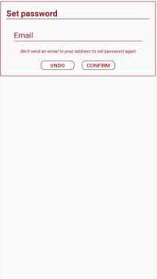
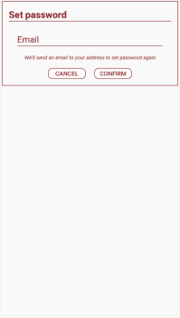
Prototype 2 (1)
before after

Slide 24
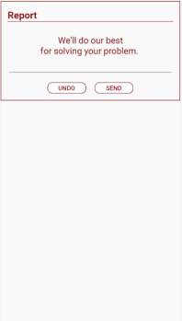
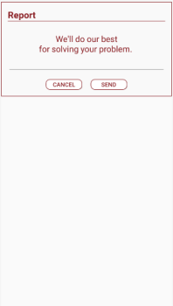
Prototype 2 (2)
before after

Slide 25
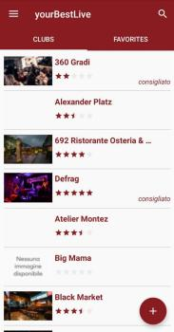
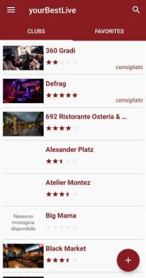
Prototype 2 (3)
before after

Slide 26
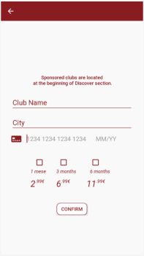
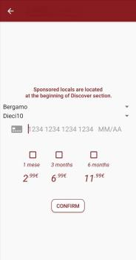
Prototype 2 (4)
before after

Slide 27
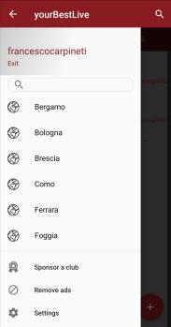

Prototype 2 (5)
before after

Slide 28
Think Aloud Session
We took 16 pople of different ages and performed the experiment using these criteria:
We explained to people who we are and ehat we are doing;
We said to every one to do the same task, i.e. adding a new club to the app, individually;
The experiments has been done saying to the users that they should have said aloud what they were doing, what they thought and so on;
We took note of what they said during the previous step.

Slide 29
Think Aloud Results (1)
The test has been done with people with age ranging from 19 years to 50, hence we perfectly reflected the ages that appeared during the first stages of the project development. No one had specific issues in using the application, although older people were slower because less familiar with technology in general. The task was simple to accomplish thanks to the FloatingActionButton present in the app's main activity. We are satisfied by the results even if there was no label onto the floating button saying that it would have led to that task.

Slide 30
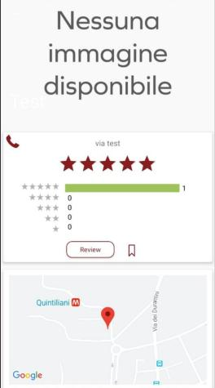
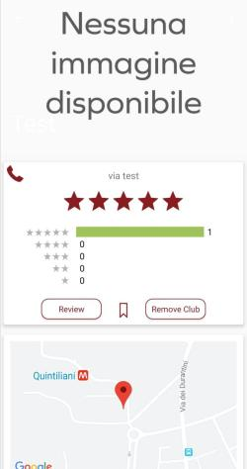
Think Aloud Results (2)
A minor problem we encountered is that club information cannot be modified after club creation, so if they are wrong there is a problem. We decided to implement a button which removes the club (clickable only by the club owner/responsible) so the creator can recreate it from scratch, correcting the errors:
before after

Slide 31
Controlled Experiment (1)
During the design phase we have implemented two distinct interfaces for the "Add a new club to the app" task. The first one uses a FloatingActionButton which is on the clubs list (i.e. main page of yourBestLive) and which corresponds to the most common way of adding something new to an app in most cases. We also made another interface in which we removed the floating button and instead we added a menu item to the Navigation left menu, accessible from the three-lines button at top left. This is usually done for app actions that are not often performed. Our assumption is that the first alternative is faster and more intuitive than the second. We did a controlled experiment to verify our thoughts.

Slide 32
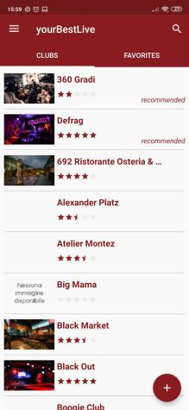
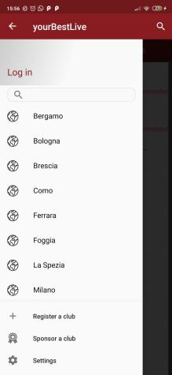
Controlled Experiment (2)
Interface style 1 Interface style2

Slide 33
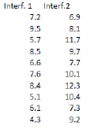
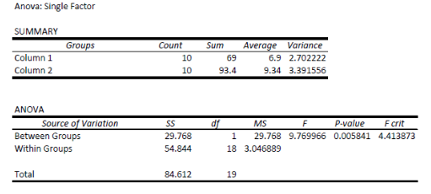
Controlled Experiment (3)
F > F crit, so the null hypotesis is rejected;
Interface style 1 is better.

Slide 34
Future Works
This project can be expanded, for example with native design elements instead of the Android default ones, and innovative additional functions. For example:
more payment methods, allowing users to use also the newest bank cards, like the ones of mobile banking, etc.;
improve login methods, adding Google Sign-In and other famous social network- related methods like Twitter;
country extension which should allow the user to choose a country before continuing to the app, in such a way as to filter presented clubs properly.

