Slide 1
ICE: an Interactive Configuration Explorer for High Dimensional Categorical Parameter Spaces.
Giuliano Abruzzo 1712313
Jacopo Ferraro 1708198

Slide 2
Introduction
The ICE tool:
This paper presents the ICE tool, a novel approach for categorical parameter space analysis in the context of a dependent numerical variable. We use ICE in order to learn how the dependent numerical variable is affected by the parameter settings given multiple optimization objectives. Some of the most important features are:
No loss of information
Possibility to filter
Show complete distribution of dependent variable
Analyze the spread of the dependent numerical variable with respect to every parameter
Partitioning the parameter space with interactive filter

Slide 3
Existing Parameter Visualization Methods (1)
Correlation Techniques:
Like Cramer’s V, ANOVA, or Pearson Correlation for datasets with very high dimensionality, it can hard to study correlations between in the overall distribution of the dataset, so they will give ambiguous results
Clustering Techniques:
Most clustering techniques are not directly applicable to study categorial parameter spaces, other like K-Mode, or Squeezers, are designed to capture specific relationships in the data. The problem is that each algorithm captures only a particular relationship in the dataset based on the similarity criterion

Slide 4
Existing Parameter Visualization Methods (2)
High dimensional Data Visualization Techniques:
Parallel Sets
Dimensionality reduction
MCA
Parallel sets is one of the most popular method for visualize multidimensional categorical data, but the problem is that the plot can become too cluttered to project any useful information.
Techniques like PCA or MDS, can be used by converting the numerical data to categorical data. These methods are good for visualizing relationships between datapoint, but the effectiveness decrease as the dimensionality of the dataset increase.
MCA is the counterpart of the PCA for categorical data, is effective in visualizing associations among the levels of categories, but there is a certain loss of information, and it also tends to get cluttered when the number of categories and levels grow large.

Slide 5
Comparative Analysis (1)
H1: The visualization can display the distributions of the dependent numerical variable for each parameter
H2: The visualization makes it possible to compare or correlate the parameters in the dataset with respect to their impact on the target numerical variable
H3: The visualization should be able to filter parameters in order to track the best configuration for a desired goal
H4: The visualization displays the statistics of the dependent numerical variable for each parameter
H5: The visualization provides cues to the analyst for ﬁltering the parameter space
H6: The visualization provides a summarized display of the dependent numerical variable values which can be reached from a given parameter setting

Slide 6
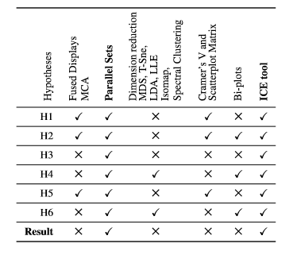
Comparative Analysis (2)
Only parallel sets and ICE ﬁt all hypotheses, but the results of the user study proved the effectiveness of ICE tool over Parallel Sets both in terms of accuracy and time to ﬁlter the parameter space

Slide 7
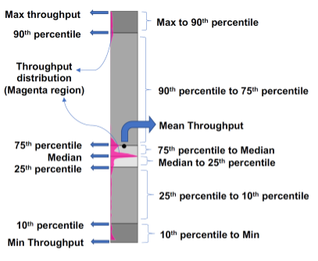
Range-Distribution (R-D) Bars
The lower/upper limit of each bar is determined by the lowest/highest value of the dependent numerical variable that can be achieved for all conﬁgurations with the parameter level the bar represents.
Each bar is a sequence of combinations of grays which represent the range of percentiles. The magenta region shows the distribution of the target variable over the range. Statistical information is shown with lines separating the percentile ranges and a black dot displaying the mean value.

Slide 8
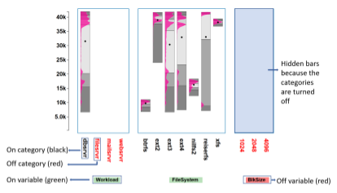
Parameter Explorer
Multiple bars are stacked, grouped by parameters and their levels. This grouping allows for easy comparison of the impact of numerical variable on the parameters.
The statistics (mean and percentiles) are shown as alternating shades of gray for each parameter level, hence partially satisfying R1
The user can completely select or remove a parameter from the dataset, this satisfies the filtering requirement R3.
All parameters can be correlated based on user objectives for a system optimization, this satisﬁes requirements R2 and R1.

Slide 9
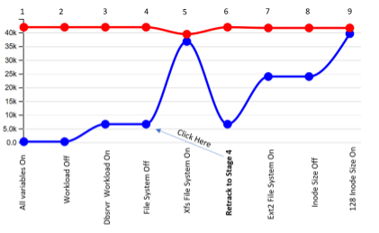
Provenance Terminal
The Provenance Terminal can be used to see and compare the dependent variable ranges for the various iterated parameter conﬁguration, and it also allows the analyst to roll back to a previous parameter conﬁguration, so it satisfies R6.
Each stage of the selection is shown with a red circular pointer on a red line, while the minimum value is shown with a blue circular pointer on a blue line. This view is updated with each user interaction

Slide 10
Aggregate View
The Aggregate View is located to the right of the Parameter Explorer.
While the main purpose of each Parameter Explorer R-D bar is to convey the dependent numerical variable distributions possible if the respective parameter level is chosen, the Aggregate View communicates the distribution possible with all currently selected parameter levels .
It can be used to quickly visualize the impact of a transition from one parameter conﬁguration to another.

Slide 11
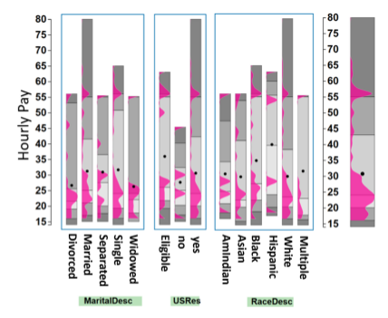
Case Studies – HR Dataset
The dataset has seven categorical variables, and one dependent numerical variable: Hourly Pay Rate. Thanks to the Parameter Explorer we notice:
Married workers had the highest hourly pay and the mean was highest for single.
The mean hourly pay of non-residents who are eligible is higher than those of the residents.
White races have the highest pay among all races
The executive department had the highest hourly pay

Slide 12
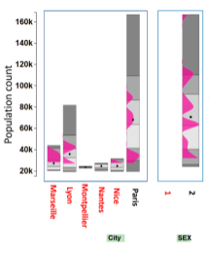
Case Studies – French Population
It consists of four categorical variables (City, MOC (Method of Cohabitation), Age group, and sex). The dependent numerical variable, Population count. The expert through ICE was able to discover that:
The population count for a few categories in Paris is exceptionally high compared to other categories because the mean is very low compared to the highest value
The mean population of the age range 60–80 is the highest in all cities
The age group 20 to 40 is the lowest on average for all cities
The average number of females is higher than the average number of males for the overall population

Slide 13
Conclusions and future works
ICE overcomes the existing challenges by providing an effective layout for parameter space visualization.
Multiple conﬁgurations can be compared for their impact on the target variable based on any objective, and also supports multi-objective ﬁltering since it presents full statistics and distribution information to the user for each parameter level.
Future works:
For larger datasets, techniques to combine multiple parameters can be incorporated to prevent excessive thinning of the bars
Some related precomputed solutions can be provided to the analyst based on optimization objectives to start off with the search process
It will be useful to incorporate cost measures into ICE and provide support for real time cost based ﬁltering.

Slide 14
Thank you!

