Slide 1
Visual Analytics on
Videogame Sales
Giuliano Abruzzo 1712313
Jacopo Ferraro 1708198

Slide 2
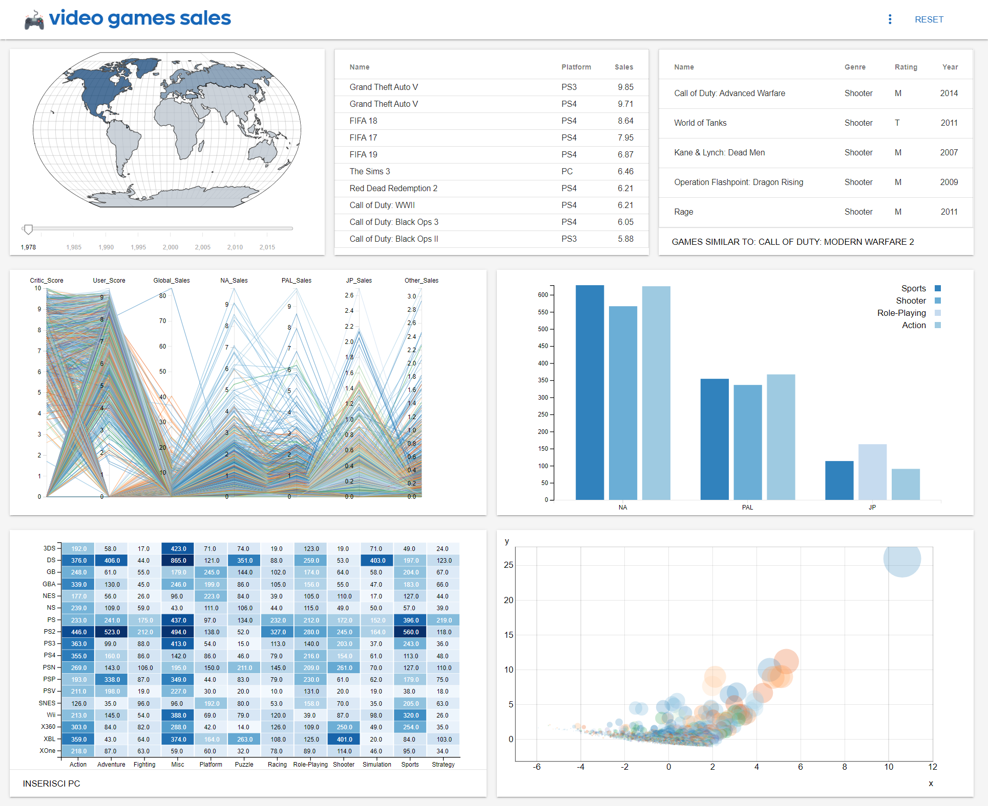
Visual Analytics on
Videogame Sales
Giuliano Abruzzo 1712313
Jacopo Ferraro 1708198

Slide 3
Introduction
The videogame market is an important part of the entertainment sector. This has grown exponentially over the past decade, and will reach a total value of $ 148.8 billion next year. The most used platforms are Mobile (smartphones and tablets), for a total of 10.1 million users. PCs with 7.6 million and consoles with 6 million. But these data are constantly changing and evolving over time, as well as the habits and preferences of gamers. For this reason we have developed a series of visualizations on this part of market, so that we can explain and analyze this theme that people of all ages have been enjoying for years.

Slide 4
Dataset (1)
The video games sales dataset, that we used, contains a list of video games with sales greater than 100,000 copies from 1975 to 2019 and it includes:
Name - The games name
Platform - Platform of the games release
Year - Year of the game's release
Genre - Genre of the game
Publisher - Publisher of the game
NA_Sales - Sales in North America (in millions)
PAL_Sales - Sales in Europe (in millions)
JP_Sales - Sales in Japan (in millions)
Other_Sales - Sales in the rest of the world (in millions)
Global_Sales - Total worldwide sales

Slide 5
Dataset (2)
Rank - Ranking of overall sales
ESRB_Rating – Rating Categories that suggest age appropriateness
Developer – Developer of the game
Critic Score - Professional critic score
User Score – User critic score
Since the number of videogames with User Score in this dataset is very low (about 300), we decide to combine this dataset with the Metacritic Games Dataset. So, we obtain a final dataset with 20.000 tuples, 15 attributes (categorical and numerical) and an AS index of 300.000.

Slide 6
Map
4 sets of countries: North America, Europe, Japan, Others
Countries are colored based on videogames sold
This value is represented by a color blue scale, where the darker blue means more sold
Hovering on a country will show a tip with the number of sold
Values change according to the selected year from the slider

Slide 7
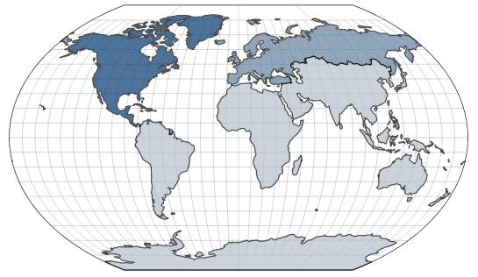
Map

Slide 8
Table
Shows the 10 most sold videogames
Specifies name, platform and sales for each videogame
On click, it will show the 5 most similar videogames using cosine similarity
Values change according to the selected country from the map
Values change according to the selected year from the slider

Slide 9
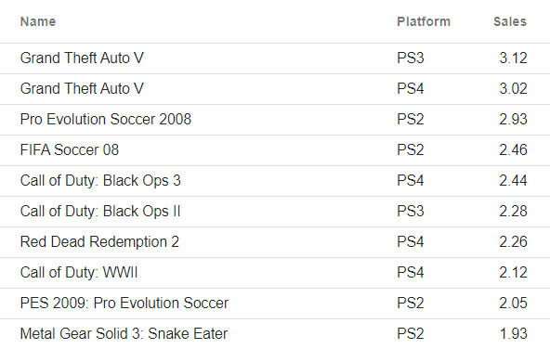
Table

Slide 10
Cosine Similarity
Shows the 5 most similar videogames
Specifies name, genre, ESRB rating and year for each videogame
Measure of similarity between vectors based on the angle: smaller the angle, higher the similarity
Vectors based on ESRB rating, critic score and user score
Values change according to the selected videogame from the table

Slide 11
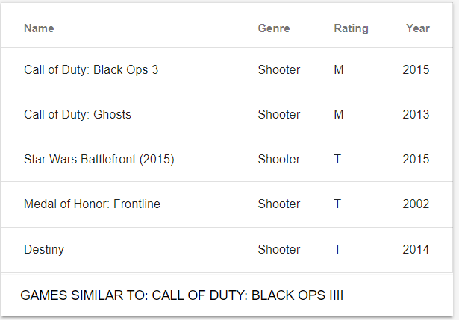
Cosine Similarity

Slide 12
Parallel Coordinates
7 axis to represent the most interesting databes attributes
Each line represent a videogame
The color encodes the classification of the genres according to the legend
Hovering on a line will highlight all the videogames with the same genres
Hovering on a line will show a tip with the genre description
Values change according to the selected year from the slider

Slide 13
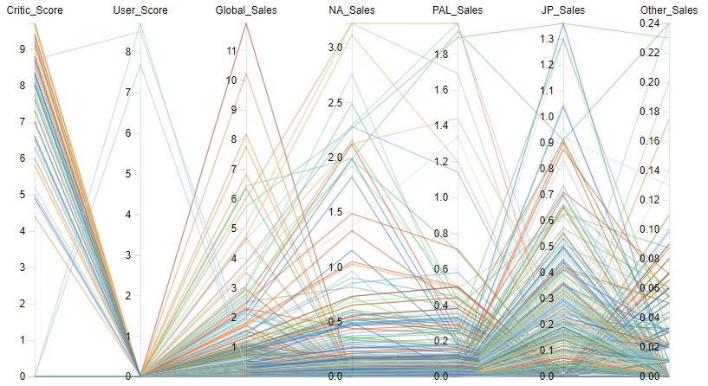
Parallel Coordinates

Slide 14
Grouped Barchart
X-axis reports the sets of countries, Y-axis reports the number of sales
Show the three most sold genres for each country
Same color encoding used in the parallel coordinates based on genre
Dedicated legend of genres
Values change according to the selected year from the slider

Slide 15
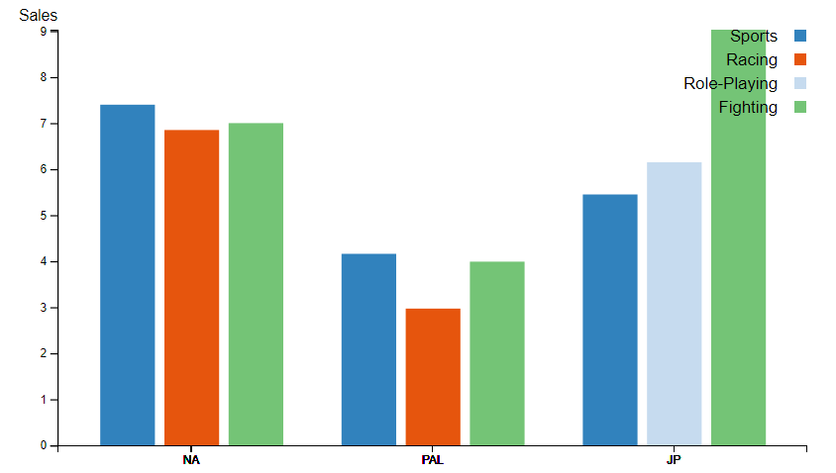
Grouped Barchart

Slide 16
Scatterplot
Represent the three components computed by PCA (Sales, User score, Critic Score) in order to compute a dimensional reduction of the database
Same color encoding used in the parallel coordinates and grouped barchart based on genre
Allows the user to identify clusters
Hovering on a point will be shown a tip with the description of the relative videogame
The user can zoom on a specific point

Slide 17
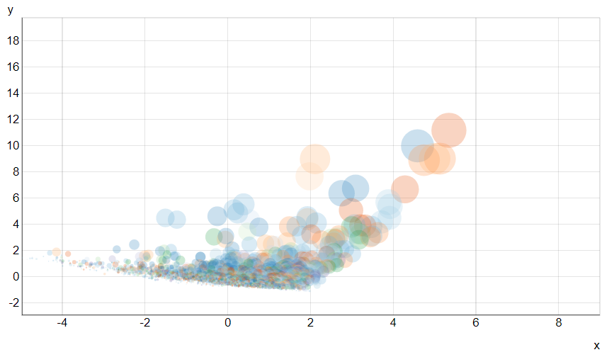
Scatterplot

Slide 18
Heatmap
Show the number of sales of each genres for each platform
Each cell is colored based on the number of sales
This value is represented by a color blue scale, where the darker blue means more sold
Dedicated button to insert or remove the PC platform in the plot

Slide 19
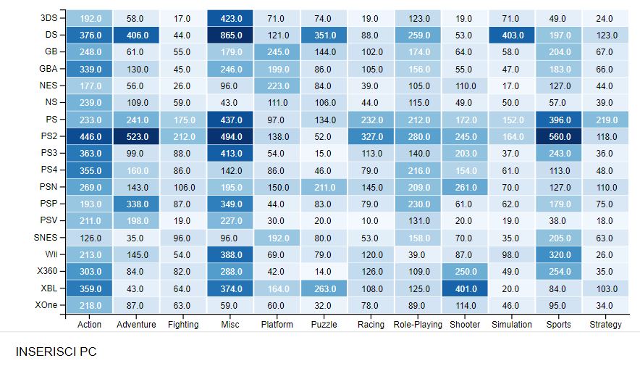
Heatmap

Slide 20
Analytics
Set up a Python web server Flask running local
Use Pandas Library for calculations, data filtering and data for map and other graphs
Specific python scripts for filtering and preprocess the dataset
Material theme for the visual part

Slide 21
Conclusion
This tool can be useful to everybody as an informative system
Easy to understand and pleasant to see
Easily visualize how the number of sales, the type of genres are changed during the years for each country and for each platform

Slide 22
Thank you!

