Slide 1
Capturing Traffic
Capture file: <packetsfile>.cap

Slide 2
The capturing workhorses
Two different tasks intertwined
Making a copy of the Ethernet frames
Windows: winpcap ( https://www.winpcap.org/ )
Linux: dumpcap ( https://linux.die.net/man/1/dumpcap )
Interpreting the content of this copied data
Wireshark GUI
TCPdump CLI

Slide 3
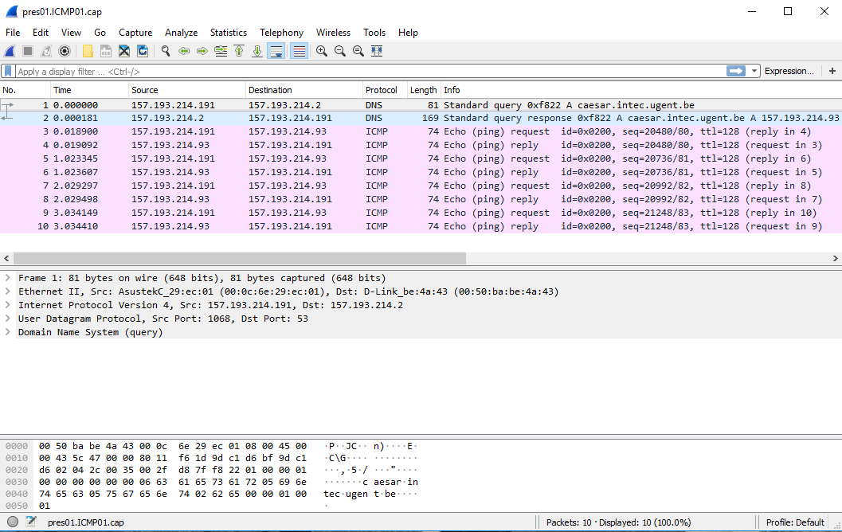
Wireshark

Slide 4
TCPdump
CLI tool to verify incoming or outgoing traffic
Interpreting the content captured by dumpcap
E.g. display all traffic on an interface
tcpdump –ni eth1
E.g. limit traffic to icmp (a.o. ping)
tcpdump –n icmp

Slide 5
TCPdump – a HTTP initialisation
tcpdump -ni eth2 host 96.101.83.211 and tcp port 80
tcpdump: verbose output suppressed, use -v or -vv for full protocol decode
listening on eth2, link-type EN10MB (Ethernet), capture size 262144 bytes
23:32:25.971476 IP 192.168.7.110.61750 > 96.101.83.211.80: Flags [S], seq 3356861255, win 17520, options [mss 1460,nop,wscale 8,nop,nop,sackOK], length 0
23:32:25.976169 IP 96.101.83.211.80 > 192.168.7.110.61750: Flags [.], ack 451, win 946, length 0
23:32:25.975607 IP 192.168.7.110.61750 > 96.101.83.211.80: Flags [.], ack 3005480021, win 68, length 0
23:32:25.976036 IP 192.168.7.110.61750 > 96.101.83.211.80: Flags [P.], seq 0:451, ack 1, win 68, length 451: HTTP: GET / HTTP/1.1
23:32:25.977449 IP 96.101.83.211.80 > 192.168.7.110.61750: Flags [P.], seq 1:322, ack 451, win 946, length 321: HTTP: HTTP/1.1 200 OK
23:32:26.021163 IP 192.168.7.110.61750 > 96.101.83.211.80: Flags [.], ack 322, win 67, length 0
23:32:26.306230 IP 192.168.7.110.61750 > 96.101.83.211.80: Flags [.], ack 826, win 65, length 0
23:32:31.221145 IP 96.101.83.211.80 > 192.168.7.110.61750: Flags [F.], seq 826, ack 869, win 980, length 0
23:32:31.395592 IP 192.168.7.110.61750 > 96.101.83.211.80: Flags [.], ack 827, win 65, length 0
3way handshake
transfer
Sluiten TCP conn.
Notes:
In the example, whitespace has been used to indicate a typical TCP connection.
The first 3 packets are the three-way handshake (SYN, SYN-ACK, ACK).
Afterwards, when the connection is set up, the HTTP GET is followed by the index.html page of the webserver.
Finally, the TCP connection is terminated (typically 4 packets, active & passive close).

Slide 6
TCPdump – a HTTP initialization bis
1
2
3
4
5
6
7
8
9
10
tcpdump -ni eth2 host 96.101.83.211 and tcp port 80
tcpdump: verbose output suppressed, use -v or -vv for full protocol decode
listening on eth2, link-type EN10MB (Ethernet), capture size 262144 bytes
23:32:25.971476 IP 192.168.7.110.61750 > 96.101.83.211.80: Flags [S], seq 3356861255, win 17520, options [mss 1460,nop,wscale 8,nop,nop,sackOK], length 0
23:32:25.971409 IP 96.101.83.211.80 > 192.168.7.110.61749: Flags [S.], seq 2183418549, ack 1210696658, win 29200, options [mss 1460,nop,nop,sackOK,nop,wscale 5], length 0
23:32:25.975607 IP 192.168.7.110.61750 > 96.101.83.211.80: Flags [.], ack 3005480021, win 68, length 0
23:32:25.976036 IP 192.168.7.110.61750 > 96.101.83.211.80: Flags [P.], seq 0:451, ack 1, win 68, length 451: HTTP: GET / HTTP/1.1
23:32:25.976169 IP 96.101.83.211.80 > 192.168.7.110.61750: Flags [.], ack 451, win 946, length 0
23:32:25.977449 IP 96.101.83.211.80 > 192.168.7.110.61750: Flags [P.], seq 1:322, ack 451, win 946, length 321: HTTP: HTTP/1.1 200 OK
23:32:26.021163 IP 192.168.7.110.61750 > 96.101.83.211.80: Flags [.], ack 322, win 67, length 0
23:32:26.306230 IP 192.168.7.110.61750 > 96.101.83.211.80: Flags [.], ack 826, win 65, length 0
23:32:31.221145 IP 96.101.83.211.80 > 192.168.7.110.61750: Flags [F.], seq 826, ack 869, win 980, length 0
23:32:31.395592 IP 192.168.7.110.61750 > 96.101.83.211.80: Flags [.], ack 827, win 65, length 0
Notes:
In this example, things are less clear cut.
The three-way handshake can be found in frames 1, 3 and 5 – the 2nd frame of the handshake is not displayed in the correct order.
Furthermore, between frames 1 and 3 a frame of a previous connection can be found – clearly indicated by the client port number which is different.

Slide 7
TCPdump – a HTTP initialization ?
tcpdump -ni eth2 host 96.101.83.211 and not tcp port 22
# What’s this filter … ?
tcpdump: verbose output suppressed, use -v or -vv for full protocol decode
listening on nas0, link-type EN10MB (Ethernet), capture size 262144 bytes
11:13:37.423806 IP 157.193.43.50.59408 > 96.101.83.211.443: Flags [S], seq 1635164190, win 29200, options [mss 1460,sackOK,TS val 2243309789 ecr 0,nop,wscale 7], length 0
11:13:37.423997 IP 96.101.83.211.443 > 157.193.43.50.59408: Flags [R.], seq 0, ack 1635164191, win 0, length 0
11:13:51.548369 IP 157.193.43.50.59410 > 96.101.83.211.443: Flags [S], seq 3641867353, win 29200, options [mss 1460,sackOK,TS val 2243313321 ecr 0,nop,wscale 7], length 0
11:13:51.548560 IP 96.101.83.211.443 > 157.193.43.50.59410: Flags [R.], seq 0, ack 3641867354, win 0, length 0
[R.] -> RST flag
Notes:
The example above indicated a trial to connect to port 443, but the port is not enabled on the server. Therefore, the TCP/IP layer is responding with a RST flag to the SYN request.
The three-way handshake is not succeeding.

Slide 8
TCPdump – one sided …
tcpdump -n icmp
tcpdump: verbose output suppressed, use -v or -vv for full protocol decode
listening on nas0, link-type EN10MB (Ethernet), capture size 262144 bytes
08:58:55.338855 IP 96.101.83.211 > 157.193.43.50: ICMP echo request, id 18672, seq 12, length 64
08:58:56.338703 IP 96.101.83.211 > 157.193.43.50: ICMP echo request, id 18672, seq 13, length 64
08:58:57.338559 IP 96.101.83.211 > 157.193.43.50: ICMP echo request, id 18672, seq 14, length 64
08:58:58.338413 IP 96.101.83.211 > 157.193.43.50: ICMP echo request, id 18672, seq 15, length 64
08:58:59.338270 IP 96.101.83.211 > 157.193.43.50: ICMP echo request, id 18672, seq 16, length 64
Is your ping not working,
Or is the server not responding?
Ping is “firewalled” very often …

Slide 9
Ethical Hacker
https://www.vrt.be/vrtnws/nl/2017/09/27/vlaamse-gemeentewebsites-kwetsbaar-voor-cybercriminelen/
By just using Wireshark, you can get into the news and identify yourself as an Ethical Hacker

