Slide 1



CSPlyaers Team 2022 UN Youth Hackathon
Alberto Neto
Nickolas Machado
Matheus da Silva
ferreiraneto304@gmail.com
nickolasrochamachado@gmail.com
matheusjunqueira.job@gmail.com
Jr Data Scientist
Angolan
Jr Machine Learning Engineer
Brazilian
BI Intern
Brazilian

Slide 2

Objective
To find the variables that can explain if a country’s diet is healthy through other data rather than food measurements, and to create a predictive model to find how healthy a diet will be in the coming years.

Slide 3
TimeLine
Data Extraction
We selected some Socioeconomic databases on the websites provided by the organization.
Exploration and Treatment of Data
We will process and explore the data in detail to define more assertive targets
Algorithm implementation
Implement Machine Learning algorithms and predictive model to reach the final results.
Graphic presentation of results
Final Presentation Ppt
Finally, the final work that will be submitted to the organization, showing the results in detail in a descriptive and graphic way.
We will graphically present the results obtained and the correlation of the selected variables.

Slide 4
ETL (Data Extraction, Transformation and Load)
It was the most expensive part of our project, we looked for several databases to find the ones that matches our subject. The chosen datasets are described below:
Datasets:
Prices for Nutrition:
Contains measurements of food prices and related data for a healthy diet in each country.
CPI (INFLATION):
Measures the buying power of population. Can be useful alongside the last database for explaining if higher prices affects the availability of food.
World Development Index:
Provides lots of other features related to education, health, economy. We find there are potential indicators we didn´t added to the modelling, in this dataset.

Slide 5
ETL (Data Extraction, Transformation and Load)
It was the most expensive part of our project, we looked for several databases to find the ones that matches our subject. The chosen datasets are described below:
Datasets:
Global Dietary Database:
Provides how much food each country eat separated by their respective categories, e.g., whole grains, dairy…
AHEI-2018
Our target formula. AHEI-2018 is a dataset calculated in Global dietary quality in 185 countries from 1990 to 2018 show wide differences by nation, age, education, and urbanicity we used to extract the AHEI formula.

Slide 6
Algorithm implementation
AHEI
While looking for a target we found a great candidate, named Alternative Healthy Eating Index (AHEI), which scores how healthy is a person diet given its food components (e.g., carbo, protein…)
Process
Our team tried to find an already calculated index for measures diets, but most of them were private, or considered other factors that could add bias on our model, such as underweight or hypertension. In order to fix this, we used the Global Dietary DataBase (GDD) to get each country diet composition.
Formula Problem
Even tough, the GDD provide us an understanding of the food, we still ran into the problem of calculating it because there were categories that would require nutrition knowledge to work with. For example, GDD contains the cheese category, but for calculating AHEI we should know how much fat the person consumes, cheese contains fat, but how to relate it to fat?
Selection Method
We used the RFE algorithm to choose the most useful features for explaining the model while not incurring into multicollinearity. For each dataset we use a different number of features to select until it starts taking non causal indicators (based on our knowledge)

Slide 7
Algorithm implementation
Forecast
We planned to use Facebook’s Prophet in order to model a timeseries problem with seasonality and trend and still have the explainability capacity.
Visualization
After generating the final model and forecast, we pretended to plot geographic plot graphs with useful risk information on nutrition and to generate country rankings.

Slide 8
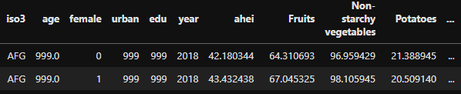
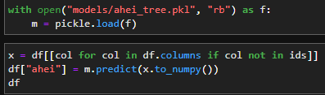
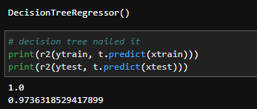
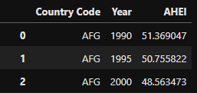
Target
Solution of the formula problem
We found a paper that points to .csv file with the AHEI values for GDD data from 2018. By using this data, we trained a decision tree to generate a model that can calculate AHEI.
Due to the decision tree success, we calculated the AHEI for the other years, we aggregated it by country, and we interpolated values on the missing years between surveys. This allowed us to get a status of how good is the diet of a country
Figure 1. AHEI 2018 merged with GDD raw data
Figure 3. Calculating other years with the tree
Figure 2. Decision Tree fitting GDD with AHEI
Figure 4. Calculated and aggregated AHEI by country and year

Slide 9
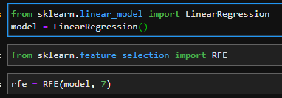
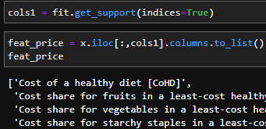
Features
Selection
We selected three main feature datasets: World Development Index, CPI, and Prices for Nutrition for reasons stated before.
Because these datasets had too many features, we decided to use an automatic feature selection method named Recursive Feature Eliminator (RFE) in order to find the most independent and relevant features from these datasets.
Figure 5. RFE from Linear Regression
Figure 6. Example of features selected by RFE

Slide 10
Features
Selected Features
After using RFE, we decided to manually check the most meaningful ones and to selected them based on our knowledge. The chosen features are stated below:
Human Capital Index (HCI): Measures the capital lost by a country due to poor education or health systems. RFE selected 5 different variations of it, but we picked only the regular HCI in order to avoid multicollinearity and because it seems important for us the model relates AHEI to non nutritional features.
Consumer Price Index (CPI): Gives the model an understanding of how much the prices are above the population buying power. Important to support how affordable is the country’s food.
Components Share: A set of 6 features containing how much each food component, like Oils, Proteins, Starch, contribute to the country’s healthy diet cost. Important because show us how much a meal component cost from the total.
Healthy Diet Cost: How much the population pays for a healthy meal in USD. Useful for the cases where the cost prohibits the people from buying healthy components.

Slide 11
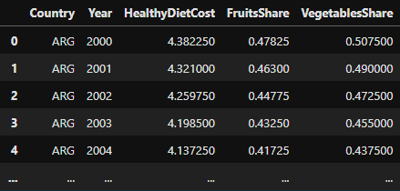
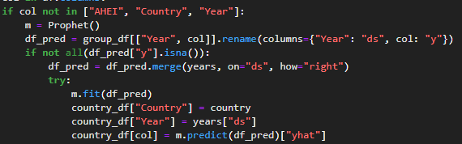
Features
Predicting Features
Because the datasets contained gaps between years and because they start from different years, we decided to pick the ones from 2000 up to today, since it wouldn’t affect GDD data prevalence and will keep a good amount of historic data for the features for predicting them.
After filtering, we choose to use Facebook’s Prophet for filling the missing values in the past and the future through seasonality and trend only. This way we could introduce realism to our data without requiring to learn patterns from lots of examples. Also, we forecasted up to 2025.
Figure 7. Feature prediction algorithm
Figure 8. Some predicted features

Slide 12
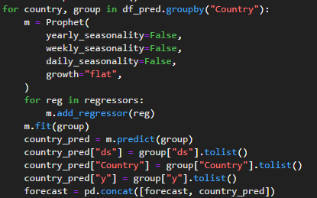
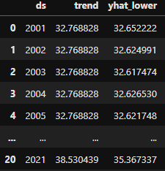
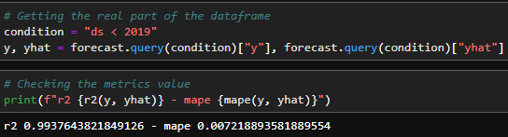
Forecast
Predicting AHEI using the Features
Wused the features with prophet as its regressors without trend and seasonality fitting. We did this because we wanted to evaluate how these features could contribute to the model AHEI.
Figure 11. r2 and mape values for the model
Figure 9. AHEI prediction algorithm
Figure 10. Example of constant trend by country

Slide 13
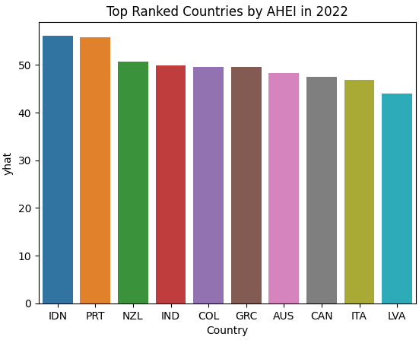
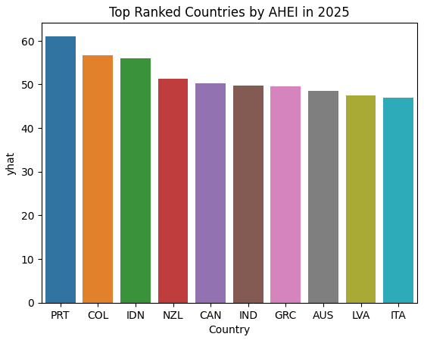
Results
Visualization
Country rankings: We find an interesting topic is to check what is the current AHEI value in now days and in 2025 to see what countries currently have the best and the worst diets in terms of nutrition and how will they be in the future.
Figure 12
Figure 13

Slide 14
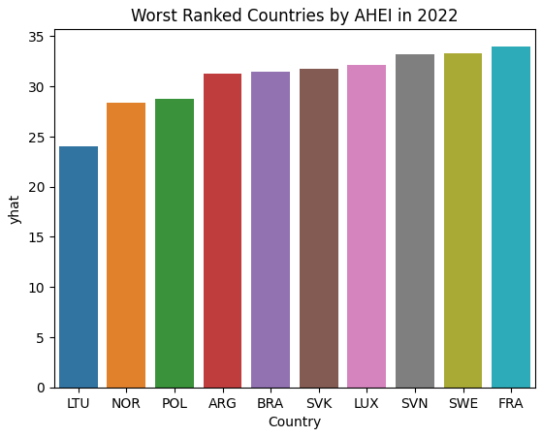
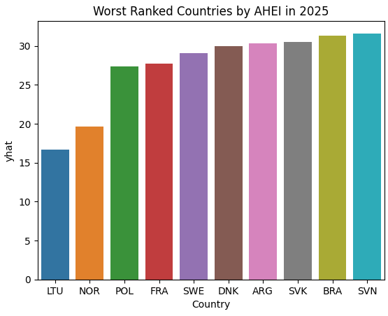
Results
Visualization
Country rankings: We find an interesting topic is to check what is the current AHEI value in now days and in 2025 to see what countries currently have the best and the worst diets in terms of nutrition and how will they be in the future.
Figure 14
Figure 15

Slide 15
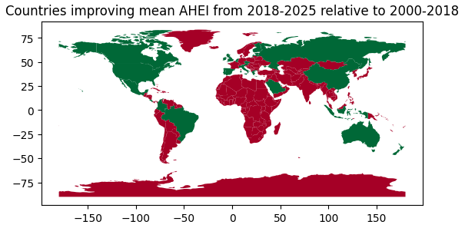
Results
Visualization
Countries with probability of improving its diet quality in the future compared to their past AHEIs: This plot was designed to show what countries are probably need less attention in a nutritional meaning.
Figure 16. The countries in green were predicted as improving, while the red ones are worsening or not present in the forecast.

Slide 16
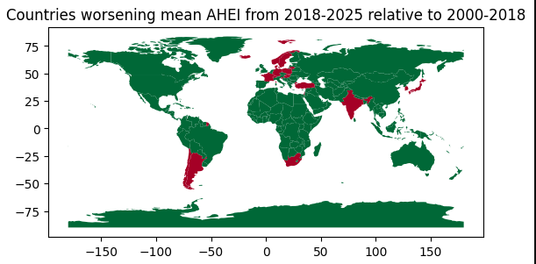
Results
Visualization
Countries with probability of worsening its diet quality in the future compared to their past AHEIs: This plot was designed to show what countries are probably going to require more attention on this topic in the future
Figure 17. The countries in red were predicted as worsening, while the green ones are improving or not present in the forecast.

Slide 17
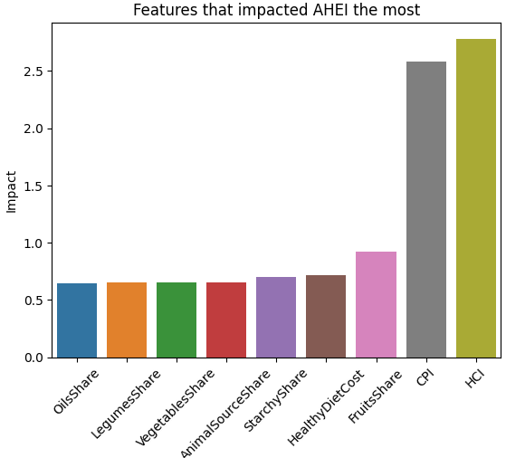
Results
Visualization
Features impact on the forecast: Because the trend is flat, it is possible to analyze which of the features we choose are the most impactful on the model forecast. This would allow us to see what are the other factors that most influence on a diet quality without the need of knowing the food composition
Figure 18

Slide 18
References
World Development Indicators, The World Bank. https://databank.worldbank.org/source/world-development-indicators
Food PricesFor Nutrition, The World Bank. https://databank.worldbank.org/source/food-prices-for-nutrition
Miller, V., Webb, P., Cudhea, F. et al. Global dietary quality in 185 countries from 1990 to 2018 show wide differences by nation, age, education, and urbanicity. Nat Food 3, 694–702 (2022). https://doi.org/10.1038/s43016-022-00594-9
Global Dietary Database. https://www.globaldietarydatabase.org/
Global Nutrition Report. https://globalnutritionreport.org/

