Slide 1

Lockstep: An Ensemble Approach to Social Media Bot Behavior Analysis using Machine Learning
Students: Hunter Williams, Ethan Wigby, Samuel Adeniyi, Victoria Katcha, Dev Patel
Advisor: Dr. Felix Hamza-Lup

Slide 2
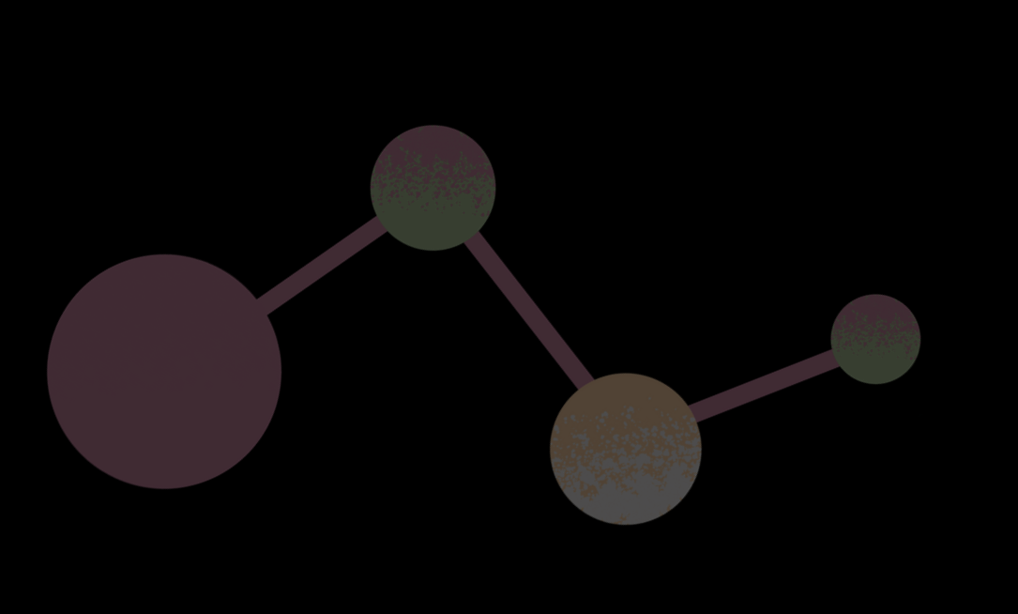
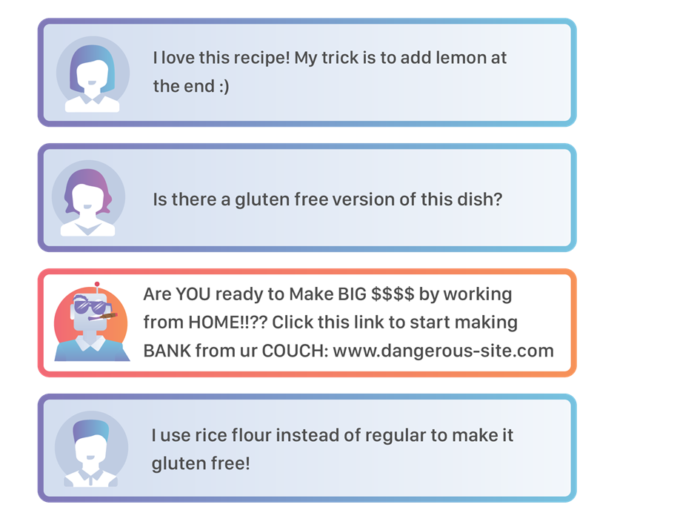
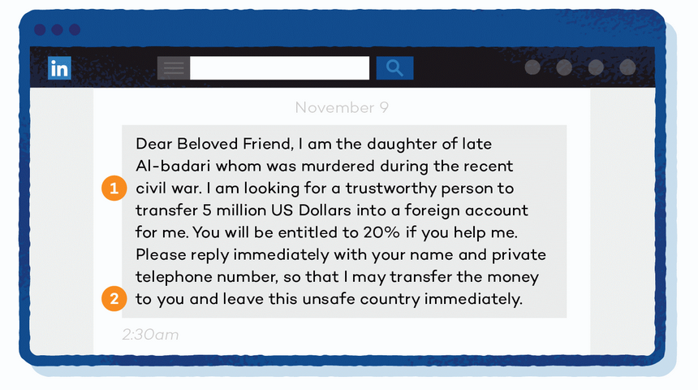
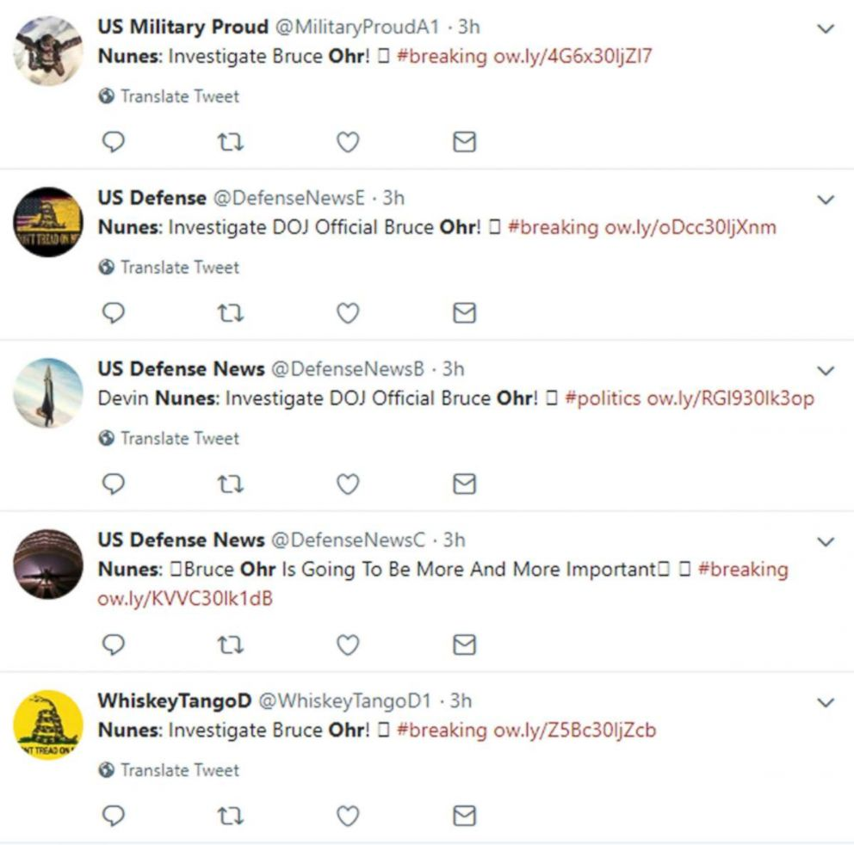
Social Bots:
Background
Social bots combine algorithms and complex instructions in attempts to automate interactions or participation in a social community. An advanced Chatbot that can initiate conversation, imitate other profiles, and coordinate to spread information or deliver spam.
15 % of Twitter active userbase in 2017. [1] 11% of Facebook activity in 2019. [2] Imperva reported about 50% of internet traffic in 2023 was associated with bots. [3]
Source: [4]
Source: [5]
Source: [6]
Notes:
What we hope to cover here:
Make the audience care about what we have to offer! Why should they care about bot detection or lockstep?
Bots are a growing problem!
Has the audience ever experienced spammers like these on their feeds, or perhaps has been contacted by a user doing one of those Nigerian prince scams? Chances are those were bots! Didn’t that suck? Maybe it did, but either way it’s an opening to get the audience to care. Lockstep does something about these guys, right? Then they might care more about the ideas here in return.
The stats at the bottom could described with better detail as::
A study done in 2017 showed that 15% of the active users on Twitter (now X), were bot profiles.
A study done in 2019 showed that 11% of facebook’s activity is likely from bots.
An internet security company, Imperva, put out a ‘bad bot’ report that found 50% of (what is implied to be all) internet traffic to be related to bots
The stats above should be interesting! Despite not being a majority, those numbers are very significant. Take for example, research that has been done that has indicated that only a small number of bots are needed within a large community in order to sway opinion.
The 50% of internet traffic should even be shocking! That one has some particulars though: in this report, bots doesn’t just mean social bots – it means any type of automated program designed to send traffic over the internet while automating some task. This could be spam bots, bot network communication, etc… (Just in case you get asked)
Introduce lockstep as a possible solution as we get to the end of our attempt to make the audience care
By slide 3, they should already have heard the word ‘Lockstep’ and ‘Bot detection’.
The key implied connection between the stats, the examples, and the definitions are that the social bot trend is growing! Exploding even if we really did research! Lockstep deals with tackling the scale of this problem.
Wouldn’t it be hard to keep up with costs if we tried to scan the activity of a gorillion users with a super complicated algorithm that uses two 4060s to do inference?
Doesn’t it seem impossible for moderation teams to keep up with the growth?
Look to the real world for additional information or examples that can reach the audience with familiarity!
I don’t see a ton of ways to angle around the fact that other methods for social bot detection exist. Plan to say acknowledge it!
Those models are supposed to sound more complicated or complex than Lockstep. That’s our drag: simplicity.
We try to avoid saying one thing is strictly better than another here, because so much more testing has to be done to make such claims.
By the end of this slide, you want to be wrapping up a quick acknowledgement that other methods to exist, because it’s time to tell the audience why Lockstep matters.

Slide 3

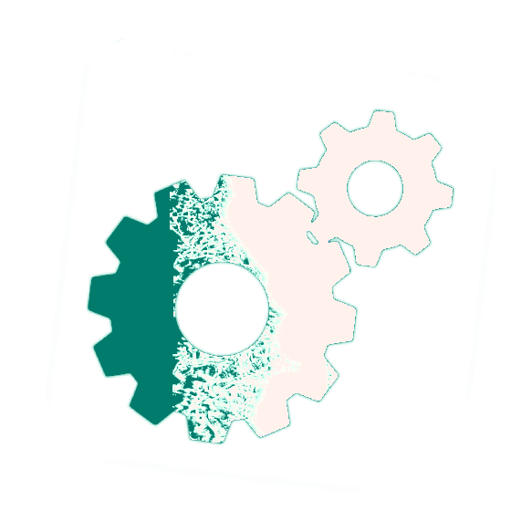

Social Bots:
Behavior
What we know to look for when identifying bot behavior:
Known Behavior Indicators e.g. ‘Obvious Signs’ Strict patterns in posting schedules Complete lack of patterns in posting schedule ‘Time slot’ patterns for activity or purpose Strange balance in metrics such as follow:follower counts Message repetition Single-Purpose content saturates account E.g. influence campaigns, advertisements [7]
Less obvious bot behavior Description lengths: A shorter description length on average URL Posting Habits: Frequently, and with pattern, posting URLs that link to telegram channels, NFT marketplaces, advertising blogs, or news articles. Community relationships: Groups of bots appear at the same time as target communities’ peak activity
Avg. Description Length (Words)
Sample Size
Notes:
When we get here, the audience should have heard about Lockstep. They should know that lockstep is a tool for social bot detection or bot behavior detection, whichever way it comes out.
We hope the audience is asking themselves about bot-detection in their head by now, so this slide hopes to play into that.
What does bot behavior look like? What is lockstep looking for?
It’s really general context behind what bot behavior looks like; important to note that these aren’t specifically everything that Lockstep looks at.
On top:
Known behavior: These are things that you could look at and say ‘yeah a bot might do that’ and head nod along to when the speaker starts talking about how to classify bot behavior.
Bots might have a super strict posting schedule, e.g. posting a weather update to a group of users on the hour every hour.
Bots might have no schedule at all because they are run constantly – posting 24/7 night/day.
Interesting behavior
Even if it doesn’t sound interesting, try to sound interested in the idea that the average profile description for labelled bot accounts is shorter than that of human accounts.
“Huh? Isn’t ChatGPT super wordy?”
Bring up the chart here!
Bots tend to post URLs in patterns
Particularly, bots like to post URLs that lure visitors into places where they might spend money or divulge information.
Bots tend to gather around influential profiles, tend to have strange public metrics.

Slide 4
Lockstep:
An Ensemble Approach
Hypothesis: An ensemble model focused on simplicity and efficiency is a powerful solution for scaling to the needs of a social media platform or community.
Motivation: Social bots have the potential to be used as tools for influence. Current methods are either computationally costly and unfeasible at scale, or do not generalize well on larger datasets.
Approach: Lockstep’s framework balances traditional machine learning algorithms and the involvement of neural networks to produce competitive, interpretable, generalizable, and fast predictions.
Notes:
What is the problem that we are trying to solve here?
That… Current methods of bot detection are overcomplicated and don’t scale well.
How do we know that the models don’t scale well?
Supposedly those Twibot-22 results that serve as a high-score board for F1 scores indicate that.
What do you mean overcomplicated?
Too much learning on neural networks for pattern analysis when we don’t have do.
Botometer X, the most recent popular example of a social bot detection tool, used DNN, GNN, and Random forests in its ensemble. BotMoe, another recent methodology, uses GNNs, pretrained language model functions, a transformer layer and a multi-layer perceptron for classification.
Doesn’t that all sound complicated just to score 20 points under this garbage heap glued together?
When we get here, the audience should know that bot detection tools already exist, and that Lockstep somehow offers something that these tools don’t. Well, it’s time to sell that product!... While giving out as little information as possible!
Lockstep’s goal is to try and be ‘simple’. We are trying to indirectly say that the types of models used, and the architecture of this methodology are simple, and that this simplicity somehow implies that this model is more cost effective to implement or scale. It probably IS, but we haven’t done enough testing to outright say that.

Slide 5
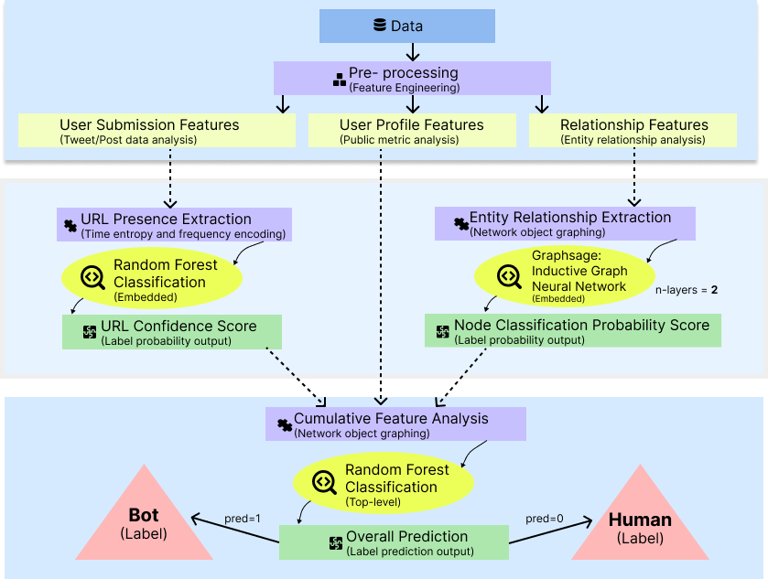
Lockstep:
An Ensemble Approach
Three Models Architecture: Simplicity performs better when attempting to detect social bots at the scale of a social media platform.
30 Pre-Processed Features + 2 Embedded Model Features Random Forest → URL Confidence GraphSage GNN→ Relationship Confidence
32 Total Engineered Features
+ Temporal Information,
Engineered Raw Features
Top Layer Model:
  Random Forest Classifier
= 0 (Human) or 1 (Bot)
Notes:
Here, the audience should know what lockstep promises to do, and during the tenure of this slide, we should tell the audience how that happens.
Our top-level model is a Random Forest Classifier, operating on an assortment of features that we have engineered from what TwiBot-22 provides us. In addition, there are two two ‘special’ features that are really embedded model output.
These two special features are similar in nature to ‘confidence scores’. These confidence scores have significance in final classification scores that increase the model’s performance.
You could, I guess, take the three squares in the diagram to the right ot mean there are three ‘kinda layers’. The bottom kinda-layer would be the Data/Data pre-processing layer, and during the experiment this is where we do a lot of pre-adding user profile features before running the whole model.
The middle layer comprises of the embedded models, which some of the information from the pre-processing layer is used for.
The top layer is the random forest classifier that takes all of these features and then makes a prediction on them.

Slide 6
  Features
  Annotated (Pre-Labelled Dataset)
  1m Users
  140k bots, 860k Humans
  86m Tweets
  170m Edges (Relationships)
  9:1 Humans to Bots
  Language Agnostic
  Largest to date
  Source: [8,9]
Dataset:
Twibot-22
github.com/LuoUndergradXJTU/TwiBot-22
Notes:
When we get to this slide, the audience should know about Lockstep, and have a general idea of how the model architecture works.
Over the next couple of slides, we are going to talk a little about the resources that we used to train and build Lockstep, and then a little about the ‘interesting’ parts of Lockstep before we get to results.
The content on this slide is devoted to the Twibot-22 dataset, which we use to both train and test Lockstep. It’s a really big dataset with some unbalanced-ness that makes it a good representative for real world bot populations.
The chart on the right, Dataset Human to Bot Ratio Comparison
We are supposed to paint the picture that Twibot-22 is a ‘challenging dataset for models like this’.

Slide 7
Dataset:
Twibot-22
Competitor F1 scores on Twibot-22
publicly viewable at
github.com/LuoUndergradXJTU/TwiBot-22
Notes:
Really meant to be a quick supplement to the previous slide 7, this chart is meant to show the audience that perfect scores on Twibot-22 are still far off.
These scores are pulled from the main readme of the repository on the left, where the dataset’s information is actually hosted by it’s creator. They are submitted by the community and compiled on that page.
We don’t need to explicitly say these scores are ‘bad’, but we can adjust tone to kind of poke some fun at the lower scores. Hopefully this gets the audience curious about how lockstep compares with these results. Well, we got that!

Slide 8
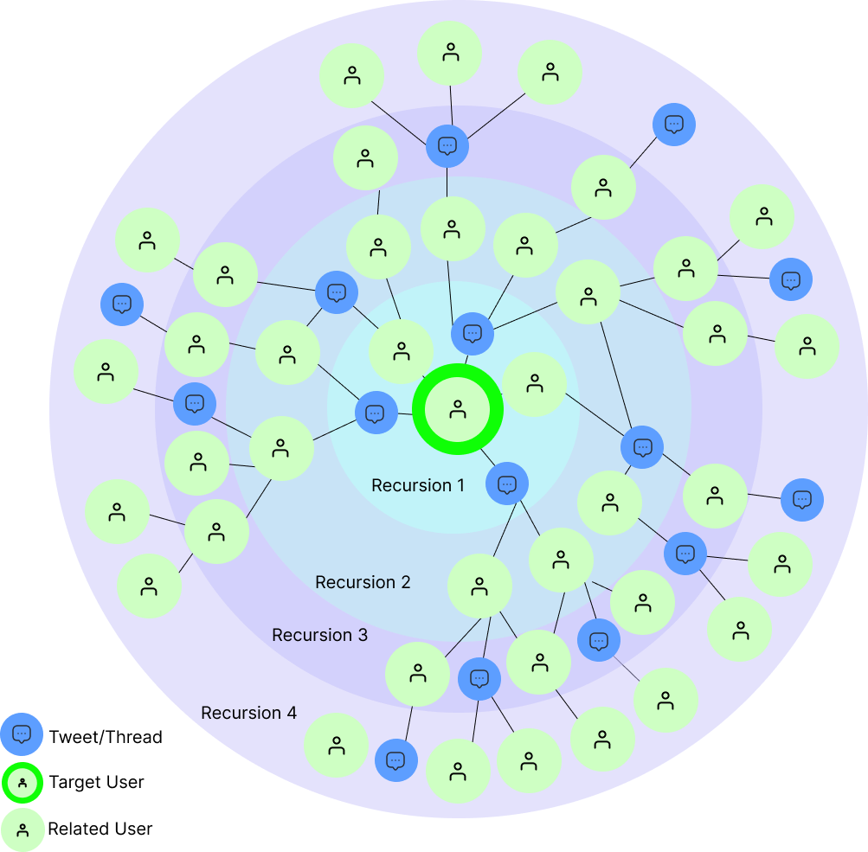
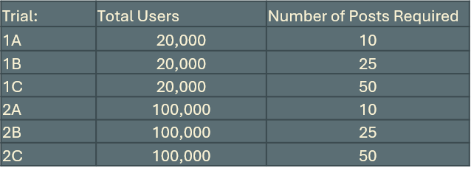
Lockstep:
Sampling/Testing
- Sampling Strategies
Stratification with Minority Oversampling
  Making a 2:1 Human: Bot from a 9:1 Ratio
Relation Graph Sampling
  Subset of all 170m relationships based on depth of a user from any one of the training set users.
- Testing Strategies
2 Trials, 3 Tests Each: 6 Experiments
Different sized pool of users per trial.
Minimum sampled posts required per test.
Features on top-level normalized in all tests.
Evaluated based on average of all experiments.
Relationship Sampling Visualization
Notes:
So, by this point the audience should know about Twibot-22 and why we chose it for Lockstep.
Before we describe how the information in the dataset is used and any more about how lockstep actually works, this slide is meant to cover the details of how we sample the dataset for information and how we have organized tests to generate a better representative result.
Stratification with sampling applies to both the graph model and the top-level model, but it’s done a little different for each.
Stratification of samples generally means to sample a set in such a biased way as to compensate for imbalanced data classes. Minority oversampling means that our technique for stratification is to oversample the minority class to reduce the gap between the ratios.
We can’t load the entire relationship model every time we want to evaluate a user based on neighboring relationships. It’s too big and most of it would go unused.
To prevent this, our model extracts a limited depth of entities and relationships from the original targeted set of users by recursing over the relationship edge file and incrementally building onto the list of targeted users with any entity ID we found associated with a target user the previous iteration. That is what the circle diagram shows
On the right, the table shows a combination of trial and testing variables for each of the 6 tests. The trial names will be important later in identifying the results of individual experiments in another slide.
Some important things to know but not necessarily say are:
We haven’t run Lockstep and the entire twibot-22 dataset. We have two sample set sizes, and the idea is that the results will stay consistent enough across them to show that the model can be generalized.
We run 6 total tests, although that doesn’t mean that the model was only run six times.
In each test, the selected users were different.

Slide 9
Lockstep:
Overview of Features
-Pre-processed
# URLs in Profile
# Hashtags in Profile
# Mentions in Profile
Profile Description Length
Profile Username Length
Follower:Following
Tweet:Following
Account Age
Time Between Posts
Total/Avg RT
Total/Avg Likes
Total/Avg Quotes
Chi Distance of metrics: Likes on Posts, Retweets of Posts, Quotes of Posts
Likes:No Likes Ratio
Retweets:Zero Retweets Ratio
Entropy Calculations: Post Times
Media Attached Percentage
Location Enabled Post Percentae
-Raw (Dataset)
Creation Date
Profile Link Metadata
Location String Presence
Profile URL String Presence
Public Metrics:
  Follower Count
  Following Count
  Tweet Count
  Listed Count
  -Embedded Models
-Graph Model Probability
  User relationship patterns.
-URL Confidence
  URL Appearance Frequency
  Appearance Time Entropy
  (Weekdays, hours)
Main Model
Notes:
What to say on this slide depends on how much time you need to waste at this point.
We should be some time into the presentation by now and are hopefully starting to see the finish line.
You should NOT read this like a list. It’s almost purely reinforcement eye candy for whatever you decide to say.
These are all of the features that Lockstep weights when making an prediction on a user profile. Some of these features actually refer to more than one in-code feature.
The features highlighted in ‘blue’ are ‘interesting’ and if extra time should be spent, then it should explain these.
Chi distance of metrics refers to a score that represents the ‘likeness’ of two sets of distribution through the Euclidian distance calculated between them. In this application, testing has shown that the overall distribution of likes and retweets on posts across the dataset as a whole tends to follow a Benford law type normal distribution. We use the distance between this standard distribution and the actual distribution of likes and retweets on a user’s post as features.
Entropy calculation means that we use computed entropy to measure the diversity of values within a range of values in a distribution. When we apply that to temporal information, we get a score that kind-of represents the diversity of when a user is active each day or when a user tends to post during the day or weekday.
Graph model probability = Graph confidence score
Lockstep looks at the entities that have interacted with a target profile and based on metrics and types of interactions between entities, weights it’s confidence that some attribute of the user’s position within a graphed out network indicates some prone-ness to bot behavior.
URL Confidence = URL Confidence Score
Lockstep takes a list of URLs that have appeared in a URL’s post, counts them per URL and attaches information about when a URL is used each day. We use this information to build a model for bot-behavior detection based on the likelihood of the type of URL posted and the frequency of posting it has some correlation to bot behavior.
Like the entropy calculation mentioned above, in addition to URL domain and appearance frequency, this also measures diversity in which a URL appears during a day or week.

Slide 10
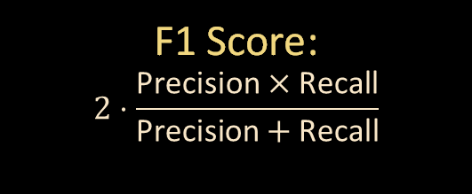
Lockstep:
Results
$\text{F}\text{1 }\text{Score}$:
$$2⋅\frac{\text{Precision}×\text{Recall}}{\text{Precision}+\text{Recall}}$$
Average* F1: 0.78
Average* AUC/ROC: 0.85
*Average of ALL experiments.
Notes:
So the audience should now know how Lockstep works. The audience should have the idea that the dataset we are working with presents unique challenges to bot-detection, and we hope they are wondering how Lockstep did versus the chart they saw before. Well, this is it! It’s the same chart as seen on slide 7, but we have added Lockstep’s averaged score to it for comparison.
It might be a good idea to become familiar with what the F1 score represents. If asked, it’s okay to acknowledge that the F1 score isn’t a perfect measurement for performance, but it’s something we have available for comparison.
You can mention the high AUC/ROC score of Lockstep if you want. I left it out of the slides because I don’t have AUC/ROCs for all the other models to compare to.
The chart on the right is meant to display a trend between the test scale or constraints and the resulting F1 score. It shows the results of all tests. If we see a downward trendline, that’s bad because it means we probably can’t scale the things we are weighting. Fortunately, we have a trendline that meanders upwards, which is a good sign for Lockstep!
We see the trial/test information table again, and you can see that the trial names coincide with points on the X axis for the chart on the right.

Slide 11
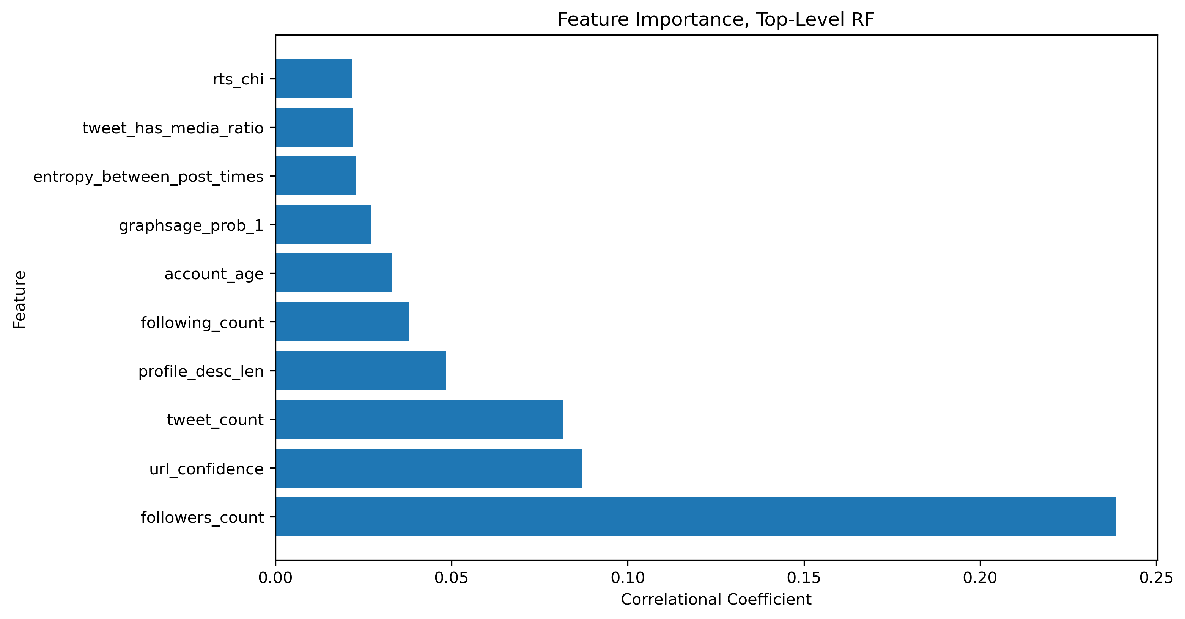
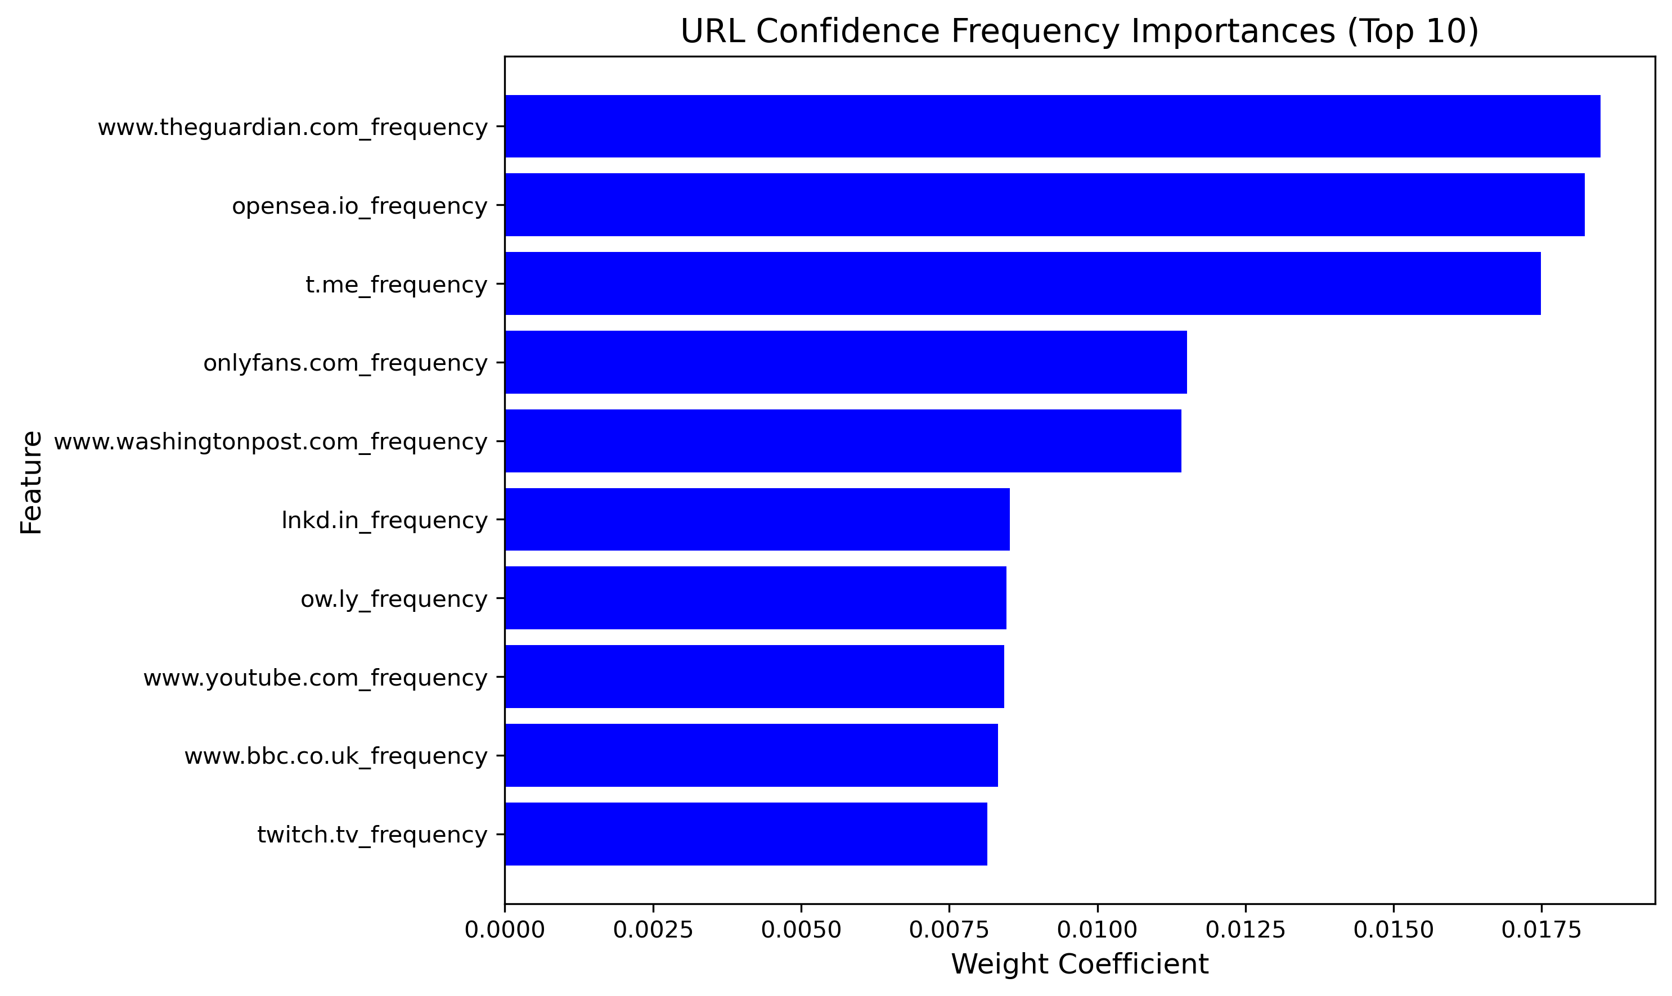
Lockstep:
Trends
  followers_count/tweet_count: strong generalization capabilities
  url_confidence: probability output from model analyzing behavior relationships of URL posting habits: ‘URL Confidence Model’
  The profile description length.
  A high frequency in posting links to NFT markets.
  A high frequency of posting links to telegram channels.
  A high frequency in posting news articles.
  A high frequency of posting links to advertisement sources, like blogs.
Notes:
Another slide that is ripe with open-ended ness. Hopefully, the audience is at least a tiny bit impressed by the previous results. We covered a slide on bot behavior early on, but this slide actually shows the ‘feature importances’ for the random forest models that were used in Lockstep. It’s a discussion piece that can be elaborated on for as long as we need to. Or you could just point and say neat and a couple of extra things and move on.
‘Feature importance’ is not a measurement of how much of a direct indicator something is. It means that the model found some positive or negative magnitude correlation between a particular feature and a particular outcome. For example, having followers_count and tweet_count in the list of significant features is more likely to mean something akin to ‘the model found a relationship between these two variables that can be quantified and estimated by coefficient’.
We actually don’t know which variables interact with which in specific here, and are making assumptions based on presence alone. It’s possible to get more information about how the model weighted these, but it’s not an out-of-the-box feature of random forests. Definitely don’t mention this fact, though.
Similarly, we could say that the presence of the URL confidence score on this chart means that some significance was found in the probabilities the sub-model output. That’s probably true. What significance however, is a lot less human understandable.
The chart on the bottom, URL Confidence Frequency Importances, might be a little easier to interpret.

Slide 12
Lockstep:
Conclusion
Results: Lockstep competes with and outperforms more complex competitors on Twibot-22, using methods that cost less to implement and scale consistently.
Conclusions: Lockstep’s consistent results across trials and tests show that a simpler model may be a cost effective and consistent first-line of defense in the identification and moderation of bot traffic. Simple models can go a long way towards safeguarding social interactions.
End of presentation. References on next slide.

Slide 13
References
[1] O. Varol, E. Ferrara, C. A. Davis, F. Menczer, and A. Flammini, “Online Human-Bot Interactions: Detection, Estimation, and Characterization,” Mar. 27, 2017, arXiv: arXiv:1703.03107. doi: 10.48550/arXiv.1703.03107.
[2] M. Zago et al., “Screening Out Social Bots Interference: Are There Any Silver Bullets?,” IEEE Communications Magazine, vol. 57, no. 8, pp. 98–104, Aug. 2019, doi: 10.1109/MCOM.2019.1800520.
[3] Bad Bot Report. (September 2024). Retrieved November 19, 2024 from
https://www.imperva.com/resources/resource-library/reports/2024-bad-bot-report/
[4] “What is a spam bot? | How spam comments and spam messages spread.” Accessed: Dec. 03, 2024. [Online]. Available: https://www.cloudflare.com/learning/bots/what-is-a-spambot/
[5] P. Security, “10 Social Media Scams and How to Spot Them,” Panda Security Mediacenter. Accessed: Dec. 03, 2024. [Online]. Available: https://www.pandasecurity.com/en/mediacenter/social-media-scams/
[6] A. B. C. News, “Twitter quietly kills suspected firearm-themed bot network,” ABC News. Accessed: Dec. 03, 2024. [Online]. Available: https://abcnews.go.com/Politics/twitter-quietly-kills-suspected-firearm-themed-bot-network/story?id=57221053
[7] R. J. Oentaryo, A. Murdopo, P. K. Prasetyo, and E.-P. Lim, “On Profiling Bots in Social Media,” vol. 10046, 2016, pp. 92–109. doi: 10.1007/978-3-319-47880-7_6.
[8] “LuoUndergradXJTU/TwiBot-22: Offical repository of TwiBot-22 @ NeurIPS 2022, Datasets and Benchmarks Track.” Accessed: Dec. 03, 2024. [Online]. Available: https://github.com/LuoUndergradXJTU/TwiBot-22
[9] S. Feng et al., “TwiBot-22: Towards Graph-Based Twitter Bot Detection,” Feb. 12, 2023, arXiv: arXiv:2206.04564. doi: 10.48550/arXiv.2206.04564.
Notes:
Thanks for listening. Any questions?

