Slide 1
Predicting Final-Hour
SPX Price Movements
Intraday market features and short-dated options trading
Harsh Khatri
Dissertation presentation

Slide 2
Research problem and questions
Core problem
Five research questions
Can information known by 15:00 anticipate the SPX move into the close?
RQ1
Predict final-hour direction.
RQ2
Predict absolute movement in basis points.
Why it matters
0DTE option premiums react sharply to small SPX moves.
Statistical accuracy alone does not establish economic value.
Execution costs can reverse an apparently profitable result.
RQ3
Identify large moves and the most useful features.
RQ4
Test whether signals concentrate meaningful opportunities.
RQ5
Backtest an SPX 0DTE rule after costs.
2/10

Slide 3
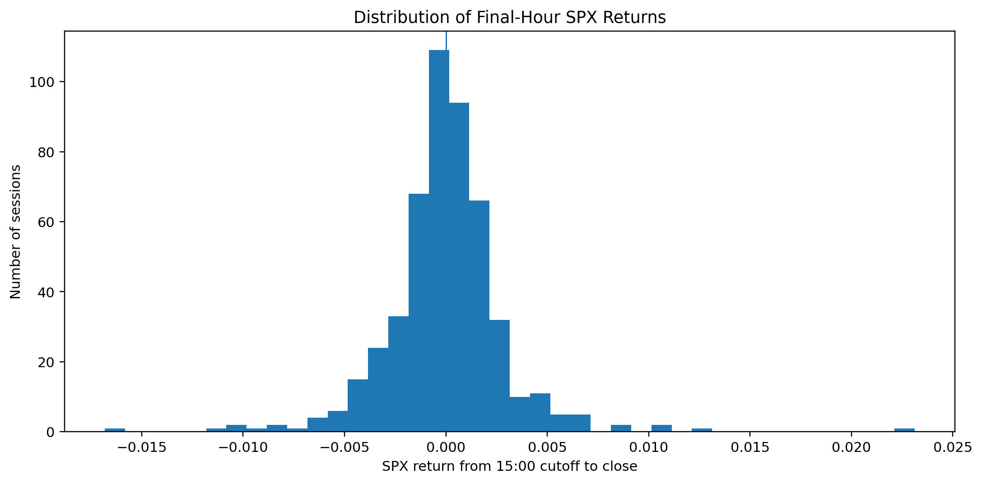
Data and prediction targets
Market data
One-minute SPX, SPY and VIX data from Massive
18 July 2024 to 17 July 2026
501 aligned sessions, with 434 strict and 486 relaxed modelling sessions
Prediction boundary
Features end at 14:59. The target spans the 14:59 to 15:59 closes.
Targets
Final-hour returns cluster near zero, with a small number of large moves.
RQ1 direction
RQ2 absolute movement in bps
RQ3 move of at least 27.5 bps
3/10

Slide 4
Chronological modelling and leakage controls
Strict-dataset split
Train
18 Jul 2024 to 3 Dec 2025
303 sessions
Validation
4 Dec 2025 to 20 Mar 2026
65 sessions
Test
23 Mar 2026 to 17 Jul 2026
66 sessions
Leakage controls
Model comparison
Expanding-window validation preserved time order.
Each training fold fitted its own preprocessing steps.
Nested validation separated tuning from later evaluation.
The analysis compared linear, neighbour, tree, kernel and neural models with simple trading and statistical benchmarks.
Every outer-fold prediction came from a model that had not seen that session.
4/10

Slide 5
Predictive results for RQ1 to RQ3
Task
Selected model
Result and benchmark
RQ1
Direction
Histogram Gradient
Boosting
Balanced accuracy 0.544 ± 0.070
Below 60-minute mean reversion at 0.569
RQ2
Magnitude
RBF SVR
MAE 13.97 ± 5.41 bps versus 15.29 bps median benchmark
Out-of-sample R² approximately 0.003
RQ3
Large move
RBF SVC
Average precision 0.501 ± 0.189 versus prevalence 0.275
Performance varied by fold
The models ranked market activity more effectively than they predicted direction.
5/10

Slide 6
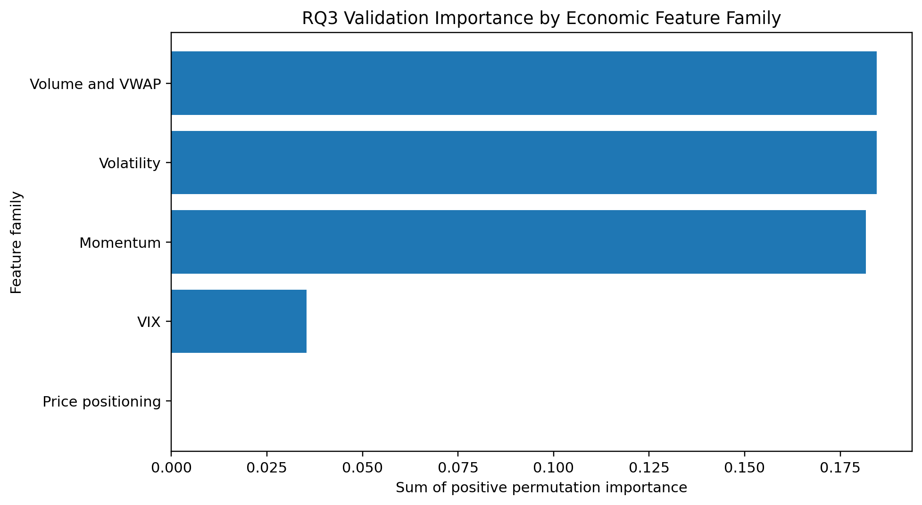
Features associated with larger moves
Main evidence
Volume and VWAP, volatility and momentum led grouped importance.
Cumulative SPY volume and ATR percentage led individual importance.
Importance varied by fold, so it shows association rather than causality.
Added complexity did not help
The exploratory LSTM underperformed the classical models on matching dates.
6/10

Slide 7
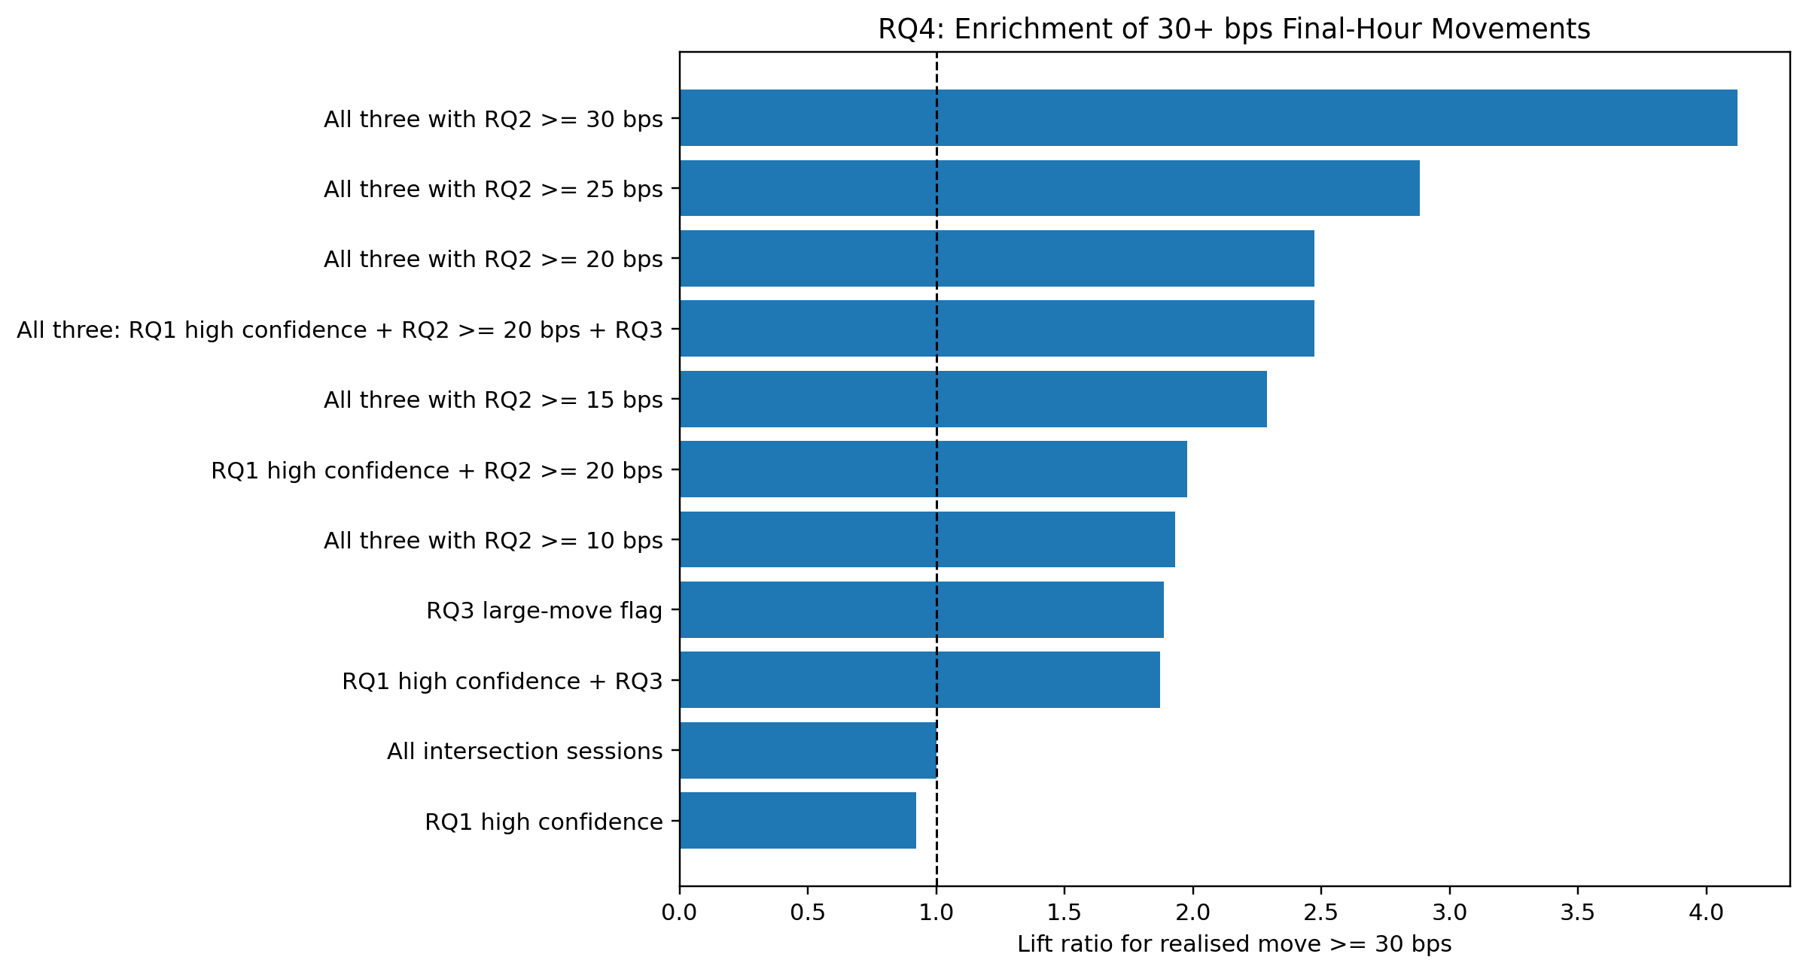
RQ4: larger-move concentration
All sessions
Frozen rule
Sessions
276
20
Coverage
100%
7.2%
Mean absolute move
22.80 bps
38.16 bps
Moves at least 30 bps
24.3%
60.0%
2.5×
observed lift in 30+ bps moves
Only 20 sessions passed the frozen rule, so uncertainty remained high.
7/10

Slide 8
RQ5: profitable history, inconclusive evidence
17
$9,551
64.7%
53.5%
usable ATM 0DTE trades
ML-direction total P&L
win rate
mean return on premium
Primary rule
Why the result remains inconclusive
Buy the nearest ATM call or put at 15:00 to 15:05, exit at 15:55 to 15:59, and apply the medium synthetic cost assumption.
Mean reversion slightly beat ML direction on the same dates.
Removing the five best trades changed P&L to -$2,143.
The bootstrap interval for mean profit crossed zero.
Trade bars and synthetic costs cannot reproduce NBBO fills.
ML direction
$9,551 P&L
-$2,143 max drawdown
60-minute mean reversion
$9,691 P&L
-$1,604 max drawdown
8/10

Slide 9
Conclusion and limitations
Intraday information helped identify larger-move sessions, but the evidence did not establish a reliable directional or trading edge.
Evidence supported
Evidence did not establish
Modest ranking ability for movement magnitude
Useful large-move classification relative to prevalence
A combined filter that concentrated larger final-hour moves
Stable directional predictability
An ML advantage over simple mean reversion
A live, independently profitable 0DTE strategy
Next test
Freeze the models and rules, add historical NBBO quotes, and evaluate a longer unseen period through prospective paper trading.
Main constraints: two years of modelling data, 17 options trades, synthetic execution costs and no prospective trading test.
9/10

Slide 10
Questions?
Intraday signals identified more active final-hour sessions,
but the evidence did not establish a reliable trading edge.

