Slide 1
MATH 26
ANALYTIC GEOMETRY AND CALCULUS 1

Slide 2
CHAPTER 1
Analytic Geometry and the Conic Sections

Slide 3

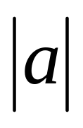
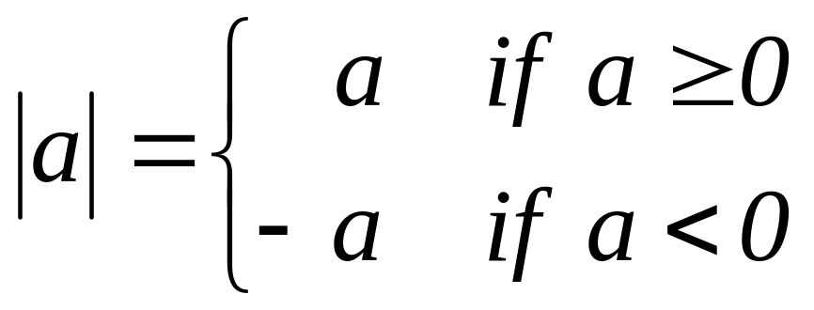
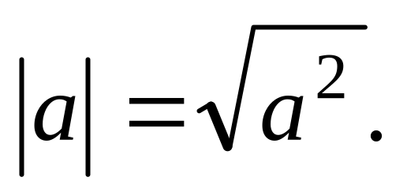
1.1 Coordinates and Lines
The absolute value of a real number (denoted by ) is given by the formula
The absolute value of a real number (denoted by ) is given by the formula
The absolute value of a real number (denoted by ) is given by the formula
The absolute value of a real number (denoted by ) is given by the formula
The absolute value of a real number (denoted by ) is given by the formula
The absolute value of a real number (denoted by ) is given by the formula
The absolute value of a real number (denoted by ) is given by the formula
The absolute value of a real number (denoted by ) is given by the formula
The absolute value of a real number (denoted by ) is given by the formula
Equivalently, we have

Slide 4
On a number line, the absolute value of a number is just the undirected distance of the number from the origin.
-a 0 a

Slide 5
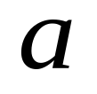
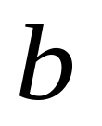
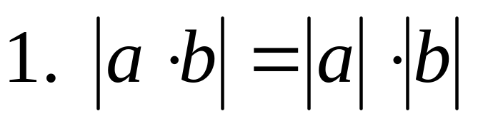
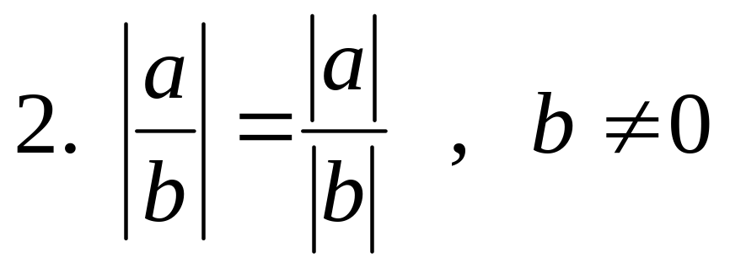
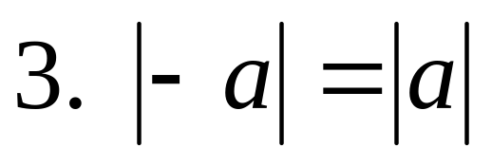
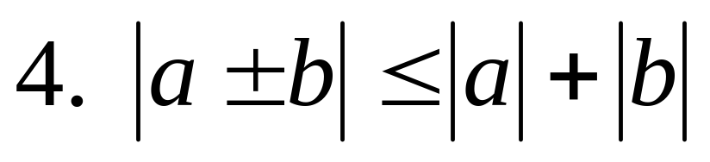
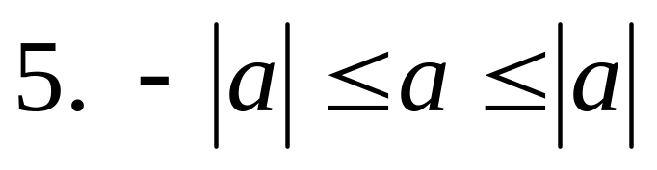
Properties of Absolute Value
Let and be real numbers. Then

Slide 6
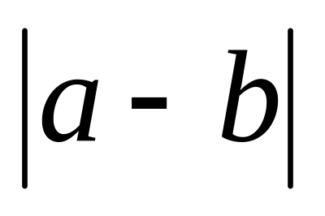
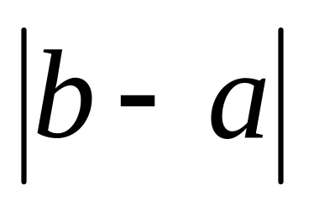

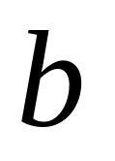
The distance between two real
numbers a and b is also given by
or

Slide 7
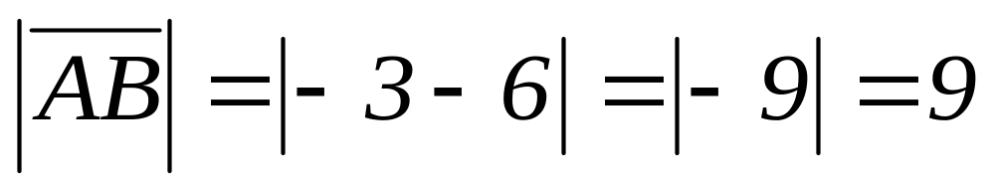
Example. Let A(–3) and B(6) be points on the same number line. Determine the distance between A and B.
Solution:

Slide 8


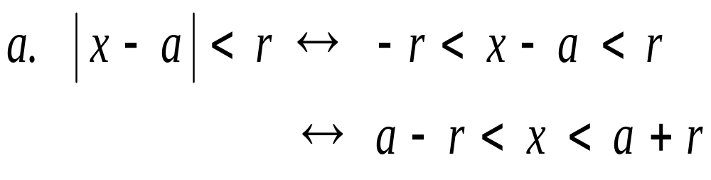
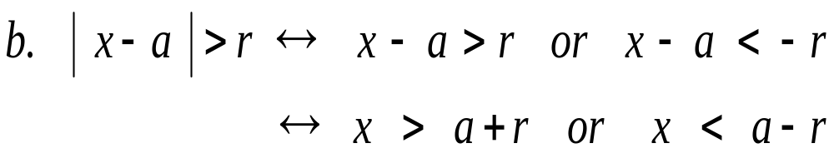
Additional Properties
Let and be real numbers with > 0. Then

Slide 9
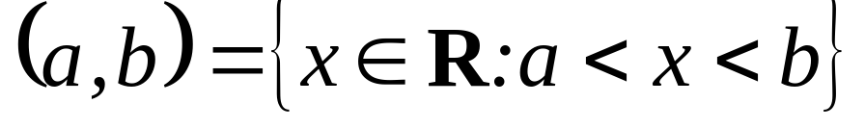
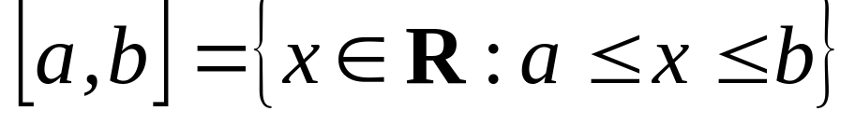
Interval Notations
The open interval consists of all real numbers between a and b. Equivalently,
The closed interval consists of all real numbers between a and b and including a and b. Equivalently,

Slide 10
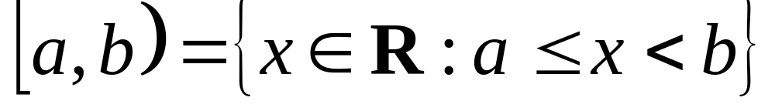
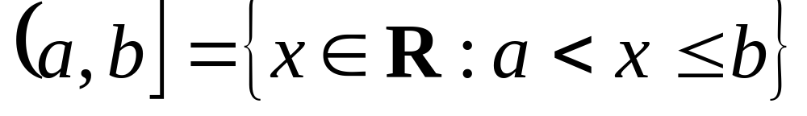
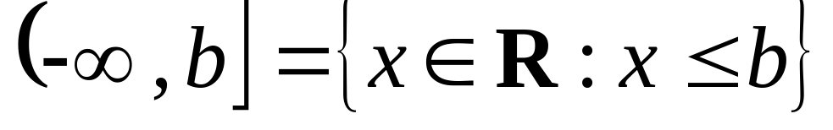
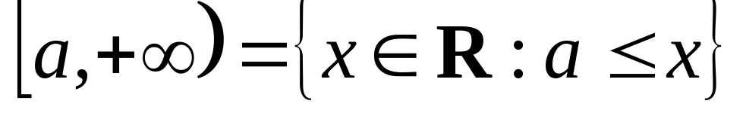
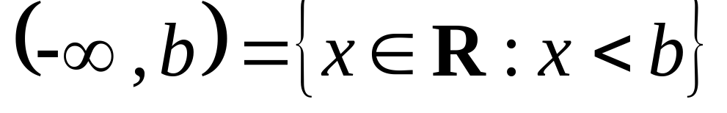
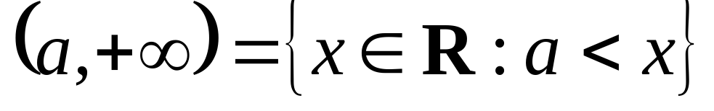
Other types of intervals
,

Slide 11
Cartesian Plane
y-axis
II: x < 0, y > 0
I: x > 0, y > 0
x-axis
III: x < 0, y < 0
IV: x > 0, y < 0

Slide 12
The number x in the ordered pair is called the abscissa of the point while the number y is the ordinate.
The abscissa and the ordinate of a point are called the rectangular or Cartesian coordinates of the point.
The x-axis and the y-axis are called coordinate axes and they divide the plane into four parts, called quadrants. The quadrants are numbered by I, II, III, and IV.

Slide 13
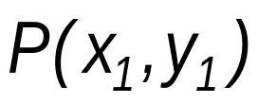
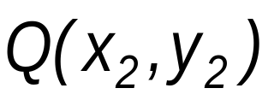
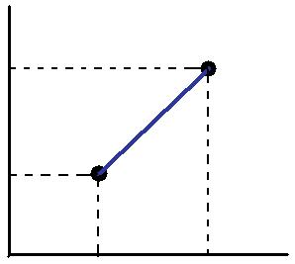




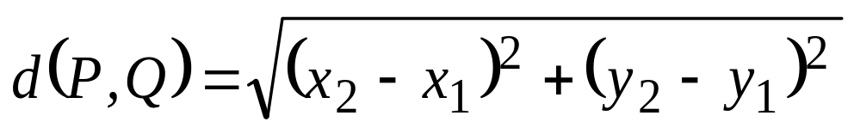



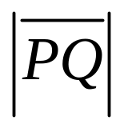
Distance Formula
The distance between
two points and on the same plane is given by the formula
(The distance between points P and Q can also be denoted by ).

Slide 14
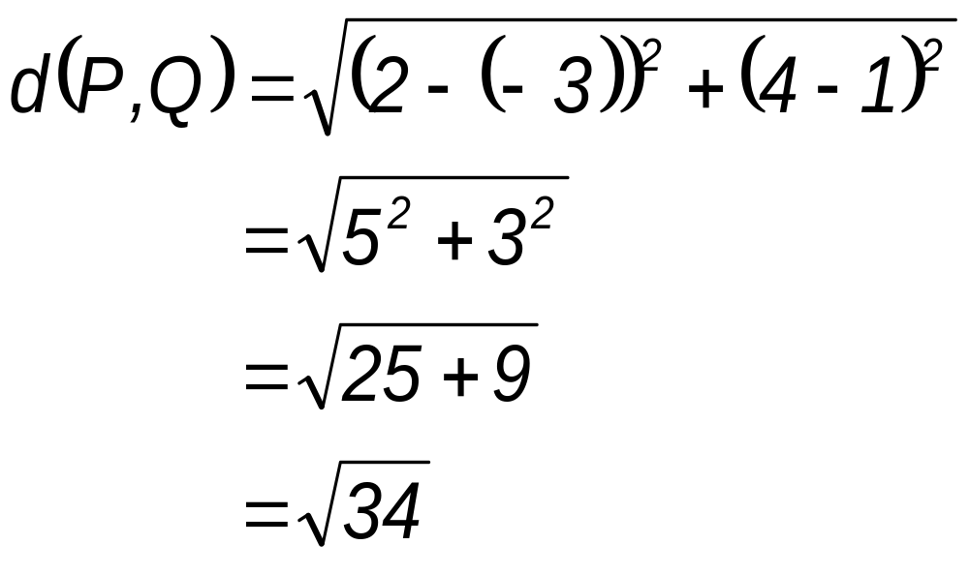
Example. Determine the distance between the points P(-3,1) and Q(2,4).
Solution

Slide 15
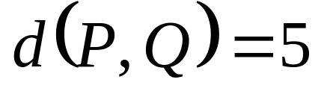
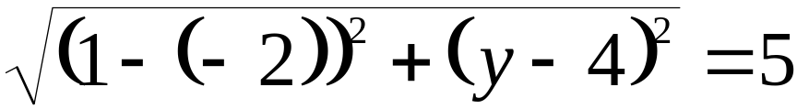
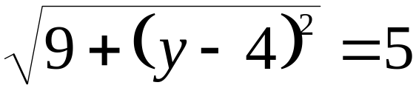
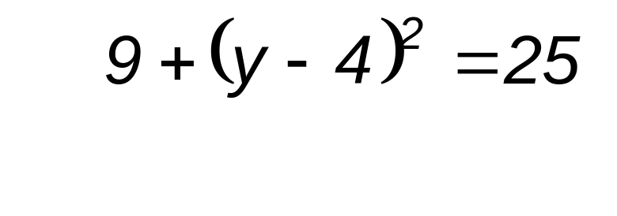
Example. If the distance between P(-2,4) and Q(1,y) is 5, determine the value(s) of y.
Solution
Since then
so that .
Squaring both
sides of the last equation,
we get

Slide 16
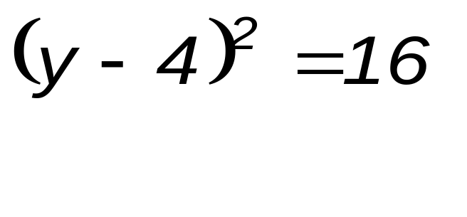
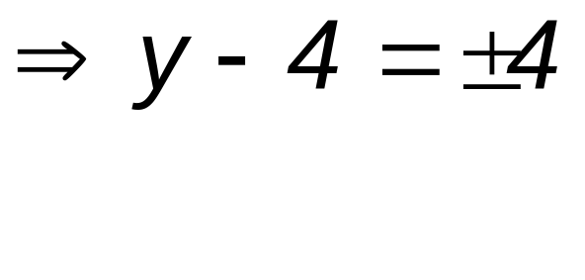
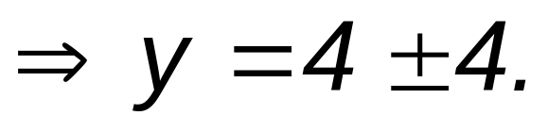
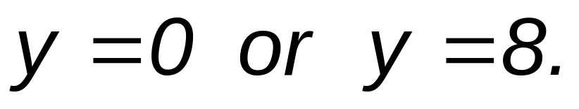
Then
Thus,

Slide 17
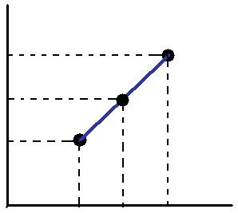






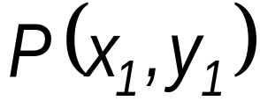
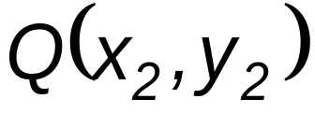



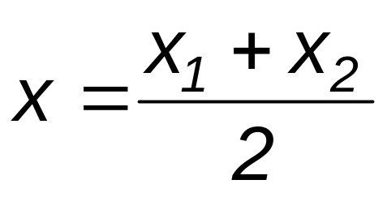
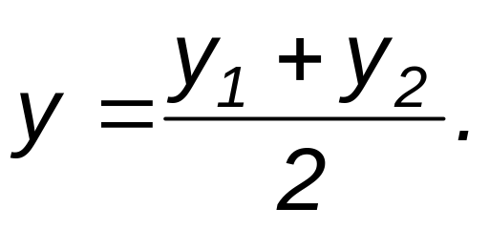
Midpoint Formula
The midpoint M of
the line segment
joining the points
and
has coordinates
and

Slide 18
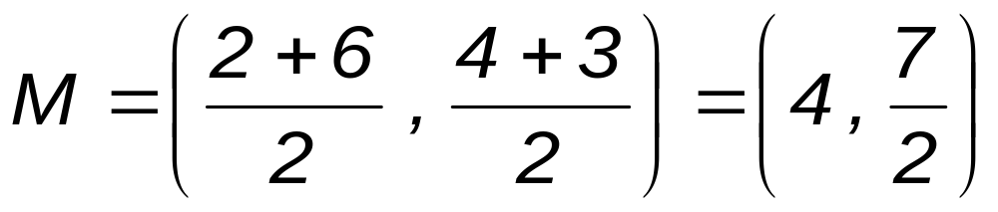
Example. Find the midpoint of the line segment whose endpoints are P(2,4) and Q(6,3).
Solution

Slide 19
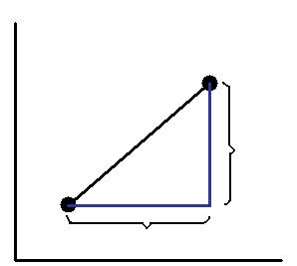
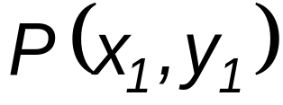



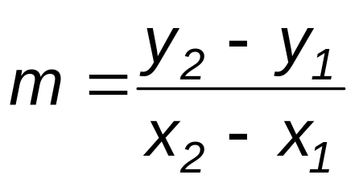
Slope of a Line
The slope m of the
line joining two points
and
is given by
(Note: The slope of a vertical line is undefined.)

Slide 20
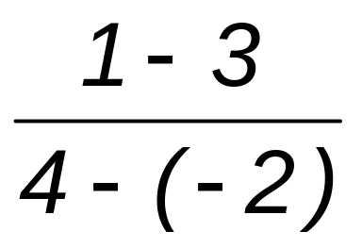
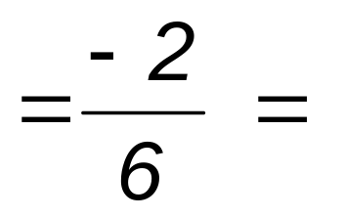
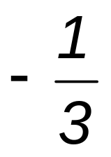
Example. Determine the slope of the line passing through the points P(-2,3) and Q(4,1) .
Solution
m =

Slide 21
Parallel Lines
Two non-vertical lines and are said to be parallel if and only if their slopes are equal.
L₁
L₂

Slide 22
Perpendicular Lines
Two non-vertical and non-horizontal lines and are said to be perpendicular if and only if the product of their slopes is negative 1.
L₁
L₂

Slide 23



Example. The slope of a line is 2. Determine the slope of a second line
if and are
a. parallel b. perpendicular
Solution
a. If L₁ and L₂ are parallel then their slopes are equal. Thus, the slope of L₂ is also 2.
b. If L₁ and L₂ are perpendicular then the product of their slopes is equal to -1. Thus, the slope of L₂ is -1/2.

Slide 24
General and Slope-Intercept Forms of Equations of Lines

Slide 25

General Equation of a Line
The general equation of a line is given by
where A, B and C are constants and not both A and B are zero.

Slide 26







Example. Determine if the given points lie on the line given by
a. b.
Solution
A point lies on the line if and only if its coordinates satisfy the equation of the line.
a. At the point , and . If we substitute these values in the given equation, we get .

Slide 27




b. At the point ,
and . If we substitute
these values in the given
equation, we get
which is true.
Thus, lies on the line given by

Slide 28

Slope-intercept Form Equation of a Line
Let m is slope of the line and b be the y-intercept of that line then the slope-intercept form equation of a line or equation of a line in slope-intercept form is given by

Slide 29


Example. Give the general equation of the line passing through the point (-7,-5) and perpendicular to the line given by .
Solution
First, determine the slope of the given line.
The slope of the given line is -3/4.

Slide 30

Since the two lines are perpendicular then the slope of the line containing (-7,-5) is 4/3.
The general equation of the line is 4x-3y+13=0.

Slide 31

Assignment #1: (1/2 yellow paper)
Due: June 23, recit time
Find the value of k such that the line given by
a. is parallel to the line given by x-8y=-4
b. has slope equal to 2
c. passes through (-1, 6)

Slide 32
Other Forms of Equations of Lines

Slide 33



Two-point Form Equation of Line
Let and be known points on a line then the two-point form equation of a line or equation of a line in two-point form is given by

Slide 34





Example. Give the general equation of the line passing through the points (2,3) and (-1,-2).
Solution
The general equation of the line is

Slide 35



Intercept Form Equation of a Line
Suppose a and b are the x-intercept and y-intercept, respectively, of a line such that
and . Then the intercept form equation of a line or equation of a line in intercept form is given by

Slide 36


Example. Give the intercept form and the general equation of the line passing through (2,0) and (0,1).
Solution
Since 2 and 1 are the x-intercept and y-intercept, respectively, then the intercept form is given by
and the general form is given by

Slide 37

Point-slope Form Equation of a Line
Let m be the slope of a line that passes through the point (x₁,y₁) then the point-slope form equation of a line or equation of a line in point-slope form is given by

Slide 38

Example. Find the general equation of the line given a slope equal to -1 and x-intercept equal to 6.
Solution
y
=
−
x
+
6
⇒
x
+
y
−
6
=
0
The general equation of the line is .

Slide 39



Distance Between a Point and a Line
The distance d from a point to a line L with equation is given by

Slide 40




Example. Determine the distance between the point (2,3) and the line given by .
Solution
From the formula, we have
Then,
Thus,

