Slide 1
2.1 The Limit of a Function
Notes:
;l'l'l

Slide 2
Function
A function is a set of ordered pairs of numbers (x, y) in which no two distinct ordered pairs have the same first number. The set of all admissible values of x is called the domain of the function, and the set of all resulting values of y is called the range of the function.

Slide 3
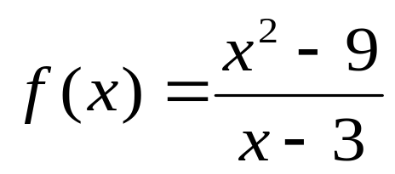

Function
6
3

Slide 4
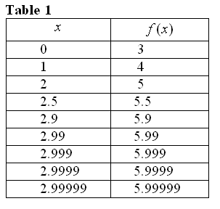
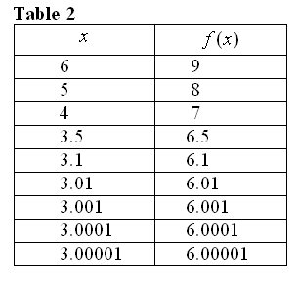
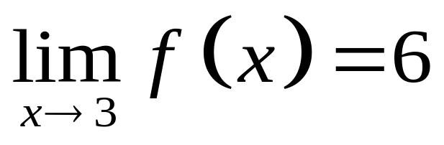
The Limit of a Function
6
3
the limit of f(x), as x approaches 3, is 6

Slide 5
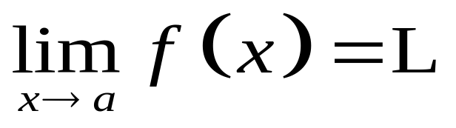
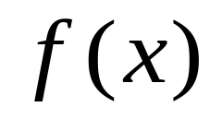
The Limit of a Function
Let f be a function defined at every number in some open interval containing a, except possibly at the number a itself. The limit of f(x), as x approaches a, is L, written as
if for every ∈ > 0 , no matter how small, there exists a δ > 0 such that if 0 < ⎜x – a ⎜< δ then ⎜ – L ⎜ < ∈.

Slide 6

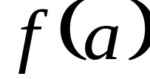
The Limit of a Function
In finding the limit of a function as x approaches a number a, we are not concerned with the value of the function when x = a, but only with the values of the function when x is close to a ( i.e., can exist even if is undefined).

Slide 7
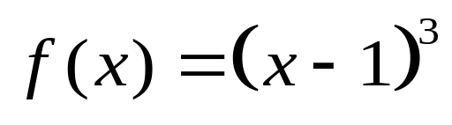
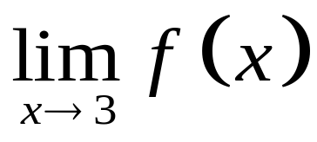
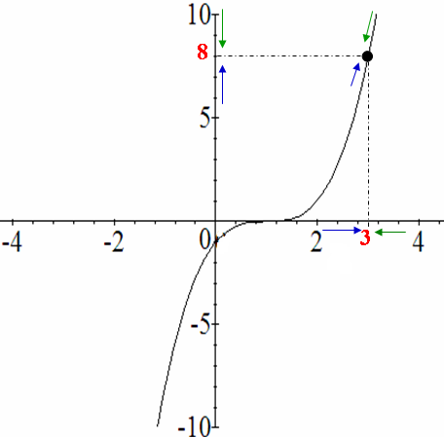
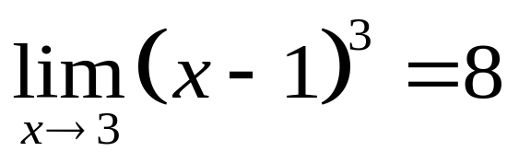
Example 1 Let . Sketch the graph of f and use the graph to find .
Solution:
The graph of f is shown in the adjacent figure. From the graph, we see that the values of f approach 8 when x is near 3. Thus,

Slide 8
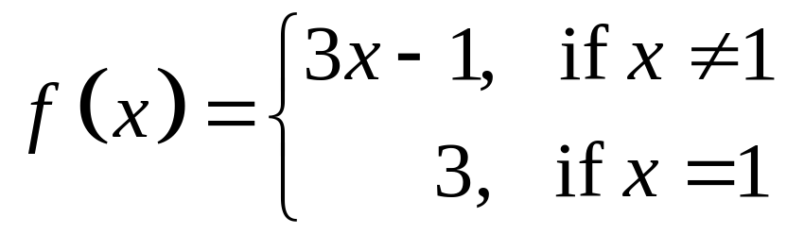

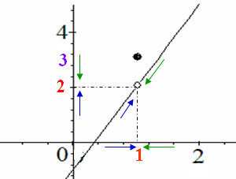
Example 2 Let . Sketch the
graph of f and use the graph to find
Solution:
Note that, although f(1) = 3, this has nothing to do with the limit of the function as x approaches 1.

Slide 9
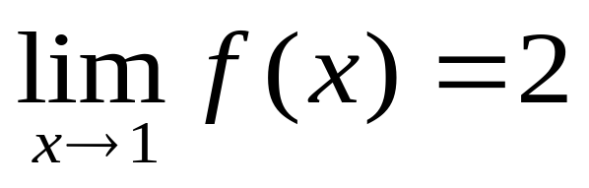
Example 2 Let . Sketch the
graph of f and use the graph to find
Solution:

Slide 11
2.2 Theorems on Limits of Functions

Slide 12
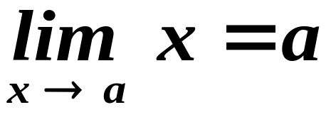
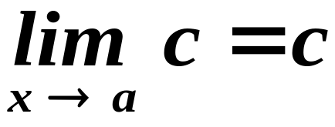
Theorems on Limits of Functions
Theorem 1:
Theorem 2:
, where is c a constant

Slide 13
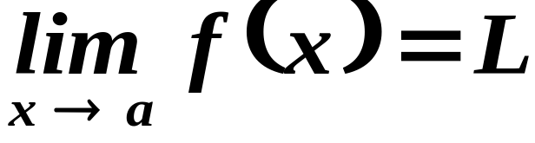
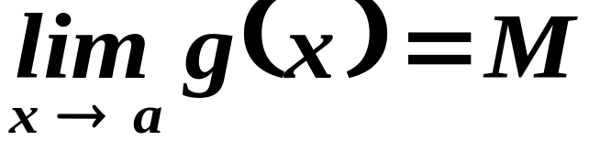
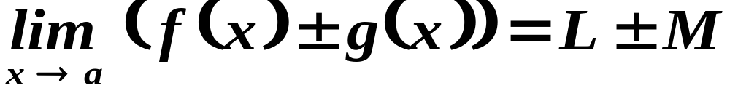
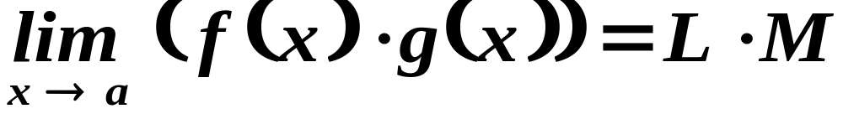
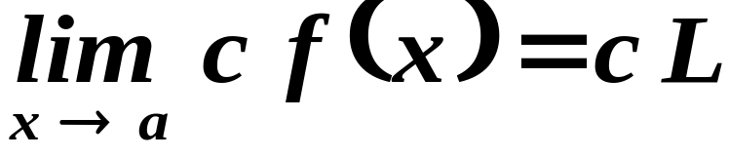
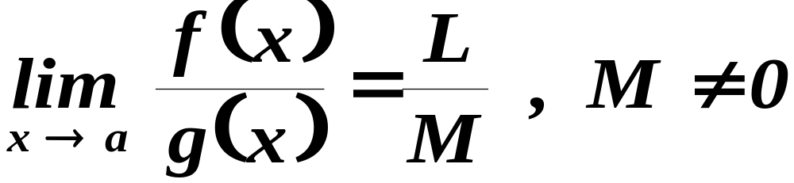
Theorems on Limits of Functions
If
and
then
Theorem 3:
Theorem 4:
Theorem 5:
Theorem 6:

Slide 14
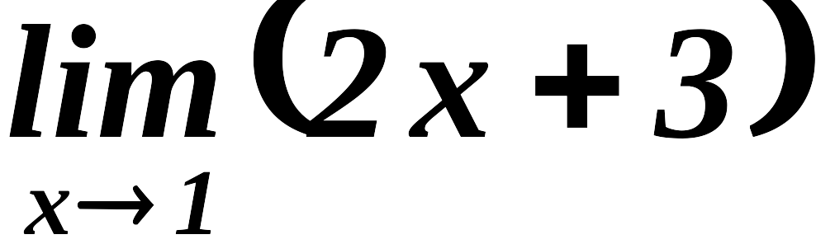
Example 1:

Slide 15
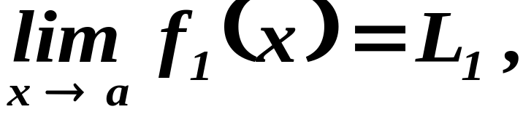
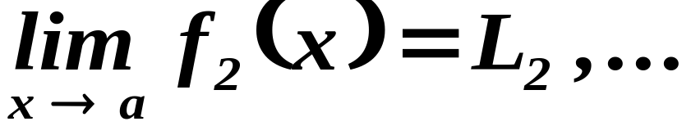
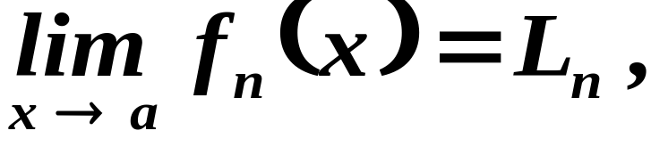
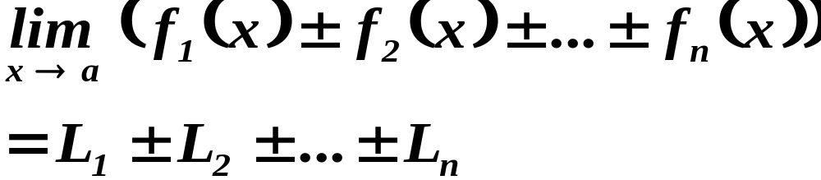
Theorems on Limits of Functions
If
then
Theorem 7:

Slide 16
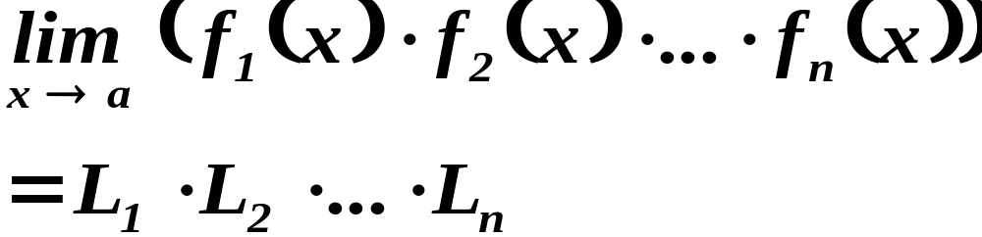
Theorems on Limits of Functions
If
then
Theorem 8:

Slide 17

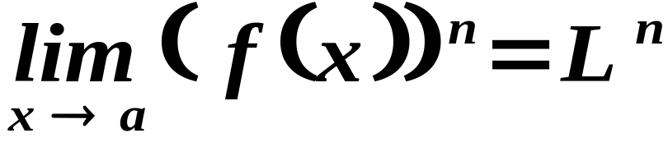
Theorems on Limits of Functions
If
and
is any positive integer then
Theorem 9:

Slide 18
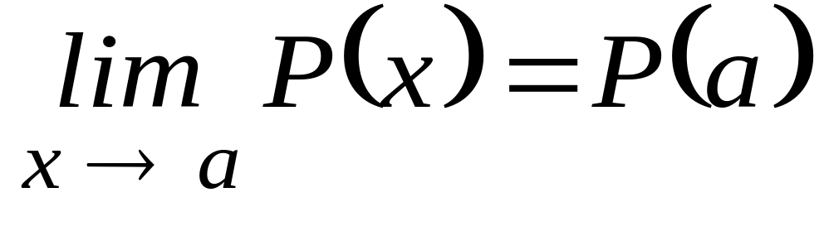
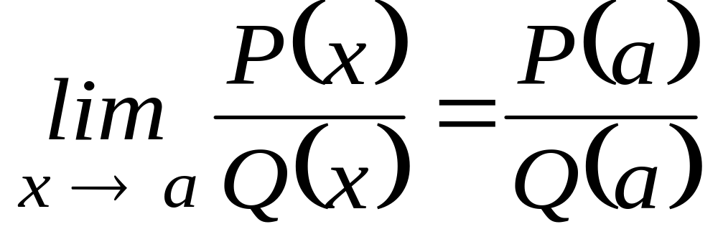
Theorems on Limits of Functions
Theorem 10:
where P is a polynomial function
Theorem 11:
where P and Q are polynomial functions

Slide 19
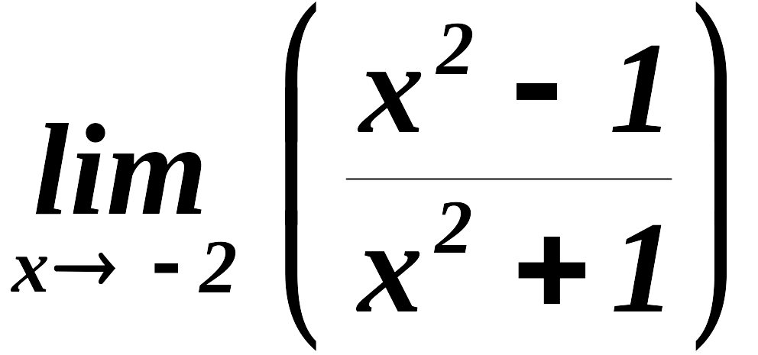
Example 2:

Slide 20
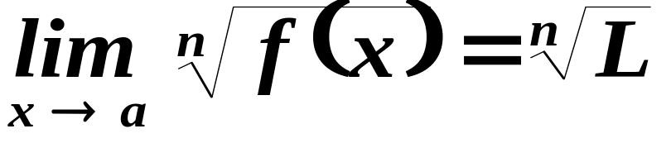

Theorems on Limits of Functions
If
and
is any positive integer then
Theorem 12:
If is even then the theorem holds if .

Slide 21
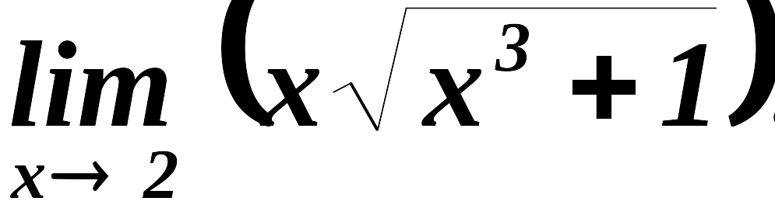
Example 3:

Slide 22
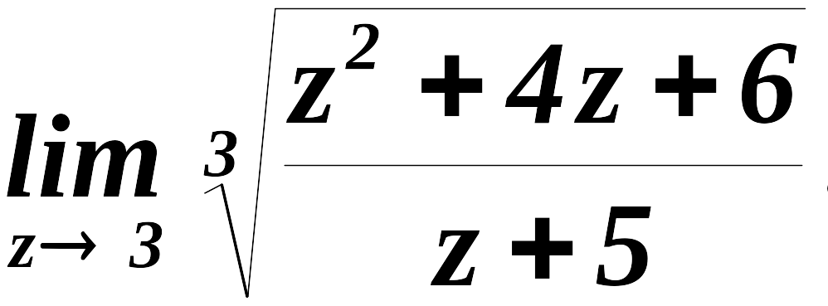
Example 4:

Slide 23
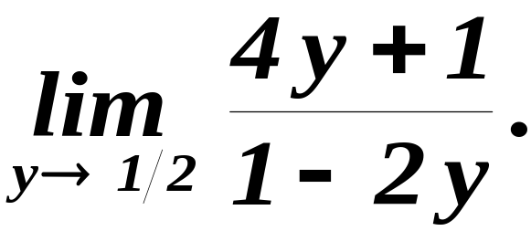

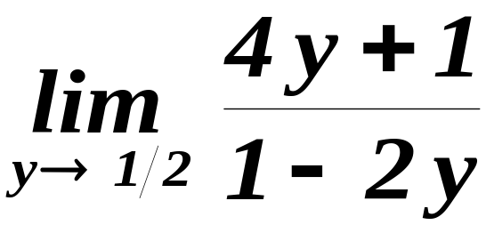
Example 5. Evaluate
SOLUTION
By direct substitution, we will notice that it will take the form 2/0, which is undefined.
Thus,
does not exist.

Slide 24
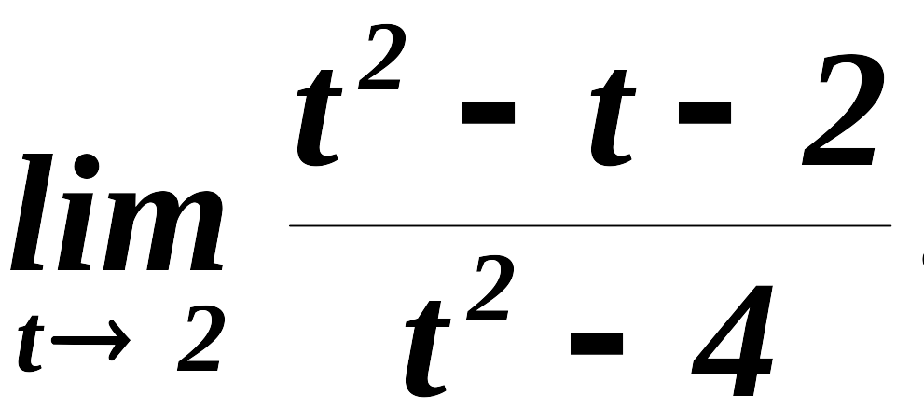
Example 6:

Slide 25
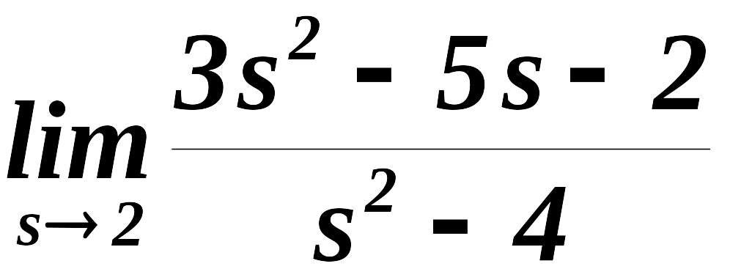
Example 7:

Slide 26
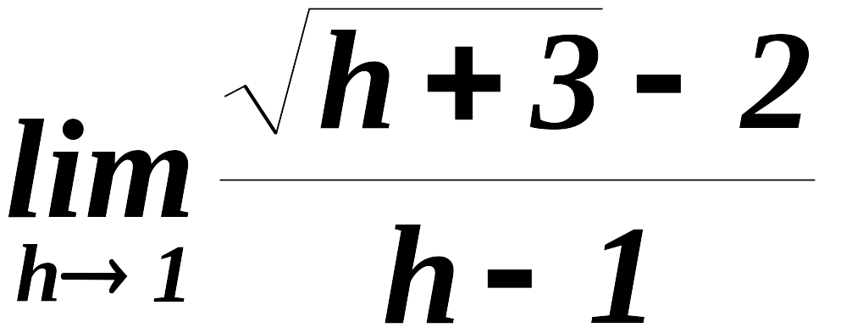
Example 8.

Slide 27
End of 2.2

