Slide 1
MATH 26
ANALYTIC GEOMETRY AND CALCULUS 1

Slide 2
CHAPTER 1
Analytic Geometry and the Conic Sections

Slide 3
1.2 Analytic Proof
One way to prove some geometric theorems is to make use of, or refer to, a coordinate system. Such a proof is called an analytic proof .

Slide 4
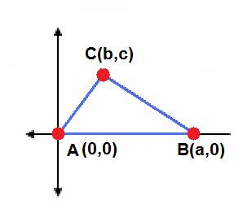
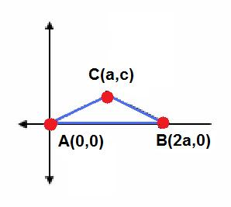
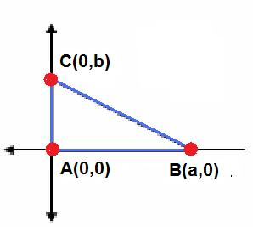
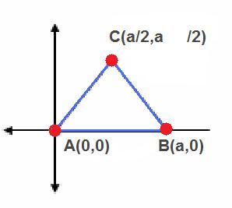

Triangles
general triangle
isosceles triangle
right triangle
equilateral triangle

Slide 5
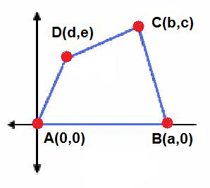
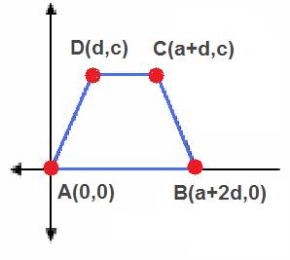
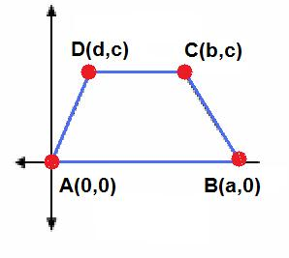
Quadrilaterals
general quadrilateral
isosceles trapezoid
trapezoid

Slide 6
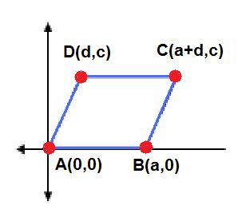
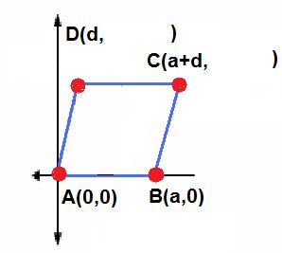


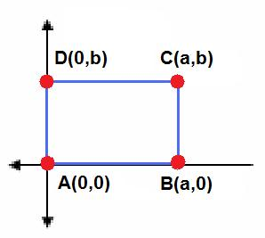
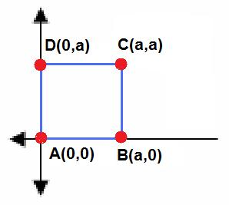
Quadrilaterals
parallelogram
rhombus
rectangle
square

Slide 7
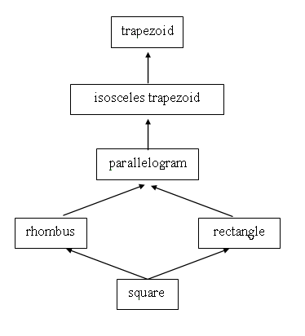
Heirarchy of Quadrelaterals

Slide 8
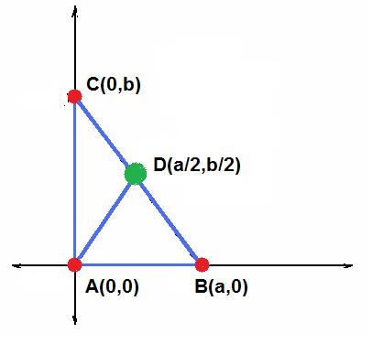
Example. Prove analytically that the midpoint of the hypotenuse of a right triangle is equidistant from the three vertices.
Solution
Consider the
right triangle with vertices A,B, and C and D be the midpoint of the hypotenuse.

Slide 9

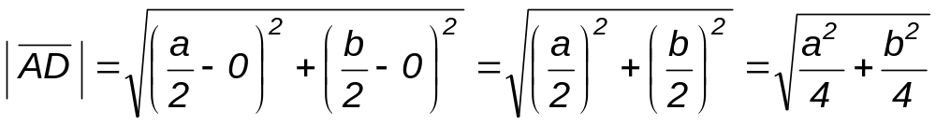
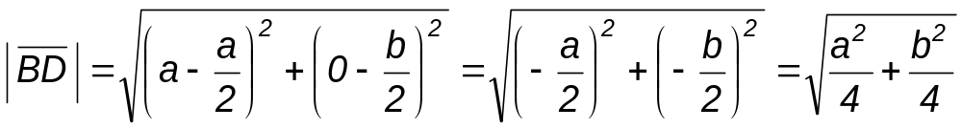
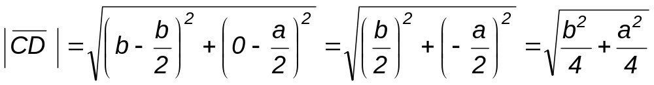
We need to show that,
Hence, the midpoint D of the hypotenuse is equidistant from the vertices A,B, and C.

Slide 10
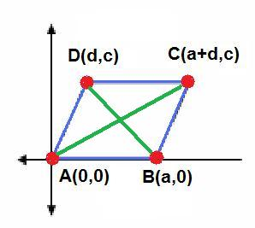
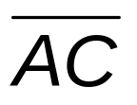
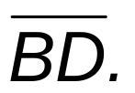
Example. Prove analytically that if the diagonals of a parallelogram are congruent then the parallelogram is a rectangle.
Solution
Consider the parallelogram with vertices A, B, C, and D and with diagonals
and

Slide 11
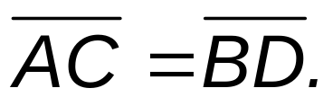
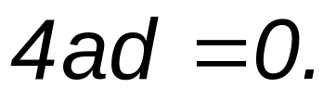
If the diagonals are congruent then
This implies that,
Then,

Slide 12
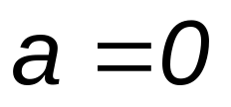
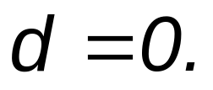
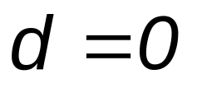
As a consequence,
or
If
then point B has coordinates (0,0) also.
If
then the vertices of the parallelogram are (0,0), (a,0), (a,c) and (0,c).
Hence, if the diagonals of a parallelogram are congruent then the parallelogram is a rectangle.

Slide 13
-----------------End of 1.2---------------------

