Slide 1
MATH 26
ANALYTIC GEOMETRY
AND CALCULUS I
1.3
Conic
Sections

Slide 2
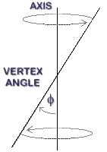
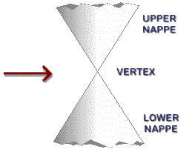
Right Circular Cone

Slide 3
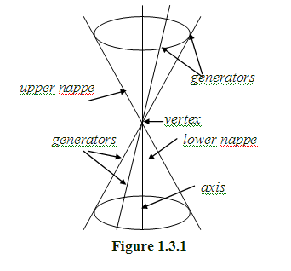
Right Circular Cone
A line lying entirely on the cone is called a generator of the cone, and all generators of a cone pass through its vertex .

Slide 4
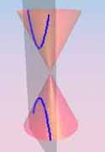
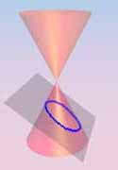
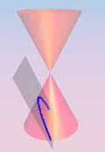
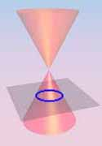
Conic Sections (or conics)
A conic section is the intersection of a plane and a right circular cone with two nappes.

Slide 5
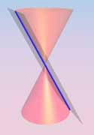
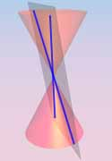
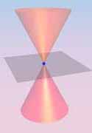
Types of Conic Sections
A degenerate conic is either a point, a line or two intersecting lines.

Slide 6
Types of Conic Sections
A non-degenerate conic is either a parabola, an ellipse or a hyperbola

Slide 7
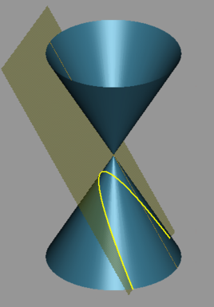
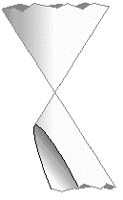
Non-degenerate Conics
If the cutting plane is parallel to one and only one generator, the curve of intersection is called a parabola.

Slide 8
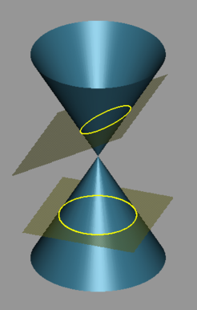

Non-degenerate Conics
If the cutting plane is not parallel to any generator; that is, it cuts all generators, the curve of intersection is called an ellipse.

Slide 9
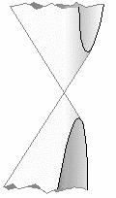
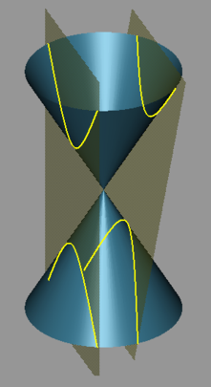
Non-degenerate Conics
If the cutting plane is parallel to two generators, the curve of intersection is a hyperbola.

Slide 10
Non-degenerate Conic
A non-degenerate conic is a set of points P on the plane such that the ratio of the undirected distance of P from a fixed point (called focus) to the undirected distance of P from a fixed line not through the fixed point (called the directrix) is a constant.
Q₂
P₂
Q₁
P₁
focus
F
directrix

Slide 11
Non-degenerate Conic
Q₂
P₂
The constant ratio is called the eccentricity of the conic, which we will denote by e.
Q₁
P₁
focus
F
directrix

Slide 12

Non-degenerate Conic
Q
P
Let P be a point on a conic with focus at F and let Q be the projection of P on the directrix. Then,
Q₂
P₂
Q₁
P₁
focus
F
directrix

Slide 13
Non-degenerate Conic
The line through a focus and perpendicular to a directrix of a conic is called the principal axis of the conic.
A point of intersection of the conic and its principal axis is called a vertex of the conic.
Q
P
Q₂
P₂
Q₁
P₁
focus
vertex
F
directrix
principal axis

Slide 14
Non-degenerate Conic
Given the eccentricity e of a conic section, the conic is
  parabola if e = 1;
  ellipse if 0 < e < 1;
  hyperbola if e > 1.
Q
P
Q₂
P₂
Q₁
P₁
focus
vertex
F
directrix
principal axis

