Slide 1
1.4 Parabola
MATH 26
ANALYTIC GEOMETRY
AND CALCULUS I

Slide 2
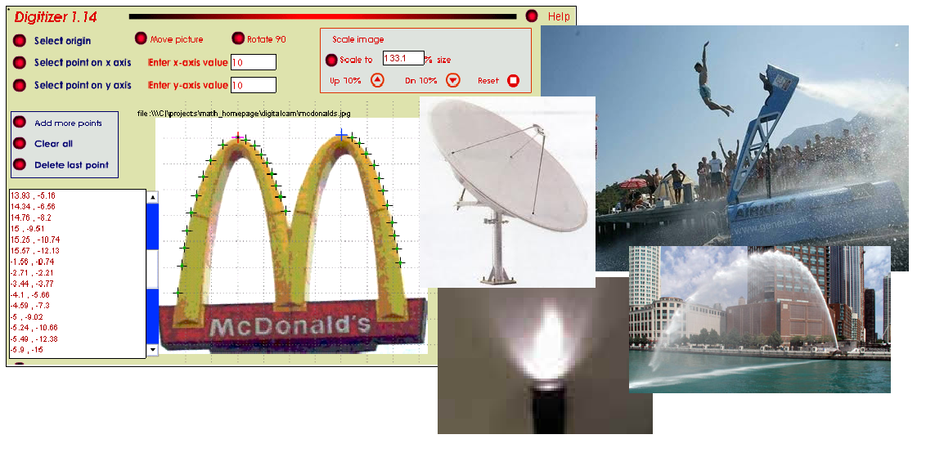

Slide 3
1.4 Parabola
Objectives: At the end of this section students should be able to:
give the standard equation of a parabola;
identify parts of a parabola;
sketch the graph of a parabola.

Slide 4
Non-degenerate Conic
Given the eccentricity e of a conic section, the conic is
  parabola if e = 1;
  ellipse if 0 < e < 1;
  hyperbola if e > 1.
Q
P
Q₂
P₂
Q₁
P₁
focus
vertex
F
directrix
principal axis

Slide 5
Parabola
directrix
A parabola is the set of all points on the plane which are equidistant from a focus and a directrix.
Q(-p, y)
P(x, y)
vertex
F(p, 0)

Slide 6
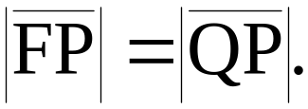
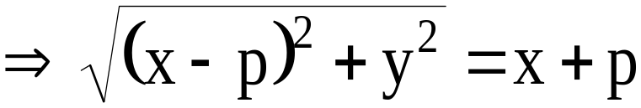
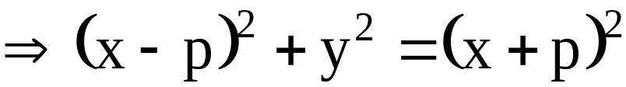
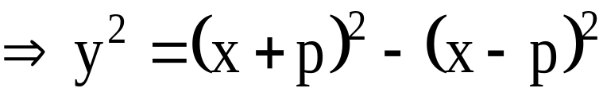
Parabola
directrix
From the definition,
Q(-p, y)
P(x, y)
vertex
F(p, 0)

Slide 7
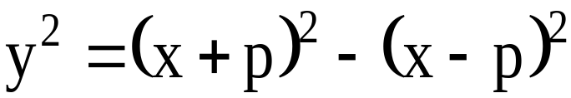
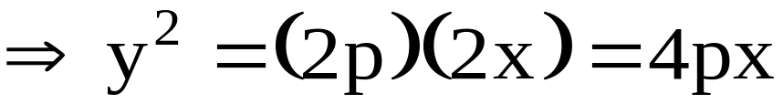
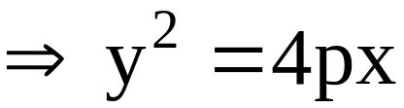
Parabola

Slide 8
Standard Equation
The equation y² = 4px is called the standard equation of a parabola with
vertex at the origin
focus at (p,0)
the line given by x = - p as directrix
x-axis as its principal axis

Slide 9
Standard Equation
If y² = 4px is the equation of a parabola, then
  a. the parabola opens to right if p > 0;
b. the parabola opens to the left if p < 0.

Slide 10
Standard Equation
The equation x² = 4py is called the standard equation of a parabola with
vertex at the origin
focus at (0, p)
the line given by y = - p as directrix
y-axis as its principal axis

Slide 11
Standard Equation
If x² = 4py is the equation of a parabola, then
  a. the parabola opens upward if p > 0;
b. the parabola opens downward if p < 0.

Slide 12

Latus Rectum
The line segment joining two points on a parabola which passes through the focus of the parabola and perpendicular to its principal axis is called the latus rectum of the parabola.
F
principal axis
Note: The length of the latus rectum is equal to |4p|.

Slide 13

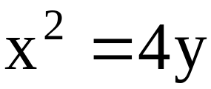

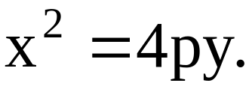
EXAMPLE 1: Determine the vertex, focus, principal axis, directrix, endpoints of the latus rectum and give a sketch of the graph of the following parabola;
SOLUTION:
The given equation is of the form
The parabola opens upward since p = 1 > 0.

Slide 14
SOLUTION (continuation)…
standard equation: x² = 4y
Principal axis: y-axis
Vertex: (0,0)
Focus: (0,1)
The equation of the directrix is given by y = -1.
principal axis

Slide 15
SOLUTION (continuation)…
Length of the latus
rectum: 4
Endpoints of the latus
rectum: (2,1) and (-2,1).
principal axis

Slide 16
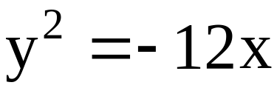
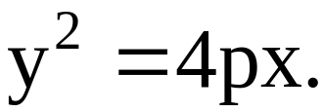
EXAMPLE 2: Determine the vertex, focus, principal axis, directrix, endpoints of the latus rectum and give a sketch of the graph of the following parabola;
SOLUTION:
The given equation is of the form
The parabola opens to the left since p = -3 < 0.

Slide 17
SOLUTION (continuation)…
standard equation:
y² = -12x
Principal axis: x-axis
Vertex: (0,0)
Focus: (-3,0)

Slide 18
SOLUTION (continuation)…
The equation of the directrix is given by x = 3.
The endpoints of the latus rectum are at (-3,6) and (-3,-6).

Slide 19
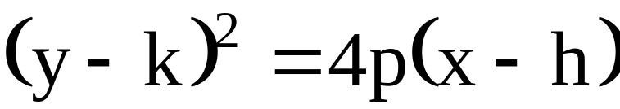
Parabola with vertex at (h, k)
If the vertex of a parabola is at (h,k) and the principal axis is the line y = k, then the standard equation of the parabola is
(As before, the parabola opens to the right or to the left depending on the sign of p.)

Slide 20
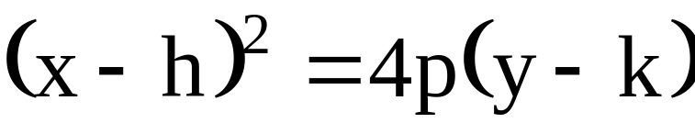
Parabola with vertex at (h, k)
If the vertex of a parabola is at (h,k) and the principal axis is the line x = h, then the standard equation of the parabola is
(As before, the parabola opens upward or downward depending on the sign of p.)

Slide 21
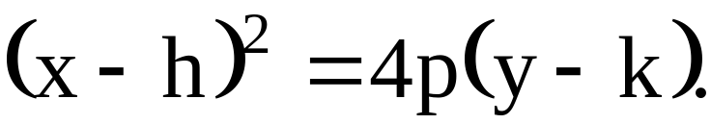
EXAMPLE 3: Determine the vertex, focus, principal axis, directrix, endpoints of the latus rectum and give a sketch of the graph of the parabola
(x - 2)² = -8(y-1).
SOLUTION:
The given equation is of the form
The parabola opens downward since p = -2 < 0.

Slide 22
SOLUTION (continuation)…
standard equation:
(x - 2)² = -8(y-1)
Principal axis: x = 2
Vertex: (2, 1)
Focus: (2, -1)

Slide 23
SOLUTION (continuation)…
Equation of the directrix: y = 3
Length of the latus rectum: 8 units
Endpoints of the latus rectum: (6,-1) and (-2,-1)

Slide 24
EXAMPLE 4: Determine the vertex, focus, principal axis, directrix, endpoints of the latus rectum and give a sketch of the graph of the parabola
(y + 2)² = 4(x-1).
SOLUTION:
Try this on your own!!!

Slide 25
EXAMPLE 5: Determine the standard equation of the parabola with vertex at (3,3) and the endpoints of the latus rectum are at (4,5) and (4,1).
SOLUTION:
The parabola opens to the right.
The standard equation is of the form
(y - k)² = 4p(x - h)

Slide 26
SOLUTION (continuation)…
The vertex is at (3,3), Therefore, h = 3 and k = 3.
The length of the latus rectum is 4 and the parabola opens to the right then p = 1.
Hence, the standard equation of the parabola is (y - 3)² = 4( x - 3).

Slide 27
EXAMPLE 6: Determine the standard equation of the parabola with vertex at (2,-1), the graph passing through the point (-4,3), and the principal axis is parallel to the y-axis.

Slide 28
EXAMPLE 7: Determine the vertex, focus, principal axis, equation of the directrix, and the endpoints of the latus rectum of the parabola
x² – 4x – 8y – 20 = 0

Slide 29
END OF 1.4

